Slide 1
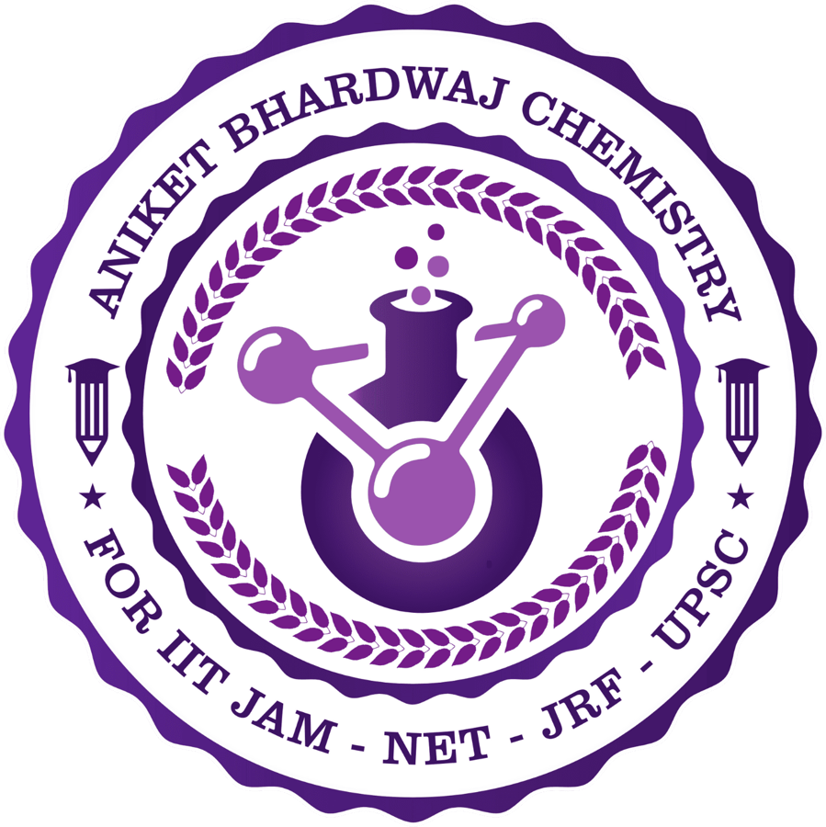

ABC CHEMISTRY
Mr. Aniket Bhardwaj · 15+ Years Mentorship
Main Group Elements
Premium CSIR-NET PYQ Book
97 CSIR-NET Previous-Year Questions · Fully Solved with Distractor Analysis
3-Slide Solutions
Distractor Analysis
Exam Tricks
Revision Sheets
CSIR-NET · GATE · IIT-JAM — 11 Topics · 97 Real PYQs
Mr. Aniket Bhardwaj
@abcchemistry24
Instagram · YouTube · Facebook
( Mr. Aniket Bhardwaj By ABC Chemistry ) · www.abcchemistry.com · 9212142427

Slide 2
Course Contents
11 Topics · 97 PYQs · tap a topic to jump
1
Alkali Metals (Group 1)
6%
2
Alkaline Earth Metals (Group 2)
2%
6 Qs E 6 · M 0 · H 0
2 Qs E 1 · M 0 · H 1
3
Boron & Aluminium Group (Group 13)
21%
4
Carbon & Silicon Group (Group 14)
30%
20 Qs E 0 · M 1 · H 19
29 Qs E 0 · M 0 · H 29
5
Nitrogen & Phosphorus Group (Group 15)
22%
6
Oxygen & Sulfur Group (Group 16)
3%
21 Qs E 0 · M 1 · H 20
3 Qs E 0 · M 2 · H 1
7
Halogens (Group 17)
9%
8
Periodic Trends & General Properties
2%
9 Qs E 0 · M 9 · H 0
2 Qs E 2 · M 0 · H 0
9
Main Group Chemistry – General
5%
5 Qs E 0 · M 5 · H 0
Legend: E Easy M Medium H Hard · % = exam weightage (share of the chapter)
( Mr. Aniket Bhardwaj By ABC Chemistry )

Slide 3
TOPIC 1
Alkali Metals (Group 1)
6 questions · Easy 6 | Medium 0 | Hard 0 · PYQ frequency: Occasional
( Mr. Aniket Bhardwaj By ABC Chemistry ) · www.abcchemistry.com · 9212142427

Slide 4
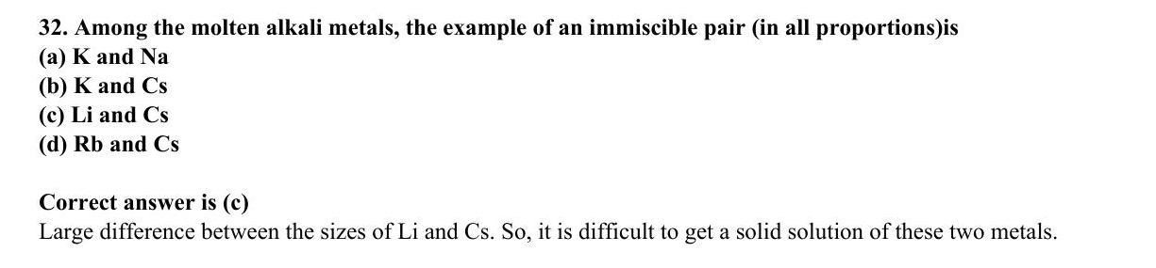
ABC CHEMISTRY
CSIR-DEC 2013
Mr. Aniket Bhardwaj
Easy
MCQ
Alkali Metals (Group 1)
Question 32 of 97
Q32
DEC 2013
QUESTION INSIGHTS
Among the molten alkali metals, the example of an immiscible pair (in all proportions)is
(a) K and Na
(b) K and Cs
(c) Li and Cs
(d) Rb and Cs
ESTIMATED TIME
1–1.5 min
DIFFICULTY
Easy
CONCEPT TESTED
Superoxides, peroxides, solvated electrons, diagonal Li–Mg relationship
PYQ FREQUENCY
Occasional · 4 papers
REVISION PRIORITY
★★★☆☆
EXPECTED LEVEL
Part B
MEMORY HOOK
Bigger alkali cation stabilises bigger anion: Li+ (tiny)→oxide, Na+ (medium)→peroxide, K+/Rb+/Cs+ (big)→superoxide.
( Mr. Aniket Bhardwaj By ABC Chemistry ) · www.abcchemistry.com · 9212142427
Q32 · Question

Slide 5
ABC CHEMISTRY
CSIR-DEC 2013
Mr. Aniket Bhardwaj
Easy
MCQ
Alkali Metals (Group 1)
Question 32 of 97
Correct Answer C Li and Cs
✓
CONCEPT
SHORTCUT / EXAM TRICK
Group 1 metals (Li–Cs) have one valence electron and form +1 ions. With O2 they give oxides (Li2O), peroxides (Na2O2), or superoxides (KO2, RbO2, CsO2). In liquid NH3, they produce solvated electrons – powerful reductants that reduce O2 to O2-.
Li→Li2O, Na→Na2O2, K/Rb/Cs→MO2 with O2. Diagonal relationship: Li behaves like Mg (forms Li3N directly, Li2O not peroxide, LiF insoluble in water).
↓
COMMON MISTAKE
LOGIC / WORKING
Thinking all alkali metals form peroxides with O2 – only Na does; heavier ones give superoxides.
Lithium, with its much smaller atom and higher melting point, is immiscible with the heavy alkali metals; molten Li and Cs (also Li/K, Li/Rb) separate into two layers, while Na–K, K–Cs and Rb–Cs mix freely.
Therefore the answer is (C).
EXAM TIP
Solvated electrons in liq. NH3: M→[M(NH3)n]+ + e-(solvated). These reduce O2 to superoxide. Alkali metals in liq. NH3 are one-electron reducing agents.
MEMORY TRICK
Bigger alkali cation stabilises bigger anion: Li+ (tiny)→oxide, Na+ (medium)→peroxide, K+/Rb+/Cs+ (big)→superoxide.
FINAL: (C) Li and Cs
( Mr. Aniket Bhardwaj By ABC Chemistry ) · www.abcchemistry.com · 9212142427
Q32 · Answer & Explanation

Slide 6
ABC CHEMISTRY
CSIR-DEC 2013
Mr. Aniket Bhardwaj
Easy
MCQ
Alkali Metals (Group 1)
Question 32 of 97
Why the Other Options Are Wrong
Correct answer: C
A
K and Na
Why (C) is the key — Lithium, with its much smaller atom and higher melting point, is immiscible with the heavy alkali metals; molten Li and Cs (also Li/K, Li/Rb) separate into two layers, while Na–K, K–Cs and Rb–Cs mix freely.
B
K and Cs
Option (B) is ruled out by the same reasoning: Lithium, with its much smaller atom and higher melting point, is immiscible with the heavy alkali metals; molten Li and Cs (also Li/K, Li/Rb) separate into two…
D
Rb and Cs
Option (D) is ruled out by the same reasoning: Lithium, with its much smaller atom and higher melting point, is immiscible with the heavy alkali metals; molten Li and Cs (also Li/K, Li/Rb) separate into two…
( Mr. Aniket Bhardwaj By ABC Chemistry ) · www.abcchemistry.com · 9212142427
Q32 · Distractor Analysis

Slide 7
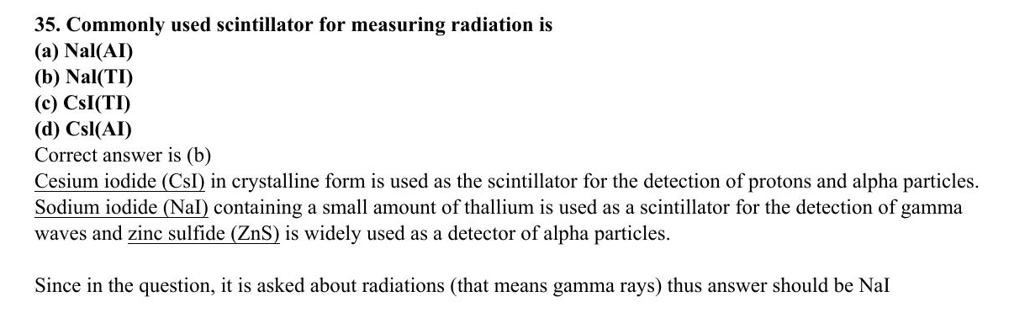
ABC CHEMISTRY
CSIR-DEC 2013
Mr. Aniket Bhardwaj
Easy
MCQ
Alkali Metals (Group 1)
Question 35 of 97
Q35
DEC 2013
QUESTION INSIGHTS
ESTIMATED TIME
1–1.5 min
DIFFICULTY
Easy
CONCEPT TESTED
Superoxides, peroxides, solvated electrons, diagonal Li–Mg relationship
PYQ FREQUENCY
Occasional · 4 papers
REVISION PRIORITY
★★★☆☆
EXPECTED LEVEL
Part B
MEMORY HOOK
Bigger alkali cation stabilises bigger anion: Li+ (tiny)→oxide, Na+ (medium)→peroxide, K+/Rb+/Cs+ (big)→superoxide.
( Mr. Aniket Bhardwaj By ABC Chemistry ) · www.abcchemistry.com · 9212142427
Q35 · Question

Slide 8
ABC CHEMISTRY
CSIR-DEC 2013
Mr. Aniket Bhardwaj
Easy
MCQ
Alkali Metals (Group 1)
Question 35 of 97
Correct Answer B Nal(TI)
✓
CONCEPT
SHORTCUT / EXAM TRICK
Group 1 metals (Li–Cs) have one valence electron and form +1 ions. With O2 they give oxides (Li2O), peroxides (Na2O2), or superoxides (KO2, RbO2, CsO2). In liquid NH3, they produce solvated electrons – powerful reductants that reduce O2 to O2-.
Li→Li2O, Na→Na2O2, K/Rb/Cs→MO2 with O2. Diagonal relationship: Li behaves like Mg (forms Li3N directly, Li2O not peroxide, LiF insoluble in water).
↓
COMMON MISTAKE
LOGIC / WORKING
Thinking all alkali metals form peroxides with O2 – only Na does; heavier ones give superoxides.
Key principle: alkali metal reactivity and superoxide/peroxide/solvated electron chemistry. Correct answer is (B).
EXAM TIP
Solvated electrons in liq. NH3: M→[M(NH3)n]+ + e-(solvated). These reduce O2 to superoxide. Alkali metals in liq. NH3 are one-electron reducing agents.
MEMORY TRICK
Bigger alkali cation stabilises bigger anion: Li+ (tiny)→oxide, Na+ (medium)→peroxide, K+/Rb+/Cs+ (big)→superoxide.
FINAL: (B) Nal(TI)
( Mr. Aniket Bhardwaj By ABC Chemistry ) · www.abcchemistry.com · 9212142427
Q35 · Answer & Explanation

Slide 9
ABC CHEMISTRY
CSIR-DEC 2013
Mr. Aniket Bhardwaj
Easy
MCQ
Alkali Metals (Group 1)
Question 35 of 97
Why the Other Options Are Wrong
Correct answer: B
A
Nal(AI)
Inconsistent with alkali metal reactivity and superoxide/peroxide/solvated electron chemistry; correct choice is (B). See worked explanation.
C
CsI(TI)
Inconsistent with alkali metal reactivity and superoxide/peroxide/solvated electron chemistry; correct choice is (B). See worked explanation.
D
Csl(AI)
Inconsistent with alkali metal reactivity and superoxide/peroxide/solvated electron chemistry; correct choice is (B). See worked explanation.
( Mr. Aniket Bhardwaj By ABC Chemistry ) · www.abcchemistry.com · 9212142427
Q35 · Distractor Analysis

Slide 10
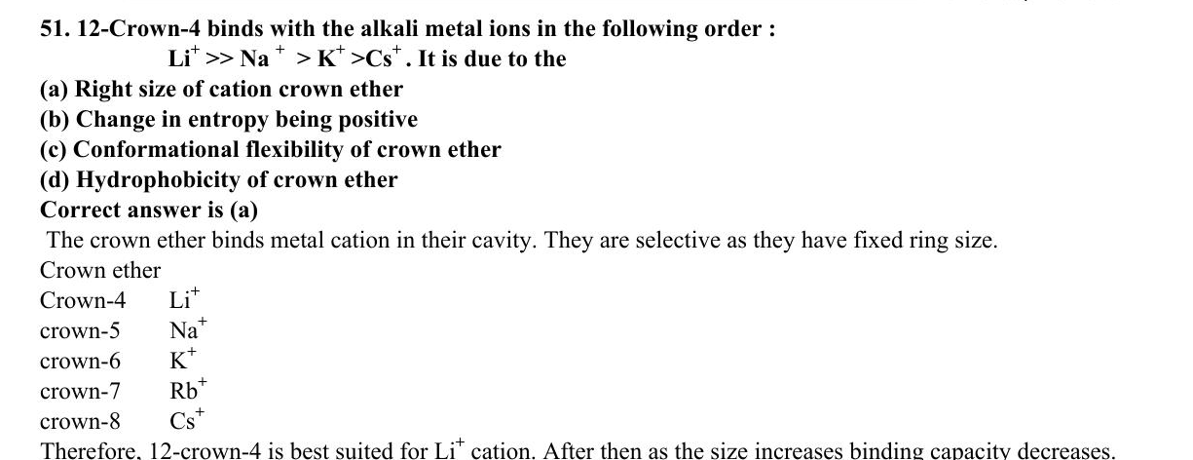
ABC CHEMISTRY
CSIR-JUNE 2014
Mr. Aniket Bhardwaj
Easy
MCQ
Alkali Metals (Group 1)
Question 51 of 97
Q51
JUNE 2014
QUESTION INSIGHTS
ESTIMATED TIME
1–1.5 min
DIFFICULTY
Easy
CONCEPT TESTED
Superoxides, peroxides, solvated electrons, diagonal Li–Mg relationship
PYQ FREQUENCY
Occasional · 4 papers
REVISION PRIORITY
★★★☆☆
EXPECTED LEVEL
Part B
MEMORY HOOK
Bigger alkali cation stabilises bigger anion: Li+ (tiny)→oxide, Na+ (medium)→peroxide, K+/Rb+/Cs+ (big)→superoxide.
( Mr. Aniket Bhardwaj By ABC Chemistry ) · www.abcchemistry.com · 9212142427
Q51 · Question

Slide 11
ABC CHEMISTRY
CSIR-JUNE 2014
Mr. Aniket Bhardwaj
Easy
MCQ
Alkali Metals (Group 1)
Question 51 of 97
Correct Answer A Right size match of cation to crown ether cavity
✓
CONCEPT
SHORTCUT / EXAM TRICK
Group 1 metals (Li–Cs) have one valence electron and form +1 ions. With O2 they give oxides (Li2O), peroxides (Na2O2), or superoxides (KO2, RbO2, CsO2). In liquid NH3, they produce solvated electrons – powerful reductants that reduce O2 to O2-.
Li→Li2O, Na→Na2O2, K/Rb/Cs→MO2 with O2. Diagonal relationship: Li behaves like Mg (forms Li3N directly, Li2O not peroxide, LiF insoluble in water).
↓
COMMON MISTAKE
LOGIC / WORKING
Thinking all alkali metals form peroxides with O2 – only Na does; heavier ones give superoxides.
Key principle: alkali metal reactivity and superoxide/peroxide/solvated electron chemistry. Correct answer is (A).
EXAM TIP
Solvated electrons in liq. NH3: M→[M(NH3)n]+ + e-(solvated). These reduce O2 to superoxide. Alkali metals in liq. NH3 are one-electron reducing agents.
MEMORY TRICK
Bigger alkali cation stabilises bigger anion: Li+ (tiny)→oxide, Na+ (medium)→peroxide, K+/Rb+/Cs+ (big)→superoxide.
FINAL: (A) Right size match of cation to crown ether cavity
( Mr. Aniket Bhardwaj By ABC Chemistry ) · www.abcchemistry.com · 9212142427
Q51 · Answer & Explanation

Slide 12
ABC CHEMISTRY
CSIR-JUNE 2014
Mr. Aniket Bhardwaj
Easy
MCQ
Alkali Metals (Group 1)
Question 51 of 97
Why the Other Options Are Wrong
Correct answer: A
B
Change in entropy being positive
Inconsistent with alkali metal reactivity and superoxide/peroxide/solvated electron chemistry; correct choice is (A). See worked explanation.
C
Conformational flexibility of crown ether
Inconsistent with alkali metal reactivity and superoxide/peroxide/solvated electron chemistry; correct choice is (A). See worked explanation.
D
Hydrophobicity of crown ether
Inconsistent with alkali metal reactivity and superoxide/peroxide/solvated electron chemistry; correct choice is (A). See worked explanation.
( Mr. Aniket Bhardwaj By ABC Chemistry ) · www.abcchemistry.com · 9212142427
Q51 · Distractor Analysis

Slide 13
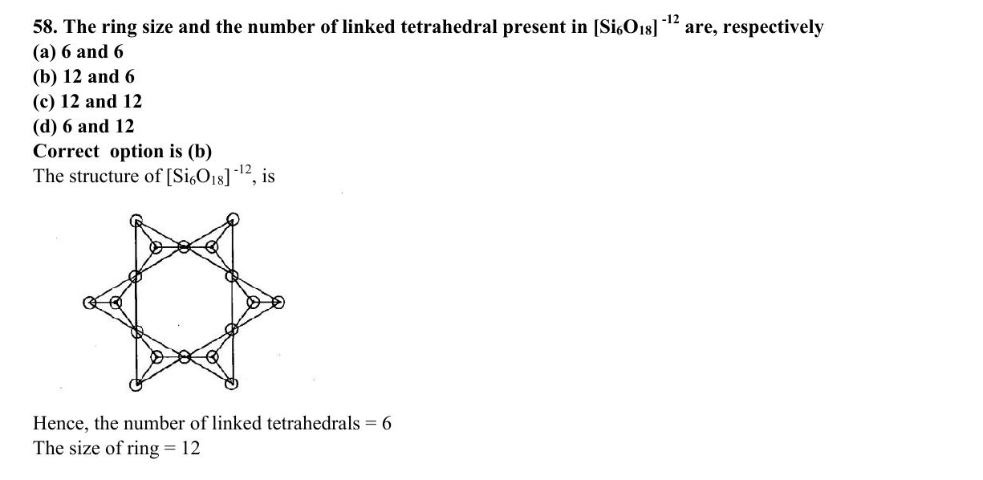
ABC CHEMISTRY
CSIR-DEC 2015
Mr. Aniket Bhardwaj
Easy
MCQ
Alkali Metals (Group 1)
Question 58 of 97
Q58
DEC 2015
QUESTION INSIGHTS
The ring size and the number of linked tetrahedral present in [Si₆O₁₈]¹²⁻ are, respectively
(a) 6 and 6
(b) 12 and 6
(c) 12 and 12
(d) 6 and 12
ESTIMATED TIME
1–1.5 min
DIFFICULTY
Easy
CONCEPT TESTED
Superoxides, peroxides, solvated electrons, diagonal Li–Mg relationship
PYQ FREQUENCY
Occasional · 4 papers
REVISION PRIORITY
★★★☆☆
EXPECTED LEVEL
Part B
MEMORY HOOK
Bigger alkali cation stabilises bigger anion: Li+ (tiny)→oxide, Na+ (medium)→peroxide, K+/Rb+/Cs+ (big)→superoxide.
( Mr. Aniket Bhardwaj By ABC Chemistry ) · www.abcchemistry.com · 9212142427
Q58 · Question

Slide 14
ABC CHEMISTRY
CSIR-DEC 2015
Mr. Aniket Bhardwaj
Easy
MCQ
Alkali Metals (Group 1)
Question 58 of 97
Correct Answer B 12 and 6
✓
CONCEPT
SHORTCUT / EXAM TRICK
Group 1 metals (Li–Cs) have one valence electron and form +1 ions. With O2 they give oxides (Li2O), peroxides (Na2O2), or superoxides (KO2, RbO2, CsO2). In liquid NH3, they produce solvated electrons – powerful reductants that reduce O2 to O2-.
Li→Li2O, Na→Na2O2, K/Rb/Cs→MO2 with O2. Diagonal relationship: Li behaves like Mg (forms Li3N directly, Li2O not peroxide, LiF insoluble in water).
↓
COMMON MISTAKE
LOGIC / WORKING
Thinking all alkali metals form peroxides with O2 – only Na does; heavier ones give superoxides.
The cyclic silicate [Si₆O₁₈]¹²⁻ (beryl-type) is a ring of six SiO₄ tetrahedra linked by six bridging O, i.e. a 12-membered Si–O ring (b).
Therefore the answer is (B).
EXAM TIP
Solvated electrons in liq. NH3: M→[M(NH3)n]+ + e-(solvated). These reduce O2 to superoxide. Alkali metals in liq. NH3 are one-electron reducing agents.
MEMORY TRICK
Bigger alkali cation stabilises bigger anion: Li+ (tiny)→oxide, Na+ (medium)→peroxide, K+/Rb+/Cs+ (big)→superoxide.
FINAL: (B) 12 and 6
( Mr. Aniket Bhardwaj By ABC Chemistry ) · www.abcchemistry.com · 9212142427
Q58 · Answer & Explanation

Slide 15
ABC CHEMISTRY
CSIR-DEC 2015
Mr. Aniket Bhardwaj
Easy
MCQ
Alkali Metals (Group 1)
Question 58 of 97
Why the Other Options Are Wrong
Correct answer: B
A
6 and 6
Why (B) is the key — The cyclic silicate [Si₆O₁₈]¹²⁻ (beryl-type) is a ring of six SiO₄ tetrahedra linked by six bridging O, i.e. a 12-membered Si–O ring (b).
C
12 and 12
Option (C) is ruled out by the same reasoning: The cyclic silicate [Si₆O₁₈]¹²⁻ (beryl-type) is a ring of six SiO₄ tetrahedra linked by six bridging O, i.e. a 12-membered Si–O ring
D
6 and 12
Option (D) is ruled out by the same reasoning: The cyclic silicate [Si₆O₁₈]¹²⁻ (beryl-type) is a ring of six SiO₄ tetrahedra linked by six bridging O, i.e. a 12-membered Si–O ring
( Mr. Aniket Bhardwaj By ABC Chemistry ) · www.abcchemistry.com · 9212142427
Q58 · Distractor Analysis

Slide 16
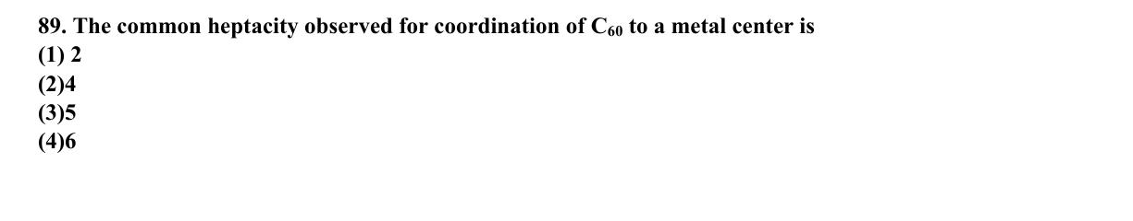
ABC CHEMISTRY
CSIR-DEC 2019
Mr. Aniket Bhardwaj
Easy
MCQ
Alkali Metals (Group 1)
Question 89 of 97
Q89
DEC 2019
QUESTION INSIGHTS
ESTIMATED TIME
1–1.5 min
DIFFICULTY
Easy
CONCEPT TESTED
Superoxides, peroxides, solvated electrons, diagonal Li–Mg relationship
PYQ FREQUENCY
Occasional · 4 papers
REVISION PRIORITY
★★★☆☆
EXPECTED LEVEL
Part B
MEMORY HOOK
Bigger alkali cation stabilises bigger anion: Li+ (tiny)→oxide, Na+ (medium)→peroxide, K+/Rb+/Cs+ (big)→superoxide.
( Mr. Aniket Bhardwaj By ABC Chemistry ) · www.abcchemistry.com · 9212142427
Q89 · Question

Slide 17
ABC CHEMISTRY
CSIR-DEC 2019
Mr. Aniket Bhardwaj
Easy
MCQ
Alkali Metals (Group 1)
Question 89 of 97
Correct Answer A Option A (see PDF)
✓
CONCEPT
SHORTCUT / EXAM TRICK
Group 1 metals (Li–Cs) have one valence electron and form +1 ions. With O2 they give oxides (Li2O), peroxides (Na2O2), or superoxides (KO2, RbO2, CsO2). In liquid NH3, they produce solvated electrons – powerful reductants that reduce O2 to O2-.
Li→Li2O, Na→Na2O2, K/Rb/Cs→MO2 with O2. Diagonal relationship: Li behaves like Mg (forms Li3N directly, Li2O not peroxide, LiF insoluble in water).
↓
COMMON MISTAKE
LOGIC / WORKING
Thinking all alkali metals form peroxides with O2 – only Na does; heavier ones give superoxides.
Key principle: alkali metal reactivity and superoxide/peroxide/solvated electron chemistry. Correct answer is (A).
EXAM TIP
Solvated electrons in liq. NH3: M→[M(NH3)n]+ + e-(solvated). These reduce O2 to superoxide. Alkali metals in liq. NH3 are one-electron reducing agents.
MEMORY TRICK
Bigger alkali cation stabilises bigger anion: Li+ (tiny)→oxide, Na+ (medium)→peroxide, K+/Rb+/Cs+ (big)→superoxide.
FINAL: (A) Option A (see PDF)
( Mr. Aniket Bhardwaj By ABC Chemistry ) · www.abcchemistry.com · 9212142427
Q89 · Answer & Explanation

Slide 18
ABC CHEMISTRY
CSIR-DEC 2019
Mr. Aniket Bhardwaj
Easy
MCQ
Alkali Metals (Group 1)
Question 89 of 97
Why the Other Options Are Wrong
Correct answer: A
B
Option B (see PDF)
Inconsistent with alkali metal reactivity and superoxide/peroxide/solvated electron chemistry; correct choice is (A). See worked explanation.
C
Option C (see PDF)
Inconsistent with alkali metal reactivity and superoxide/peroxide/solvated electron chemistry; correct choice is (A). See worked explanation.
D
Option D (see PDF)
Inconsistent with alkali metal reactivity and superoxide/peroxide/solvated electron chemistry; correct choice is (A). See worked explanation.
( Mr. Aniket Bhardwaj By ABC Chemistry ) · www.abcchemistry.com · 9212142427
Q89 · Distractor Analysis

Slide 19
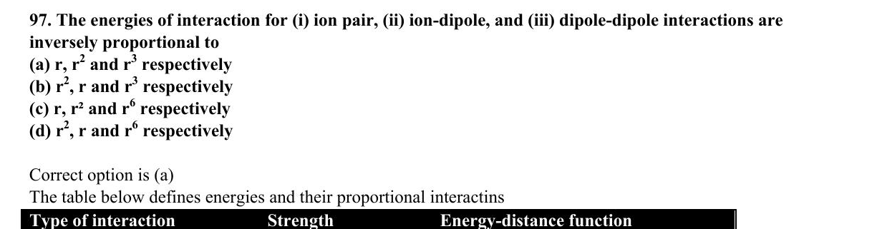
ABC CHEMISTRY
CSIR-DEC 2019
Mr. Aniket Bhardwaj
Easy
MCQ
Alkali Metals (Group 1)
Question 97 of 97
Q97
DEC 2019
QUESTION INSIGHTS
ESTIMATED TIME
1–1.5 min
DIFFICULTY
Easy
CONCEPT TESTED
Superoxides, peroxides, solvated electrons, diagonal Li–Mg relationship
PYQ FREQUENCY
Occasional · 4 papers
REVISION PRIORITY
★★★☆☆
EXPECTED LEVEL
Part B
MEMORY HOOK
Bigger alkali cation stabilises bigger anion: Li+ (tiny)→oxide, Na+ (medium)→peroxide, K+/Rb+/Cs+ (big)→superoxide.
( Mr. Aniket Bhardwaj By ABC Chemistry ) · www.abcchemistry.com · 9212142427
Q97 · Question

Slide 20
ABC CHEMISTRY
CSIR-DEC 2019
Mr. Aniket Bhardwaj
Easy
MCQ
Alkali Metals (Group 1)
Question 97 of 97
Correct Answer A r, r₂ and r₃ respectively
✓
CONCEPT
SHORTCUT / EXAM TRICK
Group 1 metals (Li–Cs) have one valence electron and form +1 ions. With O2 they give oxides (Li2O), peroxides (Na2O2), or superoxides (KO2, RbO2, CsO2). In liquid NH3, they produce solvated electrons – powerful reductants that reduce O2 to O2-.
Li→Li2O, Na→Na2O2, K/Rb/Cs→MO2 with O2. Diagonal relationship: Li behaves like Mg (forms Li3N directly, Li2O not peroxide, LiF insoluble in water).
↓
COMMON MISTAKE
LOGIC / WORKING
Thinking all alkali metals form peroxides with O2 – only Na does; heavier ones give superoxides.
Key principle: alkali metal reactivity and superoxide/peroxide/solvated electron chemistry. Correct answer is (A).
EXAM TIP
Solvated electrons in liq. NH3: M→[M(NH3)n]+ + e-(solvated). These reduce O2 to superoxide. Alkali metals in liq. NH3 are one-electron reducing agents.
MEMORY TRICK
Bigger alkali cation stabilises bigger anion: Li+ (tiny)→oxide, Na+ (medium)→peroxide, K+/Rb+/Cs+ (big)→superoxide.
FINAL: (A) r, r₂ and r₃ respectively
( Mr. Aniket Bhardwaj By ABC Chemistry ) · www.abcchemistry.com · 9212142427
Q97 · Answer & Explanation

Slide 21
ABC CHEMISTRY
CSIR-DEC 2019
Mr. Aniket Bhardwaj
Easy
MCQ
Alkali Metals (Group 1)
Question 97 of 97
Why the Other Options Are Wrong
Correct answer: A
B
r₂, r and r₃ respectively
Inconsistent with alkali metal reactivity and superoxide/peroxide/solvated electron chemistry; correct choice is (A). See worked explanation.
C
r, r² and r₆ respectively
Inconsistent with alkali metal reactivity and superoxide/peroxide/solvated electron chemistry; correct choice is (A). See worked explanation.
D
r₂, r and r₆ respectively
Inconsistent with alkali metal reactivity and superoxide/peroxide/solvated electron chemistry; correct choice is (A). See worked explanation.
( Mr. Aniket Bhardwaj By ABC Chemistry ) · www.abcchemistry.com · 9212142427
Q97 · Distractor Analysis

Slide 22
TOPIC REVISION
6 PYQs · Last-minute revision
Alkali Metals (Group 1)
TOPIC SUMMARY
IMPORTANT FORMULA SHEET
Group 1 metals (Li–Cs) have one valence electron and form +1 ions. With O2 they give oxides (Li2O), peroxides (Na2O2), or superoxides (KO2, RbO2, CsO2). In liquid NH3, they produce solvated electrons – powerful reductants that reduce O2 to O2-.
Li+O2→Li2O
Na+O2→Na2O2
K/Rb/Cs+O2→MO2
M+nNH3→[M(NH3)n]+ + e-(solvated)
FREQUENTLY ASKED CONCEPTS
COMMON MISTAKES & QUICK NOTES
Superoxide vs peroxide formation
Diagonal Li–Mg relationship
Solvated electrons in liq. NH3
Ionization energy trend
Watch out:
Thinking all alkali metals form peroxides with O2 – only Na does; heavier ones give superoxides.
Last-minute:
Li→Li2O, Na→Na2O2, K/Rb/Cs→MO2 with O2. Diagonal relationship: Li behaves like Mg (forms Li3N directly, Li2O not peroxide, LiF insoluble in water).
MOST-REPEATED PYQs & EXPECTED IN EXAM
PYQs in this topic: Q32 Q35 Q51 Q58 Q89 Q97
Expect 1 question(s) next session on Superoxides, peroxides, solvated electrons, diagonal Li–Mg relationship.
( Mr. Aniket Bhardwaj By ABC Chemistry ) · www.abcchemistry.com · 9212142427

Slide 23
TOPIC 2
Alkaline Earth Metals (Group 2)
2 questions · Easy 1 | Medium 0 | Hard 1 · PYQ frequency: Rare
( Mr. Aniket Bhardwaj By ABC Chemistry ) · www.abcchemistry.com · 9212142427

Slide 24
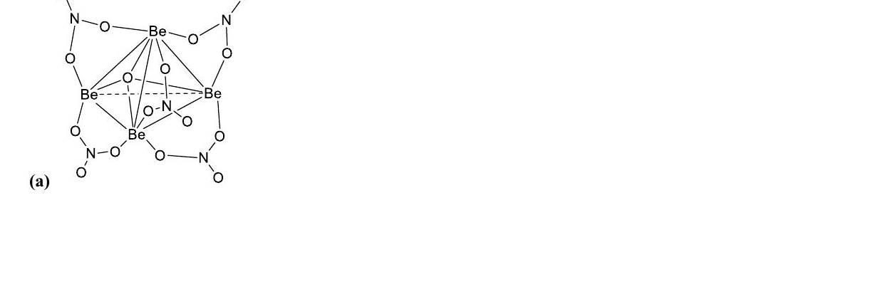
ABC CHEMISTRY
CSIR-JUNE 2012
Mr. Aniket Bhardwaj
Hard
MCQ
Alkaline Earth Metals (Group 2)
Question 14 of 97
Q14
JUNE 2012
QUESTION INSIGHTS
ESTIMATED TIME
3–5 min
DIFFICULTY
Hard
CONCEPT TESTED
Diagonal Be–Al relationship, solubility trends, amphoteric BeO, BeF2 structure
PYQ FREQUENCY
Rare · 2 papers
REVISION PRIORITY
★★★★★
EXPECTED LEVEL
Part C (high merit)
MEMORY HOOK
Sulphates – solubility goes South (decreases). Hydroxides – Happy going Down (increases).
( Mr. Aniket Bhardwaj By ABC Chemistry ) · www.abcchemistry.com · 9212142427
Q14 · Question

Slide 25
ABC CHEMISTRY
CSIR-JUNE 2012
Mr. Aniket Bhardwaj
Hard
MCQ
Alkaline Earth Metals (Group 2)
Question 14 of 97
Correct Answer A Be cluster with 5 NO3 units and one bridging O (correct — see structure)
✓
CONCEPT
SHORTCUT / EXAM TRICK
Group 2 metals (Be–Ba): Be is anomalous (diagonal with Al), forms covalent compounds and amphoteric BeO. Sulfate solubility decreases down (BaSO4 insoluble); hydroxide solubility increases down.
Be anomalous: covalent, amphoteric oxide, no reaction with cold water. BeF2 is a covalent chain polymer. Sulfates decrease, hydroxides increase in solubility down the group.
↓
COMMON MISTAKE
LOGIC / WORKING
Confusing BeF2 (covalent polymer) with ionic compounds; Be does not react with cold water unlike Mg.
Key principle: alkaline earth metal periodic trends and anomalous Be behaviour. Correct answer is (A).
EXAM TIP
BeO is amphoteric: reacts with HCl and NaOH. BeF2 has linear Be with bridging F (chain polymer). Be does not react with cold water but Mg does slowly.
MEMORY TRICK
Sulphates – solubility goes South (decreases). Hydroxides – Happy going Down (increases).
FINAL: (A) Be cluster with 5 NO3 units and one bridging O (correct — see structure)
( Mr. Aniket Bhardwaj By ABC Chemistry ) · www.abcchemistry.com · 9212142427
Q14 · Answer & Explanation

Slide 26
ABC CHEMISTRY
CSIR-JUNE 2012
Mr. Aniket Bhardwaj
Hard
MCQ
Alkaline Earth Metals (Group 2)
Question 14 of 97
Why the Other Options Are Wrong
Correct answer: A
B
Discrete Be(NO3)2 ionic pairs
Inconsistent with alkaline earth metal periodic trends and anomalous Be behaviour; correct choice is (A). See worked explanation.
C
Polymeric chain -Be-NO3- units
Inconsistent with alkaline earth metal periodic trends and anomalous Be behaviour; correct choice is (A). See worked explanation.
D
Tetrahedral BeO4 core with NO3 groups
Inconsistent with alkaline earth metal periodic trends and anomalous Be behaviour; correct choice is (A). See worked explanation.
( Mr. Aniket Bhardwaj By ABC Chemistry ) · www.abcchemistry.com · 9212142427
Q14 · Distractor Analysis

Slide 27
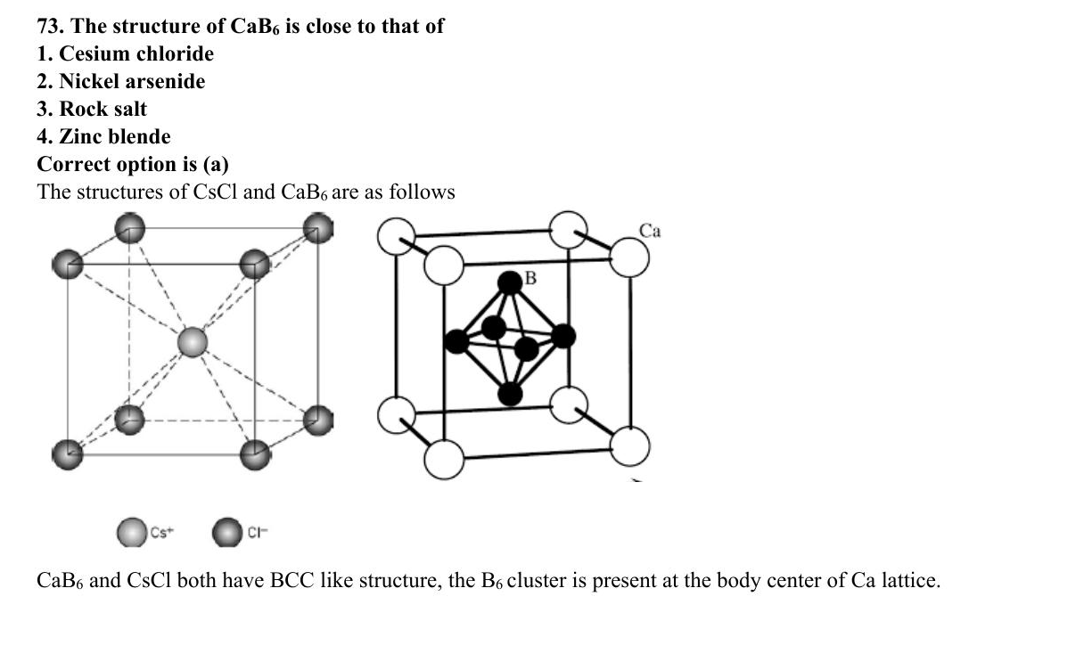
ABC CHEMISTRY
CSIR-JUNE 2018
Mr. Aniket Bhardwaj
Easy
MCQ
Alkaline Earth Metals (Group 2)
Question 73 of 97
Q73
JUNE 2018
QUESTION INSIGHTS
ESTIMATED TIME
1–1.5 min
DIFFICULTY
Easy
CONCEPT TESTED
Diagonal Be–Al relationship, solubility trends, amphoteric BeO, BeF2 structure
PYQ FREQUENCY
Rare · 2 papers
REVISION PRIORITY
★★★☆☆
EXPECTED LEVEL
Part B
MEMORY HOOK
Sulphates – solubility goes South (decreases). Hydroxides – Happy going Down (increases).
( Mr. Aniket Bhardwaj By ABC Chemistry ) · www.abcchemistry.com · 9212142427
Q73 · Question

Slide 28
ABC CHEMISTRY
CSIR-JUNE 2018
Mr. Aniket Bhardwaj
Easy
MCQ
Alkaline Earth Metals (Group 2)
Question 73 of 97
Correct Answer A Option A (see PDF)
✓
CONCEPT
SHORTCUT / EXAM TRICK
Group 2 metals (Be–Ba): Be is anomalous (diagonal with Al), forms covalent compounds and amphoteric BeO. Sulfate solubility decreases down (BaSO4 insoluble); hydroxide solubility increases down.
Be anomalous: covalent, amphoteric oxide, no reaction with cold water. BeF2 is a covalent chain polymer. Sulfates decrease, hydroxides increase in solubility down the group.
↓
COMMON MISTAKE
LOGIC / WORKING
Confusing BeF2 (covalent polymer) with ionic compounds; Be does not react with cold water unlike Mg.
Key principle: alkaline earth metal periodic trends and anomalous Be behaviour. Correct answer is (A).
EXAM TIP
BeO is amphoteric: reacts with HCl and NaOH. BeF2 has linear Be with bridging F (chain polymer). Be does not react with cold water but Mg does slowly.
MEMORY TRICK
Sulphates – solubility goes South (decreases). Hydroxides – Happy going Down (increases).
FINAL: (A) Option A (see PDF)
( Mr. Aniket Bhardwaj By ABC Chemistry ) · www.abcchemistry.com · 9212142427
Q73 · Answer & Explanation

Slide 29
ABC CHEMISTRY
CSIR-JUNE 2018
Mr. Aniket Bhardwaj
Easy
MCQ
Alkaline Earth Metals (Group 2)
Question 73 of 97
Why the Other Options Are Wrong
Correct answer: A
B
Option B (see PDF)
Inconsistent with alkaline earth metal periodic trends and anomalous Be behaviour; correct choice is (A). See worked explanation.
C
Option C (see PDF)
Inconsistent with alkaline earth metal periodic trends and anomalous Be behaviour; correct choice is (A). See worked explanation.
D
Option D (see PDF)
Inconsistent with alkaline earth metal periodic trends and anomalous Be behaviour; correct choice is (A). See worked explanation.
( Mr. Aniket Bhardwaj By ABC Chemistry ) · www.abcchemistry.com · 9212142427
Q73 · Distractor Analysis

Slide 30
TOPIC REVISION
2 PYQs · Last-minute revision
Alkaline Earth Metals (Group 2)
TOPIC SUMMARY
IMPORTANT FORMULA SHEET
Group 2 metals (Be–Ba): Be is anomalous (diagonal with Al), forms covalent compounds and amphoteric BeO. Sulfate solubility decreases down (BaSO4 insoluble); hydroxide solubility increases down.
BeO + 2HCl → BeCl2 + H2O
BeO + 2NaOH → Na2BeO2 + H2O
Sulfate sol.: Be>Mg>Ca>Sr>Ba
Hydroxide sol.: Be<Mg<Ca<Sr<Ba
FREQUENTLY ASKED CONCEPTS
COMMON MISTAKES & QUICK NOTES
Diagonal Be–Al relationship
Amphoteric BeO
Solubility trends
Polymeric BeF2
Watch out:
Confusing BeF2 (covalent polymer) with ionic compounds; Be does not react with cold water unlike Mg.
Last-minute:
Be anomalous: covalent, amphoteric oxide, no reaction with cold water. BeF2 is a covalent chain polymer. Sulfates decrease, hydroxides increase in solubility down the group.
MOST-REPEATED PYQs & EXPECTED IN EXAM
PYQs in this topic: Q14 Q73
Expect 1 question(s) next session on Diagonal Be–Al relationship, solubility trends, amphoteric BeO, BeF2 structure.
( Mr. Aniket Bhardwaj By ABC Chemistry ) · www.abcchemistry.com · 9212142427

Slide 31
TOPIC 3
Boron & Aluminium Group (Group 13)
20 questions · Easy 0 | Medium 1 | Hard 19 · PYQ frequency: High
( Mr. Aniket Bhardwaj By ABC Chemistry ) · www.abcchemistry.com · 9212142427

Slide 32
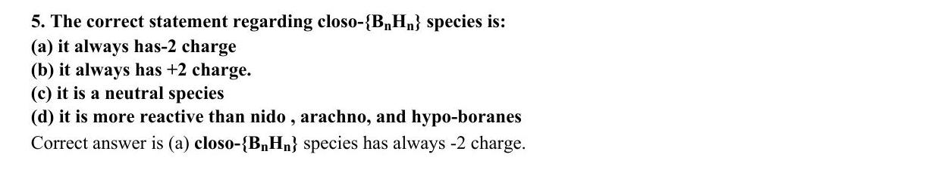
ABC CHEMISTRY
CSIR-DEC 2011
Mr. Aniket Bhardwaj
Hard
MCQ
Boron & Aluminium Group (Group 13)
Question 5 of 97
Q5
DEC 2011
QUESTION INSIGHTS
The correct statement regarding closo-\BₙHₙ\ species is:
(a) it always has a 2⁻ charge
(b) it always has a 2⁺ charge
(c) it is a neutral species
(d) it is more reactive than nido, arachno, and hypo-boranes
ESTIMATED TIME
3–5 min
DIFFICULTY
Hard
CONCEPT TESTED
Wade's rules, Lewis acidity of BX3, closo/nido/arachno boranes
PYQ FREQUENCY
High · 11 paper
REVISION PRIORITY
★★★★★
EXPECTED LEVEL
Part C (high merit)
MEMORY HOOK
F donates most pi electrons → reduces Lewis acidity most. BCl3>BPh3>BMe3: steric and electronic factors together.
( Mr. Aniket Bhardwaj By ABC Chemistry ) · www.abcchemistry.com · 9212142427
Q5 · Question

Slide 33
ABC CHEMISTRY
CSIR-DEC 2011
Mr. Aniket Bhardwaj
Hard
MCQ
Boron & Aluminium Group (Group 13)
Question 5 of 97
Correct Answer A it always has⁻² charge
✓
CONCEPT
SHORTCUT / EXAM TRICK
Group 13 (B–Tl): B is a metalloid; Al is metallic. Both are Lewis acids. Boranes follow Wade's rules: closo BnHn2- (n+1 SEP, charge always -2), nido (n+2 SEP), arachno (n+3 SEP). Lewis acidity: BCl3>BPh3>BMe3 (F/Cl pi-donation reduces Lewis acidity in BF3).
Lewis acidity towards pyridine: BCl3>BPh3>BMe3. Wade's SEP: closo n+1, nido n+2, arachno n+3. Closo BnHn always has -2 charge.
↓
COMMON MISTAKE
LOGIC / WORKING
Thinking BF3 is the strongest Lewis acid — BCl3 is stronger because F lone-pair donation weakens BF3 more than Cl weakens BCl3.
closo-Boranes need n + 1 skeletal pairs, which for BₙHₙ requires two extra electrons: they exist only as [BₙHₙ]²⁻ dianions, and are the least reactive class.
Therefore the answer is (A).
EXAM TIP
BCl3 is stronger Lewis acid than BF3 because F lone pairs back-donate into empty p orbital more than Cl. Al2Me6 has 3c-2e Al-C-Al bridges.
MEMORY TRICK
F donates most pi electrons → reduces Lewis acidity most. BCl3>BPh3>BMe3: steric and electronic factors together.
FINAL: (A) it always has⁻² charge
( Mr. Aniket Bhardwaj By ABC Chemistry ) · www.abcchemistry.com · 9212142427
Q5 · Answer & Explanation

Slide 34
ABC CHEMISTRY
CSIR-DEC 2011
Mr. Aniket Bhardwaj
Hard
MCQ
Boron & Aluminium Group (Group 13)
Question 5 of 97
Why the Other Options Are Wrong
Correct answer: A
B
it always has +2 charge.
Why (A) is the key — closo-Boranes need n + 1 skeletal pairs, which for BₙHₙ requires two extra electrons: they exist only as [BₙHₙ]²⁻ dianions, and are the least reactive class.
C
it is a neutral species
Option (C) is ruled out by the same reasoning: closo-Boranes need n + 1 skeletal pairs, which for BₙHₙ requires two extra electrons: they exist only as [BₙHₙ]²⁻ dianions, and are the least reactive
D
it is more reactive than nido , arachno, and hypo-boranes
Option (D) is ruled out by the same reasoning: closo-Boranes need n + 1 skeletal pairs, which for BₙHₙ requires two extra electrons: they exist only as [BₙHₙ]²⁻ dianions, and are the least reactive
( Mr. Aniket Bhardwaj By ABC Chemistry ) · www.abcchemistry.com · 9212142427
Q5 · Distractor Analysis

Slide 35
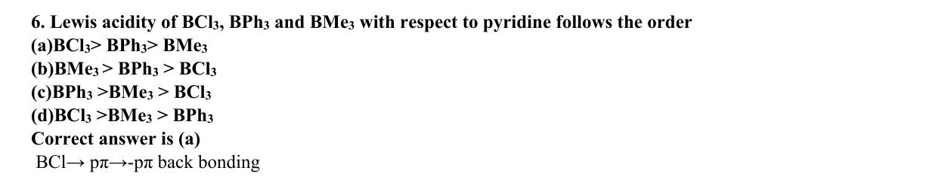
ABC CHEMISTRY
CSIR-DEC 2011
Mr. Aniket Bhardwaj
Hard
MCQ
Boron & Aluminium Group (Group 13)
Question 6 of 97
Q6
DEC 2011
QUESTION INSIGHTS
Lewis acidity of BCl₃, BPh₃ and BMe₃ with respect to pyridine follows the order
(a) BCl₃>BPh₃>BMe₃
(b) BMe₃>BPh₃>BCl₃
(c) BPh₃>BMe₃>BCl₃
(d) BCl₃>BMe₃>BPh₃
ESTIMATED TIME
3–5 min
DIFFICULTY
Hard
CONCEPT TESTED
Wade's rules, Lewis acidity of BX3, closo/nido/arachno boranes
PYQ FREQUENCY
High · 11 paper
REVISION PRIORITY
★★★★★
EXPECTED LEVEL
Part C (high merit)
MEMORY HOOK
F donates most pi electrons → reduces Lewis acidity most. BCl3>BPh3>BMe3: steric and electronic factors together.
( Mr. Aniket Bhardwaj By ABC Chemistry ) · www.abcchemistry.com · 9212142427
Q6 · Question

Slide 36
ABC CHEMISTRY
CSIR-DEC 2011
Mr. Aniket Bhardwaj
Hard
MCQ
Boron & Aluminium Group (Group 13)
Question 6 of 97
Correct Answer A BCl₃> BPh₃> BMe₃
✓
CONCEPT
SHORTCUT / EXAM TRICK
Group 13 (B–Tl): B is a metalloid; Al is metallic. Both are Lewis acids. Boranes follow Wade's rules: closo BnHn2- (n+1 SEP, charge always -2), nido (n+2 SEP), arachno (n+3 SEP). Lewis acidity: BCl3>BPh3>BMe3 (F/Cl pi-donation reduces Lewis acidity in BF3).
Lewis acidity towards pyridine: BCl3>BPh3>BMe3. Wade's SEP: closo n+1, nido n+2, arachno n+3. Closo BnHn always has -2 charge.
↓
COMMON MISTAKE
LOGIC / WORKING
Thinking BF3 is the strongest Lewis acid — BCl3 is stronger because F lone-pair donation weakens BF3 more than Cl weakens BCl3.
Toward pyridine: BCl₃ > BPh₃ > BMe₃ (a).
Therefore the answer is (A).
EXAM TIP
BCl3 is stronger Lewis acid than BF3 because F lone pairs back-donate into empty p orbital more than Cl. Al2Me6 has 3c-2e Al-C-Al bridges.
MEMORY TRICK
F donates most pi electrons → reduces Lewis acidity most. BCl3>BPh3>BMe3: steric and electronic factors together.
FINAL: (A) BCl₃> BPh₃> BMe₃
( Mr. Aniket Bhardwaj By ABC Chemistry ) · www.abcchemistry.com · 9212142427
Q6 · Answer & Explanation

Slide 37
ABC CHEMISTRY
CSIR-DEC 2011
Mr. Aniket Bhardwaj
Hard
MCQ
Boron & Aluminium Group (Group 13)
Question 6 of 97
Why the Other Options Are Wrong
Correct answer: A
B
BMe₃ > BPh₃ > BCl₃
Why (A) is the key — Toward pyridine: BCl₃ > BPh₃ > BMe₃ (a).
C
BPh₃ >BMe₃ > BCl₃
Option (C) is ruled out by the same reasoning: Toward pyridine: BCl₃ > BPh₃ > BMe₃
D
BCl₃ >BMe₃ > BPh₃
Option (D) is ruled out by the same reasoning: Toward pyridine: BCl₃ > BPh₃ > BMe₃
( Mr. Aniket Bhardwaj By ABC Chemistry ) · www.abcchemistry.com · 9212142427
Q6 · Distractor Analysis

Slide 38
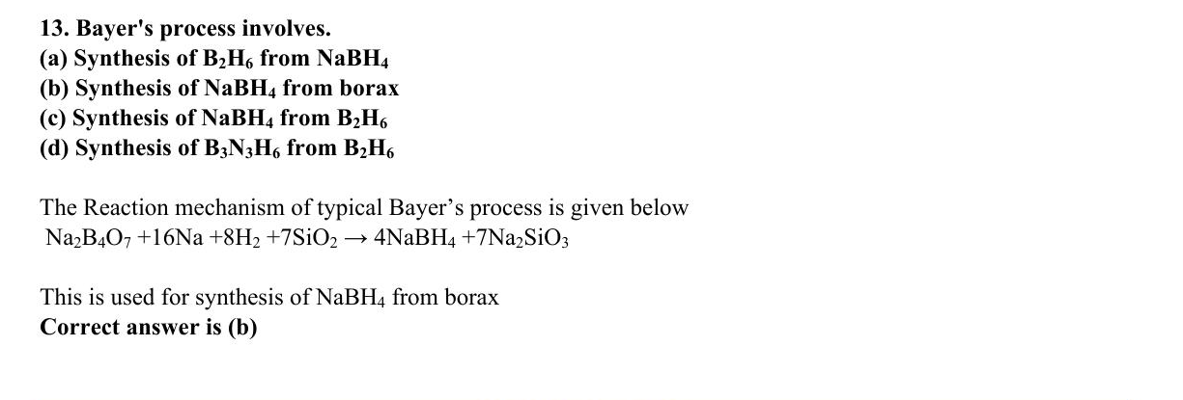
ABC CHEMISTRY
CSIR-DEC 2011
Mr. Aniket Bhardwaj
Hard
MCQ
Boron & Aluminium Group (Group 13)
Question 13 of 97
Q13
DEC 2011
QUESTION INSIGHTS
Bayer's process involves.
(a) Synthesis of B₂ H₆ from NaBH₄
(b) Synthesis of NaBH₄ from borax
(c) Synthesis of NaBH₄ from B₂ H₆
(d) Synthesis of B₃N₃H₆ from B₂H₆
ESTIMATED TIME
3–5 min
DIFFICULTY
Hard
CONCEPT TESTED
Wade's rules, Lewis acidity of BX3, closo/nido/arachno boranes
PYQ FREQUENCY
High · 11 paper
REVISION PRIORITY
★★★★★
EXPECTED LEVEL
Part C (high merit)
MEMORY HOOK
F donates most pi electrons → reduces Lewis acidity most. BCl3>BPh3>BMe3: steric and electronic factors together.
( Mr. Aniket Bhardwaj By ABC Chemistry ) · www.abcchemistry.com · 9212142427
Q13 · Question

Slide 39
ABC CHEMISTRY
CSIR-DEC 2011
Mr. Aniket Bhardwaj
Hard
MCQ
Boron & Aluminium Group (Group 13)
Question 13 of 97
Correct Answer B Synthesis of NaBH4 from borax
✓
CONCEPT
SHORTCUT / EXAM TRICK
Group 13 (B–Tl): B is a metalloid; Al is metallic. Both are Lewis acids. Boranes follow Wade's rules: closo BnHn2- (n+1 SEP, charge always -2), nido (n+2 SEP), arachno (n+3 SEP). Lewis acidity: BCl3>BPh3>BMe3 (F/Cl pi-donation reduces Lewis acidity in BF3).
Lewis acidity towards pyridine: BCl3>BPh3>BMe3. Wade's SEP: closo n+1, nido n+2, arachno n+3. Closo BnHn always has -2 charge.
↓
COMMON MISTAKE
LOGIC / WORKING
Thinking BF3 is the strongest Lewis acid — BCl3 is stronger because F lone-pair donation weakens BF3 more than Cl weakens BCl3.
The Bayer process makes NaBH₄ from borax (b).
Therefore the answer is (B).
EXAM TIP
BCl3 is stronger Lewis acid than BF3 because F lone pairs back-donate into empty p orbital more than Cl. Al2Me6 has 3c-2e Al-C-Al bridges.
MEMORY TRICK
F donates most pi electrons → reduces Lewis acidity most. BCl3>BPh3>BMe3: steric and electronic factors together.
FINAL: (B) Synthesis of NaBH4 from borax
( Mr. Aniket Bhardwaj By ABC Chemistry ) · www.abcchemistry.com · 9212142427
Q13 · Answer & Explanation

Slide 40
ABC CHEMISTRY
CSIR-DEC 2011
Mr. Aniket Bhardwaj
Hard
MCQ
Boron & Aluminium Group (Group 13)
Question 13 of 97
Why the Other Options Are Wrong
Correct answer: B
A
Synthesis of B2H6 from NaBH4
Why (B) is the key — The Bayer process makes NaBH₄ from borax (b).
C
Synthesis of NaBH4 from B2H6
Option (C) is ruled out by the same reasoning: The Bayer process makes NaBH₄ from borax
D
Synthesis of B3N3H6 from B2H6
Option (D) is ruled out by the same reasoning: The Bayer process makes NaBH₄ from borax
( Mr. Aniket Bhardwaj By ABC Chemistry ) · www.abcchemistry.com · 9212142427
Q13 · Distractor Analysis

Slide 41
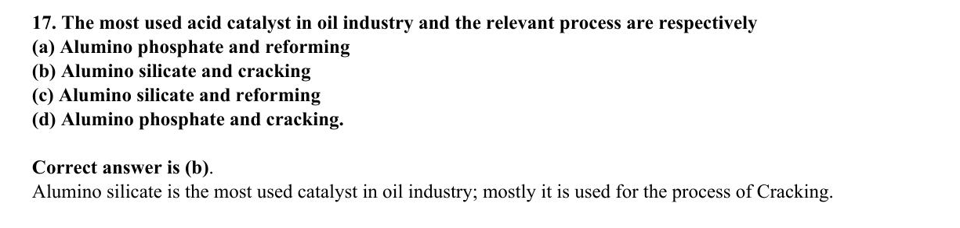
ABC CHEMISTRY
CSIR-JUNE 2012
Mr. Aniket Bhardwaj
Hard
MCQ
Boron & Aluminium Group (Group 13)
Question 17 of 97
Q17
JUNE 2012
QUESTION INSIGHTS
The most used acid catalyst in oil industry and the relevant process are respectively
(a) Alumino phosphate and reforming
(b) Alumino silicate and cracking
(c) Alumino silicate and reforming
(d) Alumino phosphate and cracking
ESTIMATED TIME
3–5 min
DIFFICULTY
Hard
CONCEPT TESTED
Wade's rules, Lewis acidity of BX3, closo/nido/arachno boranes
PYQ FREQUENCY
High · 11 paper
REVISION PRIORITY
★★★★★
EXPECTED LEVEL
Part C (high merit)
MEMORY HOOK
F donates most pi electrons → reduces Lewis acidity most. BCl3>BPh3>BMe3: steric and electronic factors together.
( Mr. Aniket Bhardwaj By ABC Chemistry ) · www.abcchemistry.com · 9212142427
Q17 · Question

Slide 42
ABC CHEMISTRY
CSIR-JUNE 2012
Mr. Aniket Bhardwaj
Hard
MCQ
Boron & Aluminium Group (Group 13)
Question 17 of 97
Correct Answer B Alumino silicate and cracking
✓
CONCEPT
SHORTCUT / EXAM TRICK
Group 13 (B–Tl): B is a metalloid; Al is metallic. Both are Lewis acids. Boranes follow Wade's rules: closo BnHn2- (n+1 SEP, charge always -2), nido (n+2 SEP), arachno (n+3 SEP). Lewis acidity: BCl3>BPh3>BMe3 (F/Cl pi-donation reduces Lewis acidity in BF3).
Lewis acidity towards pyridine: BCl3>BPh3>BMe3. Wade's SEP: closo n+1, nido n+2, arachno n+3. Closo BnHn always has -2 charge.
↓
COMMON MISTAKE
LOGIC / WORKING
Thinking BF3 is the strongest Lewis acid — BCl3 is stronger because F lone-pair donation weakens BF3 more than Cl weakens BCl3.
Zeolitic aluminosilicates (e.g. Y zeolite) are the solid-acid catalysts of fluid catalytic cracking, the largest catalytic process in refining.
Therefore the answer is (B).
EXAM TIP
BCl3 is stronger Lewis acid than BF3 because F lone pairs back-donate into empty p orbital more than Cl. Al2Me6 has 3c-2e Al-C-Al bridges.
MEMORY TRICK
F donates most pi electrons → reduces Lewis acidity most. BCl3>BPh3>BMe3: steric and electronic factors together.
FINAL: (B) Alumino silicate and cracking
( Mr. Aniket Bhardwaj By ABC Chemistry ) · www.abcchemistry.com · 9212142427
Q17 · Answer & Explanation

Slide 43
ABC CHEMISTRY
CSIR-JUNE 2012
Mr. Aniket Bhardwaj
Hard
MCQ
Boron & Aluminium Group (Group 13)
Question 17 of 97
Why the Other Options Are Wrong
Correct answer: B
A
Alumino phosphate and reforming
Why (B) is the key — Zeolitic aluminosilicates (e.g. Y zeolite) are the solid-acid catalysts of fluid catalytic cracking, the largest catalytic process in refining.
C
Alumino silicate and reforming
Option (C) is ruled out by the same reasoning: Zeolitic aluminosilicates (e.g. Y zeolite) are the solid-acid catalysts of fluid catalytic cracking, the largest catalytic process in
D
Alumino phosphate and cracking.
Option (D) is ruled out by the same reasoning: Zeolitic aluminosilicates (e.g. Y zeolite) are the solid-acid catalysts of fluid catalytic cracking, the largest catalytic process in
( Mr. Aniket Bhardwaj By ABC Chemistry ) · www.abcchemistry.com · 9212142427
Q17 · Distractor Analysis

Slide 44
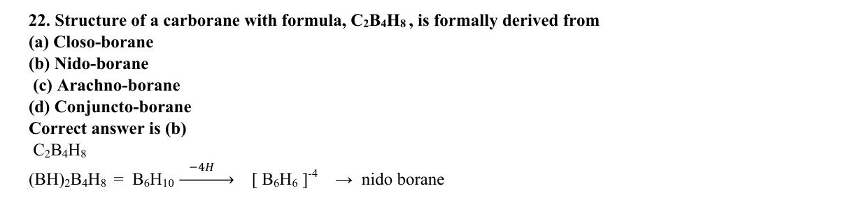
ABC CHEMISTRY
CSIR-DEC 2012
Mr. Aniket Bhardwaj
Hard
MCQ
Boron & Aluminium Group (Group 13)
Question 22 of 97
Q22
DEC 2012
QUESTION INSIGHTS
Structure of a carborane with formula, C₂ B₄ H₈, is formally derived from
(a) Closo-borane
(b) Nido-borane
(c) Arachno-borane
(d) Conjuncto-borane
ESTIMATED TIME
3–5 min
DIFFICULTY
Hard
CONCEPT TESTED
Wade's rules, Lewis acidity of BX3, closo/nido/arachno boranes
PYQ FREQUENCY
High · 11 paper
REVISION PRIORITY
★★★★★
EXPECTED LEVEL
Part C (high merit)
MEMORY HOOK
F donates most pi electrons → reduces Lewis acidity most. BCl3>BPh3>BMe3: steric and electronic factors together.
( Mr. Aniket Bhardwaj By ABC Chemistry ) · www.abcchemistry.com · 9212142427
Q22 · Question

Slide 45
ABC CHEMISTRY
CSIR-DEC 2012
Mr. Aniket Bhardwaj
Hard
MCQ
Boron & Aluminium Group (Group 13)
Question 22 of 97
Correct Answer B Nido-borane
✓
CONCEPT
SHORTCUT / EXAM TRICK
Group 13 (B–Tl): B is a metalloid; Al is metallic. Both are Lewis acids. Boranes follow Wade's rules: closo BnHn2- (n+1 SEP, charge always -2), nido (n+2 SEP), arachno (n+3 SEP). Lewis acidity: BCl3>BPh3>BMe3 (F/Cl pi-donation reduces Lewis acidity in BF3).
Lewis acidity towards pyridine: BCl3>BPh3>BMe3. Wade's SEP: closo n+1, nido n+2, arachno n+3. Closo BnHn always has -2 charge.
↓
COMMON MISTAKE
LOGIC / WORKING
Thinking BF3 is the strongest Lewis acid — BCl3 is stronger because F lone-pair donation weakens BF3 more than Cl weakens BCl3.
C₂B₄H₈ (≡ B₆H₁₀) is a nido cluster (b).
Therefore the answer is (B).
EXAM TIP
BCl3 is stronger Lewis acid than BF3 because F lone pairs back-donate into empty p orbital more than Cl. Al2Me6 has 3c-2e Al-C-Al bridges.
MEMORY TRICK
F donates most pi electrons → reduces Lewis acidity most. BCl3>BPh3>BMe3: steric and electronic factors together.
FINAL: (B) Nido-borane
( Mr. Aniket Bhardwaj By ABC Chemistry ) · www.abcchemistry.com · 9212142427
Q22 · Answer & Explanation

Slide 46
ABC CHEMISTRY
CSIR-DEC 2012
Mr. Aniket Bhardwaj
Hard
MCQ
Boron & Aluminium Group (Group 13)
Question 22 of 97
Why the Other Options Are Wrong
Correct answer: B
A
Closo-borane
Why (B) is the key — C₂B₄H₈ (≡ B₆H₁₀) is a nido cluster (b).
C
Arachno-borane
Option (C) is ruled out by the same reasoning: C₂B₄H₈ (≡ B₆H₁₀) is a nido cluster
D
Conjuncto-borane
Option (D) is ruled out by the same reasoning: C₂B₄H₈ (≡ B₆H₁₀) is a nido cluster
( Mr. Aniket Bhardwaj By ABC Chemistry ) · www.abcchemistry.com · 9212142427
Q22 · Distractor Analysis

Slide 47
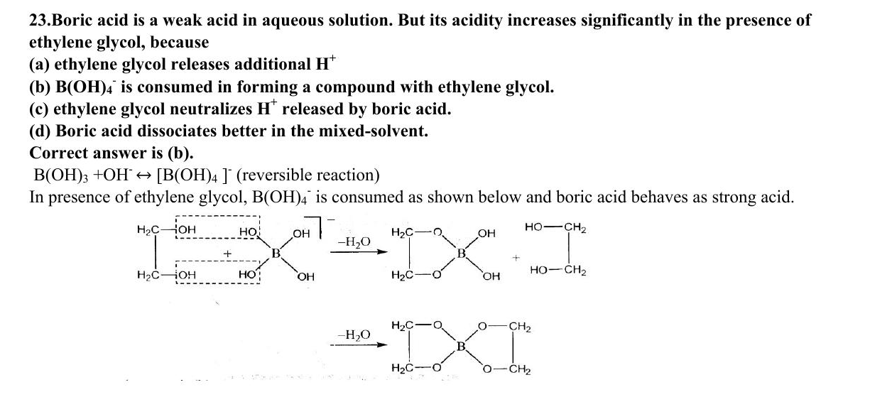
ABC CHEMISTRY
CSIR-DEC 2012
Mr. Aniket Bhardwaj
Medium
MCQ
Boron & Aluminium Group (Group 13)
Question 23 of 97
Q23
DEC 2012
QUESTION INSIGHTS
Boric acid is a weak acid in aqueous solution. But its acidity increases significantly in the presence of ethylene glycol, because
(a) ethylene glycol releases additional H⁺
(b) B(OH)₄⁻ is consumed in forming a compound with ethylene glycol
(c) ethylene glycol neutralizes H⁺ released by boric acid
(d) Boric acid dissociates better in the mixed-solvent
ESTIMATED TIME
2–3 min
DIFFICULTY
Medium
CONCEPT TESTED
Wade's rules, Lewis acidity of BX3, closo/nido/arachno boranes
PYQ FREQUENCY
High · 11 paper
REVISION PRIORITY
★★★★☆
EXPECTED LEVEL
Part B / Part C
MEMORY HOOK
F donates most pi electrons → reduces Lewis acidity most. BCl3>BPh3>BMe3: steric and electronic factors together.
( Mr. Aniket Bhardwaj By ABC Chemistry ) · www.abcchemistry.com · 9212142427
Q23 · Question

Slide 48
ABC CHEMISTRY
CSIR-DEC 2012
Mr. Aniket Bhardwaj
Medium
MCQ
Boron & Aluminium Group (Group 13)
Question 23 of 97
Correct Answer B B(OH)4- is consumed in forming a complex with ethylene glycol
✓
CONCEPT
SHORTCUT / EXAM TRICK
Group 13 (B–Tl): B is a metalloid; Al is metallic. Both are Lewis acids. Boranes follow Wade's rules: closo BnHn2- (n+1 SEP, charge always -2), nido (n+2 SEP), arachno (n+3 SEP). Lewis acidity: BCl3>BPh3>BMe3 (F/Cl pi-donation reduces Lewis acidity in BF3).
Lewis acidity towards pyridine: BCl3>BPh3>BMe3. Wade's SEP: closo n+1, nido n+2, arachno n+3. Closo BnHn always has -2 charge.
↓
COMMON MISTAKE
LOGIC / WORKING
Thinking BF3 is the strongest Lewis acid — BCl3 is stronger because F lone-pair donation weakens BF3 more than Cl weakens BCl3.
Key principle: Wade's rules, Lewis acidity of BX3, and borane structures. Correct answer is (B).
EXAM TIP
BCl3 is stronger Lewis acid than BF3 because F lone pairs back-donate into empty p orbital more than Cl. Al2Me6 has 3c-2e Al-C-Al bridges.
MEMORY TRICK
F donates most pi electrons → reduces Lewis acidity most. BCl3>BPh3>BMe3: steric and electronic factors together.
FINAL: (B) B(OH)4- is consumed in forming a complex with ethylene glycol
( Mr. Aniket Bhardwaj By ABC Chemistry ) · www.abcchemistry.com · 9212142427
Q23 · Answer & Explanation

Slide 49
ABC CHEMISTRY
CSIR-DEC 2012
Mr. Aniket Bhardwaj
Medium
MCQ
Boron & Aluminium Group (Group 13)
Question 23 of 97
Why the Other Options Are Wrong
Correct answer: B
A
Ethylene glycol releases additional H+
Inconsistent with Wade's rules, Lewis acidity of BX3, and borane structures; correct choice is (B). See worked explanation.
C
Ethylene glycol neutralizes H+ released by boric acid
Inconsistent with Wade's rules, Lewis acidity of BX3, and borane structures; correct choice is (B). See worked explanation.
D
Boric acid dissociates better in the mixed-solvent
Inconsistent with Wade's rules, Lewis acidity of BX3, and borane structures; correct choice is (B). See worked explanation.
( Mr. Aniket Bhardwaj By ABC Chemistry ) · www.abcchemistry.com · 9212142427
Q23 · Distractor Analysis

Slide 50
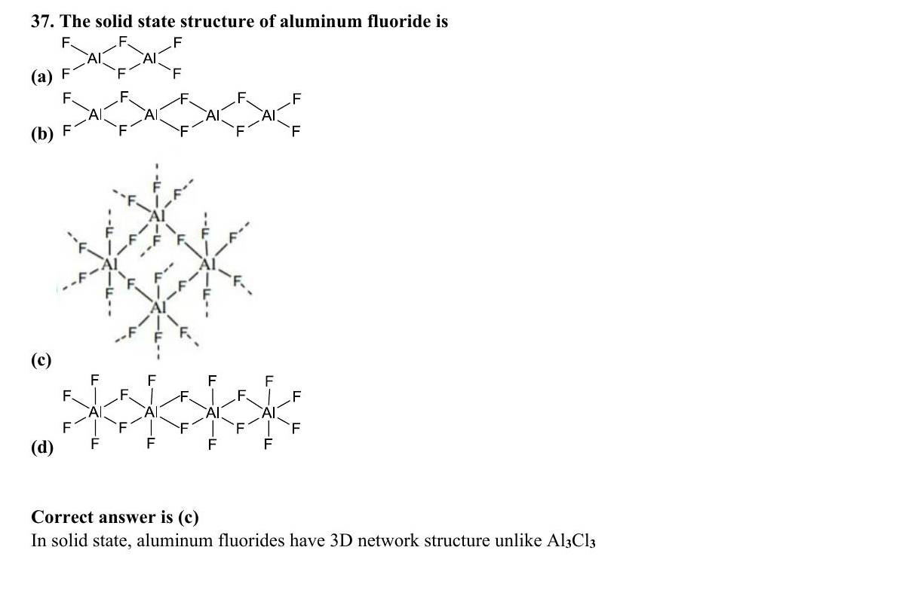
ABC CHEMISTRY
CSIR-DEC 2013
Mr. Aniket Bhardwaj
Hard
MCQ
Boron & Aluminium Group (Group 13)
Question 37 of 97
Q37
DEC 2013
QUESTION INSIGHTS
ESTIMATED TIME
3–5 min
DIFFICULTY
Hard
CONCEPT TESTED
Wade's rules, Lewis acidity of BX3, closo/nido/arachno boranes
PYQ FREQUENCY
High · 11 paper
REVISION PRIORITY
★★★★★
EXPECTED LEVEL
Part C (high merit)
MEMORY HOOK
F donates most pi electrons → reduces Lewis acidity most. BCl3>BPh3>BMe3: steric and electronic factors together.
( Mr. Aniket Bhardwaj By ABC Chemistry ) · www.abcchemistry.com · 9212142427
Q37 · Question

Slide 51
ABC CHEMISTRY
CSIR-DEC 2013
Mr. Aniket Bhardwaj
Hard
MCQ
Boron & Aluminium Group (Group 13)
Question 37 of 97
Correct Answer C Option C (see PDF)
✓
CONCEPT
SHORTCUT / EXAM TRICK
Group 13 (B–Tl): B is a metalloid; Al is metallic. Both are Lewis acids. Boranes follow Wade's rules: closo BnHn2- (n+1 SEP, charge always -2), nido (n+2 SEP), arachno (n+3 SEP). Lewis acidity: BCl3>BPh3>BMe3 (F/Cl pi-donation reduces Lewis acidity in BF3).
Lewis acidity towards pyridine: BCl3>BPh3>BMe3. Wade's SEP: closo n+1, nido n+2, arachno n+3. Closo BnHn always has -2 charge.
↓
COMMON MISTAKE
LOGIC / WORKING
Thinking BF3 is the strongest Lewis acid — BCl3 is stronger because F lone-pair donation weakens BF3 more than Cl weakens BCl3.
Key principle: Wade's rules, Lewis acidity of BX3, and borane structures. Correct answer is (C).
EXAM TIP
BCl3 is stronger Lewis acid than BF3 because F lone pairs back-donate into empty p orbital more than Cl. Al2Me6 has 3c-2e Al-C-Al bridges.
MEMORY TRICK
F donates most pi electrons → reduces Lewis acidity most. BCl3>BPh3>BMe3: steric and electronic factors together.
FINAL: (C) Option C (see PDF)
( Mr. Aniket Bhardwaj By ABC Chemistry ) · www.abcchemistry.com · 9212142427
Q37 · Answer & Explanation

Slide 52
ABC CHEMISTRY
CSIR-DEC 2013
Mr. Aniket Bhardwaj
Hard
MCQ
Boron & Aluminium Group (Group 13)
Question 37 of 97
Why the Other Options Are Wrong
Correct answer: C
A
Option A (see PDF)
Inconsistent with Wade's rules, Lewis acidity of BX3, and borane structures; correct choice is (C). See worked explanation.
B
Option B (see PDF)
Inconsistent with Wade's rules, Lewis acidity of BX3, and borane structures; correct choice is (C). See worked explanation.
D
Option D (see PDF)
Inconsistent with Wade's rules, Lewis acidity of BX3, and borane structures; correct choice is (C). See worked explanation.
( Mr. Aniket Bhardwaj By ABC Chemistry ) · www.abcchemistry.com · 9212142427
Q37 · Distractor Analysis

Slide 53
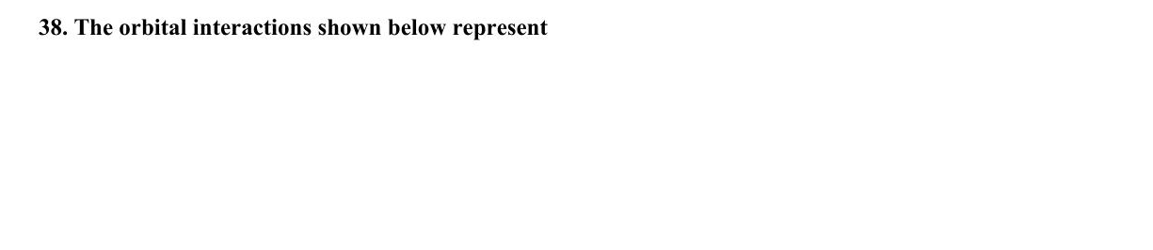
ABC CHEMISTRY
CSIR-DEC 2013
Mr. Aniket Bhardwaj
Hard
MCQ
Boron & Aluminium Group (Group 13)
Question 38 of 97
Q38
DEC 2013
QUESTION INSIGHTS
ESTIMATED TIME
3–5 min
DIFFICULTY
Hard
CONCEPT TESTED
Wade's rules, Lewis acidity of BX3, closo/nido/arachno boranes
PYQ FREQUENCY
High · 11 paper
REVISION PRIORITY
★★★★★
EXPECTED LEVEL
Part C (high merit)
MEMORY HOOK
F donates most pi electrons → reduces Lewis acidity most. BCl3>BPh3>BMe3: steric and electronic factors together.
( Mr. Aniket Bhardwaj By ABC Chemistry ) · www.abcchemistry.com · 9212142427
Q38 · Question

Slide 54
ABC CHEMISTRY
CSIR-DEC 2013
Mr. Aniket Bhardwaj
Hard
MCQ
Boron & Aluminium Group (Group 13)
Question 38 of 97
Correct Answer C CH-Li interaction in Li4(CH3) 4
✓
CONCEPT
SHORTCUT / EXAM TRICK
Group 13 (B–Tl): B is a metalloid; Al is metallic. Both are Lewis acids. Boranes follow Wade's rules: closo BnHn2- (n+1 SEP, charge always -2), nido (n+2 SEP), arachno (n+3 SEP). Lewis acidity: BCl3>BPh3>BMe3 (F/Cl pi-donation reduces Lewis acidity in BF3).
Lewis acidity towards pyridine: BCl3>BPh3>BMe3. Wade's SEP: closo n+1, nido n+2, arachno n+3. Closo BnHn always has -2 charge.
↓
COMMON MISTAKE
LOGIC / WORKING
Thinking BF3 is the strongest Lewis acid — BCl3 is stronger because F lone-pair donation weakens BF3 more than Cl weakens BCl3.
Key principle: Wade's rules, Lewis acidity of BX3, and borane structures. Correct answer is (C).
EXAM TIP
BCl3 is stronger Lewis acid than BF3 because F lone pairs back-donate into empty p orbital more than Cl. Al2Me6 has 3c-2e Al-C-Al bridges.
MEMORY TRICK
F donates most pi electrons → reduces Lewis acidity most. BCl3>BPh3>BMe3: steric and electronic factors together.
FINAL: (C) CH-Li interaction in Li4(CH3) 4
( Mr. Aniket Bhardwaj By ABC Chemistry ) · www.abcchemistry.com · 9212142427
Q38 · Answer & Explanation

Slide 55
ABC CHEMISTRY
CSIR-DEC 2013
Mr. Aniket Bhardwaj
Hard
MCQ
Boron & Aluminium Group (Group 13)
Question 38 of 97
Why the Other Options Are Wrong
Correct answer: C
A
CH-Al interactions in Al2 (CH3) 6
Inconsistent with Wade's rules, Lewis acidity of BX3, and borane structures; correct choice is (C). See worked explanation.
B
B-H interactions in B2H6
Inconsistent with Wade's rules, Lewis acidity of BX3, and borane structures; correct choice is (C). See worked explanation.
D
CH3CH2-Mg interactions in EtMgBr.(OEt2) 2
Inconsistent with Wade's rules, Lewis acidity of BX3, and borane structures; correct choice is (C). See worked explanation.
( Mr. Aniket Bhardwaj By ABC Chemistry ) · www.abcchemistry.com · 9212142427
Q38 · Distractor Analysis

Slide 56
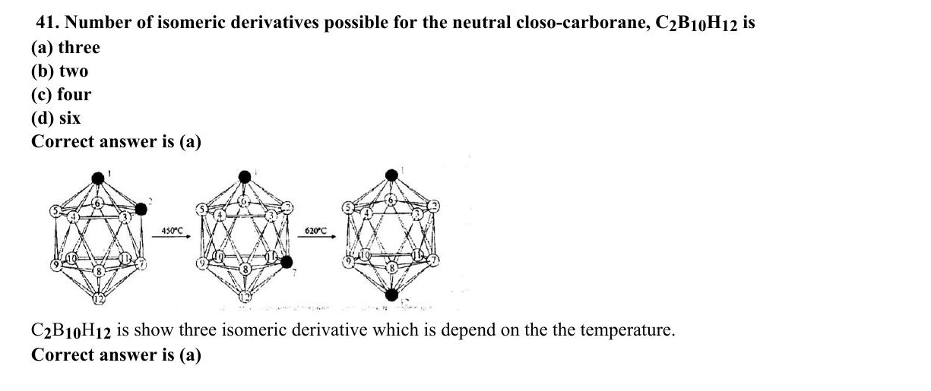
ABC CHEMISTRY
CSIR-DEC 2013
Mr. Aniket Bhardwaj
Hard
MCQ
Boron & Aluminium Group (Group 13)
Question 41 of 97
Q41
DEC 2013
QUESTION INSIGHTS
Number of isomeric derivatives possible for the neutral closo-carborane, C₂ B₁₀ H₁₂ is
(a) three
(b) two
(c) four
(d) six
ESTIMATED TIME
3–5 min
DIFFICULTY
Hard
CONCEPT TESTED
Wade's rules, Lewis acidity of BX3, closo/nido/arachno boranes
PYQ FREQUENCY
High · 11 paper
REVISION PRIORITY
★★★★★
EXPECTED LEVEL
Part C (high merit)
MEMORY HOOK
F donates most pi electrons → reduces Lewis acidity most. BCl3>BPh3>BMe3: steric and electronic factors together.
( Mr. Aniket Bhardwaj By ABC Chemistry ) · www.abcchemistry.com · 9212142427
Q41 · Question

Slide 57
ABC CHEMISTRY
CSIR-DEC 2013
Mr. Aniket Bhardwaj
Hard
MCQ
Boron & Aluminium Group (Group 13)
Question 41 of 97
Correct Answer A three
✓
CONCEPT
SHORTCUT / EXAM TRICK
Group 13 (B–Tl): B is a metalloid; Al is metallic. Both are Lewis acids. Boranes follow Wade's rules: closo BnHn2- (n+1 SEP, charge always -2), nido (n+2 SEP), arachno (n+3 SEP). Lewis acidity: BCl3>BPh3>BMe3 (F/Cl pi-donation reduces Lewis acidity in BF3).
Lewis acidity towards pyridine: BCl3>BPh3>BMe3. Wade's SEP: closo n+1, nido n+2, arachno n+3. Closo BnHn always has -2 charge.
↓
COMMON MISTAKE
LOGIC / WORKING
Thinking BF3 is the strongest Lewis acid — BCl3 is stronger because F lone-pair donation weakens BF3 more than Cl weakens BCl3.
ortho, meta and para C₂B₁₀H₁₂ — three (a).
Therefore the answer is (A).
EXAM TIP
BCl3 is stronger Lewis acid than BF3 because F lone pairs back-donate into empty p orbital more than Cl. Al2Me6 has 3c-2e Al-C-Al bridges.
MEMORY TRICK
F donates most pi electrons → reduces Lewis acidity most. BCl3>BPh3>BMe3: steric and electronic factors together.
FINAL: (A) three
( Mr. Aniket Bhardwaj By ABC Chemistry ) · www.abcchemistry.com · 9212142427
Q41 · Answer & Explanation

Slide 58
ABC CHEMISTRY
CSIR-DEC 2013
Mr. Aniket Bhardwaj
Hard
MCQ
Boron & Aluminium Group (Group 13)
Question 41 of 97
Why the Other Options Are Wrong
Correct answer: A
B
two
Why (A) is the key — ortho, meta and para C₂B₁₀H₁₂ — three (a).
C
four
Option (C) is ruled out by the same reasoning: ortho, meta and para C₂B₁₀H₁₂ — three
D
six
Option (D) is ruled out by the same reasoning: ortho, meta and para C₂B₁₀H₁₂ — three
( Mr. Aniket Bhardwaj By ABC Chemistry ) · www.abcchemistry.com · 9212142427
Q41 · Distractor Analysis

Slide 59
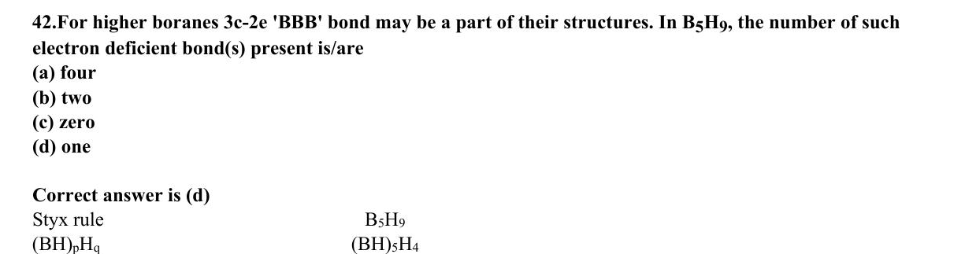
ABC CHEMISTRY
CSIR-DEC 2013
Mr. Aniket Bhardwaj
Hard
MCQ
Boron & Aluminium Group (Group 13)
Question 42 of 97
Q42
DEC 2013
QUESTION INSIGHTS
For higher boranes 3c-2e 'BBB' bond may be a part of their structures. In B₅ H₉, the number of such electron deficient bond(s) present is/are
(a) four
(b) two
(c) zero
(d) one
ESTIMATED TIME
3–5 min
DIFFICULTY
Hard
CONCEPT TESTED
Wade's rules, Lewis acidity of BX3, closo/nido/arachno boranes
PYQ FREQUENCY
High · 11 paper
REVISION PRIORITY
★★★★★
EXPECTED LEVEL
Part C (high merit)
MEMORY HOOK
F donates most pi electrons → reduces Lewis acidity most. BCl3>BPh3>BMe3: steric and electronic factors together.
( Mr. Aniket Bhardwaj By ABC Chemistry ) · www.abcchemistry.com · 9212142427
Q42 · Question

Slide 60
ABC CHEMISTRY
CSIR-DEC 2013
Mr. Aniket Bhardwaj
Hard
MCQ
Boron & Aluminium Group (Group 13)
Question 42 of 97
Correct Answer D One
✓
CONCEPT
SHORTCUT / EXAM TRICK
Group 13 (B–Tl): B is a metalloid; Al is metallic. Both are Lewis acids. Boranes follow Wade's rules: closo BnHn2- (n+1 SEP, charge always -2), nido (n+2 SEP), arachno (n+3 SEP). Lewis acidity: BCl3>BPh3>BMe3 (F/Cl pi-donation reduces Lewis acidity in BF3).
Lewis acidity towards pyridine: BCl3>BPh3>BMe3. Wade's SEP: closo n+1, nido n+2, arachno n+3. Closo BnHn always has -2 charge.
↓
COMMON MISTAKE
LOGIC / WORKING
Thinking BF3 is the strongest Lewis acid — BCl3 is stronger because F lone-pair donation weakens BF3 more than Cl weakens BCl3.
B H₉ (styx 4120): four B–H–B bridges, one closed 3c-2e BBB bond, two B–B bonds — one BBB bond.
Therefore the answer is (D).
EXAM TIP
BCl3 is stronger Lewis acid than BF3 because F lone pairs back-donate into empty p orbital more than Cl. Al2Me6 has 3c-2e Al-C-Al bridges.
MEMORY TRICK
F donates most pi electrons → reduces Lewis acidity most. BCl3>BPh3>BMe3: steric and electronic factors together.
FINAL: (D) One
( Mr. Aniket Bhardwaj By ABC Chemistry ) · www.abcchemistry.com · 9212142427
Q42 · Answer & Explanation

Slide 61
ABC CHEMISTRY
CSIR-DEC 2013
Mr. Aniket Bhardwaj
Hard
MCQ
Boron & Aluminium Group (Group 13)
Question 42 of 97
Why the Other Options Are Wrong
Correct answer: D
A
Four
Why (D) is the key — B H₉ (styx 4120): four B–H–B bridges, one closed 3c-2e BBB bond, two B–B bonds — one BBB bond.
B
Two
Option (B) is ruled out by the same reasoning: B H₉ (styx 4120): four B–H–B bridges, one closed 3c-2e BBB bond, two B–B bonds — one BBB
C
Zero
Option (C) is ruled out by the same reasoning: B H₉ (styx 4120): four B–H–B bridges, one closed 3c-2e BBB bond, two B–B bonds — one BBB
( Mr. Aniket Bhardwaj By ABC Chemistry ) · www.abcchemistry.com · 9212142427
Q42 · Distractor Analysis

Slide 62
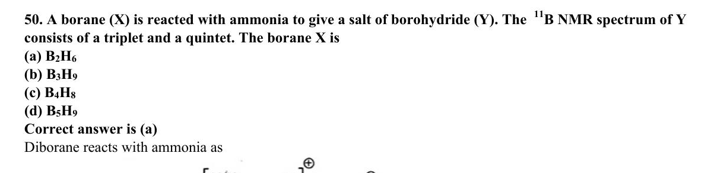
ABC CHEMISTRY
CSIR-DEC 2014
Mr. Aniket Bhardwaj
Hard
MCQ
Boron & Aluminium Group (Group 13)
Question 50 of 97
Q50
DEC 2014
QUESTION INSIGHTS
ESTIMATED TIME
3–5 min
DIFFICULTY
Hard
CONCEPT TESTED
Wade's rules, Lewis acidity of BX3, closo/nido/arachno boranes
PYQ FREQUENCY
High · 11 paper
REVISION PRIORITY
★★★★★
EXPECTED LEVEL
Part C (high merit)
MEMORY HOOK
F donates most pi electrons → reduces Lewis acidity most. BCl3>BPh3>BMe3: steric and electronic factors together.
( Mr. Aniket Bhardwaj By ABC Chemistry ) · www.abcchemistry.com · 9212142427
Q50 · Question

Slide 63
ABC CHEMISTRY
CSIR-DEC 2014
Mr. Aniket Bhardwaj
Hard
MCQ
Boron & Aluminium Group (Group 13)
Question 50 of 97
Correct Answer A B₂H₆
✓
CONCEPT
SHORTCUT / EXAM TRICK
Group 13 (B–Tl): B is a metalloid; Al is metallic. Both are Lewis acids. Boranes follow Wade's rules: closo BnHn2- (n+1 SEP, charge always -2), nido (n+2 SEP), arachno (n+3 SEP). Lewis acidity: BCl3>BPh3>BMe3 (F/Cl pi-donation reduces Lewis acidity in BF3).
Lewis acidity towards pyridine: BCl3>BPh3>BMe3. Wade's SEP: closo n+1, nido n+2, arachno n+3. Closo BnHn always has -2 charge.
↓
COMMON MISTAKE
LOGIC / WORKING
Thinking BF3 is the strongest Lewis acid — BCl3 is stronger because F lone-pair donation weakens BF3 more than Cl weakens BCl3.
Key principle: Wade's rules, Lewis acidity of BX3, and borane structures. Correct answer is (A).
EXAM TIP
BCl3 is stronger Lewis acid than BF3 because F lone pairs back-donate into empty p orbital more than Cl. Al2Me6 has 3c-2e Al-C-Al bridges.
MEMORY TRICK
F donates most pi electrons → reduces Lewis acidity most. BCl3>BPh3>BMe3: steric and electronic factors together.
FINAL: (A) B₂H₆
( Mr. Aniket Bhardwaj By ABC Chemistry ) · www.abcchemistry.com · 9212142427
Q50 · Answer & Explanation

Slide 64
ABC CHEMISTRY
CSIR-DEC 2014
Mr. Aniket Bhardwaj
Hard
MCQ
Boron & Aluminium Group (Group 13)
Question 50 of 97
Why the Other Options Are Wrong
Correct answer: A
B
B₃H₉
Inconsistent with Wade's rules, Lewis acidity of BX3, and borane structures; correct choice is (A). See worked explanation.
C
B₄H₈
Inconsistent with Wade's rules, Lewis acidity of BX3, and borane structures; correct choice is (A). See worked explanation.
D
B₅H₉
Inconsistent with Wade's rules, Lewis acidity of BX3, and borane structures; correct choice is (A). See worked explanation.
( Mr. Aniket Bhardwaj By ABC Chemistry ) · www.abcchemistry.com · 9212142427
Q50 · Distractor Analysis

Slide 65
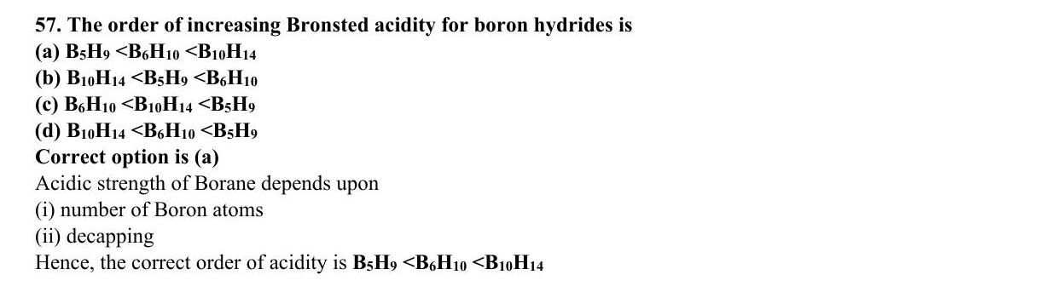
ABC CHEMISTRY
CSIR-DEC 2015
Mr. Aniket Bhardwaj
Hard
MCQ
Boron & Aluminium Group (Group 13)
Question 57 of 97
Q57
DEC 2015
QUESTION INSIGHTS
ESTIMATED TIME
3–5 min
DIFFICULTY
Hard
CONCEPT TESTED
Wade's rules, Lewis acidity of BX3, closo/nido/arachno boranes
PYQ FREQUENCY
High · 11 paper
REVISION PRIORITY
★★★★★
EXPECTED LEVEL
Part C (high merit)
MEMORY HOOK
F donates most pi electrons → reduces Lewis acidity most. BCl3>BPh3>BMe3: steric and electronic factors together.
( Mr. Aniket Bhardwaj By ABC Chemistry ) · www.abcchemistry.com · 9212142427
Q57 · Question

Slide 66
ABC CHEMISTRY
CSIR-DEC 2015
Mr. Aniket Bhardwaj
Hard
MCQ
Boron & Aluminium Group (Group 13)
Question 57 of 97
Correct Answer A B₅H₉ <B₆H₁₀ <B₁₀H₁₄
✓
CONCEPT
SHORTCUT / EXAM TRICK
Group 13 (B–Tl): B is a metalloid; Al is metallic. Both are Lewis acids. Boranes follow Wade's rules: closo BnHn2- (n+1 SEP, charge always -2), nido (n+2 SEP), arachno (n+3 SEP). Lewis acidity: BCl3>BPh3>BMe3 (F/Cl pi-donation reduces Lewis acidity in BF3).
Lewis acidity towards pyridine: BCl3>BPh3>BMe3. Wade's SEP: closo n+1, nido n+2, arachno n+3. Closo BnHn always has -2 charge.
↓
COMMON MISTAKE
LOGIC / WORKING
Thinking BF3 is the strongest Lewis acid — BCl3 is stronger because F lone-pair donation weakens BF3 more than Cl weakens BCl3.
Key principle: Wade's rules, Lewis acidity of BX3, and borane structures. Correct answer is (A).
EXAM TIP
BCl3 is stronger Lewis acid than BF3 because F lone pairs back-donate into empty p orbital more than Cl. Al2Me6 has 3c-2e Al-C-Al bridges.
MEMORY TRICK
F donates most pi electrons → reduces Lewis acidity most. BCl3>BPh3>BMe3: steric and electronic factors together.
FINAL: (A) B₅H₉ <B₆H₁₀ <B₁₀H₁₄
( Mr. Aniket Bhardwaj By ABC Chemistry ) · www.abcchemistry.com · 9212142427
Q57 · Answer & Explanation

Slide 67
ABC CHEMISTRY
CSIR-DEC 2015
Mr. Aniket Bhardwaj
Hard
MCQ
Boron & Aluminium Group (Group 13)
Question 57 of 97
Why the Other Options Are Wrong
Correct answer: A
B
B₁₀H₁₄ <B₅H₉ <B₆H₁₀
Inconsistent with Wade's rules, Lewis acidity of BX3, and borane structures; correct choice is (A). See worked explanation.
C
B₆H₁₀ <B₁₀H₁₄ <B₅H₉
Inconsistent with Wade's rules, Lewis acidity of BX3, and borane structures; correct choice is (A). See worked explanation.
D
B₁₀H₁₄ <B₆H₁₀ <B₅H₉
Inconsistent with Wade's rules, Lewis acidity of BX3, and borane structures; correct choice is (A). See worked explanation.
( Mr. Aniket Bhardwaj By ABC Chemistry ) · www.abcchemistry.com · 9212142427
Q57 · Distractor Analysis

Slide 68
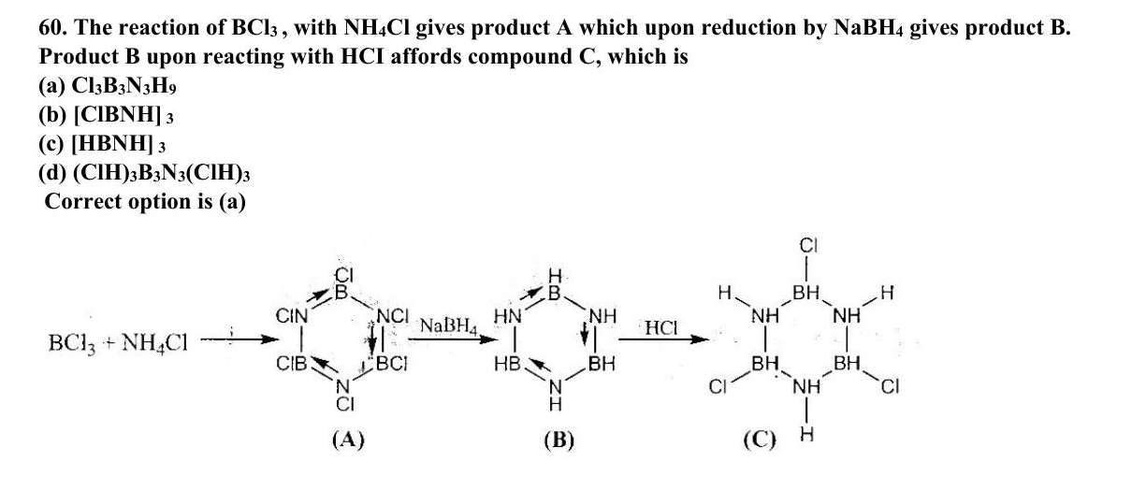
ABC CHEMISTRY
CSIR-DEC 2015
Mr. Aniket Bhardwaj
Hard
MCQ
Boron & Aluminium Group (Group 13)
Question 60 of 97
Q60
DEC 2015
QUESTION INSIGHTS
The reaction of BCl₃, with NH₄Cl gives product A which upon reduction by NaBH₄ gives product B. Product B upon reacting with HCl affords compound C, which is
(a) Cl₃ B₃ N₃ H₉
(b) [ClBNH]₃
(c) [HBNH]₃
(d) (ClH)₃ B₃ N₃(ClH)₃
ESTIMATED TIME
3–5 min
DIFFICULTY
Hard
CONCEPT TESTED
Wade's rules, Lewis acidity of BX3, closo/nido/arachno boranes
PYQ FREQUENCY
High · 11 paper
REVISION PRIORITY
★★★★★
EXPECTED LEVEL
Part C (high merit)
MEMORY HOOK
F donates most pi electrons → reduces Lewis acidity most. BCl3>BPh3>BMe3: steric and electronic factors together.
( Mr. Aniket Bhardwaj By ABC Chemistry ) · www.abcchemistry.com · 9212142427
Q60 · Question

Slide 69
ABC CHEMISTRY
CSIR-DEC 2015
Mr. Aniket Bhardwaj
Hard
MCQ
Boron & Aluminium Group (Group 13)
Question 60 of 97
Correct Answer A Cl₃B₃N₃H₉
✓
CONCEPT
SHORTCUT / EXAM TRICK
Group 13 (B–Tl): B is a metalloid; Al is metallic. Both are Lewis acids. Boranes follow Wade's rules: closo BnHn2- (n+1 SEP, charge always -2), nido (n+2 SEP), arachno (n+3 SEP). Lewis acidity: BCl3>BPh3>BMe3 (F/Cl pi-donation reduces Lewis acidity in BF3).
Lewis acidity towards pyridine: BCl3>BPh3>BMe3. Wade's SEP: closo n+1, nido n+2, arachno n+3. Closo BnHn always has -2 charge.
↓
COMMON MISTAKE
LOGIC / WORKING
Thinking BF3 is the strongest Lewis acid — BCl3 is stronger because F lone-pair donation weakens BF3 more than Cl weakens BCl3.
A = B-trichloroborazine [ClBNH]₃; B = borazine [HBNH]₃; borazine adds three HCl across its B–N bonds (Cl to B, H to N) to give the cyclic adduct B₃N₃H₉Cl₃ (Cl₃B₃N₃H₉).
Therefore the answer is (A).
EXAM TIP
BCl3 is stronger Lewis acid than BF3 because F lone pairs back-donate into empty p orbital more than Cl. Al2Me6 has 3c-2e Al-C-Al bridges.
MEMORY TRICK
F donates most pi electrons → reduces Lewis acidity most. BCl3>BPh3>BMe3: steric and electronic factors together.
FINAL: (A) Cl₃B₃N₃H₉
( Mr. Aniket Bhardwaj By ABC Chemistry ) · www.abcchemistry.com · 9212142427
Q60 · Answer & Explanation

Slide 70
ABC CHEMISTRY
CSIR-DEC 2015
Mr. Aniket Bhardwaj
Hard
MCQ
Boron & Aluminium Group (Group 13)
Question 60 of 97
Why the Other Options Are Wrong
Correct answer: A
B
[ClBNH] 3
Why (A) is the key — A = B-trichloroborazine [ClBNH]₃; B = borazine [HBNH]₃; borazine adds three HCl across its B–N bonds (Cl to B, H to N) to give the cyclic adduct B₃N₃H₉Cl₃ (Cl₃B₃N₃H₉).
C
[HBNH] 3
Option (C) is ruled out by the same reasoning: A = B-trichloroborazine [ClBNH]₃; B = borazine [HBNH]₃; borazine adds three HCl across its B–N bonds (Cl to B, H to N) to give the cyclic adduct B₃N₃H₉Cl₃…
D
(ClH)₃B₃N₃(ClH)₃
Option (D) is ruled out by the same reasoning: A = B-trichloroborazine [ClBNH]₃; B = borazine [HBNH]₃; borazine adds three HCl across its B–N bonds (Cl to B, H to N) to give the cyclic adduct B₃N₃H₉Cl₃…
( Mr. Aniket Bhardwaj By ABC Chemistry ) · www.abcchemistry.com · 9212142427
Q60 · Distractor Analysis

Slide 71
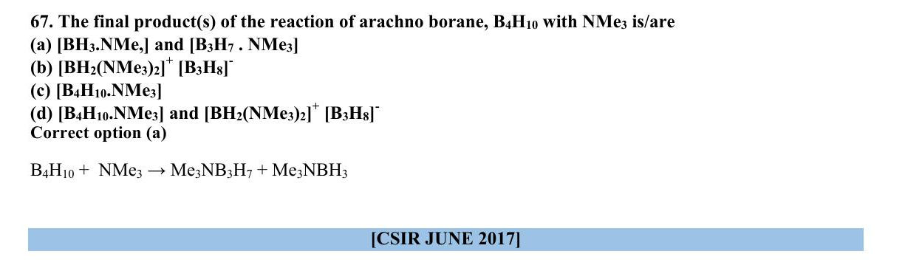
ABC CHEMISTRY
CSIR-Dec 2016
Mr. Aniket Bhardwaj
Hard
MCQ
Boron & Aluminium Group (Group 13)
Question 67 of 97
Q67
Dec 2016
QUESTION INSIGHTS
ESTIMATED TIME
3–5 min
DIFFICULTY
Hard
CONCEPT TESTED
Wade's rules, Lewis acidity of BX3, closo/nido/arachno boranes
PYQ FREQUENCY
High · 11 paper
REVISION PRIORITY
★★★★★
EXPECTED LEVEL
Part C (high merit)
MEMORY HOOK
F donates most pi electrons → reduces Lewis acidity most. BCl3>BPh3>BMe3: steric and electronic factors together.
( Mr. Aniket Bhardwaj By ABC Chemistry ) · www.abcchemistry.com · 9212142427
Q67 · Question

Slide 72
ABC CHEMISTRY
CSIR-Dec 2016
Mr. Aniket Bhardwaj
Hard
MCQ
Boron & Aluminium Group (Group 13)
Question 67 of 97
Correct Answer A [BH₃.NMe,] and [B₃H₇ . NMe₃]
✓
CONCEPT
SHORTCUT / EXAM TRICK
Group 13 (B–Tl): B is a metalloid; Al is metallic. Both are Lewis acids. Boranes follow Wade's rules: closo BnHn2- (n+1 SEP, charge always -2), nido (n+2 SEP), arachno (n+3 SEP). Lewis acidity: BCl3>BPh3>BMe3 (F/Cl pi-donation reduces Lewis acidity in BF3).
Lewis acidity towards pyridine: BCl3>BPh3>BMe3. Wade's SEP: closo n+1, nido n+2, arachno n+3. Closo BnHn always has -2 charge.
↓
COMMON MISTAKE
LOGIC / WORKING
Thinking BF3 is the strongest Lewis acid — BCl3 is stronger because F lone-pair donation weakens BF3 more than Cl weakens BCl3.
Key principle: Wade's rules, Lewis acidity of BX3, and borane structures. Correct answer is (A).
EXAM TIP
BCl3 is stronger Lewis acid than BF3 because F lone pairs back-donate into empty p orbital more than Cl. Al2Me6 has 3c-2e Al-C-Al bridges.
MEMORY TRICK
F donates most pi electrons → reduces Lewis acidity most. BCl3>BPh3>BMe3: steric and electronic factors together.
FINAL: (A) [BH₃.NMe,] and [B₃H₇ . NMe₃]
( Mr. Aniket Bhardwaj By ABC Chemistry ) · www.abcchemistry.com · 9212142427
Q67 · Answer & Explanation

Slide 73
ABC CHEMISTRY
CSIR-Dec 2016
Mr. Aniket Bhardwaj
Hard
MCQ
Boron & Aluminium Group (Group 13)
Question 67 of 97
Why the Other Options Are Wrong
Correct answer: A
B
[BH₂(NMe₃)₂]+ [B₃H₈]-
Inconsistent with Wade's rules, Lewis acidity of BX3, and borane structures; correct choice is (A). See worked explanation.
C
[B₄H₁₀.NMe₃]
Inconsistent with Wade's rules, Lewis acidity of BX3, and borane structures; correct choice is (A). See worked explanation.
D
[B₄H₁₀.NMe₃] and [BH₂(NMe₃)₂]+ [B₃H₈]-
Inconsistent with Wade's rules, Lewis acidity of BX3, and borane structures; correct choice is (A). See worked explanation.
( Mr. Aniket Bhardwaj By ABC Chemistry ) · www.abcchemistry.com · 9212142427
Q67 · Distractor Analysis

Slide 74
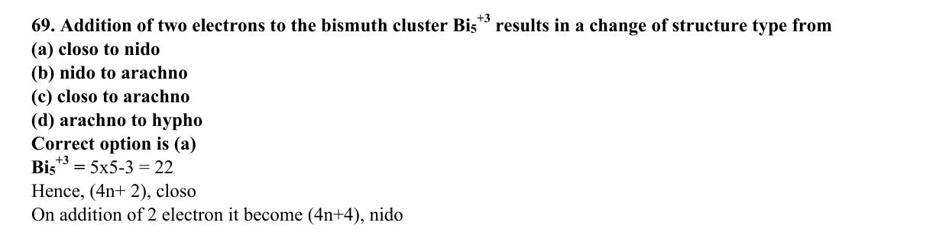
ABC CHEMISTRY
CSIR-JUNE 2017
Mr. Aniket Bhardwaj
Hard
MCQ
Boron & Aluminium Group (Group 13)
Question 69 of 97
Q69
JUNE 2017
QUESTION INSIGHTS
Addition of two electrons to the bismuth cluster Bi₅³⁺ results in a change of structure type from
(a) closo to nido
(b) nido to arachno
(c) closo to arachno
(d) arachno to hypho
ESTIMATED TIME
3–5 min
DIFFICULTY
Hard
CONCEPT TESTED
Wade's rules, Lewis acidity of BX3, closo/nido/arachno boranes
PYQ FREQUENCY
High · 11 paper
REVISION PRIORITY
★★★★★
EXPECTED LEVEL
Part C (high merit)
MEMORY HOOK
F donates most pi electrons → reduces Lewis acidity most. BCl3>BPh3>BMe3: steric and electronic factors together.
( Mr. Aniket Bhardwaj By ABC Chemistry ) · www.abcchemistry.com · 9212142427
Q69 · Question

Slide 75
ABC CHEMISTRY
CSIR-JUNE 2017
Mr. Aniket Bhardwaj
Hard
MCQ
Boron & Aluminium Group (Group 13)
Question 69 of 97
Correct Answer A closo to nido
✓
CONCEPT
SHORTCUT / EXAM TRICK
Group 13 (B–Tl): B is a metalloid; Al is metallic. Both are Lewis acids. Boranes follow Wade's rules: closo BnHn2- (n+1 SEP, charge always -2), nido (n+2 SEP), arachno (n+3 SEP). Lewis acidity: BCl3>BPh3>BMe3 (F/Cl pi-donation reduces Lewis acidity in BF3).
Lewis acidity towards pyridine: BCl3>BPh3>BMe3. Wade's SEP: closo n+1, nido n+2, arachno n+3. Closo BnHn always has -2 charge.
↓
COMMON MISTAKE
LOGIC / WORKING
Thinking BF3 is the strongest Lewis acid — BCl3 is stronger because F lone-pair donation weakens BF3 more than Cl weakens BCl3.
Bi ⁺ has 5×3 − 3 = 12 = 2n + 2 skeletal electrons (closo trigonal bipyramid); adding two gives 2n + 4, a nido square pyramid.
Therefore the answer is (A).
EXAM TIP
BCl3 is stronger Lewis acid than BF3 because F lone pairs back-donate into empty p orbital more than Cl. Al2Me6 has 3c-2e Al-C-Al bridges.
MEMORY TRICK
F donates most pi electrons → reduces Lewis acidity most. BCl3>BPh3>BMe3: steric and electronic factors together.
FINAL: (A) closo to nido
( Mr. Aniket Bhardwaj By ABC Chemistry ) · www.abcchemistry.com · 9212142427
Q69 · Answer & Explanation

Slide 76
ABC CHEMISTRY
CSIR-JUNE 2017
Mr. Aniket Bhardwaj
Hard
MCQ
Boron & Aluminium Group (Group 13)
Question 69 of 97
Why the Other Options Are Wrong
Correct answer: A
B
nido to arachno
Why (A) is the key — Bi ⁺ has 5×3 − 3 = 12 = 2n + 2 skeletal electrons (closo trigonal bipyramid); adding two gives 2n + 4, a nido square pyramid.
C
closo to arachno
Option (C) is ruled out by the same reasoning: Bi ⁺ has 5×3 − 3 = 12 = 2n + 2 skeletal electrons (closo trigonal bipyramid); adding two gives 2n + 4, a nido square
D
arachno to hypho
Option (D) is ruled out by the same reasoning: Bi ⁺ has 5×3 − 3 = 12 = 2n + 2 skeletal electrons (closo trigonal bipyramid); adding two gives 2n + 4, a nido square
( Mr. Aniket Bhardwaj By ABC Chemistry ) · www.abcchemistry.com · 9212142427
Q69 · Distractor Analysis

Slide 77
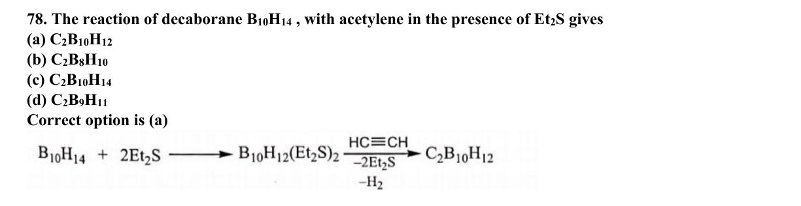
ABC CHEMISTRY
CSIR-DEC 2018
Mr. Aniket Bhardwaj
Hard
MCQ
Boron & Aluminium Group (Group 13)
Question 78 of 97
Q78
DEC 2018
QUESTION INSIGHTS
ESTIMATED TIME
3–5 min
DIFFICULTY
Hard
CONCEPT TESTED
Wade's rules, Lewis acidity of BX3, closo/nido/arachno boranes
PYQ FREQUENCY
High · 11 paper
REVISION PRIORITY
★★★★★
EXPECTED LEVEL
Part C (high merit)
MEMORY HOOK
F donates most pi electrons → reduces Lewis acidity most. BCl3>BPh3>BMe3: steric and electronic factors together.
( Mr. Aniket Bhardwaj By ABC Chemistry ) · www.abcchemistry.com · 9212142427
Q78 · Question

Slide 78
ABC CHEMISTRY
CSIR-DEC 2018
Mr. Aniket Bhardwaj
Hard
MCQ
Boron & Aluminium Group (Group 13)
Question 78 of 97
Correct Answer A C₂B₁₀H₁₂
✓
CONCEPT
SHORTCUT / EXAM TRICK
Group 13 (B–Tl): B is a metalloid; Al is metallic. Both are Lewis acids. Boranes follow Wade's rules: closo BnHn2- (n+1 SEP, charge always -2), nido (n+2 SEP), arachno (n+3 SEP). Lewis acidity: BCl3>BPh3>BMe3 (F/Cl pi-donation reduces Lewis acidity in BF3).
Lewis acidity towards pyridine: BCl3>BPh3>BMe3. Wade's SEP: closo n+1, nido n+2, arachno n+3. Closo BnHn always has -2 charge.
↓
COMMON MISTAKE
LOGIC / WORKING
Thinking BF3 is the strongest Lewis acid — BCl3 is stronger because F lone-pair donation weakens BF3 more than Cl weakens BCl3.
Key principle: Wade's rules, Lewis acidity of BX3, and borane structures. Correct answer is (A).
EXAM TIP
BCl3 is stronger Lewis acid than BF3 because F lone pairs back-donate into empty p orbital more than Cl. Al2Me6 has 3c-2e Al-C-Al bridges.
MEMORY TRICK
F donates most pi electrons → reduces Lewis acidity most. BCl3>BPh3>BMe3: steric and electronic factors together.
FINAL: (A) C₂B₁₀H₁₂
( Mr. Aniket Bhardwaj By ABC Chemistry ) · www.abcchemistry.com · 9212142427
Q78 · Answer & Explanation

Slide 79
ABC CHEMISTRY
CSIR-DEC 2018
Mr. Aniket Bhardwaj
Hard
MCQ
Boron & Aluminium Group (Group 13)
Question 78 of 97
Why the Other Options Are Wrong
Correct answer: A
B
C₂B₈H₁₀
Inconsistent with Wade's rules, Lewis acidity of BX3, and borane structures; correct choice is (A). See worked explanation.
C
C₂B₁₀H₁₄
Inconsistent with Wade's rules, Lewis acidity of BX3, and borane structures; correct choice is (A). See worked explanation.
D
C₂B₉H₁₁
Inconsistent with Wade's rules, Lewis acidity of BX3, and borane structures; correct choice is (A). See worked explanation.
( Mr. Aniket Bhardwaj By ABC Chemistry ) · www.abcchemistry.com · 9212142427
Q78 · Distractor Analysis

Slide 80
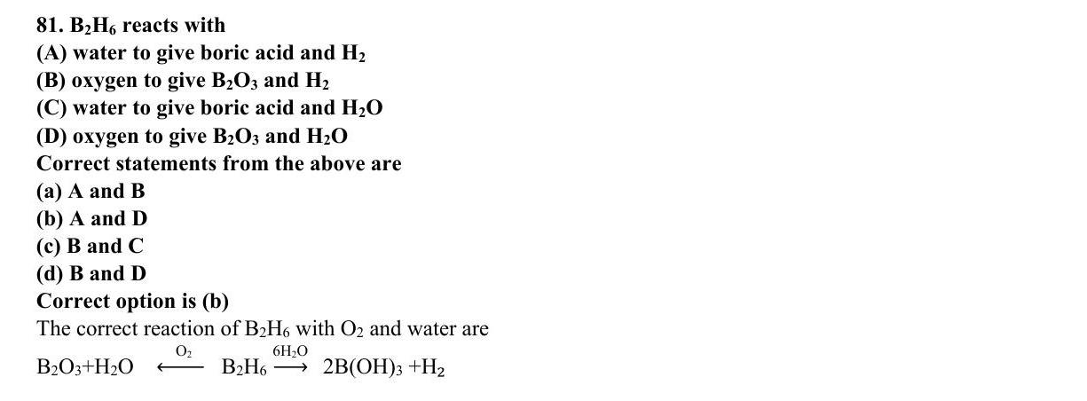
ABC CHEMISTRY
CSIR-DEC 2018
Mr. Aniket Bhardwaj
Hard
MCQ
Boron & Aluminium Group (Group 13)
Question 81 of 97
Q81
DEC 2018
QUESTION INSIGHTS
ESTIMATED TIME
3–5 min
DIFFICULTY
Hard
CONCEPT TESTED
Wade's rules, Lewis acidity of BX3, closo/nido/arachno boranes
PYQ FREQUENCY
High · 11 paper
REVISION PRIORITY
★★★★★
EXPECTED LEVEL
Part C (high merit)
MEMORY HOOK
F donates most pi electrons → reduces Lewis acidity most. BCl3>BPh3>BMe3: steric and electronic factors together.
( Mr. Aniket Bhardwaj By ABC Chemistry ) · www.abcchemistry.com · 9212142427
Q81 · Question

Slide 81
ABC CHEMISTRY
CSIR-DEC 2018
Mr. Aniket Bhardwaj
Hard
MCQ
Boron & Aluminium Group (Group 13)
Question 81 of 97
Correct Answer B oxygen to give B2O3 and H2
✓
CONCEPT
SHORTCUT / EXAM TRICK
Group 13 (B–Tl): B is a metalloid; Al is metallic. Both are Lewis acids. Boranes follow Wade's rules: closo BnHn2- (n+1 SEP, charge always -2), nido (n+2 SEP), arachno (n+3 SEP). Lewis acidity: BCl3>BPh3>BMe3 (F/Cl pi-donation reduces Lewis acidity in BF3).
Lewis acidity towards pyridine: BCl3>BPh3>BMe3. Wade's SEP: closo n+1, nido n+2, arachno n+3. Closo BnHn always has -2 charge.
↓
COMMON MISTAKE
LOGIC / WORKING
Thinking BF3 is the strongest Lewis acid — BCl3 is stronger because F lone-pair donation weakens BF3 more than Cl weakens BCl3.
Key principle: Wade's rules, Lewis acidity of BX3, and borane structures. Correct answer is (B).
EXAM TIP
BCl3 is stronger Lewis acid than BF3 because F lone pairs back-donate into empty p orbital more than Cl. Al2Me6 has 3c-2e Al-C-Al bridges.
MEMORY TRICK
F donates most pi electrons → reduces Lewis acidity most. BCl3>BPh3>BMe3: steric and electronic factors together.
FINAL: (B) oxygen to give B2O3 and H2
( Mr. Aniket Bhardwaj By ABC Chemistry ) · www.abcchemistry.com · 9212142427
Q81 · Answer & Explanation

Slide 82
ABC CHEMISTRY
CSIR-DEC 2018
Mr. Aniket Bhardwaj
Hard
MCQ
Boron & Aluminium Group (Group 13)
Question 81 of 97
Why the Other Options Are Wrong
Correct answer: B
A
water to give boric acid and H2
Inconsistent with Wade's rules, Lewis acidity of BX3, and borane structures; correct choice is (B). See worked explanation.
C
water to give boric acid and H2O
Inconsistent with Wade's rules, Lewis acidity of BX3, and borane structures; correct choice is (B). See worked explanation.
D
oxygen to give B2O3 and H2O
Inconsistent with Wade's rules, Lewis acidity of BX3, and borane structures; correct choice is (B). See worked explanation.
( Mr. Aniket Bhardwaj By ABC Chemistry ) · www.abcchemistry.com · 9212142427
Q81 · Distractor Analysis

Slide 83
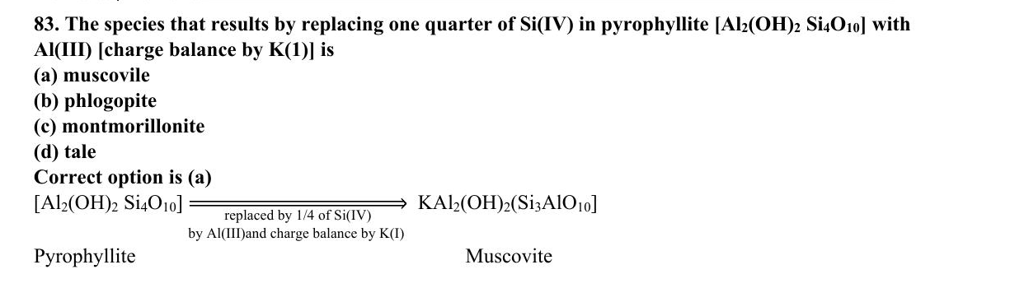
ABC CHEMISTRY
CSIR-JUNE 2019
Mr. Aniket Bhardwaj
Hard
MCQ
Boron & Aluminium Group (Group 13)
Question 83 of 97
Q83
JUNE 2019
QUESTION INSIGHTS
ESTIMATED TIME
3–5 min
DIFFICULTY
Hard
CONCEPT TESTED
Wade's rules, Lewis acidity of BX3, closo/nido/arachno boranes
PYQ FREQUENCY
High · 11 paper
REVISION PRIORITY
★★★★★
EXPECTED LEVEL
Part C (high merit)
MEMORY HOOK
F donates most pi electrons → reduces Lewis acidity most. BCl3>BPh3>BMe3: steric and electronic factors together.
( Mr. Aniket Bhardwaj By ABC Chemistry ) · www.abcchemistry.com · 9212142427
Q83 · Question

Slide 84
ABC CHEMISTRY
CSIR-JUNE 2019
Mr. Aniket Bhardwaj
Hard
MCQ
Boron & Aluminium Group (Group 13)
Question 83 of 97
Correct Answer A muscovile
✓
CONCEPT
SHORTCUT / EXAM TRICK
Group 13 (B–Tl): B is a metalloid; Al is metallic. Both are Lewis acids. Boranes follow Wade's rules: closo BnHn2- (n+1 SEP, charge always -2), nido (n+2 SEP), arachno (n+3 SEP). Lewis acidity: BCl3>BPh3>BMe3 (F/Cl pi-donation reduces Lewis acidity in BF3).
Lewis acidity towards pyridine: BCl3>BPh3>BMe3. Wade's SEP: closo n+1, nido n+2, arachno n+3. Closo BnHn always has -2 charge.
↓
COMMON MISTAKE
LOGIC / WORKING
Thinking BF3 is the strongest Lewis acid — BCl3 is stronger because F lone-pair donation weakens BF3 more than Cl weakens BCl3.
Key principle: Wade's rules, Lewis acidity of BX3, and borane structures. Correct answer is (A).
EXAM TIP
BCl3 is stronger Lewis acid than BF3 because F lone pairs back-donate into empty p orbital more than Cl. Al2Me6 has 3c-2e Al-C-Al bridges.
MEMORY TRICK
F donates most pi electrons → reduces Lewis acidity most. BCl3>BPh3>BMe3: steric and electronic factors together.
FINAL: (A) muscovile
( Mr. Aniket Bhardwaj By ABC Chemistry ) · www.abcchemistry.com · 9212142427
Q83 · Answer & Explanation

Slide 85
ABC CHEMISTRY
CSIR-JUNE 2019
Mr. Aniket Bhardwaj
Hard
MCQ
Boron & Aluminium Group (Group 13)
Question 83 of 97
Why the Other Options Are Wrong
Correct answer: A
B
phlogopite
Inconsistent with Wade's rules, Lewis acidity of BX3, and borane structures; correct choice is (A). See worked explanation.
C
montmorillonite
Inconsistent with Wade's rules, Lewis acidity of BX3, and borane structures; correct choice is (A). See worked explanation.
D
tale
Inconsistent with Wade's rules, Lewis acidity of BX3, and borane structures; correct choice is (A). See worked explanation.
( Mr. Aniket Bhardwaj By ABC Chemistry ) · www.abcchemistry.com · 9212142427
Q83 · Distractor Analysis

Slide 86
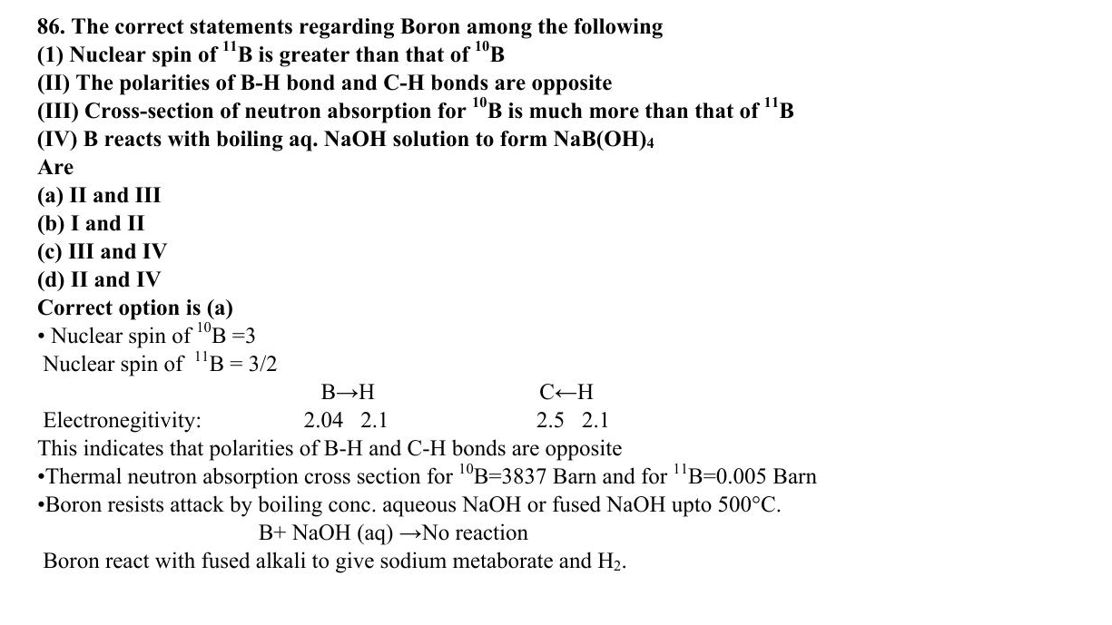
ABC CHEMISTRY
CSIR-JUNE 2019
Mr. Aniket Bhardwaj
Hard
MCQ
Boron & Aluminium Group (Group 13)
Question 86 of 97
Q86
JUNE 2019
QUESTION INSIGHTS
The correct statements regarding Boron among the following (1) Nuclear spin of ¹¹ B is greater than that of ¹⁰ B (II) The polarities of B-H bond and C-H bonds are opposite (III) Cross-section of neutron absorption for ¹⁰ B is much more than that of ¹¹ B (IV) B reacts with boiling aq. NaOH solution to form NaB(OH)₄
(a) II and III
(b) I and II
(c) III and IV
(d) II and IV
ESTIMATED TIME
3–5 min
DIFFICULTY
Hard
CONCEPT TESTED
Wade's rules, Lewis acidity of BX3, closo/nido/arachno boranes
PYQ FREQUENCY
High · 11 paper
REVISION PRIORITY
★★★★★
EXPECTED LEVEL
Part C (high merit)
MEMORY HOOK
F donates most pi electrons → reduces Lewis acidity most. BCl3>BPh3>BMe3: steric and electronic factors together.
( Mr. Aniket Bhardwaj By ABC Chemistry ) · www.abcchemistry.com · 9212142427
Q86 · Question

Slide 87
ABC CHEMISTRY
CSIR-JUNE 2019
Mr. Aniket Bhardwaj
Hard
MCQ
Boron & Aluminium Group (Group 13)
Question 86 of 97
Correct Answer A II and III
✓
CONCEPT
SHORTCUT / EXAM TRICK
Group 13 (B–Tl): B is a metalloid; Al is metallic. Both are Lewis acids. Boranes follow Wade's rules: closo BnHn2- (n+1 SEP, charge always -2), nido (n+2 SEP), arachno (n+3 SEP). Lewis acidity: BCl3>BPh3>BMe3 (F/Cl pi-donation reduces Lewis acidity in BF3).
Lewis acidity towards pyridine: BCl3>BPh3>BMe3. Wade's SEP: closo n+1, nido n+2, arachno n+3. Closo BnHn always has -2 charge.
↓
COMMON MISTAKE
LOGIC / WORKING
Thinking BF3 is the strongest Lewis acid — BCl3 is stronger because F lone-pair donation weakens BF3 more than Cl weakens BCl3.
B–H (B^δ+–H^δ−) is polarised opposite to C–H. ¹⁰B has a huge neutron cross-section. ¹¹B (I = 3/2) has a smaller spin than ¹⁰B (I = 3). Crystalline boron is not attacked by boiling aqueous NaOH. II and III (a).
Therefore the answer is (A).
EXAM TIP
BCl3 is stronger Lewis acid than BF3 because F lone pairs back-donate into empty p orbital more than Cl. Al2Me6 has 3c-2e Al-C-Al bridges.
MEMORY TRICK
F donates most pi electrons → reduces Lewis acidity most. BCl3>BPh3>BMe3: steric and electronic factors together.
FINAL: (A) II and III
( Mr. Aniket Bhardwaj By ABC Chemistry ) · www.abcchemistry.com · 9212142427
Q86 · Answer & Explanation

Slide 88
ABC CHEMISTRY
CSIR-JUNE 2019
Mr. Aniket Bhardwaj
Hard
MCQ
Boron & Aluminium Group (Group 13)
Question 86 of 97
Why the Other Options Are Wrong
Correct answer: A
B
I and II
Why (A) is the key — B–H (B^δ+–H^δ−) is polarised opposite to C–H. ¹⁰B has a huge neutron cross-section. ¹¹B (I = 3/2) has a smaller spin than ¹⁰B (I = 3). Crystalline boron is not attacked by boiling aqueous NaOH. II and III (a).
C
III and IV
Option (C) is ruled out by the same reasoning: B–H (B^δ+–H^δ−) is polarised opposite to C–H. ¹⁰B has a huge neutron cross-section. ¹¹B (I = 3/2) has a smaller spin than ¹⁰B (I = 3). Crystalline boron is not…
D
II and IV
Option (D) is ruled out by the same reasoning: B–H (B^δ+–H^δ−) is polarised opposite to C–H. ¹⁰B has a huge neutron cross-section. ¹¹B (I = 3/2) has a smaller spin than ¹⁰B (I = 3). Crystalline boron is not…
( Mr. Aniket Bhardwaj By ABC Chemistry ) · www.abcchemistry.com · 9212142427
Q86 · Distractor Analysis

Slide 89
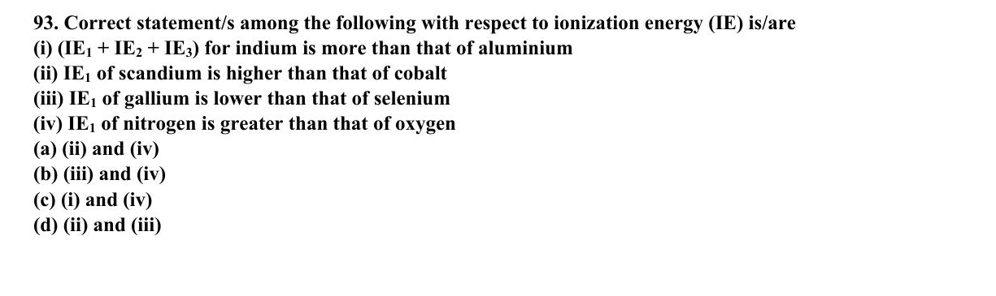
ABC CHEMISTRY
CSIR-DEC 2019
Mr. Aniket Bhardwaj
Hard
MCQ
Boron & Aluminium Group (Group 13)
Question 93 of 97
Q93
DEC 2019
QUESTION INSIGHTS
Correct statement/s among the following with respect to ionization energy (IE) is/are (i) (IE₁+IE₂+IE₃) for indium is more than that of aluminium (ii) IE₁ of scandium is higher than that of cobalt (iii) IE₁ of gallium is lower than that of selenium (iv) IE₁ of nitrogen is greater than that of oxygen
(a) (ii) and (iv)
(b) (iii) and (iv)
(c) (i) and (iv)
(d) (ii) and (iii)
ESTIMATED TIME
3–5 min
DIFFICULTY
Hard
CONCEPT TESTED
Wade's rules, Lewis acidity of BX3, closo/nido/arachno boranes
PYQ FREQUENCY
High · 11 paper
REVISION PRIORITY
★★★★★
EXPECTED LEVEL
Part C (high merit)
MEMORY HOOK
F donates most pi electrons → reduces Lewis acidity most. BCl3>BPh3>BMe3: steric and electronic factors together.
( Mr. Aniket Bhardwaj By ABC Chemistry ) · www.abcchemistry.com · 9212142427
Q93 · Question

Slide 90
ABC CHEMISTRY
CSIR-DEC 2019
Mr. Aniket Bhardwaj
Hard
MCQ
Boron & Aluminium Group (Group 13)
Question 93 of 97
Correct Answer B (iii) and (iv)
✓
CONCEPT
SHORTCUT / EXAM TRICK
Group 13 (B–Tl): B is a metalloid; Al is metallic. Both are Lewis acids. Boranes follow Wade's rules: closo BnHn2- (n+1 SEP, charge always -2), nido (n+2 SEP), arachno (n+3 SEP). Lewis acidity: BCl3>BPh3>BMe3 (F/Cl pi-donation reduces Lewis acidity in BF3).
Lewis acidity towards pyridine: BCl3>BPh3>BMe3. Wade's SEP: closo n+1, nido n+2, arachno n+3. Closo BnHn always has -2 charge.
↓
COMMON MISTAKE
LOGIC / WORKING
Thinking BF3 is the strongest Lewis acid — BCl3 is stronger because F lone-pair donation weakens BF3 more than Cl weakens BCl3.
(i) false — the sum for In (≈5083 kJ) is less than Al (≈5139). (ii) false — IE₁(Sc) 633 < IE₁(Co) 760. (iii) true — Ga 579 < Se 941. (iv) true — half-filled 2p³ makes N (1402) > O (1314).
Therefore the answer is (B).
EXAM TIP
BCl3 is stronger Lewis acid than BF3 because F lone pairs back-donate into empty p orbital more than Cl. Al2Me6 has 3c-2e Al-C-Al bridges.
MEMORY TRICK
F donates most pi electrons → reduces Lewis acidity most. BCl3>BPh3>BMe3: steric and electronic factors together.
FINAL: (B) (iii) and (iv)
( Mr. Aniket Bhardwaj By ABC Chemistry ) · www.abcchemistry.com · 9212142427
Q93 · Answer & Explanation

Slide 91
ABC CHEMISTRY
CSIR-DEC 2019
Mr. Aniket Bhardwaj
Hard
MCQ
Boron & Aluminium Group (Group 13)
Question 93 of 97
Why the Other Options Are Wrong
Correct answer: B
A
(ii) and (iv)
Why (B) is the key — (i) false — the sum for In (≈5083 kJ) is less than Al (≈5139). (ii) false — IE₁(Sc) 633 < IE₁(Co) 760. (iii) true — Ga 579 < Se 941. (iv) true — half-filled 2p³ makes N (1402) > O (1314).
C
(i) and (iv)
Option (C) is ruled out by the same reasoning: (i) false — the sum for In (≈5083 kJ) is less than Al (≈5139). (ii) false — IE₁(Sc) 633 < IE₁(Co) 760. (iii) true — Ga 579 < Se 941. (iv) true — half-filled…
D
(ii) and (iii) Main Group Elements
Option (D) is ruled out by the same reasoning: (i) false — the sum for In (≈5083 kJ) is less than Al (≈5139). (ii) false — IE₁(Sc) 633 < IE₁(Co) 760. (iii) true — Ga 579 < Se 941. (iv) true — half-filled…
( Mr. Aniket Bhardwaj By ABC Chemistry ) · www.abcchemistry.com · 9212142427
Q93 · Distractor Analysis

Slide 92
TOPIC REVISION
20 PYQs · Last-minute revision
Boron & Aluminium Group (Group 13)
TOPIC SUMMARY
IMPORTANT FORMULA SHEET
Group 13 (B–Tl): B is a metalloid; Al is metallic. Both are Lewis acids. Boranes follow Wade's rules: closo BnHn2- (n+1 SEP, charge always -2), nido (n+2 SEP), arachno (n+3 SEP). Lewis acidity: BCl3>BPh3>BMe3 (F/Cl pi-donation reduces Lewis acidity in BF3).
Closo BnHn2-: n+1 SEP, charge -2
Nido BnHn+4: n+2 SEP
Arachno BnHn+6: n+3 SEP
Lewis acidity: BCl3>BPh3>BMe3
FREQUENTLY ASKED CONCEPTS
COMMON MISTAKES & QUICK NOTES
Closo/nido/arachno boranes
Wade's rules for SEP
Lewis acidity of BX3
3c-2e bonds in boranes
Watch out:
Thinking BF3 is the strongest Lewis acid — BCl3 is stronger because F lone-pair donation weakens BF3 more than Cl weakens BCl3.
Last-minute:
Lewis acidity towards pyridine: BCl3>BPh3>BMe3. Wade's SEP: closo n+1, nido n+2, arachno n+3. Closo BnHn always has -2 charge.
MOST-REPEATED PYQs & EXPECTED IN EXAM
PYQs in this topic: Q5 Q6 Q13 Q17 Q22 Q23 Q37 Q38 Q41 Q42 Q50 Q57 Q60 Q67 Q69 Q78 Q81 Q83 Q86 Q93
Expect 3 question(s) next session on Wade's rules, Lewis acidity of BX3, closo/nido/arachno boranes.
( Mr. Aniket Bhardwaj By ABC Chemistry ) · www.abcchemistry.com · 9212142427

Slide 93
TOPIC 4
Carbon & Silicon Group (Group 14)
29 questions · Easy 0 | Medium 0 | Hard 29 · PYQ frequency: Very High
( Mr. Aniket Bhardwaj By ABC Chemistry ) · www.abcchemistry.com · 9212142427

Slide 94
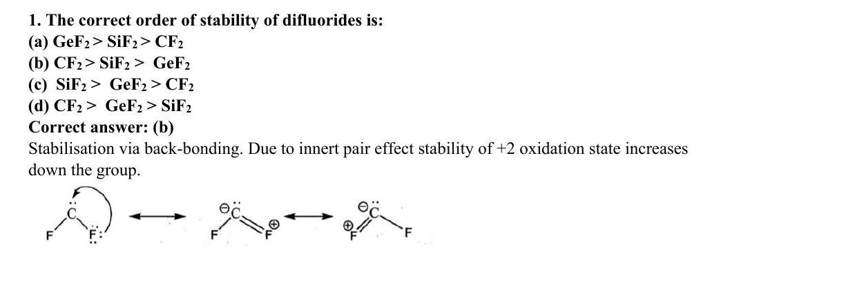
ABC CHEMISTRY
CSIR-JUNE 2011
Mr. Aniket Bhardwaj
Hard
MCQ
Carbon & Silicon Group (Group 14)
Question 1 of 97
Q1
JUNE 2011
QUESTION INSIGHTS
ESTIMATED TIME
3–5 min
DIFFICULTY
Hard
CONCEPT TESTED
Inert pair effect, difluoride stability, silicate structures, graphite vs diamond
PYQ FREQUENCY
Very High · 13 papers
REVISION PRIORITY
★★★★★
EXPECTED LEVEL
Part C (high merit)
MEMORY HOOK
Carbon is molecular (CO2, small, makes pi bonds), Silicon is polymeric (SiO2, big, uses d-orbitals for 3D network).
( Mr. Aniket Bhardwaj By ABC Chemistry ) · www.abcchemistry.com · 9212142427
Q1 · Question

Slide 95
ABC CHEMISTRY
CSIR-JUNE 2011
Mr. Aniket Bhardwaj
Hard
MCQ
Carbon & Silicon Group (Group 14)
Question 1 of 97
Correct Answer B CF2 > SiF2 > GeF2
✓
CONCEPT
SHORTCUT / EXAM TRICK
Group 14 (C–Pb): inert pair effect stabilises +2 state down the group (Pb2+ most stable). C forms ppi-ppi bonds (CO2 molecular); Si prefers sigma bonding (SiO2 polymeric network). Difluoride stability: CF2>SiF2>GeF2 (F→C pi back-bonding stabilises CF2).
CF2 most stable difluoride (back-bonding). Inert pair: Pb2+>>Sn2+>Ge2+ stability. CO2 is linear molecular; SiO2 is 3D network. Silicones: -Si(R2)-O- chains.
↓
COMMON MISTAKE
LOGIC / WORKING
Confusing difluoride stability (CF2 most stable, back-bonding) with inert pair (Pb2+ most stable). These are DIFFERENT trends pointing OPPOSITE directions.
Key principle: inert pair effect, difluoride stability, and silicate structures. Correct answer is (B).
EXAM TIP
CF2 stability due to ppi-ppi back-bond from F to empty p on C. This is opposite to inert pair trend. Graphite conducts electricity along planes (sp2 C, delocalised pi electrons).
MEMORY TRICK
Carbon is molecular (CO2, small, makes pi bonds), Silicon is polymeric (SiO2, big, uses d-orbitals for 3D network).
FINAL: (B) CF2 > SiF2 > GeF2
( Mr. Aniket Bhardwaj By ABC Chemistry ) · www.abcchemistry.com · 9212142427
Q1 · Answer & Explanation

Slide 96
ABC CHEMISTRY
CSIR-JUNE 2011
Mr. Aniket Bhardwaj
Hard
MCQ
Carbon & Silicon Group (Group 14)
Question 1 of 97
Why the Other Options Are Wrong
Correct answer: B
A
GeF2 > SiF2 > CF2
Inconsistent with inert pair effect, difluoride stability, and silicate structures; correct choice is (B). See worked explanation.
C
SiF2 > GeF2 > CF2
Inconsistent with inert pair effect, difluoride stability, and silicate structures; correct choice is (B). See worked explanation.
D
CF2 > GeF2 > SiF2
Inconsistent with inert pair effect, difluoride stability, and silicate structures; correct choice is (B). See worked explanation.
( Mr. Aniket Bhardwaj By ABC Chemistry ) · www.abcchemistry.com · 9212142427
Q1 · Distractor Analysis

Slide 97
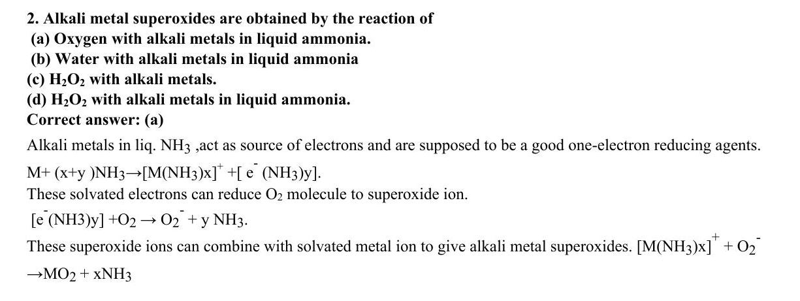
ABC CHEMISTRY
CSIR-JUNE 2011
Mr. Aniket Bhardwaj
Hard
MCQ
Carbon & Silicon Group (Group 14)
Question 2 of 97
Q2
JUNE 2011
QUESTION INSIGHTS
Alkali metal superoxides are obtained by the reaction of
(a) Oxygen with alkali metals in liquid ammonia
(b) Water with alkali metals in liquid ammonia
(c) H₂ O₂ with alkali metals
(d) H₂ O₂ with alkali metals in liquid ammonia
ESTIMATED TIME
3–5 min
DIFFICULTY
Hard
CONCEPT TESTED
Inert pair effect, difluoride stability, silicate structures, graphite vs diamond
PYQ FREQUENCY
Very High · 13 papers
REVISION PRIORITY
★★★★★
EXPECTED LEVEL
Part C (high merit)
MEMORY HOOK
Carbon is molecular (CO2, small, makes pi bonds), Silicon is polymeric (SiO2, big, uses d-orbitals for 3D network).
( Mr. Aniket Bhardwaj By ABC Chemistry ) · www.abcchemistry.com · 9212142427
Q2 · Question

Slide 98
ABC CHEMISTRY
CSIR-JUNE 2011
Mr. Aniket Bhardwaj
Hard
MCQ
Carbon & Silicon Group (Group 14)
Question 2 of 97
Correct Answer A Oxygen with alkali metals in liquid ammonia.
✓
CONCEPT
SHORTCUT / EXAM TRICK
Group 14 (C–Pb): inert pair effect stabilises +2 state down the group (Pb2+ most stable). C forms ppi-ppi bonds (CO2 molecular); Si prefers sigma bonding (SiO2 polymeric network). Difluoride stability: CF2>SiF2>GeF2 (F→C pi back-bonding stabilises CF2).
CF2 most stable difluoride (back-bonding). Inert pair: Pb2+>>Sn2+>Ge2+ stability. CO2 is linear molecular; SiO2 is 3D network. Silicones: -Si(R2)-O- chains.
↓
COMMON MISTAKE
LOGIC / WORKING
Confusing difluoride stability (CF2 most stable, back-bonding) with inert pair (Pb2+ most stable). These are DIFFERENT trends pointing OPPOSITE directions.
Passing oxygen through the metal–ammonia solution gives the superoxide MO₂ (e.g. KO₂); H₂O₂ or water give peroxides/hydroxides.
Therefore the answer is (A).
EXAM TIP
CF2 stability due to ppi-ppi back-bond from F to empty p on C. This is opposite to inert pair trend. Graphite conducts electricity along planes (sp2 C, delocalised pi electrons).
MEMORY TRICK
Carbon is molecular (CO2, small, makes pi bonds), Silicon is polymeric (SiO2, big, uses d-orbitals for 3D network).
FINAL: (A) Oxygen with alkali metals in liquid ammonia.
( Mr. Aniket Bhardwaj By ABC Chemistry ) · www.abcchemistry.com · 9212142427
Q2 · Answer & Explanation

Slide 99
ABC CHEMISTRY
CSIR-JUNE 2011
Mr. Aniket Bhardwaj
Hard
MCQ
Carbon & Silicon Group (Group 14)
Question 2 of 97
Why the Other Options Are Wrong
Correct answer: A
B
Water with alkali metals in liquid ammonia
Why (A) is the key — Passing oxygen through the metal–ammonia solution gives the superoxide MO₂ (e.g. KO₂); H₂O₂ or water give peroxides/hydroxides.
C
H₂O₂ with alkali metals.
Option (C) is ruled out by the same reasoning: Passing oxygen through the metal–ammonia solution gives the superoxide MO₂ (e.g. KO₂); H₂O₂ or water give
D
H₂O₂ with alkali metals in liquid ammonia.
Option (D) is ruled out by the same reasoning: Passing oxygen through the metal–ammonia solution gives the superoxide MO₂ (e.g. KO₂); H₂O₂ or water give
( Mr. Aniket Bhardwaj By ABC Chemistry ) · www.abcchemistry.com · 9212142427
Q2 · Distractor Analysis

Slide 100
ABC CHEMISTRY
CSIR-JUNE 2011
Mr. Aniket Bhardwaj
Hard
MCQ
Carbon & Silicon Group (Group 14)
Question 3 of 97
Q3
JUNE 2011
QUESTION INSIGHTS
ESTIMATED TIME
3–5 min
DIFFICULTY
Hard
CONCEPT TESTED
Inert pair effect, difluoride stability, silicate structures, graphite vs diamond
PYQ FREQUENCY
Very High · 13 papers
REVISION PRIORITY
★★★★★
EXPECTED LEVEL
Part C (high merit)
MEMORY HOOK
Carbon is molecular (CO2, small, makes pi bonds), Silicon is polymeric (SiO2, big, uses d-orbitals for 3D network).
( Mr. Aniket Bhardwaj By ABC Chemistry ) · www.abcchemistry.com · 9212142427
Q3 · Question

Slide 101
ABC CHEMISTRY
CSIR-JUNE 2011
Mr. Aniket Bhardwaj
Hard
MCQ
Carbon & Silicon Group (Group 14)
Question 3 of 97
Correct Answer A Tri sodium phosphate (i) Plasticizer
✓
CONCEPT
SHORTCUT / EXAM TRICK
Group 14 (C–Pb): inert pair effect stabilises +2 state down the group (Pb2+ most stable). C forms ppi-ppi bonds (CO2 molecular); Si prefers sigma bonding (SiO2 polymeric network). Difluoride stability: CF2>SiF2>GeF2 (F→C pi back-bonding stabilises CF2).
CF2 most stable difluoride (back-bonding). Inert pair: Pb2+>>Sn2+>Ge2+ stability. CO2 is linear molecular; SiO2 is 3D network. Silicones: -Si(R2)-O- chains.
↓
COMMON MISTAKE
LOGIC / WORKING
Confusing difluoride stability (CF2 most stable, back-bonding) with inert pair (Pb2+ most stable). These are DIFFERENT trends pointing OPPOSITE directions.
Key principle: inert pair effect, difluoride stability, and silicate structures. Correct answer is (A).
EXAM TIP
CF2 stability due to ppi-ppi back-bond from F to empty p on C. This is opposite to inert pair trend. Graphite conducts electricity along planes (sp2 C, delocalised pi electrons).
MEMORY TRICK
Carbon is molecular (CO2, small, makes pi bonds), Silicon is polymeric (SiO2, big, uses d-orbitals for 3D network).
FINAL: (A) Tri sodium phosphate (i) Plasticizer
( Mr. Aniket Bhardwaj By ABC Chemistry ) · www.abcchemistry.com · 9212142427
Q3 · Answer & Explanation

Slide 102
ABC CHEMISTRY
CSIR-JUNE 2011
Mr. Aniket Bhardwaj
Hard
MCQ
Carbon & Silicon Group (Group 14)
Question 3 of 97
Why the Other Options Are Wrong
Correct answer: A
B
Tri aryl phosphates (ii) Water softener
Inconsistent with inert pair effect, difluoride stability, and silicate structures; correct choice is (A). See worked explanation.
C
Tri ethyl phosphate (iii) Toothpaste
Inconsistent with inert pair effect, difluoride stability, and silicate structures; correct choice is (A). See worked explanation.
D
Calcium hydrogen phosphate (iv) Insecticides
Inconsistent with inert pair effect, difluoride stability, and silicate structures; correct choice is (A). See worked explanation.
( Mr. Aniket Bhardwaj By ABC Chemistry ) · www.abcchemistry.com · 9212142427
Q3 · Distractor Analysis

Slide 103
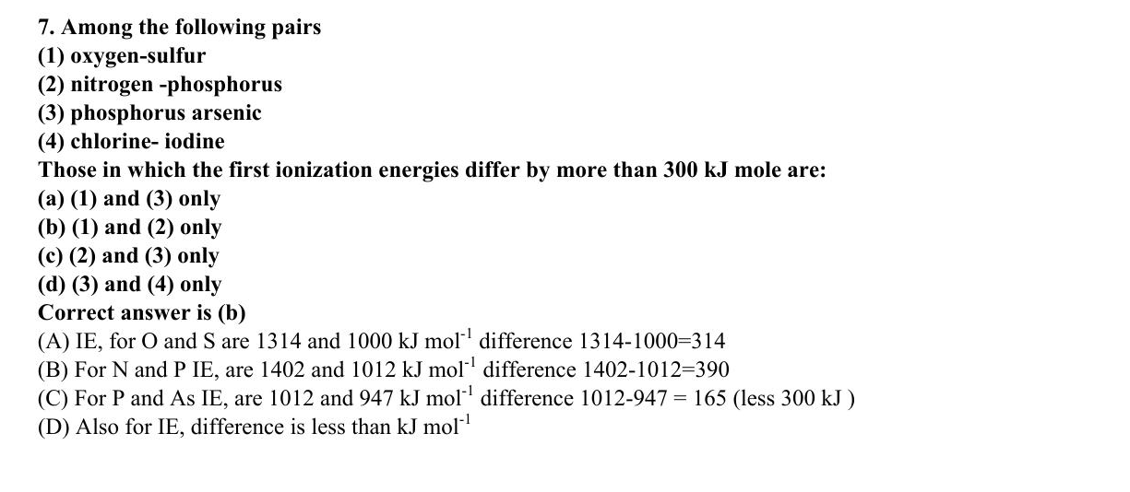
ABC CHEMISTRY
CSIR-DEC 2011
Mr. Aniket Bhardwaj
Hard
MCQ
Carbon & Silicon Group (Group 14)
Question 7 of 97
Q7
DEC 2011
QUESTION INSIGHTS
Among the following pairs (1) oxygen-sulfur & (2) nitrogen-phosphorus (3) phosphorus arsenic & (4) chlorine-iodine Those in which the first ionization energies differ by more than 300 kJ mole are:
(a) (1) and (3) only
(b) (1) and (2) only
(c) (2) and (3) only
(d) (3) and (4) only
ESTIMATED TIME
3–5 min
DIFFICULTY
Hard
CONCEPT TESTED
Inert pair effect, difluoride stability, silicate structures, graphite vs diamond
PYQ FREQUENCY
Very High · 13 papers
REVISION PRIORITY
★★★★★
EXPECTED LEVEL
Part C (high merit)
MEMORY HOOK
Carbon is molecular (CO2, small, makes pi bonds), Silicon is polymeric (SiO2, big, uses d-orbitals for 3D network).
( Mr. Aniket Bhardwaj By ABC Chemistry ) · www.abcchemistry.com · 9212142427
Q7 · Question

Slide 104
ABC CHEMISTRY
CSIR-DEC 2011
Mr. Aniket Bhardwaj
Hard
MCQ
Carbon & Silicon Group (Group 14)
Question 7 of 97
Correct Answer B (1) and (2) only
✓
CONCEPT
SHORTCUT / EXAM TRICK
Group 14 (C–Pb): inert pair effect stabilises +2 state down the group (Pb2+ most stable). C forms ppi-ppi bonds (CO2 molecular); Si prefers sigma bonding (SiO2 polymeric network). Difluoride stability: CF2>SiF2>GeF2 (F→C pi back-bonding stabilises CF2).
CF2 most stable difluoride (back-bonding). Inert pair: Pb2+>>Sn2+>Ge2+ stability. CO2 is linear molecular; SiO2 is 3D network. Silicones: -Si(R2)-O- chains.
↓
COMMON MISTAKE
LOGIC / WORKING
Confusing difluoride stability (CF2 most stable, back-bonding) with inert pair (Pb2+ most stable). These are DIFFERENT trends pointing OPPOSITE directions.
First IEs (kJ mol⁻¹): O 1314/S 1000 (Δ = 314), N 1402/P 1012 (390), P 1012/As 947 (65), Cl 1251/I 1008 (243). Only pairs (1) and (2) differ by more than 300.
Therefore the answer is (B).
EXAM TIP
CF2 stability due to ppi-ppi back-bond from F to empty p on C. This is opposite to inert pair trend. Graphite conducts electricity along planes (sp2 C, delocalised pi electrons).
MEMORY TRICK
Carbon is molecular (CO2, small, makes pi bonds), Silicon is polymeric (SiO2, big, uses d-orbitals for 3D network).
FINAL: (B) (1) and (2) only
( Mr. Aniket Bhardwaj By ABC Chemistry ) · www.abcchemistry.com · 9212142427
Q7 · Answer & Explanation

Slide 105
ABC CHEMISTRY
CSIR-DEC 2011
Mr. Aniket Bhardwaj
Hard
MCQ
Carbon & Silicon Group (Group 14)
Question 7 of 97
Why the Other Options Are Wrong
Correct answer: B
A
(1) and (3) only
Why (B) is the key — First IEs (kJ mol⁻¹): O 1314/S 1000 (Δ = 314), N 1402/P 1012 (390), P 1012/As 947 (65), Cl 1251/I 1008 (243). Only pairs (1) and (2) differ by more than 300.
C
(2) and (3) only
Option (C) is ruled out by the same reasoning: First IEs (kJ mol⁻¹): O 1314/S 1000 (Δ = 314), N 1402/P 1012 (390), P 1012/As 947 (65), Cl 1251/I 1008 (243). Only pairs (1) and (2) differ by more than
D
(3) and (4) only
Option (D) is ruled out by the same reasoning: First IEs (kJ mol⁻¹): O 1314/S 1000 (Δ = 314), N 1402/P 1012 (390), P 1012/As 947 (65), Cl 1251/I 1008 (243). Only pairs (1) and (2) differ by more than
( Mr. Aniket Bhardwaj By ABC Chemistry ) · www.abcchemistry.com · 9212142427
Q7 · Distractor Analysis

Slide 106
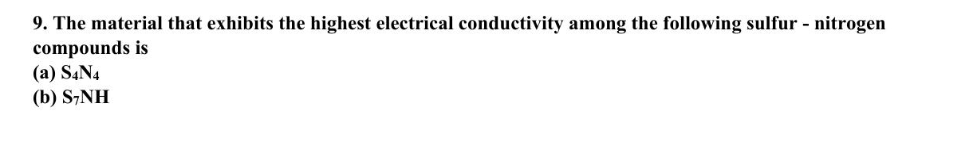
ABC CHEMISTRY
CSIR-DEC 2011
Mr. Aniket Bhardwaj
Hard
MCQ
Carbon & Silicon Group (Group 14)
Question 9 of 97
Q9
DEC 2011
QUESTION INSIGHTS
ESTIMATED TIME
3–5 min
DIFFICULTY
Hard
CONCEPT TESTED
Inert pair effect, difluoride stability, silicate structures, graphite vs diamond
PYQ FREQUENCY
Very High · 13 papers
REVISION PRIORITY
★★★★★
EXPECTED LEVEL
Part C (high merit)
MEMORY HOOK
Carbon is molecular (CO2, small, makes pi bonds), Silicon is polymeric (SiO2, big, uses d-orbitals for 3D network).
( Mr. Aniket Bhardwaj By ABC Chemistry ) · www.abcchemistry.com · 9212142427
Q9 · Question

Slide 107
ABC CHEMISTRY
CSIR-DEC 2011
Mr. Aniket Bhardwaj
Hard
MCQ
Carbon & Silicon Group (Group 14)
Question 9 of 97
Correct Answer D (SN) x
✓
CONCEPT
SHORTCUT / EXAM TRICK
Group 14 (C–Pb): inert pair effect stabilises +2 state down the group (Pb2+ most stable). C forms ppi-ppi bonds (CO2 molecular); Si prefers sigma bonding (SiO2 polymeric network). Difluoride stability: CF2>SiF2>GeF2 (F→C pi back-bonding stabilises CF2).
CF2 most stable difluoride (back-bonding). Inert pair: Pb2+>>Sn2+>Ge2+ stability. CO2 is linear molecular; SiO2 is 3D network. Silicones: -Si(R2)-O- chains.
↓
COMMON MISTAKE
LOGIC / WORKING
Confusing difluoride stability (CF2 most stable, back-bonding) with inert pair (Pb2+ most stable). These are DIFFERENT trends pointing OPPOSITE directions.
Key principle: inert pair effect, difluoride stability, and silicate structures. Correct answer is (D).
EXAM TIP
CF2 stability due to ppi-ppi back-bond from F to empty p on C. This is opposite to inert pair trend. Graphite conducts electricity along planes (sp2 C, delocalised pi electrons).
MEMORY TRICK
Carbon is molecular (CO2, small, makes pi bonds), Silicon is polymeric (SiO2, big, uses d-orbitals for 3D network).
FINAL: (D) (SN) x
( Mr. Aniket Bhardwaj By ABC Chemistry ) · www.abcchemistry.com · 9212142427
Q9 · Answer & Explanation

Slide 108
ABC CHEMISTRY
CSIR-DEC 2011
Mr. Aniket Bhardwaj
Hard
MCQ
Carbon & Silicon Group (Group 14)
Question 9 of 97
Why the Other Options Are Wrong
Correct answer: D
A
S₄N₄
Inconsistent with inert pair effect, difluoride stability, and silicate structures; correct choice is (D). See worked explanation.
B
S₇NH Main Group Elements
Inconsistent with inert pair effect, difluoride stability, and silicate structures; correct choice is (D). See worked explanation.
C
S₂N₂
Inconsistent with inert pair effect, difluoride stability, and silicate structures; correct choice is (D). See worked explanation.
( Mr. Aniket Bhardwaj By ABC Chemistry ) · www.abcchemistry.com · 9212142427
Q9 · Distractor Analysis

Slide 109
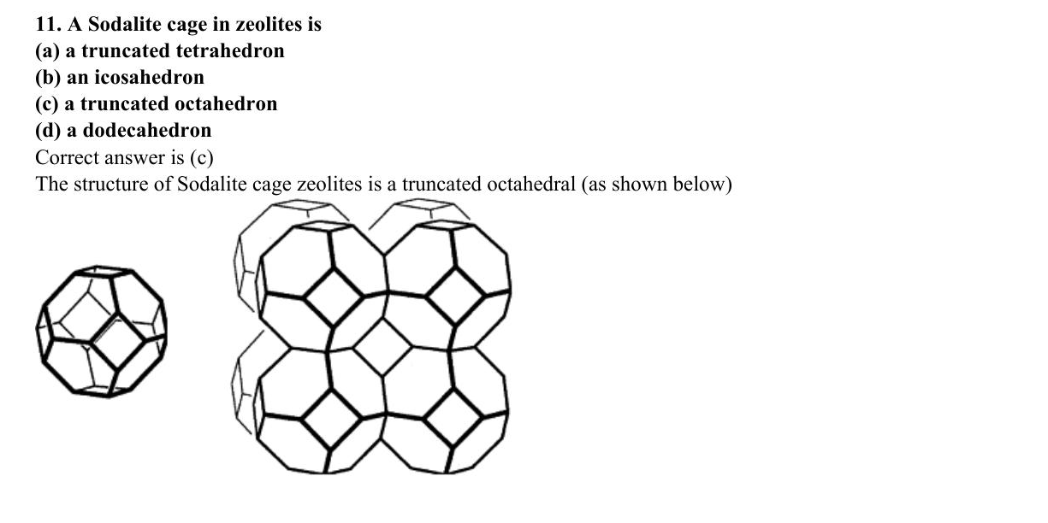
ABC CHEMISTRY
CSIR-DEC 2011
Mr. Aniket Bhardwaj
Hard
MCQ
Carbon & Silicon Group (Group 14)
Question 11 of 97
Q11
DEC 2011
QUESTION INSIGHTS
A Sodalite cage in zeolites is
(a) a truncated tetrahedron
(b) an icosahedron
(c) a truncated octahedron
(d) a dodecahedron
ESTIMATED TIME
3–5 min
DIFFICULTY
Hard
CONCEPT TESTED
Inert pair effect, difluoride stability, silicate structures, graphite vs diamond
PYQ FREQUENCY
Very High · 13 papers
REVISION PRIORITY
★★★★★
EXPECTED LEVEL
Part C (high merit)
MEMORY HOOK
Carbon is molecular (CO2, small, makes pi bonds), Silicon is polymeric (SiO2, big, uses d-orbitals for 3D network).
( Mr. Aniket Bhardwaj By ABC Chemistry ) · www.abcchemistry.com · 9212142427
Q11 · Question

Slide 110
ABC CHEMISTRY
CSIR-DEC 2011
Mr. Aniket Bhardwaj
Hard
MCQ
Carbon & Silicon Group (Group 14)
Question 11 of 97
Correct Answer C a truncated octahedron
✓
CONCEPT
SHORTCUT / EXAM TRICK
Group 14 (C–Pb): inert pair effect stabilises +2 state down the group (Pb2+ most stable). C forms ppi-ppi bonds (CO2 molecular); Si prefers sigma bonding (SiO2 polymeric network). Difluoride stability: CF2>SiF2>GeF2 (F→C pi back-bonding stabilises CF2).
CF2 most stable difluoride (back-bonding). Inert pair: Pb2+>>Sn2+>Ge2+ stability. CO2 is linear molecular; SiO2 is 3D network. Silicones: -Si(R2)-O- chains.
↓
COMMON MISTAKE
LOGIC / WORKING
Confusing difluoride stability (CF2 most stable, back-bonding) with inert pair (Pb2+ most stable). These are DIFFERENT trends pointing OPPOSITE directions.
The sodalite (Î²) cage is a truncated octahedron with 24 T-atom vertices, 8 hexagonal and 6 square faces.
Therefore the answer is (C).
EXAM TIP
CF2 stability due to ppi-ppi back-bond from F to empty p on C. This is opposite to inert pair trend. Graphite conducts electricity along planes (sp2 C, delocalised pi electrons).
MEMORY TRICK
Carbon is molecular (CO2, small, makes pi bonds), Silicon is polymeric (SiO2, big, uses d-orbitals for 3D network).
FINAL: (C) a truncated octahedron
( Mr. Aniket Bhardwaj By ABC Chemistry ) · www.abcchemistry.com · 9212142427
Q11 · Answer & Explanation

Slide 111
ABC CHEMISTRY
CSIR-DEC 2011
Mr. Aniket Bhardwaj
Hard
MCQ
Carbon & Silicon Group (Group 14)
Question 11 of 97
Why the Other Options Are Wrong
Correct answer: C
A
a truncated tetrahedron
Why (C) is the key — The sodalite (Î²) cage is a truncated octahedron with 24 T-atom vertices, 8 hexagonal and 6 square faces.
B
an icosahedron
Option (B) is ruled out by the same reasoning: The sodalite (Î²) cage is a truncated octahedron with 24 T-atom vertices, 8 hexagonal and 6 square
D
a dodecahedron
Option (D) is ruled out by the same reasoning: The sodalite (Î²) cage is a truncated octahedron with 24 T-atom vertices, 8 hexagonal and 6 square
( Mr. Aniket Bhardwaj By ABC Chemistry ) · www.abcchemistry.com · 9212142427
Q11 · Distractor Analysis

Slide 112
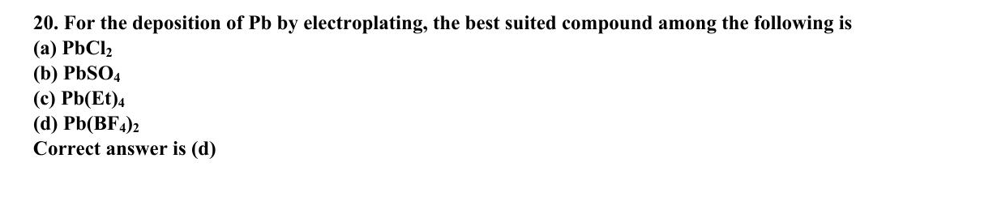
ABC CHEMISTRY
CSIR-DEC 2012
Mr. Aniket Bhardwaj
Hard
MCQ
Carbon & Silicon Group (Group 14)
Question 20 of 97
Q20
DEC 2012
QUESTION INSIGHTS
For the deposition of Pb by electroplating, the best suited compound among the following is
(a) PbCl₂
(b) PbSO₄
(c) Pb(Et)₄
(d) Pb(BF₄)₂
ESTIMATED TIME
3–5 min
DIFFICULTY
Hard
CONCEPT TESTED
Inert pair effect, difluoride stability, silicate structures, graphite vs diamond
PYQ FREQUENCY
Very High · 13 papers
REVISION PRIORITY
★★★★★
EXPECTED LEVEL
Part C (high merit)
MEMORY HOOK
Carbon is molecular (CO2, small, makes pi bonds), Silicon is polymeric (SiO2, big, uses d-orbitals for 3D network).
( Mr. Aniket Bhardwaj By ABC Chemistry ) · www.abcchemistry.com · 9212142427
Q20 · Question

Slide 113
ABC CHEMISTRY
CSIR-DEC 2012
Mr. Aniket Bhardwaj
Hard
MCQ
Carbon & Silicon Group (Group 14)
Question 20 of 97
Correct Answer D Pb(BF₄)₂
✓
CONCEPT
SHORTCUT / EXAM TRICK
Group 14 (C–Pb): inert pair effect stabilises +2 state down the group (Pb2+ most stable). C forms ppi-ppi bonds (CO2 molecular); Si prefers sigma bonding (SiO2 polymeric network). Difluoride stability: CF2>SiF2>GeF2 (F→C pi back-bonding stabilises CF2).
CF2 most stable difluoride (back-bonding). Inert pair: Pb2+>>Sn2+>Ge2+ stability. CO2 is linear molecular; SiO2 is 3D network. Silicones: -Si(R2)-O- chains.
↓
COMMON MISTAKE
LOGIC / WORKING
Confusing difluoride stability (CF2 most stable, back-bonding) with inert pair (Pb2+ most stable). These are DIFFERENT trends pointing OPPOSITE directions.
Lead fluoroborate is highly soluble and gives smooth lead deposits; PbCl₂ and PbSO₄ are insoluble and PbEt₄ is a covalent, non-conducting liquid.
Therefore the answer is (D).
EXAM TIP
CF2 stability due to ppi-ppi back-bond from F to empty p on C. This is opposite to inert pair trend. Graphite conducts electricity along planes (sp2 C, delocalised pi electrons).
MEMORY TRICK
Carbon is molecular (CO2, small, makes pi bonds), Silicon is polymeric (SiO2, big, uses d-orbitals for 3D network).
FINAL: (D) Pb(BF₄)₂
( Mr. Aniket Bhardwaj By ABC Chemistry ) · www.abcchemistry.com · 9212142427
Q20 · Answer & Explanation

Slide 114
ABC CHEMISTRY
CSIR-DEC 2012
Mr. Aniket Bhardwaj
Hard
MCQ
Carbon & Silicon Group (Group 14)
Question 20 of 97
Why the Other Options Are Wrong
Correct answer: D
A
PbCl₂
Why (D) is the key — Lead fluoroborate is highly soluble and gives smooth lead deposits; PbCl₂ and PbSO₄ are insoluble and PbEt₄ is a covalent, non-conducting liquid.
B
PbSO₄
Option (B) is ruled out by the same reasoning: Lead fluoroborate is highly soluble and gives smooth lead deposits; PbCl₂ and PbSO₄ are insoluble and PbEt₄ is a covalent, non-conducting
C
Pb(Et)₄
Option (C) is ruled out by the same reasoning: Lead fluoroborate is highly soluble and gives smooth lead deposits; PbCl₂ and PbSO₄ are insoluble and PbEt₄ is a covalent, non-conducting
( Mr. Aniket Bhardwaj By ABC Chemistry ) · www.abcchemistry.com · 9212142427
Q20 · Distractor Analysis

Slide 115
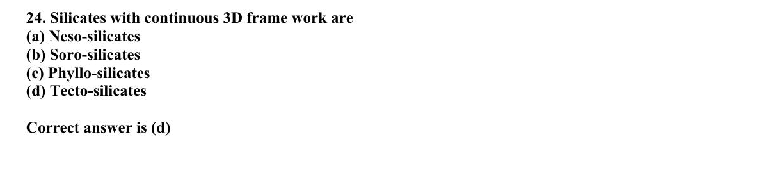
ABC CHEMISTRY
CSIR-DEC 2012
Mr. Aniket Bhardwaj
Hard
MCQ
Carbon & Silicon Group (Group 14)
Question 24 of 97
Q24
DEC 2012
QUESTION INSIGHTS
Silicates with continuous 3D frame work are
(a) Neso-silicates
(b) Soro-silicates
(c) Phyllo-silicates
(d) Tecto-silicates
ESTIMATED TIME
3–5 min
DIFFICULTY
Hard
CONCEPT TESTED
Inert pair effect, difluoride stability, silicate structures, graphite vs diamond
PYQ FREQUENCY
Very High · 13 papers
REVISION PRIORITY
★★★★★
EXPECTED LEVEL
Part C (high merit)
MEMORY HOOK
Carbon is molecular (CO2, small, makes pi bonds), Silicon is polymeric (SiO2, big, uses d-orbitals for 3D network).
( Mr. Aniket Bhardwaj By ABC Chemistry ) · www.abcchemistry.com · 9212142427
Q24 · Question

Slide 116
ABC CHEMISTRY
CSIR-DEC 2012
Mr. Aniket Bhardwaj
Hard
MCQ
Carbon & Silicon Group (Group 14)
Question 24 of 97
Correct Answer D Tecto-silicates
✓
CONCEPT
SHORTCUT / EXAM TRICK
Group 14 (C–Pb): inert pair effect stabilises +2 state down the group (Pb2+ most stable). C forms ppi-ppi bonds (CO2 molecular); Si prefers sigma bonding (SiO2 polymeric network). Difluoride stability: CF2>SiF2>GeF2 (F→C pi back-bonding stabilises CF2).
CF2 most stable difluoride (back-bonding). Inert pair: Pb2+>>Sn2+>Ge2+ stability. CO2 is linear molecular; SiO2 is 3D network. Silicones: -Si(R2)-O- chains.
↓
COMMON MISTAKE
LOGIC / WORKING
Confusing difluoride stability (CF2 most stable, back-bonding) with inert pair (Pb2+ most stable). These are DIFFERENT trends pointing OPPOSITE directions.
Tectosilicates (framework silicates: quartz, feldspars, zeolites) share all four oxygens of every tetrahedron in three dimensions.
Therefore the answer is (D).
EXAM TIP
CF2 stability due to ppi-ppi back-bond from F to empty p on C. This is opposite to inert pair trend. Graphite conducts electricity along planes (sp2 C, delocalised pi electrons).
MEMORY TRICK
Carbon is molecular (CO2, small, makes pi bonds), Silicon is polymeric (SiO2, big, uses d-orbitals for 3D network).
FINAL: (D) Tecto-silicates
( Mr. Aniket Bhardwaj By ABC Chemistry ) · www.abcchemistry.com · 9212142427
Q24 · Answer & Explanation

Slide 117
ABC CHEMISTRY
CSIR-DEC 2012
Mr. Aniket Bhardwaj
Hard
MCQ
Carbon & Silicon Group (Group 14)
Question 24 of 97
Why the Other Options Are Wrong
Correct answer: D
A
Neso-silicates
Why (D) is the key — Tectosilicates (framework silicates: quartz, feldspars, zeolites) share all four oxygens of every tetrahedron in three dimensions.
B
Soro-silicates
Option (B) is ruled out by the same reasoning: Tectosilicates (framework silicates: quartz, feldspars, zeolites) share all four oxygens of every tetrahedron in three
C
Phyllo-silicates
Option (C) is ruled out by the same reasoning: Tectosilicates (framework silicates: quartz, feldspars, zeolites) share all four oxygens of every tetrahedron in three
( Mr. Aniket Bhardwaj By ABC Chemistry ) · www.abcchemistry.com · 9212142427
Q24 · Distractor Analysis

Slide 118
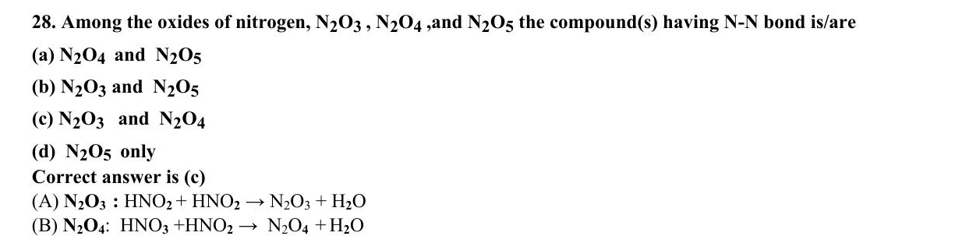
ABC CHEMISTRY
CSIR-JUNE 2013
Mr. Aniket Bhardwaj
Hard
MCQ
Carbon & Silicon Group (Group 14)
Question 28 of 97
Q28
JUNE 2013
QUESTION INSIGHTS
Among the oxides of nitrogen, N₂ O₃, N₂ O₄, and N₂ O₅ the compound(s) having N-N bond is/are
(a) N₂ O₄ and N₂ O₅
(b) N₂ O₃ and N₂ O₅
(c) N₂ O₃ and N₂ O₄
(d) N₂ O₅ only
ESTIMATED TIME
3–5 min
DIFFICULTY
Hard
CONCEPT TESTED
Inert pair effect, difluoride stability, silicate structures, graphite vs diamond
PYQ FREQUENCY
Very High · 13 papers
REVISION PRIORITY
★★★★★
EXPECTED LEVEL
Part C (high merit)
MEMORY HOOK
Carbon is molecular (CO2, small, makes pi bonds), Silicon is polymeric (SiO2, big, uses d-orbitals for 3D network).
( Mr. Aniket Bhardwaj By ABC Chemistry ) · www.abcchemistry.com · 9212142427
Q28 · Question

Slide 119
ABC CHEMISTRY
CSIR-JUNE 2013
Mr. Aniket Bhardwaj
Hard
MCQ
Carbon & Silicon Group (Group 14)
Question 28 of 97
Correct Answer C N₂O₃ and N₂O₄
✓
CONCEPT
SHORTCUT / EXAM TRICK
Group 14 (C–Pb): inert pair effect stabilises +2 state down the group (Pb2+ most stable). C forms ppi-ppi bonds (CO2 molecular); Si prefers sigma bonding (SiO2 polymeric network). Difluoride stability: CF2>SiF2>GeF2 (F→C pi back-bonding stabilises CF2).
CF2 most stable difluoride (back-bonding). Inert pair: Pb2+>>Sn2+>Ge2+ stability. CO2 is linear molecular; SiO2 is 3D network. Silicones: -Si(R2)-O- chains.
↓
COMMON MISTAKE
LOGIC / WORKING
Confusing difluoride stability (CF2 most stable, back-bonding) with inert pair (Pb2+ most stable). These are DIFFERENT trends pointing OPPOSITE directions.
N₂O₃ (ON–NO₂) and N₂O₄ (O₂N–NO₂) have N–N bonds; N₂O is O₂N–O–NO₂.
Therefore the answer is (C).
EXAM TIP
CF2 stability due to ppi-ppi back-bond from F to empty p on C. This is opposite to inert pair trend. Graphite conducts electricity along planes (sp2 C, delocalised pi electrons).
MEMORY TRICK
Carbon is molecular (CO2, small, makes pi bonds), Silicon is polymeric (SiO2, big, uses d-orbitals for 3D network).
FINAL: (C) N₂O₃ and N₂O₄
( Mr. Aniket Bhardwaj By ABC Chemistry ) · www.abcchemistry.com · 9212142427
Q28 · Answer & Explanation

Slide 120
ABC CHEMISTRY
CSIR-JUNE 2013
Mr. Aniket Bhardwaj
Hard
MCQ
Carbon & Silicon Group (Group 14)
Question 28 of 97
Why the Other Options Are Wrong
Correct answer: C
A
N₂O₄ and N₂O₅
Why (C) is the key — N₂O₃ (ON–NO₂) and N₂O₄ (O₂N–NO₂) have N–N bonds; N₂O is O₂N–O–NO₂.
B
N₂O₃ and N₂O₅
Option (B) is ruled out by the same reasoning: N₂O₃ (ON–NO₂) and N₂O₄ (O₂N–NO₂) have N–N bonds; N₂O is
D
N₂O₅ only
Option (D) is ruled out by the same reasoning: N₂O₃ (ON–NO₂) and N₂O₄ (O₂N–NO₂) have N–N bonds; N₂O is
( Mr. Aniket Bhardwaj By ABC Chemistry ) · www.abcchemistry.com · 9212142427
Q28 · Distractor Analysis

Slide 121
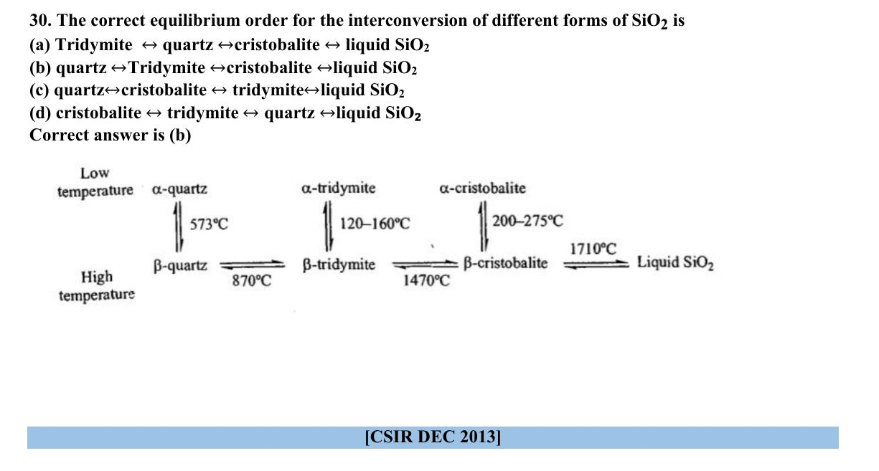
ABC CHEMISTRY
CSIR-JUNE 2013
Mr. Aniket Bhardwaj
Hard
MCQ
Carbon & Silicon Group (Group 14)
Question 30 of 97
Q30
JUNE 2013
QUESTION INSIGHTS
The correct equilibrium order for the interconversion of different forms of SiO₂ is
(a) Tridymite ⇌ quartz ⇌ cristobalite ⇌ liquid SiO₂
(b) quartz ⇌ Tridymite ⇌ cristobalite ⇌ liquid SiO₂
(c) quartz ⇌ cristobalite ⇌ tridymite ⇌ liquid SiO₂
(d) cristobalite ⇌ tridymite ⇌ quartz ⇌ liquid SiO₂
ESTIMATED TIME
3–5 min
DIFFICULTY
Hard
CONCEPT TESTED
Inert pair effect, difluoride stability, silicate structures, graphite vs diamond
PYQ FREQUENCY
Very High · 13 papers
REVISION PRIORITY
★★★★★
EXPECTED LEVEL
Part C (high merit)
MEMORY HOOK
Carbon is molecular (CO2, small, makes pi bonds), Silicon is polymeric (SiO2, big, uses d-orbitals for 3D network).
( Mr. Aniket Bhardwaj By ABC Chemistry ) · www.abcchemistry.com · 9212142427
Q30 · Question

Slide 122
ABC CHEMISTRY
CSIR-JUNE 2013
Mr. Aniket Bhardwaj
Hard
MCQ
Carbon & Silicon Group (Group 14)
Question 30 of 97
Correct Answer B quartz ⇌Tridymite ⇌cristobalite ⇌liquid SiO₂
✓
CONCEPT
SHORTCUT / EXAM TRICK
Group 14 (C–Pb): inert pair effect stabilises +2 state down the group (Pb2+ most stable). C forms ppi-ppi bonds (CO2 molecular); Si prefers sigma bonding (SiO2 polymeric network). Difluoride stability: CF2>SiF2>GeF2 (F→C pi back-bonding stabilises CF2).
CF2 most stable difluoride (back-bonding). Inert pair: Pb2+>>Sn2+>Ge2+ stability. CO2 is linear molecular; SiO2 is 3D network. Silicones: -Si(R2)-O- chains.
↓
COMMON MISTAKE
LOGIC / WORKING
Confusing difluoride stability (CF2 most stable, back-bonding) with inert pair (Pb2+ most stable). These are DIFFERENT trends pointing OPPOSITE directions.
With rising temperature: α-quartz → β-quartz (573 °C) → tridymite (870 °C) → cristobalite (1470 °C) → liquid (1710 °C).
Therefore the answer is (B).
EXAM TIP
CF2 stability due to ppi-ppi back-bond from F to empty p on C. This is opposite to inert pair trend. Graphite conducts electricity along planes (sp2 C, delocalised pi electrons).
MEMORY TRICK
Carbon is molecular (CO2, small, makes pi bonds), Silicon is polymeric (SiO2, big, uses d-orbitals for 3D network).
FINAL: (B) quartz ⇌Tridymite ⇌cristobalite ⇌liquid SiO₂
( Mr. Aniket Bhardwaj By ABC Chemistry ) · www.abcchemistry.com · 9212142427
Q30 · Answer & Explanation

Slide 123
ABC CHEMISTRY
CSIR-JUNE 2013
Mr. Aniket Bhardwaj
Hard
MCQ
Carbon & Silicon Group (Group 14)
Question 30 of 97
Why the Other Options Are Wrong
Correct answer: B
A
Tridymite ⇌ quartz ⇌cristobalite ⇌ liquid SiO₂
Why (B) is the key — With rising temperature: α-quartz → β-quartz (573 °C) → tridymite (870 °C) → cristobalite (1470 °C) → liquid (1710 °C).
C
quartz⇌cristobalite ⇌ tridymite⇌liquid SiO₂
Option (C) is ruled out by the same reasoning: With rising temperature: α-quartz → β-quartz (573 °C) → tridymite (870 °C) → cristobalite (1470 °C) → liquid (1710
D
cristobalite ⇌ tridymite ⇌ quartz ⇌liquid SiO₂
Option (D) is ruled out by the same reasoning: With rising temperature: α-quartz → β-quartz (573 °C) → tridymite (870 °C) → cristobalite (1470 °C) → liquid (1710
( Mr. Aniket Bhardwaj By ABC Chemistry ) · www.abcchemistry.com · 9212142427
Q30 · Distractor Analysis

Slide 124
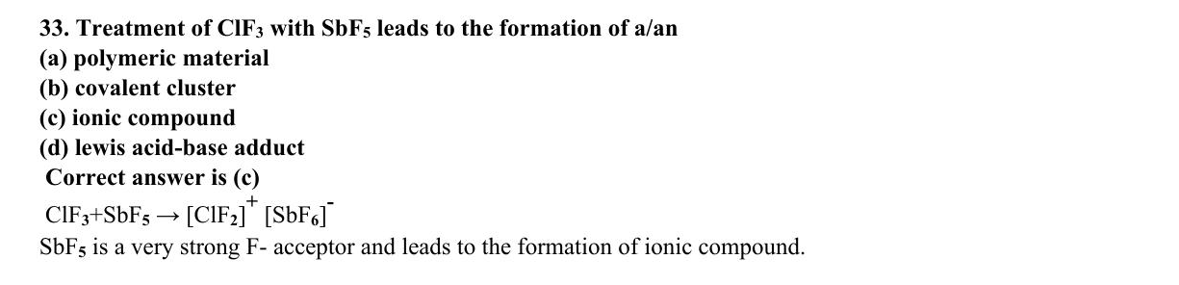
ABC CHEMISTRY
CSIR-DEC 2013
Mr. Aniket Bhardwaj
Hard
MCQ
Carbon & Silicon Group (Group 14)
Question 33 of 97
Q33
DEC 2013
QUESTION INSIGHTS
Treatment of ClF₃ with SbF₅ leads to the formation of a/an
(a) polymeric material
(b) covalent cluster
(c) ionic compound
(d) lewis acid-base adduct
ESTIMATED TIME
3–5 min
DIFFICULTY
Hard
CONCEPT TESTED
Inert pair effect, difluoride stability, silicate structures, graphite vs diamond
PYQ FREQUENCY
Very High · 13 papers
REVISION PRIORITY
★★★★★
EXPECTED LEVEL
Part C (high merit)
MEMORY HOOK
Carbon is molecular (CO2, small, makes pi bonds), Silicon is polymeric (SiO2, big, uses d-orbitals for 3D network).
( Mr. Aniket Bhardwaj By ABC Chemistry ) · www.abcchemistry.com · 9212142427
Q33 · Question

Slide 125
ABC CHEMISTRY
CSIR-DEC 2013
Mr. Aniket Bhardwaj
Hard
MCQ
Carbon & Silicon Group (Group 14)
Question 33 of 97
Correct Answer C ionic compound
✓
CONCEPT
SHORTCUT / EXAM TRICK
Group 14 (C–Pb): inert pair effect stabilises +2 state down the group (Pb2+ most stable). C forms ppi-ppi bonds (CO2 molecular); Si prefers sigma bonding (SiO2 polymeric network). Difluoride stability: CF2>SiF2>GeF2 (F→C pi back-bonding stabilises CF2).
CF2 most stable difluoride (back-bonding). Inert pair: Pb2+>>Sn2+>Ge2+ stability. CO2 is linear molecular; SiO2 is 3D network. Silicones: -Si(R2)-O- chains.
↓
COMMON MISTAKE
LOGIC / WORKING
Confusing difluoride stability (CF2 most stable, back-bonding) with inert pair (Pb2+ most stable). These are DIFFERENT trends pointing OPPOSITE directions.
SbF abstracts F⁻ from ClF₃ to give the ionic salt [ClF₂]⁺[SbF₆]⁻.
Therefore the answer is (C).
EXAM TIP
CF2 stability due to ppi-ppi back-bond from F to empty p on C. This is opposite to inert pair trend. Graphite conducts electricity along planes (sp2 C, delocalised pi electrons).
MEMORY TRICK
Carbon is molecular (CO2, small, makes pi bonds), Silicon is polymeric (SiO2, big, uses d-orbitals for 3D network).
FINAL: (C) ionic compound
( Mr. Aniket Bhardwaj By ABC Chemistry ) · www.abcchemistry.com · 9212142427
Q33 · Answer & Explanation

Slide 126
ABC CHEMISTRY
CSIR-DEC 2013
Mr. Aniket Bhardwaj
Hard
MCQ
Carbon & Silicon Group (Group 14)
Question 33 of 97
Why the Other Options Are Wrong
Correct answer: C
A
polymeric material
Why (C) is the key — SbF abstracts F⁻ from ClF₃ to give the ionic salt [ClF₂]⁺[SbF₆]⁻.
B
covalent cluster
Option (B) is ruled out by the same reasoning: SbF abstracts F⁻ from ClF₃ to give the ionic salt
D
lewis acid-base adduct
Option (D) is ruled out by the same reasoning: SbF abstracts F⁻ from ClF₃ to give the ionic salt
( Mr. Aniket Bhardwaj By ABC Chemistry ) · www.abcchemistry.com · 9212142427
Q33 · Distractor Analysis

Slide 127
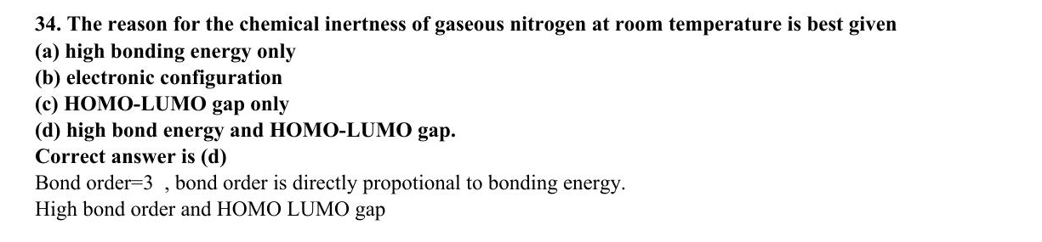
ABC CHEMISTRY
CSIR-DEC 2013
Mr. Aniket Bhardwaj
Hard
MCQ
Carbon & Silicon Group (Group 14)
Question 34 of 97
Q34
DEC 2013
QUESTION INSIGHTS
The reason for the chemical inertness of gaseous nitrogen at room temperature is best given
(a) high bonding energy only
(b) electronic configuration
(c) HOMO-LUMO gap only
(d) high bond energy and HOMO-LUMO gap
ESTIMATED TIME
3–5 min
DIFFICULTY
Hard
CONCEPT TESTED
Inert pair effect, difluoride stability, silicate structures, graphite vs diamond
PYQ FREQUENCY
Very High · 13 papers
REVISION PRIORITY
★★★★★
EXPECTED LEVEL
Part C (high merit)
MEMORY HOOK
Carbon is molecular (CO2, small, makes pi bonds), Silicon is polymeric (SiO2, big, uses d-orbitals for 3D network).
( Mr. Aniket Bhardwaj By ABC Chemistry ) · www.abcchemistry.com · 9212142427
Q34 · Question

Slide 128
ABC CHEMISTRY
CSIR-DEC 2013
Mr. Aniket Bhardwaj
Hard
MCQ
Carbon & Silicon Group (Group 14)
Question 34 of 97
Correct Answer D high bond energy and HOMO-LUMO gap.
✓
CONCEPT
SHORTCUT / EXAM TRICK
Group 14 (C–Pb): inert pair effect stabilises +2 state down the group (Pb2+ most stable). C forms ppi-ppi bonds (CO2 molecular); Si prefers sigma bonding (SiO2 polymeric network). Difluoride stability: CF2>SiF2>GeF2 (F→C pi back-bonding stabilises CF2).
CF2 most stable difluoride (back-bonding). Inert pair: Pb2+>>Sn2+>Ge2+ stability. CO2 is linear molecular; SiO2 is 3D network. Silicones: -Si(R2)-O- chains.
↓
COMMON MISTAKE
LOGIC / WORKING
Confusing difluoride stability (CF2 most stable, back-bonding) with inert pair (Pb2+ most stable). These are DIFFERENT trends pointing OPPOSITE directions.
N₂ is inert because of its very strong triple bond (945 kJ mol⁻¹) and the large HOMO–LUMO gap that makes it neither a good donor nor a good acceptor.
Therefore the answer is (D).
EXAM TIP
CF2 stability due to ppi-ppi back-bond from F to empty p on C. This is opposite to inert pair trend. Graphite conducts electricity along planes (sp2 C, delocalised pi electrons).
MEMORY TRICK
Carbon is molecular (CO2, small, makes pi bonds), Silicon is polymeric (SiO2, big, uses d-orbitals for 3D network).
FINAL: (D) high bond energy and HOMO-LUMO gap.
( Mr. Aniket Bhardwaj By ABC Chemistry ) · www.abcchemistry.com · 9212142427
Q34 · Answer & Explanation

Slide 129
ABC CHEMISTRY
CSIR-DEC 2013
Mr. Aniket Bhardwaj
Hard
MCQ
Carbon & Silicon Group (Group 14)
Question 34 of 97
Why the Other Options Are Wrong
Correct answer: D
A
high bonding energy only
Why (D) is the key — N₂ is inert because of its very strong triple bond (945 kJ mol⁻¹) and the large HOMO–LUMO gap that makes it neither a good donor nor a good acceptor.
B
electronic configuration
Option (B) is ruled out by the same reasoning: N₂ is inert because of its very strong triple bond (945 kJ mol⁻¹) and the large HOMO–LUMO gap that makes it neither a good donor nor a good
C
HOMO-LUMO gap only
Option (C) is ruled out by the same reasoning: N₂ is inert because of its very strong triple bond (945 kJ mol⁻¹) and the large HOMO–LUMO gap that makes it neither a good donor nor a good
( Mr. Aniket Bhardwaj By ABC Chemistry ) · www.abcchemistry.com · 9212142427
Q34 · Distractor Analysis

Slide 130
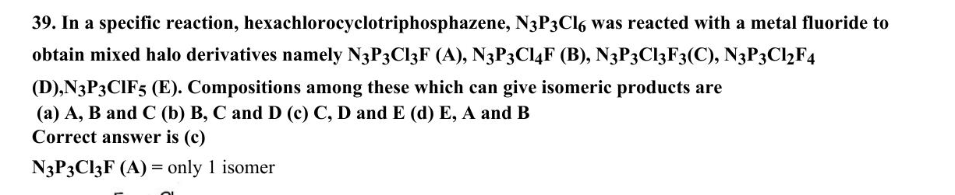
ABC CHEMISTRY
CSIR-DEC 2013
Mr. Aniket Bhardwaj
Hard
MCQ
Carbon & Silicon Group (Group 14)
Question 39 of 97
Q39
DEC 2013
QUESTION INSIGHTS
ESTIMATED TIME
3–5 min
DIFFICULTY
Hard
CONCEPT TESTED
Inert pair effect, difluoride stability, silicate structures, graphite vs diamond
PYQ FREQUENCY
Very High · 13 papers
REVISION PRIORITY
★★★★★
EXPECTED LEVEL
Part C (high merit)
MEMORY HOOK
Carbon is molecular (CO2, small, makes pi bonds), Silicon is polymeric (SiO2, big, uses d-orbitals for 3D network).
( Mr. Aniket Bhardwaj By ABC Chemistry ) · www.abcchemistry.com · 9212142427
Q39 · Question

Slide 131
ABC CHEMISTRY
CSIR-DEC 2013
Mr. Aniket Bhardwaj
Hard
MCQ
Carbon & Silicon Group (Group 14)
Question 39 of 97
Correct Answer C Option C (see PDF)
✓
CONCEPT
SHORTCUT / EXAM TRICK
Group 14 (C–Pb): inert pair effect stabilises +2 state down the group (Pb2+ most stable). C forms ppi-ppi bonds (CO2 molecular); Si prefers sigma bonding (SiO2 polymeric network). Difluoride stability: CF2>SiF2>GeF2 (F→C pi back-bonding stabilises CF2).
CF2 most stable difluoride (back-bonding). Inert pair: Pb2+>>Sn2+>Ge2+ stability. CO2 is linear molecular; SiO2 is 3D network. Silicones: -Si(R2)-O- chains.
↓
COMMON MISTAKE
LOGIC / WORKING
Confusing difluoride stability (CF2 most stable, back-bonding) with inert pair (Pb2+ most stable). These are DIFFERENT trends pointing OPPOSITE directions.
Key principle: inert pair effect, difluoride stability, and silicate structures. Correct answer is (C).
EXAM TIP
CF2 stability due to ppi-ppi back-bond from F to empty p on C. This is opposite to inert pair trend. Graphite conducts electricity along planes (sp2 C, delocalised pi electrons).
MEMORY TRICK
Carbon is molecular (CO2, small, makes pi bonds), Silicon is polymeric (SiO2, big, uses d-orbitals for 3D network).
FINAL: (C) Option C (see PDF)
( Mr. Aniket Bhardwaj By ABC Chemistry ) · www.abcchemistry.com · 9212142427
Q39 · Answer & Explanation

Slide 132
ABC CHEMISTRY
CSIR-DEC 2013
Mr. Aniket Bhardwaj
Hard
MCQ
Carbon & Silicon Group (Group 14)
Question 39 of 97
Why the Other Options Are Wrong
Correct answer: C
A
Option A (see PDF)
Inconsistent with inert pair effect, difluoride stability, and silicate structures; correct choice is (C). See worked explanation.
B
Option B (see PDF)
Inconsistent with inert pair effect, difluoride stability, and silicate structures; correct choice is (C). See worked explanation.
D
Option D (see PDF)
Inconsistent with inert pair effect, difluoride stability, and silicate structures; correct choice is (C). See worked explanation.
( Mr. Aniket Bhardwaj By ABC Chemistry ) · www.abcchemistry.com · 9212142427
Q39 · Distractor Analysis

Slide 133
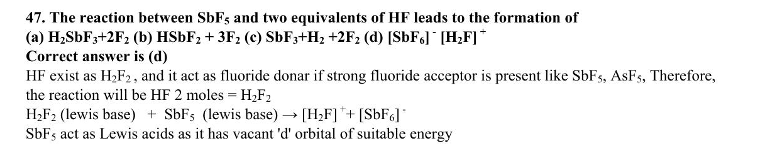
ABC CHEMISTRY
CSIR-DEC 2014
Mr. Aniket Bhardwaj
Hard
MCQ
Carbon & Silicon Group (Group 14)
Question 47 of 97
Q47
DEC 2014
QUESTION INSIGHTS
ESTIMATED TIME
3–5 min
DIFFICULTY
Hard
CONCEPT TESTED
Inert pair effect, difluoride stability, silicate structures, graphite vs diamond
PYQ FREQUENCY
Very High · 13 papers
REVISION PRIORITY
★★★★★
EXPECTED LEVEL
Part C (high merit)
MEMORY HOOK
Carbon is molecular (CO2, small, makes pi bonds), Silicon is polymeric (SiO2, big, uses d-orbitals for 3D network).
( Mr. Aniket Bhardwaj By ABC Chemistry ) · www.abcchemistry.com · 9212142427
Q47 · Question

Slide 134
ABC CHEMISTRY
CSIR-DEC 2014
Mr. Aniket Bhardwaj
Hard
MCQ
Carbon & Silicon Group (Group 14)
Question 47 of 97
Correct Answer D Option D (see PDF)
✓
CONCEPT
SHORTCUT / EXAM TRICK
Group 14 (C–Pb): inert pair effect stabilises +2 state down the group (Pb2+ most stable). C forms ppi-ppi bonds (CO2 molecular); Si prefers sigma bonding (SiO2 polymeric network). Difluoride stability: CF2>SiF2>GeF2 (F→C pi back-bonding stabilises CF2).
CF2 most stable difluoride (back-bonding). Inert pair: Pb2+>>Sn2+>Ge2+ stability. CO2 is linear molecular; SiO2 is 3D network. Silicones: -Si(R2)-O- chains.
↓
COMMON MISTAKE
LOGIC / WORKING
Confusing difluoride stability (CF2 most stable, back-bonding) with inert pair (Pb2+ most stable). These are DIFFERENT trends pointing OPPOSITE directions.
Key principle: inert pair effect, difluoride stability, and silicate structures. Correct answer is (D).
EXAM TIP
CF2 stability due to ppi-ppi back-bond from F to empty p on C. This is opposite to inert pair trend. Graphite conducts electricity along planes (sp2 C, delocalised pi electrons).
MEMORY TRICK
Carbon is molecular (CO2, small, makes pi bonds), Silicon is polymeric (SiO2, big, uses d-orbitals for 3D network).
FINAL: (D) Option D (see PDF)
( Mr. Aniket Bhardwaj By ABC Chemistry ) · www.abcchemistry.com · 9212142427
Q47 · Answer & Explanation

Slide 135
ABC CHEMISTRY
CSIR-DEC 2014
Mr. Aniket Bhardwaj
Hard
MCQ
Carbon & Silicon Group (Group 14)
Question 47 of 97
Why the Other Options Are Wrong
Correct answer: D
A
Option A (see PDF)
Inconsistent with inert pair effect, difluoride stability, and silicate structures; correct choice is (D). See worked explanation.
B
Option B (see PDF)
Inconsistent with inert pair effect, difluoride stability, and silicate structures; correct choice is (D). See worked explanation.
C
Option C (see PDF)
Inconsistent with inert pair effect, difluoride stability, and silicate structures; correct choice is (D). See worked explanation.
( Mr. Aniket Bhardwaj By ABC Chemistry ) · www.abcchemistry.com · 9212142427
Q47 · Distractor Analysis

Slide 136
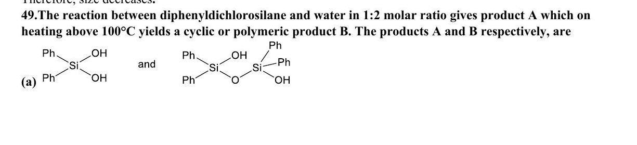
ABC CHEMISTRY
CSIR-JUNE 2014
Mr. Aniket Bhardwaj
Hard
MCQ
Carbon & Silicon Group (Group 14)
Question 49 of 97
Q49
JUNE 2014
QUESTION INSIGHTS
ESTIMATED TIME
3–5 min
DIFFICULTY
Hard
CONCEPT TESTED
Inert pair effect, difluoride stability, silicate structures, graphite vs diamond
PYQ FREQUENCY
Very High · 13 papers
REVISION PRIORITY
★★★★★
EXPECTED LEVEL
Part C (high merit)
MEMORY HOOK
Carbon is molecular (CO2, small, makes pi bonds), Silicon is polymeric (SiO2, big, uses d-orbitals for 3D network).
( Mr. Aniket Bhardwaj By ABC Chemistry ) · www.abcchemistry.com · 9212142427
Q49 · Question

Slide 137
ABC CHEMISTRY
CSIR-JUNE 2014
Mr. Aniket Bhardwaj
Hard
MCQ
Carbon & Silicon Group (Group 14)
Question 49 of 97
Correct Answer C Ph2Si(OH)2 (diphenylsilanediol) and cyclic/polymeric silicone
✓
CONCEPT
SHORTCUT / EXAM TRICK
Group 14 (C–Pb): inert pair effect stabilises +2 state down the group (Pb2+ most stable). C forms ppi-ppi bonds (CO2 molecular); Si prefers sigma bonding (SiO2 polymeric network). Difluoride stability: CF2>SiF2>GeF2 (F→C pi back-bonding stabilises CF2).
CF2 most stable difluoride (back-bonding). Inert pair: Pb2+>>Sn2+>Ge2+ stability. CO2 is linear molecular; SiO2 is 3D network. Silicones: -Si(R2)-O- chains.
↓
COMMON MISTAKE
LOGIC / WORKING
Confusing difluoride stability (CF2 most stable, back-bonding) with inert pair (Pb2+ most stable). These are DIFFERENT trends pointing OPPOSITE directions.
Key principle: inert pair effect, difluoride stability, and silicate structures. Correct answer is (C).
EXAM TIP
CF2 stability due to ppi-ppi back-bond from F to empty p on C. This is opposite to inert pair trend. Graphite conducts electricity along planes (sp2 C, delocalised pi electrons).
MEMORY TRICK
Carbon is molecular (CO2, small, makes pi bonds), Silicon is polymeric (SiO2, big, uses d-orbitals for 3D network).
FINAL: (C) Ph2Si(OH)2 (diphenylsilanediol) and cyclic/polymeric silicone
( Mr. Aniket Bhardwaj By ABC Chemistry ) · www.abcchemistry.com · 9212142427
Q49 · Answer & Explanation

Slide 138
ABC CHEMISTRY
CSIR-JUNE 2014
Mr. Aniket Bhardwaj
Hard
MCQ
Carbon & Silicon Group (Group 14)
Question 49 of 97
Why the Other Options Are Wrong
Correct answer: C
A
Ph2Si(OH)Cl and cyclic trimer
Inconsistent with inert pair effect, difluoride stability, and silicate structures; correct choice is (C). See worked explanation.
B
Ph2SiCl(OH) and linear polymer
Inconsistent with inert pair effect, difluoride stability, and silicate structures; correct choice is (C). See worked explanation.
D
Ph2SiO and HCl adduct
Inconsistent with inert pair effect, difluoride stability, and silicate structures; correct choice is (C). See worked explanation.
( Mr. Aniket Bhardwaj By ABC Chemistry ) · www.abcchemistry.com · 9212142427
Q49 · Distractor Analysis

Slide 139
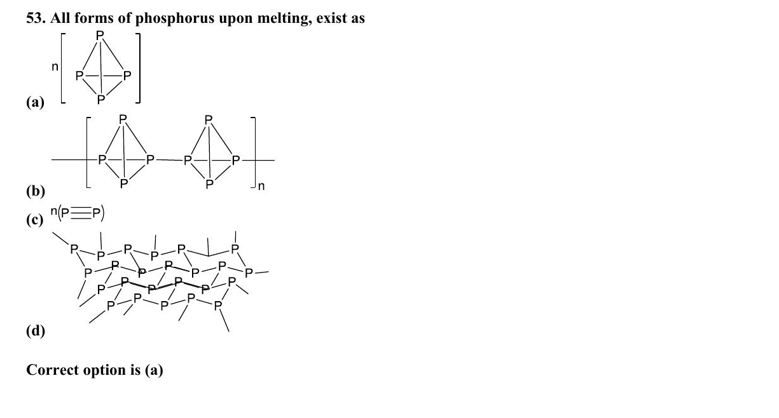
ABC CHEMISTRY
CSIR-DEC 2014
Mr. Aniket Bhardwaj
Hard
MCQ
Carbon & Silicon Group (Group 14)
Question 53 of 97
Q53
DEC 2014
QUESTION INSIGHTS
ESTIMATED TIME
3–5 min
DIFFICULTY
Hard
CONCEPT TESTED
Inert pair effect, difluoride stability, silicate structures, graphite vs diamond
PYQ FREQUENCY
Very High · 13 papers
REVISION PRIORITY
★★★★★
EXPECTED LEVEL
Part C (high merit)
MEMORY HOOK
Carbon is molecular (CO2, small, makes pi bonds), Silicon is polymeric (SiO2, big, uses d-orbitals for 3D network).
( Mr. Aniket Bhardwaj By ABC Chemistry ) · www.abcchemistry.com · 9212142427
Q53 · Question

Slide 140
ABC CHEMISTRY
CSIR-DEC 2014
Mr. Aniket Bhardwaj
Hard
MCQ
Carbon & Silicon Group (Group 14)
Question 53 of 97
Correct Answer A Option A (see PDF)
✓
CONCEPT
SHORTCUT / EXAM TRICK
Group 14 (C–Pb): inert pair effect stabilises +2 state down the group (Pb2+ most stable). C forms ppi-ppi bonds (CO2 molecular); Si prefers sigma bonding (SiO2 polymeric network). Difluoride stability: CF2>SiF2>GeF2 (F→C pi back-bonding stabilises CF2).
CF2 most stable difluoride (back-bonding). Inert pair: Pb2+>>Sn2+>Ge2+ stability. CO2 is linear molecular; SiO2 is 3D network. Silicones: -Si(R2)-O- chains.
↓
COMMON MISTAKE
LOGIC / WORKING
Confusing difluoride stability (CF2 most stable, back-bonding) with inert pair (Pb2+ most stable). These are DIFFERENT trends pointing OPPOSITE directions.
Key principle: inert pair effect, difluoride stability, and silicate structures. Correct answer is (A).
EXAM TIP
CF2 stability due to ppi-ppi back-bond from F to empty p on C. This is opposite to inert pair trend. Graphite conducts electricity along planes (sp2 C, delocalised pi electrons).
MEMORY TRICK
Carbon is molecular (CO2, small, makes pi bonds), Silicon is polymeric (SiO2, big, uses d-orbitals for 3D network).
FINAL: (A) Option A (see PDF)
( Mr. Aniket Bhardwaj By ABC Chemistry ) · www.abcchemistry.com · 9212142427
Q53 · Answer & Explanation

Slide 141
ABC CHEMISTRY
CSIR-DEC 2014
Mr. Aniket Bhardwaj
Hard
MCQ
Carbon & Silicon Group (Group 14)
Question 53 of 97
Why the Other Options Are Wrong
Correct answer: A
B
Option B (see PDF)
Inconsistent with inert pair effect, difluoride stability, and silicate structures; correct choice is (A). See worked explanation.
C
Option C (see PDF)
Inconsistent with inert pair effect, difluoride stability, and silicate structures; correct choice is (A). See worked explanation.
D
Option D (see PDF)
Inconsistent with inert pair effect, difluoride stability, and silicate structures; correct choice is (A). See worked explanation.
( Mr. Aniket Bhardwaj By ABC Chemistry ) · www.abcchemistry.com · 9212142427
Q53 · Distractor Analysis

Slide 142
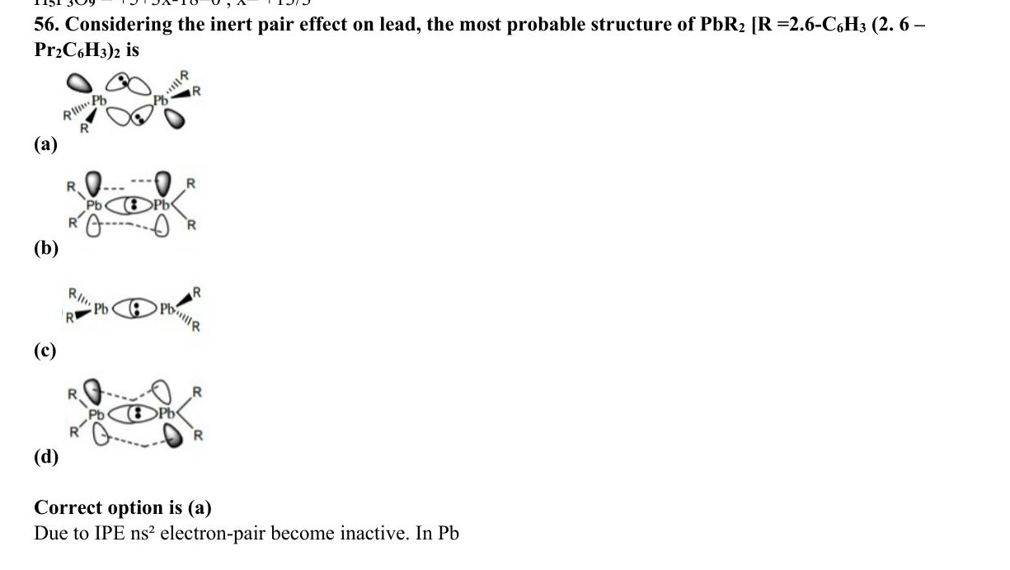
ABC CHEMISTRY
CSIR-DEC 2014
Mr. Aniket Bhardwaj
Hard
MCQ
Carbon & Silicon Group (Group 14)
Question 56 of 97
Q56
DEC 2014
QUESTION INSIGHTS
ESTIMATED TIME
3–5 min
DIFFICULTY
Hard
CONCEPT TESTED
Inert pair effect, difluoride stability, silicate structures, graphite vs diamond
PYQ FREQUENCY
Very High · 13 papers
REVISION PRIORITY
★★★★★
EXPECTED LEVEL
Part C (high merit)
MEMORY HOOK
Carbon is molecular (CO2, small, makes pi bonds), Silicon is polymeric (SiO2, big, uses d-orbitals for 3D network).
( Mr. Aniket Bhardwaj By ABC Chemistry ) · www.abcchemistry.com · 9212142427
Q56 · Question

Slide 143
ABC CHEMISTRY
CSIR-DEC 2014
Mr. Aniket Bhardwaj
Hard
MCQ
Carbon & Silicon Group (Group 14)
Question 56 of 97
Correct Answer A Option A (see PDF)
✓
CONCEPT
SHORTCUT / EXAM TRICK
Group 14 (C–Pb): inert pair effect stabilises +2 state down the group (Pb2+ most stable). C forms ppi-ppi bonds (CO2 molecular); Si prefers sigma bonding (SiO2 polymeric network). Difluoride stability: CF2>SiF2>GeF2 (F→C pi back-bonding stabilises CF2).
CF2 most stable difluoride (back-bonding). Inert pair: Pb2+>>Sn2+>Ge2+ stability. CO2 is linear molecular; SiO2 is 3D network. Silicones: -Si(R2)-O- chains.
↓
COMMON MISTAKE
LOGIC / WORKING
Confusing difluoride stability (CF2 most stable, back-bonding) with inert pair (Pb2+ most stable). These are DIFFERENT trends pointing OPPOSITE directions.
Key principle: inert pair effect, difluoride stability, and silicate structures. Correct answer is (A).
EXAM TIP
CF2 stability due to ppi-ppi back-bond from F to empty p on C. This is opposite to inert pair trend. Graphite conducts electricity along planes (sp2 C, delocalised pi electrons).
MEMORY TRICK
Carbon is molecular (CO2, small, makes pi bonds), Silicon is polymeric (SiO2, big, uses d-orbitals for 3D network).
FINAL: (A) Option A (see PDF)
( Mr. Aniket Bhardwaj By ABC Chemistry ) · www.abcchemistry.com · 9212142427
Q56 · Answer & Explanation

Slide 144
ABC CHEMISTRY
CSIR-DEC 2014
Mr. Aniket Bhardwaj
Hard
MCQ
Carbon & Silicon Group (Group 14)
Question 56 of 97
Why the Other Options Are Wrong
Correct answer: A
B
Option B (see PDF)
Inconsistent with inert pair effect, difluoride stability, and silicate structures; correct choice is (A). See worked explanation.
C
Option C (see PDF)
Inconsistent with inert pair effect, difluoride stability, and silicate structures; correct choice is (A). See worked explanation.
D
Option D (see PDF)
Inconsistent with inert pair effect, difluoride stability, and silicate structures; correct choice is (A). See worked explanation.
( Mr. Aniket Bhardwaj By ABC Chemistry ) · www.abcchemistry.com · 9212142427
Q56 · Distractor Analysis

Slide 145
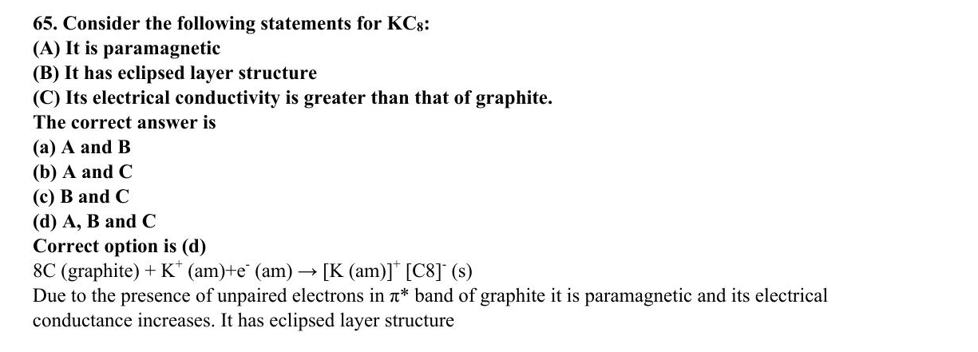
ABC CHEMISTRY
CSIR-Dec 2016
Mr. Aniket Bhardwaj
Hard
MCQ
Carbon & Silicon Group (Group 14)
Question 65 of 97
Q65
Dec 2016
QUESTION INSIGHTS
ESTIMATED TIME
3–5 min
DIFFICULTY
Hard
CONCEPT TESTED
Inert pair effect, difluoride stability, silicate structures, graphite vs diamond
PYQ FREQUENCY
Very High · 13 papers
REVISION PRIORITY
★★★★★
EXPECTED LEVEL
Part C (high merit)
MEMORY HOOK
Carbon is molecular (CO2, small, makes pi bonds), Silicon is polymeric (SiO2, big, uses d-orbitals for 3D network).
( Mr. Aniket Bhardwaj By ABC Chemistry ) · www.abcchemistry.com · 9212142427
Q65 · Question

Slide 146
ABC CHEMISTRY
CSIR-Dec 2016
Mr. Aniket Bhardwaj
Hard
MCQ
Carbon & Silicon Group (Group 14)
Question 65 of 97
Correct Answer A It is paramagnetic
✓
CONCEPT
SHORTCUT / EXAM TRICK
Group 14 (C–Pb): inert pair effect stabilises +2 state down the group (Pb2+ most stable). C forms ppi-ppi bonds (CO2 molecular); Si prefers sigma bonding (SiO2 polymeric network). Difluoride stability: CF2>SiF2>GeF2 (F→C pi back-bonding stabilises CF2).
CF2 most stable difluoride (back-bonding). Inert pair: Pb2+>>Sn2+>Ge2+ stability. CO2 is linear molecular; SiO2 is 3D network. Silicones: -Si(R2)-O- chains.
↓
COMMON MISTAKE
LOGIC / WORKING
Confusing difluoride stability (CF2 most stable, back-bonding) with inert pair (Pb2+ most stable). These are DIFFERENT trends pointing OPPOSITE directions.
Key principle: inert pair effect, difluoride stability, and silicate structures. Correct answer is (A).
EXAM TIP
CF2 stability due to ppi-ppi back-bond from F to empty p on C. This is opposite to inert pair trend. Graphite conducts electricity along planes (sp2 C, delocalised pi electrons).
MEMORY TRICK
Carbon is molecular (CO2, small, makes pi bonds), Silicon is polymeric (SiO2, big, uses d-orbitals for 3D network).
FINAL: (A) It is paramagnetic
( Mr. Aniket Bhardwaj By ABC Chemistry ) · www.abcchemistry.com · 9212142427
Q65 · Answer & Explanation

Slide 147
ABC CHEMISTRY
CSIR-Dec 2016
Mr. Aniket Bhardwaj
Hard
MCQ
Carbon & Silicon Group (Group 14)
Question 65 of 97
Why the Other Options Are Wrong
Correct answer: A
B
It has eclipsed layer structure
Inconsistent with inert pair effect, difluoride stability, and silicate structures; correct choice is (A). See worked explanation.
C
Its electrical conductivity is greater than that of graphite. The
Inconsistent with inert pair effect, difluoride stability, and silicate structures; correct choice is (A). See worked explanation.
D
A and B
Inconsistent with inert pair effect, difluoride stability, and silicate structures; correct choice is (A). See worked explanation.
( Mr. Aniket Bhardwaj By ABC Chemistry ) · www.abcchemistry.com · 9212142427
Q65 · Distractor Analysis

Slide 148
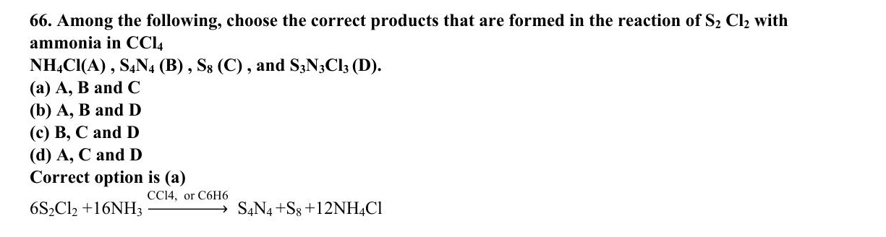
ABC CHEMISTRY
CSIR-Dec 2016
Mr. Aniket Bhardwaj
Hard
MCQ
Carbon & Silicon Group (Group 14)
Question 66 of 97
Q66
Dec 2016
QUESTION INSIGHTS
ESTIMATED TIME
3–5 min
DIFFICULTY
Hard
CONCEPT TESTED
Inert pair effect, difluoride stability, silicate structures, graphite vs diamond
PYQ FREQUENCY
Very High · 13 papers
REVISION PRIORITY
★★★★★
EXPECTED LEVEL
Part C (high merit)
MEMORY HOOK
Carbon is molecular (CO2, small, makes pi bonds), Silicon is polymeric (SiO2, big, uses d-orbitals for 3D network).
( Mr. Aniket Bhardwaj By ABC Chemistry ) · www.abcchemistry.com · 9212142427
Q66 · Question

Slide 149
ABC CHEMISTRY
CSIR-Dec 2016
Mr. Aniket Bhardwaj
Hard
MCQ
Carbon & Silicon Group (Group 14)
Question 66 of 97
Correct Answer A , S₄N₄
✓
CONCEPT
SHORTCUT / EXAM TRICK
Group 14 (C–Pb): inert pair effect stabilises +2 state down the group (Pb2+ most stable). C forms ppi-ppi bonds (CO2 molecular); Si prefers sigma bonding (SiO2 polymeric network). Difluoride stability: CF2>SiF2>GeF2 (F→C pi back-bonding stabilises CF2).
CF2 most stable difluoride (back-bonding). Inert pair: Pb2+>>Sn2+>Ge2+ stability. CO2 is linear molecular; SiO2 is 3D network. Silicones: -Si(R2)-O- chains.
↓
COMMON MISTAKE
LOGIC / WORKING
Confusing difluoride stability (CF2 most stable, back-bonding) with inert pair (Pb2+ most stable). These are DIFFERENT trends pointing OPPOSITE directions.
Key principle: inert pair effect, difluoride stability, and silicate structures. Correct answer is (A).
EXAM TIP
CF2 stability due to ppi-ppi back-bond from F to empty p on C. This is opposite to inert pair trend. Graphite conducts electricity along planes (sp2 C, delocalised pi electrons).
MEMORY TRICK
Carbon is molecular (CO2, small, makes pi bonds), Silicon is polymeric (SiO2, big, uses d-orbitals for 3D network).
FINAL: (A) , S₄N₄
( Mr. Aniket Bhardwaj By ABC Chemistry ) · www.abcchemistry.com · 9212142427
Q66 · Answer & Explanation

Slide 150
ABC CHEMISTRY
CSIR-Dec 2016
Mr. Aniket Bhardwaj
Hard
MCQ
Carbon & Silicon Group (Group 14)
Question 66 of 97
Why the Other Options Are Wrong
Correct answer: A
B
, S₈
Inconsistent with inert pair effect, difluoride stability, and silicate structures; correct choice is (A). See worked explanation.
C
, and S₃N₃Cl₃
Inconsistent with inert pair effect, difluoride stability, and silicate structures; correct choice is (A). See worked explanation.
D
.
Inconsistent with inert pair effect, difluoride stability, and silicate structures; correct choice is (A). See worked explanation.
( Mr. Aniket Bhardwaj By ABC Chemistry ) · www.abcchemistry.com · 9212142427
Q66 · Distractor Analysis

Slide 151
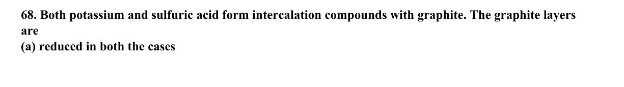
ABC CHEMISTRY
CSIR-JUNE 2017
Mr. Aniket Bhardwaj
Hard
MCQ
Carbon & Silicon Group (Group 14)
Question 68 of 97
Q68
JUNE 2017
QUESTION INSIGHTS
Both potassium and sulfuric acid form intercalation compounds with graphite. The graphite layers are
(a) reduced in both the cases
(b) oxidized in both the cases
(c) oxidized in the case of potassium and reduced in the case of sulphuric acid
(d) reduced in the case of potassium and oxidized in the case of sulphuric acid
ESTIMATED TIME
3–5 min
DIFFICULTY
Hard
CONCEPT TESTED
Inert pair effect, difluoride stability, silicate structures, graphite vs diamond
PYQ FREQUENCY
Very High · 13 papers
REVISION PRIORITY
★★★★★
EXPECTED LEVEL
Part C (high merit)
MEMORY HOOK
Carbon is molecular (CO2, small, makes pi bonds), Silicon is polymeric (SiO2, big, uses d-orbitals for 3D network).
( Mr. Aniket Bhardwaj By ABC Chemistry ) · www.abcchemistry.com · 9212142427
Q68 · Question

Slide 152
ABC CHEMISTRY
CSIR-JUNE 2017
Mr. Aniket Bhardwaj
Hard
MCQ
Carbon & Silicon Group (Group 14)
Question 68 of 97
Correct Answer D reduced in the case of potassium and oxidized in the case of sulphuric acid
✓
CONCEPT
SHORTCUT / EXAM TRICK
Group 14 (C–Pb): inert pair effect stabilises +2 state down the group (Pb2+ most stable). C forms ppi-ppi bonds (CO2 molecular); Si prefers sigma bonding (SiO2 polymeric network). Difluoride stability: CF2>SiF2>GeF2 (F→C pi back-bonding stabilises CF2).
CF2 most stable difluoride (back-bonding). Inert pair: Pb2+>>Sn2+>Ge2+ stability. CO2 is linear molecular; SiO2 is 3D network. Silicones: -Si(R2)-O- chains.
↓
COMMON MISTAKE
LOGIC / WORKING
Confusing difluoride stability (CF2 most stable, back-bonding) with inert pair (Pb2+ most stable). These are DIFFERENT trends pointing OPPOSITE directions.
Potassium donates electrons to the layers (KC₈, graphite reduced); H₂SO₄ intercalation forms C₂₄⁺HSO₄⁻ (graphite oxidised).
Therefore the answer is (D).
EXAM TIP
CF2 stability due to ppi-ppi back-bond from F to empty p on C. This is opposite to inert pair trend. Graphite conducts electricity along planes (sp2 C, delocalised pi electrons).
MEMORY TRICK
Carbon is molecular (CO2, small, makes pi bonds), Silicon is polymeric (SiO2, big, uses d-orbitals for 3D network).
FINAL: (D) reduced in the case of potassium and oxidized in the case of sulphuric acid
( Mr. Aniket Bhardwaj By ABC Chemistry ) · www.abcchemistry.com · 9212142427
Q68 · Answer & Explanation

Slide 153
ABC CHEMISTRY
CSIR-JUNE 2017
Mr. Aniket Bhardwaj
Hard
MCQ
Carbon & Silicon Group (Group 14)
Question 68 of 97
Why the Other Options Are Wrong
Correct answer: D
A
reduced in both the cases Main Group Elements
Why (D) is the key — Potassium donates electrons to the layers (KC₈, graphite reduced); H₂SO₄ intercalation forms C₂₄⁺HSO₄⁻ (graphite oxidised).
B
oxidized in both the cases
Option (B) is ruled out by the same reasoning: Potassium donates electrons to the layers (KC₈, graphite reduced); H₂SO₄ intercalation forms C₂₄⁺HSO₄⁻ (graphite
C
oxidized in the case of potassium and reduced in the case of sulphuric acid
Option (C) is ruled out by the same reasoning: Potassium donates electrons to the layers (KC₈, graphite reduced); H₂SO₄ intercalation forms C₂₄⁺HSO₄⁻ (graphite
( Mr. Aniket Bhardwaj By ABC Chemistry ) · www.abcchemistry.com · 9212142427
Q68 · Distractor Analysis

Slide 154
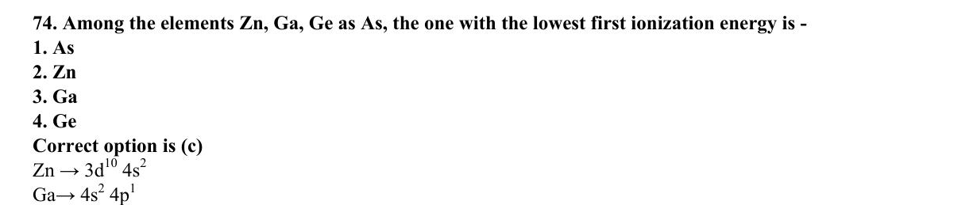
ABC CHEMISTRY
CSIR-JUNE 2018
Mr. Aniket Bhardwaj
Hard
MCQ
Carbon & Silicon Group (Group 14)
Question 74 of 97
Q74
JUNE 2018
QUESTION INSIGHTS
ESTIMATED TIME
3–5 min
DIFFICULTY
Hard
CONCEPT TESTED
Inert pair effect, difluoride stability, silicate structures, graphite vs diamond
PYQ FREQUENCY
Very High · 13 papers
REVISION PRIORITY
★★★★★
EXPECTED LEVEL
Part C (high merit)
MEMORY HOOK
Carbon is molecular (CO2, small, makes pi bonds), Silicon is polymeric (SiO2, big, uses d-orbitals for 3D network).
( Mr. Aniket Bhardwaj By ABC Chemistry ) · www.abcchemistry.com · 9212142427
Q74 · Question

Slide 155
ABC CHEMISTRY
CSIR-JUNE 2018
Mr. Aniket Bhardwaj
Hard
MCQ
Carbon & Silicon Group (Group 14)
Question 74 of 97
Correct Answer C Ga
✓
CONCEPT
SHORTCUT / EXAM TRICK
Group 14 (C–Pb): inert pair effect stabilises +2 state down the group (Pb2+ most stable). C forms ppi-ppi bonds (CO2 molecular); Si prefers sigma bonding (SiO2 polymeric network). Difluoride stability: CF2>SiF2>GeF2 (F→C pi back-bonding stabilises CF2).
CF2 most stable difluoride (back-bonding). Inert pair: Pb2+>>Sn2+>Ge2+ stability. CO2 is linear molecular; SiO2 is 3D network. Silicones: -Si(R2)-O- chains.
↓
COMMON MISTAKE
LOGIC / WORKING
Confusing difluoride stability (CF2 most stable, back-bonding) with inert pair (Pb2+ most stable). These are DIFFERENT trends pointing OPPOSITE directions.
Key principle: inert pair effect, difluoride stability, and silicate structures. Correct answer is (C).
EXAM TIP
CF2 stability due to ppi-ppi back-bond from F to empty p on C. This is opposite to inert pair trend. Graphite conducts electricity along planes (sp2 C, delocalised pi electrons).
MEMORY TRICK
Carbon is molecular (CO2, small, makes pi bonds), Silicon is polymeric (SiO2, big, uses d-orbitals for 3D network).
FINAL: (C) Ga
( Mr. Aniket Bhardwaj By ABC Chemistry ) · www.abcchemistry.com · 9212142427
Q74 · Answer & Explanation

Slide 156
ABC CHEMISTRY
CSIR-JUNE 2018
Mr. Aniket Bhardwaj
Hard
MCQ
Carbon & Silicon Group (Group 14)
Question 74 of 97
Why the Other Options Are Wrong
Correct answer: C
A
As
Inconsistent with inert pair effect, difluoride stability, and silicate structures; correct choice is (C). See worked explanation.
B
Zn
Inconsistent with inert pair effect, difluoride stability, and silicate structures; correct choice is (C). See worked explanation.
D
Ge
Inconsistent with inert pair effect, difluoride stability, and silicate structures; correct choice is (C). See worked explanation.
( Mr. Aniket Bhardwaj By ABC Chemistry ) · www.abcchemistry.com · 9212142427
Q74 · Distractor Analysis

Slide 157
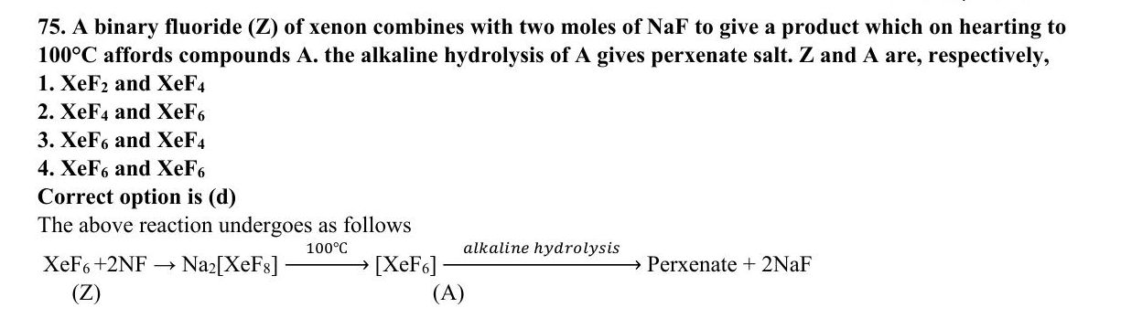
ABC CHEMISTRY
CSIR-JUNE 2018
Mr. Aniket Bhardwaj
Hard
MCQ
Carbon & Silicon Group (Group 14)
Question 75 of 97
Q75
JUNE 2018
QUESTION INSIGHTS
ESTIMATED TIME
3–5 min
DIFFICULTY
Hard
CONCEPT TESTED
Inert pair effect, difluoride stability, silicate structures, graphite vs diamond
PYQ FREQUENCY
Very High · 13 papers
REVISION PRIORITY
★★★★★
EXPECTED LEVEL
Part C (high merit)
MEMORY HOOK
Carbon is molecular (CO2, small, makes pi bonds), Silicon is polymeric (SiO2, big, uses d-orbitals for 3D network).
( Mr. Aniket Bhardwaj By ABC Chemistry ) · www.abcchemistry.com · 9212142427
Q75 · Question

Slide 158
ABC CHEMISTRY
CSIR-JUNE 2018
Mr. Aniket Bhardwaj
Hard
MCQ
Carbon & Silicon Group (Group 14)
Question 75 of 97
Correct Answer D XeF6 and XeF6
✓
CONCEPT
SHORTCUT / EXAM TRICK
Group 14 (C–Pb): inert pair effect stabilises +2 state down the group (Pb2+ most stable). C forms ppi-ppi bonds (CO2 molecular); Si prefers sigma bonding (SiO2 polymeric network). Difluoride stability: CF2>SiF2>GeF2 (F→C pi back-bonding stabilises CF2).
CF2 most stable difluoride (back-bonding). Inert pair: Pb2+>>Sn2+>Ge2+ stability. CO2 is linear molecular; SiO2 is 3D network. Silicones: -Si(R2)-O- chains.
↓
COMMON MISTAKE
LOGIC / WORKING
Confusing difluoride stability (CF2 most stable, back-bonding) with inert pair (Pb2+ most stable). These are DIFFERENT trends pointing OPPOSITE directions.
Key principle: inert pair effect, difluoride stability, and silicate structures. Correct answer is (D).
EXAM TIP
CF2 stability due to ppi-ppi back-bond from F to empty p on C. This is opposite to inert pair trend. Graphite conducts electricity along planes (sp2 C, delocalised pi electrons).
MEMORY TRICK
Carbon is molecular (CO2, small, makes pi bonds), Silicon is polymeric (SiO2, big, uses d-orbitals for 3D network).
FINAL: (D) XeF6 and XeF6
( Mr. Aniket Bhardwaj By ABC Chemistry ) · www.abcchemistry.com · 9212142427
Q75 · Answer & Explanation

Slide 159
ABC CHEMISTRY
CSIR-JUNE 2018
Mr. Aniket Bhardwaj
Hard
MCQ
Carbon & Silicon Group (Group 14)
Question 75 of 97
Why the Other Options Are Wrong
Correct answer: D
A
XeF2 and XeF4
Inconsistent with inert pair effect, difluoride stability, and silicate structures; correct choice is (D). See worked explanation.
B
XeF4 and XeF6
Inconsistent with inert pair effect, difluoride stability, and silicate structures; correct choice is (D). See worked explanation.
C
XeF6 and XeF4
Inconsistent with inert pair effect, difluoride stability, and silicate structures; correct choice is (D). See worked explanation.
( Mr. Aniket Bhardwaj By ABC Chemistry ) · www.abcchemistry.com · 9212142427
Q75 · Distractor Analysis

Slide 160

ABC CHEMISTRY
CSIR-JUNE 2018
Mr. Aniket Bhardwaj
Hard
MCQ
Carbon & Silicon Group (Group 14)
Question 77 of 97
Q77
JUNE 2018
QUESTION INSIGHTS
ESTIMATED TIME
3–5 min
DIFFICULTY
Hard
CONCEPT TESTED
Inert pair effect, difluoride stability, silicate structures, graphite vs diamond
PYQ FREQUENCY
Very High · 13 papers
REVISION PRIORITY
★★★★★
EXPECTED LEVEL
Part C (high merit)
MEMORY HOOK
Carbon is molecular (CO2, small, makes pi bonds), Silicon is polymeric (SiO2, big, uses d-orbitals for 3D network).
( Mr. Aniket Bhardwaj By ABC Chemistry ) · www.abcchemistry.com · 9212142427
Q77 · Question

Slide 161
ABC CHEMISTRY
CSIR-JUNE 2018
Mr. Aniket Bhardwaj
Hard
MCQ
Carbon & Silicon Group (Group 14)
Question 77 of 97
Correct Answer C The geometry around the central atom is planar for all.
✓
CONCEPT
SHORTCUT / EXAM TRICK
Group 14 (C–Pb): inert pair effect stabilises +2 state down the group (Pb2+ most stable). C forms ppi-ppi bonds (CO2 molecular); Si prefers sigma bonding (SiO2 polymeric network). Difluoride stability: CF2>SiF2>GeF2 (F→C pi back-bonding stabilises CF2).
CF2 most stable difluoride (back-bonding). Inert pair: Pb2+>>Sn2+>Ge2+ stability. CO2 is linear molecular; SiO2 is 3D network. Silicones: -Si(R2)-O- chains.
↓
COMMON MISTAKE
LOGIC / WORKING
Confusing difluoride stability (CF2 most stable, back-bonding) with inert pair (Pb2+ most stable). These are DIFFERENT trends pointing OPPOSITE directions.
Key principle: inert pair effect, difluoride stability, and silicate structures. Correct answer is (C).
EXAM TIP
CF2 stability due to ppi-ppi back-bond from F to empty p on C. This is opposite to inert pair trend. Graphite conducts electricity along planes (sp2 C, delocalised pi electrons).
MEMORY TRICK
Carbon is molecular (CO2, small, makes pi bonds), Silicon is polymeric (SiO2, big, uses d-orbitals for 3D network).
FINAL: (C) The geometry around the central atom is planar for all.
( Mr. Aniket Bhardwaj By ABC Chemistry ) · www.abcchemistry.com · 9212142427
Q77 · Answer & Explanation

Slide 162
ABC CHEMISTRY
CSIR-JUNE 2018
Mr. Aniket Bhardwaj
Hard
MCQ
Carbon & Silicon Group (Group 14)
Question 77 of 97
Why the Other Options Are Wrong
Correct answer: C
A
There is an M-M (M= Be, B, Ga) bond in all.
Inconsistent with inert pair effect, difluoride stability, and silicate structures; correct choice is (C). See worked explanation.
B
The oxidation state of Be, B and Ga is +2.
Inconsistent with inert pair effect, difluoride stability, and silicate structures; correct choice is (C). See worked explanation.
D
The geometry around the central atom is planar in I and II only. The
Inconsistent with inert pair effect, difluoride stability, and silicate structures; correct choice is (C). See worked explanation.
( Mr. Aniket Bhardwaj By ABC Chemistry ) · www.abcchemistry.com · 9212142427
Q77 · Distractor Analysis

Slide 163

ABC CHEMISTRY
CSIR-DEC 2018
Mr. Aniket Bhardwaj
Hard
MCQ
Carbon & Silicon Group (Group 14)
Question 79 of 97
Q79
DEC 2018
QUESTION INSIGHTS
In compound N₃ P₃ F₆, the geometry around nitrogen and phosphorus, respectively, are
(a) pyramidal and tetrahedral
(b) planar and tetrahedral
(c) pyramidal and planar
(d) planar and trigonal bipyramidal
ESTIMATED TIME
3–5 min
DIFFICULTY
Hard
CONCEPT TESTED
Inert pair effect, difluoride stability, silicate structures, graphite vs diamond
PYQ FREQUENCY
Very High · 13 papers
REVISION PRIORITY
★★★★★
EXPECTED LEVEL
Part C (high merit)
MEMORY HOOK
Carbon is molecular (CO2, small, makes pi bonds), Silicon is polymeric (SiO2, big, uses d-orbitals for 3D network).
( Mr. Aniket Bhardwaj By ABC Chemistry ) · www.abcchemistry.com · 9212142427
Q79 · Question

Slide 164
ABC CHEMISTRY
CSIR-DEC 2018
Mr. Aniket Bhardwaj
Hard
MCQ
Carbon & Silicon Group (Group 14)
Question 79 of 97
Correct Answer B planar and tetrahedral
✓
CONCEPT
SHORTCUT / EXAM TRICK
Group 14 (C–Pb): inert pair effect stabilises +2 state down the group (Pb2+ most stable). C forms ppi-ppi bonds (CO2 molecular); Si prefers sigma bonding (SiO2 polymeric network). Difluoride stability: CF2>SiF2>GeF2 (F→C pi back-bonding stabilises CF2).
CF2 most stable difluoride (back-bonding). Inert pair: Pb2+>>Sn2+>Ge2+ stability. CO2 is linear molecular; SiO2 is 3D network. Silicones: -Si(R2)-O- chains.
↓
COMMON MISTAKE
LOGIC / WORKING
Confusing difluoride stability (CF2 most stable, back-bonding) with inert pair (Pb2+ most stable). These are DIFFERENT trends pointing OPPOSITE directions.
In the cyclophosphazene ring the nitrogen atoms are planar (spÂ²-like, part of the delocalised ring) and each phosphorus is tetrahedral (two F, two N).
Therefore the answer is (B).
EXAM TIP
CF2 stability due to ppi-ppi back-bond from F to empty p on C. This is opposite to inert pair trend. Graphite conducts electricity along planes (sp2 C, delocalised pi electrons).
MEMORY TRICK
Carbon is molecular (CO2, small, makes pi bonds), Silicon is polymeric (SiO2, big, uses d-orbitals for 3D network).
FINAL: (B) planar and tetrahedral
( Mr. Aniket Bhardwaj By ABC Chemistry ) · www.abcchemistry.com · 9212142427
Q79 · Answer & Explanation

Slide 165
ABC CHEMISTRY
CSIR-DEC 2018
Mr. Aniket Bhardwaj
Hard
MCQ
Carbon & Silicon Group (Group 14)
Question 79 of 97
Why the Other Options Are Wrong
Correct answer: B
A
pyramidal and tetrahedral
Why (B) is the key — In the cyclophosphazene ring the nitrogen atoms are planar (spÂ²-like, part of the delocalised ring) and each phosphorus is tetrahedral (two F, two N).
C
pyramidal and planar
Option (C) is ruled out by the same reasoning: In the cyclophosphazene ring the nitrogen atoms are planar (spÂ²-like, part of the delocalised ring) and each phosphorus is tetrahedral (two F, two
D
planar and trigonal bipyramidal
Option (D) is ruled out by the same reasoning: In the cyclophosphazene ring the nitrogen atoms are planar (spÂ²-like, part of the delocalised ring) and each phosphorus is tetrahedral (two F, two
( Mr. Aniket Bhardwaj By ABC Chemistry ) · www.abcchemistry.com · 9212142427
Q79 · Distractor Analysis

Slide 166

ABC CHEMISTRY
CSIR-DEC 2018
Mr. Aniket Bhardwaj
Hard
MCQ
Carbon & Silicon Group (Group 14)
Question 82 of 97
Q82
DEC 2018
QUESTION INSIGHTS
ESTIMATED TIME
3–5 min
DIFFICULTY
Hard
CONCEPT TESTED
Inert pair effect, difluoride stability, silicate structures, graphite vs diamond
PYQ FREQUENCY
Very High · 13 papers
REVISION PRIORITY
★★★★★
EXPECTED LEVEL
Part C (high merit)
MEMORY HOOK
Carbon is molecular (CO2, small, makes pi bonds), Silicon is polymeric (SiO2, big, uses d-orbitals for 3D network).
( Mr. Aniket Bhardwaj By ABC Chemistry ) · www.abcchemistry.com · 9212142427
Q82 · Question

Slide 167
ABC CHEMISTRY
CSIR-DEC 2018
Mr. Aniket Bhardwaj
Hard
MCQ
Carbon & Silicon Group (Group 14)
Question 82 of 97
Correct Answer A Magic number (I) Nuclear fission
✓
CONCEPT
SHORTCUT / EXAM TRICK
Group 14 (C–Pb): inert pair effect stabilises +2 state down the group (Pb2+ most stable). C forms ppi-ppi bonds (CO2 molecular); Si prefers sigma bonding (SiO2 polymeric network). Difluoride stability: CF2>SiF2>GeF2 (F→C pi back-bonding stabilises CF2).
CF2 most stable difluoride (back-bonding). Inert pair: Pb2+>>Sn2+>Ge2+ stability. CO2 is linear molecular; SiO2 is 3D network. Silicones: -Si(R2)-O- chains.
↓
COMMON MISTAKE
LOGIC / WORKING
Confusing difluoride stability (CF2 most stable, back-bonding) with inert pair (Pb2+ most stable). These are DIFFERENT trends pointing OPPOSITE directions.
Key principle: inert pair effect, difluoride stability, and silicate structures. Correct answer is (A).
EXAM TIP
CF2 stability due to ppi-ppi back-bond from F to empty p on C. This is opposite to inert pair trend. Graphite conducts electricity along planes (sp2 C, delocalised pi electrons).
MEMORY TRICK
Carbon is molecular (CO2, small, makes pi bonds), Silicon is polymeric (SiO2, big, uses d-orbitals for 3D network).
FINAL: (A) Magic number (I) Nuclear fission
( Mr. Aniket Bhardwaj By ABC Chemistry ) · www.abcchemistry.com · 9212142427
Q82 · Answer & Explanation

Slide 168
ABC CHEMISTRY
CSIR-DEC 2018
Mr. Aniket Bhardwaj
Hard
MCQ
Carbon & Silicon Group (Group 14)
Question 82 of 97
Why the Other Options Are Wrong
Correct answer: A
B
Liquid drop model of nucleus (II) Q-value
Inconsistent with inert pair effect, difluoride stability, and silicate structures; correct choice is (A). See worked explanation.
C
Actinides (III) Radioactivity
Inconsistent with inert pair effect, difluoride stability, and silicate structures; correct choice is (A). See worked explanation.
D
Threshold energy (IV) Shell model of nucleus
Inconsistent with inert pair effect, difluoride stability, and silicate structures; correct choice is (A). See worked explanation.
( Mr. Aniket Bhardwaj By ABC Chemistry ) · www.abcchemistry.com · 9212142427
Q82 · Distractor Analysis

Slide 169

ABC CHEMISTRY
CSIR-JUNE 2019
Mr. Aniket Bhardwaj
Hard
MCQ
Carbon & Silicon Group (Group 14)
Question 85 of 97
Q85
JUNE 2019
QUESTION INSIGHTS
In the synthesis of polydimethylsiloxane, the chain forming, branching and terminating agents respectively, are
(a) Me₂ SiCl₂, Me₃ SiCl and MeSiCl₃
(b) Me₂ SiCl₂, MeSiCl₃ and Me₃ SiCl
(c) MeSiCl₃, Me₂ SiCl₂ and Me₃ SiCl
(d) Me₂ SiCl₂, MeSiCl₃ and Me₄ Si
ESTIMATED TIME
3–5 min
DIFFICULTY
Hard
CONCEPT TESTED
Inert pair effect, difluoride stability, silicate structures, graphite vs diamond
PYQ FREQUENCY
Very High · 13 papers
REVISION PRIORITY
★★★★★
EXPECTED LEVEL
Part C (high merit)
MEMORY HOOK
Carbon is molecular (CO2, small, makes pi bonds), Silicon is polymeric (SiO2, big, uses d-orbitals for 3D network).
( Mr. Aniket Bhardwaj By ABC Chemistry ) · www.abcchemistry.com · 9212142427
Q85 · Question

Slide 170
ABC CHEMISTRY
CSIR-JUNE 2019
Mr. Aniket Bhardwaj
Hard
MCQ
Carbon & Silicon Group (Group 14)
Question 85 of 97
Correct Answer B Me₂SiCl₂, MeSiCl₃ and Me₃SiCl
✓
CONCEPT
SHORTCUT / EXAM TRICK
Group 14 (C–Pb): inert pair effect stabilises +2 state down the group (Pb2+ most stable). C forms ppi-ppi bonds (CO2 molecular); Si prefers sigma bonding (SiO2 polymeric network). Difluoride stability: CF2>SiF2>GeF2 (F→C pi back-bonding stabilises CF2).
CF2 most stable difluoride (back-bonding). Inert pair: Pb2+>>Sn2+>Ge2+ stability. CO2 is linear molecular; SiO2 is 3D network. Silicones: -Si(R2)-O- chains.
↓
COMMON MISTAKE
LOGIC / WORKING
Confusing difluoride stability (CF2 most stable, back-bonding) with inert pair (Pb2+ most stable). These are DIFFERENT trends pointing OPPOSITE directions.
Me₂SiCl₂ builds the linear –O–SiMe₂–O– chain, MeSiCl₃ introduces branch points (three Si–O bonds) and Me₃SiCl caps the chain ends.
Therefore the answer is (B).
EXAM TIP
CF2 stability due to ppi-ppi back-bond from F to empty p on C. This is opposite to inert pair trend. Graphite conducts electricity along planes (sp2 C, delocalised pi electrons).
MEMORY TRICK
Carbon is molecular (CO2, small, makes pi bonds), Silicon is polymeric (SiO2, big, uses d-orbitals for 3D network).
FINAL: (B) Me₂SiCl₂, MeSiCl₃ and Me₃SiCl
( Mr. Aniket Bhardwaj By ABC Chemistry ) · www.abcchemistry.com · 9212142427
Q85 · Answer & Explanation

Slide 171
ABC CHEMISTRY
CSIR-JUNE 2019
Mr. Aniket Bhardwaj
Hard
MCQ
Carbon & Silicon Group (Group 14)
Question 85 of 97
Why the Other Options Are Wrong
Correct answer: B
A
Me₂SiCl₂ , Me₃SiCl and MeSiCl₃
Why (B) is the key — Me₂SiCl₂ builds the linear –O–SiMe₂–O– chain, MeSiCl₃ introduces branch points (three Si–O bonds) and Me₃SiCl caps the chain ends.
C
MeSiCl₃ , Me₂SiCl₂ and Me₃SiCl
Option (C) is ruled out by the same reasoning: Me₂SiCl₂ builds the linear –O–SiMe₂–O– chain, MeSiCl₃ introduces branch points (three Si–O bonds) and Me₃SiCl caps the chain
D
Me₂SiCl₂ , MeSiCl₃ and Me₄Si
Option (D) is ruled out by the same reasoning: Me₂SiCl₂ builds the linear –O–SiMe₂–O– chain, MeSiCl₃ introduces branch points (three Si–O bonds) and Me₃SiCl caps the chain
( Mr. Aniket Bhardwaj By ABC Chemistry ) · www.abcchemistry.com · 9212142427
Q85 · Distractor Analysis

Slide 172

ABC CHEMISTRY
CSIR-JUNE 2019
Mr. Aniket Bhardwaj
Hard
MCQ
Carbon & Silicon Group (Group 14)
Question 88 of 97
Q88
JUNE 2019
QUESTION INSIGHTS
Choose the correct statement(s) among the following (1) The dihedral angle in O₂F₂ is 0^°. (II) OF₂ is generally prepared by reacting fluorine gas with dilute (2\%) aq. NaOH solution (III) O₂F₂ can be readily reduced by H₂S.
(a) I and II only
(b) I, II and III
(c) II and III only
(d) II only
ESTIMATED TIME
3–5 min
DIFFICULTY
Hard
CONCEPT TESTED
Inert pair effect, difluoride stability, silicate structures, graphite vs diamond
PYQ FREQUENCY
Very High · 13 papers
REVISION PRIORITY
★★★★★
EXPECTED LEVEL
Part C (high merit)
MEMORY HOOK
Carbon is molecular (CO2, small, makes pi bonds), Silicon is polymeric (SiO2, big, uses d-orbitals for 3D network).
( Mr. Aniket Bhardwaj By ABC Chemistry ) · www.abcchemistry.com · 9212142427
Q88 · Question

Slide 173
ABC CHEMISTRY
CSIR-JUNE 2019
Mr. Aniket Bhardwaj
Hard
MCQ
Carbon & Silicon Group (Group 14)
Question 88 of 97
Correct Answer C II and III only
✓
CONCEPT
SHORTCUT / EXAM TRICK
Group 14 (C–Pb): inert pair effect stabilises +2 state down the group (Pb2+ most stable). C forms ppi-ppi bonds (CO2 molecular); Si prefers sigma bonding (SiO2 polymeric network). Difluoride stability: CF2>SiF2>GeF2 (F→C pi back-bonding stabilises CF2).
CF2 most stable difluoride (back-bonding). Inert pair: Pb2+>>Sn2+>Ge2+ stability. CO2 is linear molecular; SiO2 is 3D network. Silicones: -Si(R2)-O- chains.
↓
COMMON MISTAKE
LOGIC / WORKING
Confusing difluoride stability (CF2 most stable, back-bonding) with inert pair (Pb2+ most stable). These are DIFFERENT trends pointing OPPOSITE directions.
OF₂ is made from F₂ and 2 % aqueous NaOH. O₂F₂ is a strong fluorinating oxidant that H₂S readily reduces. The F–O–O–F dihedral is about 87°, not 0°. II and III (c).
Therefore the answer is (C).
EXAM TIP
CF2 stability due to ppi-ppi back-bond from F to empty p on C. This is opposite to inert pair trend. Graphite conducts electricity along planes (sp2 C, delocalised pi electrons).
MEMORY TRICK
Carbon is molecular (CO2, small, makes pi bonds), Silicon is polymeric (SiO2, big, uses d-orbitals for 3D network).
FINAL: (C) II and III only
( Mr. Aniket Bhardwaj By ABC Chemistry ) · www.abcchemistry.com · 9212142427
Q88 · Answer & Explanation

Slide 174
ABC CHEMISTRY
CSIR-JUNE 2019
Mr. Aniket Bhardwaj
Hard
MCQ
Carbon & Silicon Group (Group 14)
Question 88 of 97
Why the Other Options Are Wrong
Correct answer: C
A
I and II only
Why (C) is the key — OF₂ is made from F₂ and 2 % aqueous NaOH. O₂F₂ is a strong fluorinating oxidant that H₂S readily reduces. The F–O–O–F dihedral is about 87°, not 0°. II and III (c).
B
I, II and III
Option (B) is ruled out by the same reasoning: OF₂ is made from F₂ and 2 % aqueous NaOH. O₂F₂ is a strong fluorinating oxidant that H₂S readily reduces. The F–O–O–F dihedral is about 87°, not 0°. II and III…
D
II only
Option (D) is ruled out by the same reasoning: OF₂ is made from F₂ and 2 % aqueous NaOH. O₂F₂ is a strong fluorinating oxidant that H₂S readily reduces. The F–O–O–F dihedral is about 87°, not 0°. II and III…
( Mr. Aniket Bhardwaj By ABC Chemistry ) · www.abcchemistry.com · 9212142427
Q88 · Distractor Analysis

Slide 175

ABC CHEMISTRY
CSIR-DEC 2019
Mr. Aniket Bhardwaj
Hard
MCQ
Carbon & Silicon Group (Group 14)
Question 95 of 97
Q95
DEC 2019
QUESTION INSIGHTS
ESTIMATED TIME
3–5 min
DIFFICULTY
Hard
CONCEPT TESTED
Inert pair effect, difluoride stability, silicate structures, graphite vs diamond
PYQ FREQUENCY
Very High · 13 papers
REVISION PRIORITY
★★★★★
EXPECTED LEVEL
Part C (high merit)
MEMORY HOOK
Carbon is molecular (CO2, small, makes pi bonds), Silicon is polymeric (SiO2, big, uses d-orbitals for 3D network).
( Mr. Aniket Bhardwaj By ABC Chemistry ) · www.abcchemistry.com · 9212142427
Q95 · Question

Slide 176
ABC CHEMISTRY
CSIR-DEC 2019
Mr. Aniket Bhardwaj
Hard
MCQ
Carbon & Silicon Group (Group 14)
Question 95 of 97
Correct Answer A Option A (see PDF)
✓
CONCEPT
SHORTCUT / EXAM TRICK
Group 14 (C–Pb): inert pair effect stabilises +2 state down the group (Pb2+ most stable). C forms ppi-ppi bonds (CO2 molecular); Si prefers sigma bonding (SiO2 polymeric network). Difluoride stability: CF2>SiF2>GeF2 (F→C pi back-bonding stabilises CF2).
CF2 most stable difluoride (back-bonding). Inert pair: Pb2+>>Sn2+>Ge2+ stability. CO2 is linear molecular; SiO2 is 3D network. Silicones: -Si(R2)-O- chains.
↓
COMMON MISTAKE
LOGIC / WORKING
Confusing difluoride stability (CF2 most stable, back-bonding) with inert pair (Pb2+ most stable). These are DIFFERENT trends pointing OPPOSITE directions.
Key principle: inert pair effect, difluoride stability, and silicate structures. Correct answer is (A).
EXAM TIP
CF2 stability due to ppi-ppi back-bond from F to empty p on C. This is opposite to inert pair trend. Graphite conducts electricity along planes (sp2 C, delocalised pi electrons).
MEMORY TRICK
Carbon is molecular (CO2, small, makes pi bonds), Silicon is polymeric (SiO2, big, uses d-orbitals for 3D network).
FINAL: (A) Option A (see PDF)
( Mr. Aniket Bhardwaj By ABC Chemistry ) · www.abcchemistry.com · 9212142427
Q95 · Answer & Explanation

Slide 177
ABC CHEMISTRY
CSIR-DEC 2019
Mr. Aniket Bhardwaj
Hard
MCQ
Carbon & Silicon Group (Group 14)
Question 95 of 97
Why the Other Options Are Wrong
Correct answer: A
B
Option B (see PDF)
Inconsistent with inert pair effect, difluoride stability, and silicate structures; correct choice is (A). See worked explanation.
C
Option C (see PDF)
Inconsistent with inert pair effect, difluoride stability, and silicate structures; correct choice is (A). See worked explanation.
D
Option D (see PDF)
Inconsistent with inert pair effect, difluoride stability, and silicate structures; correct choice is (A). See worked explanation.
( Mr. Aniket Bhardwaj By ABC Chemistry ) · www.abcchemistry.com · 9212142427
Q95 · Distractor Analysis

Slide 178

ABC CHEMISTRY
CSIR-DEC 2019
Mr. Aniket Bhardwaj
Hard
MCQ
Carbon & Silicon Group (Group 14)
Question 96 of 97
Q96
DEC 2019
QUESTION INSIGHTS
The reaction of XeF₆ with a limited amount of quartz gives compound A . Then on reaction with an equivalent amount of XeO₃. A gives B. The products A and B are, respectively
(a) XeOF₂ and XeO₂ F₂
(b) XeOF₄ and XeO₂ F₂
(c) XeOF₂ and XeOF₄
(d) XeO₂ F₂ and XeOF₄
ESTIMATED TIME
3–5 min
DIFFICULTY
Hard
CONCEPT TESTED
Inert pair effect, difluoride stability, silicate structures, graphite vs diamond
PYQ FREQUENCY
Very High · 13 papers
REVISION PRIORITY
★★★★★
EXPECTED LEVEL
Part C (high merit)
MEMORY HOOK
Carbon is molecular (CO2, small, makes pi bonds), Silicon is polymeric (SiO2, big, uses d-orbitals for 3D network).
( Mr. Aniket Bhardwaj By ABC Chemistry ) · www.abcchemistry.com · 9212142427
Q96 · Question

Slide 179
ABC CHEMISTRY
CSIR-DEC 2019
Mr. Aniket Bhardwaj
Hard
MCQ
Carbon & Silicon Group (Group 14)
Question 96 of 97
Correct Answer B XeOF₄ and XeO₂F₂
✓
CONCEPT
SHORTCUT / EXAM TRICK
Group 14 (C–Pb): inert pair effect stabilises +2 state down the group (Pb2+ most stable). C forms ppi-ppi bonds (CO2 molecular); Si prefers sigma bonding (SiO2 polymeric network). Difluoride stability: CF2>SiF2>GeF2 (F→C pi back-bonding stabilises CF2).
CF2 most stable difluoride (back-bonding). Inert pair: Pb2+>>Sn2+>Ge2+ stability. CO2 is linear molecular; SiO2 is 3D network. Silicones: -Si(R2)-O- chains.
↓
COMMON MISTAKE
LOGIC / WORKING
Confusing difluoride stability (CF2 most stable, back-bonding) with inert pair (Pb2+ most stable). These are DIFFERENT trends pointing OPPOSITE directions.
XeOF₄ (A), XeO₂F₂ (B) (b).
Therefore the answer is (B).
EXAM TIP
CF2 stability due to ppi-ppi back-bond from F to empty p on C. This is opposite to inert pair trend. Graphite conducts electricity along planes (sp2 C, delocalised pi electrons).
MEMORY TRICK
Carbon is molecular (CO2, small, makes pi bonds), Silicon is polymeric (SiO2, big, uses d-orbitals for 3D network).
FINAL: (B) XeOF₄ and XeO₂F₂
( Mr. Aniket Bhardwaj By ABC Chemistry ) · www.abcchemistry.com · 9212142427
Q96 · Answer & Explanation

Slide 180
ABC CHEMISTRY
CSIR-DEC 2019
Mr. Aniket Bhardwaj
Hard
MCQ
Carbon & Silicon Group (Group 14)
Question 96 of 97
Why the Other Options Are Wrong
Correct answer: B
A
XeOF₂ and XeO₂F₂
Why (B) is the key — XeOF₄ (A), XeO₂F₂ (B) (b).
C
XeOF₂ and XeOF₄
Option (C) is ruled out by the same reasoning: XeOF₄ (A), XeO₂F₂ (B)
D
XeO₂F₂ and XeOF₄
Option (D) is ruled out by the same reasoning: XeOF₄ (A), XeO₂F₂ (B)
( Mr. Aniket Bhardwaj By ABC Chemistry ) · www.abcchemistry.com · 9212142427
Q96 · Distractor Analysis

Slide 181
TOPIC REVISION
29 PYQs · Last-minute revision
Carbon & Silicon Group (Group 14)
TOPIC SUMMARY
IMPORTANT FORMULA SHEET
Group 14 (C–Pb): inert pair effect stabilises +2 state down the group (Pb2+ most stable). C forms ppi-ppi bonds (CO2 molecular); Si prefers sigma bonding (SiO2 polymeric network). Difluoride stability: CF2>SiF2>GeF2 (F→C pi back-bonding stabilises CF2).
MF2 stability: CF2>SiF2>GeF2
Inert pair: +2 stability Pb>Sn>Ge
SiO4(4-) tetrahedra share corners
Graphite sp2 C; Diamond sp3 C
FREQUENTLY ASKED CONCEPTS
COMMON MISTAKES & QUICK NOTES
Inert pair effect
Difluoride stability (back-bonding)
Silicate structures
Allotropes of carbon
Watch out:
Confusing difluoride stability (CF2 most stable, back-bonding) with inert pair (Pb2+ most stable). These are DIFFERENT trends pointing OPPOSITE directions.
Last-minute:
CF2 most stable difluoride (back-bonding). Inert pair: Pb2+>>Sn2+>Ge2+ stability. CO2 is linear molecular; SiO2 is 3D network. Silicones: -Si(R2)-O- chains.
MOST-REPEATED PYQs & EXPECTED IN EXAM
PYQs in this topic: Q1 Q2 Q3 Q7 Q9 Q11 Q20 Q24 Q28 Q30 Q33 Q34 Q39 Q47 Q49 Q53 Q56 Q65 Q66 Q68 Q74 Q75 Q77 Q79 Q82 Q85 Q88 Q95 Q96
Expect 3 question(s) next session on Inert pair effect, difluoride stability, silicate structures, graphite vs diamond.
( Mr. Aniket Bhardwaj By ABC Chemistry ) · www.abcchemistry.com · 9212142427

Slide 182
TOPIC 5
Nitrogen & Phosphorus Group (Group 15)
21 questions · Easy 0 | Medium 1 | Hard 20 · PYQ frequency: Very High
( Mr. Aniket Bhardwaj By ABC Chemistry ) · www.abcchemistry.com · 9212142427

Slide 183

ABC CHEMISTRY
CSIR-DEC 2011
Mr. Aniket Bhardwaj
Hard
MCQ
Nitrogen & Phosphorus Group (Group 15)
Question 8 of 97
Q8
DEC 2011
QUESTION INSIGHTS
The reaction between NH₄ Br and Na metal in liquid ammonia (solvent) results in the products
(a) NaBr, HBr
(b) NaBr, H₂
(c) H₂, HBr
(d) HBr, H₂
ESTIMATED TIME
3–5 min
DIFFICULTY
Hard
CONCEPT TESTED
Oxoacids of P (basicity), P4Sn structures, NOx chemistry, acid anhydrides
PYQ FREQUENCY
Very High · 13 papers
REVISION PRIORITY
★★★★★
EXPECTED LEVEL
Part C (high merit)
MEMORY HOOK
P-H is invisible to acid-base chemistry (non-acidic). Only count the OH groups on P for basicity.
( Mr. Aniket Bhardwaj By ABC Chemistry ) · www.abcchemistry.com · 9212142427
Q8 · Question

Slide 184
ABC CHEMISTRY
CSIR-DEC 2011
Mr. Aniket Bhardwaj
Hard
MCQ
Nitrogen & Phosphorus Group (Group 15)
Question 8 of 97
Correct Answer B NaBr, H₂
✓
CONCEPT
SHORTCUT / EXAM TRICK
Group 15 (N–Bi): N forms ppi-ppi multiple bonds; P prefers sigma/dpi bonding. Oxoacids of P: H3PO4 (tribasic, 3 P-OH), H3PO3 (dibasic, 2 P-OH + 1 P-H), H3PO2 (monobasic, 1 P-OH + 2 P-H). P-H bonds are NON-acidic.
Count only P-OH for basicity. H3PO2 (1 OH) = monobasic. H3PO3 (2 OH) = dibasic. H3PO4 (3 OH) = tribasic. Acid anhydrides: N2O5→HNO3, P4O10→H3PO4 (not CO, not NO).
↓
COMMON MISTAKE
LOGIC / WORKING
Counting P=O as acidic, or including P-H in basicity count. H3PO3 is dibasic NOT tribasic.
NH₄⁺ is the acid of liquid ammonia; sodium reduces it: 2NH₄Br + 2Na → 2NaBr + H₂ + 2NH₃.
Therefore the answer is (B).
EXAM TIP
P4S3 has a cage with 3 S bridges on alternate P-P edges. H3PO3 is a strong reducing agent because P-H bond can be oxidised. Bismuth shows inert pair effect (+3 stable).
MEMORY TRICK
P-H is invisible to acid-base chemistry (non-acidic). Only count the OH groups on P for basicity.
FINAL: (B) NaBr, H₂
( Mr. Aniket Bhardwaj By ABC Chemistry ) · www.abcchemistry.com · 9212142427
Q8 · Answer & Explanation

Slide 185
ABC CHEMISTRY
CSIR-DEC 2011
Mr. Aniket Bhardwaj
Hard
MCQ
Nitrogen & Phosphorus Group (Group 15)
Question 8 of 97
Why the Other Options Are Wrong
Correct answer: B
A
NaBr, HBr
Why (B) is the key — NH₄⁺ is the acid of liquid ammonia; sodium reduces it: 2NH₄Br + 2Na → 2NaBr + H₂ + 2NH₃.
C
H₂, HBr
Option (C) is ruled out by the same reasoning: NH₄⁺ is the acid of liquid ammonia; sodium reduces it: 2NH₄Br + 2Na → 2NaBr + H₂ +
D
HBr, H₂
Option (D) is ruled out by the same reasoning: NH₄⁺ is the acid of liquid ammonia; sodium reduces it: 2NH₄Br + 2Na → 2NaBr + H₂ +
( Mr. Aniket Bhardwaj By ABC Chemistry ) · www.abcchemistry.com · 9212142427
Q8 · Distractor Analysis

Slide 186

ABC CHEMISTRY
CSIR-DEC 2011
Mr. Aniket Bhardwaj
Hard
MCQ
Nitrogen & Phosphorus Group (Group 15)
Question 10 of 97
Q10
DEC 2011
QUESTION INSIGHTS
The final product (s) of the reaction P(OR)₃+R^′ X is/are
(a) R^′ PO(OR)₂ and RX
(b) [R^′ PO(OR)₂] X
(c) [R^′ RPO₂(OR)] X
(d) ROR'and P(OR)₂ X
ESTIMATED TIME
3–5 min
DIFFICULTY
Hard
CONCEPT TESTED
Oxoacids of P (basicity), P4Sn structures, NOx chemistry, acid anhydrides
PYQ FREQUENCY
Very High · 13 papers
REVISION PRIORITY
★★★★★
EXPECTED LEVEL
Part C (high merit)
MEMORY HOOK
P-H is invisible to acid-base chemistry (non-acidic). Only count the OH groups on P for basicity.
( Mr. Aniket Bhardwaj By ABC Chemistry ) · www.abcchemistry.com · 9212142427
Q10 · Question

Slide 187
ABC CHEMISTRY
CSIR-DEC 2011
Mr. Aniket Bhardwaj
Hard
MCQ
Nitrogen & Phosphorus Group (Group 15)
Question 10 of 97
Correct Answer A R'PO(OR)2 and RX
✓
CONCEPT
SHORTCUT / EXAM TRICK
Group 15 (N–Bi): N forms ppi-ppi multiple bonds; P prefers sigma/dpi bonding. Oxoacids of P: H3PO4 (tribasic, 3 P-OH), H3PO3 (dibasic, 2 P-OH + 1 P-H), H3PO2 (monobasic, 1 P-OH + 2 P-H). P-H bonds are NON-acidic.
Count only P-OH for basicity. H3PO2 (1 OH) = monobasic. H3PO3 (2 OH) = dibasic. H3PO4 (3 OH) = tribasic. Acid anhydrides: N2O5→HNO3, P4O10→H3PO4 (not CO, not NO).
↓
COMMON MISTAKE
LOGIC / WORKING
Counting P=O as acidic, or including P-H in basicity count. H3PO3 is dibasic NOT tribasic.
Michaelis–Arbuzov: the phosphite is alkylated at P, and the halide then dealkylates the phosphonium ion, giving the phosphonate R′P(O)(OR)₂ and the alkyl halide RX.
Therefore the answer is (A).
EXAM TIP
P4S3 has a cage with 3 S bridges on alternate P-P edges. H3PO3 is a strong reducing agent because P-H bond can be oxidised. Bismuth shows inert pair effect (+3 stable).
MEMORY TRICK
P-H is invisible to acid-base chemistry (non-acidic). Only count the OH groups on P for basicity.
FINAL: (A) R'PO(OR)2 and RX
( Mr. Aniket Bhardwaj By ABC Chemistry ) · www.abcchemistry.com · 9212142427
Q10 · Answer & Explanation

Slide 188
ABC CHEMISTRY
CSIR-DEC 2011
Mr. Aniket Bhardwaj
Hard
MCQ
Nitrogen & Phosphorus Group (Group 15)
Question 10 of 97
Why the Other Options Are Wrong
Correct answer: A
B
[R'PO(OR)2]X
Why (A) is the key — Michaelis–Arbuzov: the phosphite is alkylated at P, and the halide then dealkylates the phosphonium ion, giving the phosphonate R′P(O)(OR)₂ and the alkyl halide RX.
C
[R'RPO2(OR)]X
Option (C) is ruled out by the same reasoning: Michaelis–Arbuzov: the phosphite is alkylated at P, and the halide then dealkylates the phosphonium ion, giving the phosphonate R′P(O)(OR)₂ and the alkyl…
D
ROR' and P(OR)2X
Option (D) is ruled out by the same reasoning: Michaelis–Arbuzov: the phosphite is alkylated at P, and the halide then dealkylates the phosphonium ion, giving the phosphonate R′P(O)(OR)₂ and the alkyl…
( Mr. Aniket Bhardwaj By ABC Chemistry ) · www.abcchemistry.com · 9212142427
Q10 · Distractor Analysis

Slide 189

ABC CHEMISTRY
CSIR-JUNE 2012
Mr. Aniket Bhardwaj
Hard
MCQ
Nitrogen & Phosphorus Group (Group 15)
Question 16 of 97
Q16
JUNE 2012
QUESTION INSIGHTS
ESTIMATED TIME
3–5 min
DIFFICULTY
Hard
CONCEPT TESTED
Oxoacids of P (basicity), P4Sn structures, NOx chemistry, acid anhydrides
PYQ FREQUENCY
Very High · 13 papers
REVISION PRIORITY
★★★★★
EXPECTED LEVEL
Part C (high merit)
MEMORY HOOK
P-H is invisible to acid-base chemistry (non-acidic). Only count the OH groups on P for basicity.
( Mr. Aniket Bhardwaj By ABC Chemistry ) · www.abcchemistry.com · 9212142427
Q16 · Question

Slide 190
ABC CHEMISTRY
CSIR-JUNE 2012
Mr. Aniket Bhardwaj
Hard
MCQ
Nitrogen & Phosphorus Group (Group 15)
Question 16 of 97
Correct Answer C , those which produce two different acids.
✓
CONCEPT
SHORTCUT / EXAM TRICK
Group 15 (N–Bi): N forms ppi-ppi multiple bonds; P prefers sigma/dpi bonding. Oxoacids of P: H3PO4 (tribasic, 3 P-OH), H3PO3 (dibasic, 2 P-OH + 1 P-H), H3PO2 (monobasic, 1 P-OH + 2 P-H). P-H bonds are NON-acidic.
Count only P-OH for basicity. H3PO2 (1 OH) = monobasic. H3PO3 (2 OH) = dibasic. H3PO4 (3 OH) = tribasic. Acid anhydrides: N2O5→HNO3, P4O10→H3PO4 (not CO, not NO).
↓
COMMON MISTAKE
LOGIC / WORKING
Counting P=O as acidic, or including P-H in basicity count. H3PO3 is dibasic NOT tribasic.
Key principle: basicity of P oxoacids (P-OH count) and NOx/P4Sn chemistry. Correct answer is (C).
EXAM TIP
P4S3 has a cage with 3 S bridges on alternate P-P edges. H3PO3 is a strong reducing agent because P-H bond can be oxidised. Bismuth shows inert pair effect (+3 stable).
MEMORY TRICK
P-H is invisible to acid-base chemistry (non-acidic). Only count the OH groups on P for basicity.
FINAL: (C) , those which produce two different acids.
( Mr. Aniket Bhardwaj By ABC Chemistry ) · www.abcchemistry.com · 9212142427
Q16 · Answer & Explanation

Slide 191
ABC CHEMISTRY
CSIR-JUNE 2012
Mr. Aniket Bhardwaj
Hard
MCQ
Nitrogen & Phosphorus Group (Group 15)
Question 16 of 97
Why the Other Options Are Wrong
Correct answer: C
A
, PCl₃
Inconsistent with basicity of P oxoacids (P-OH count) and NOx/P4Sn chemistry; correct choice is (C). See worked explanation.
B
and AsCl₃
Inconsistent with basicity of P oxoacids (P-OH count) and NOx/P4Sn chemistry; correct choice is (C). See worked explanation.
D
A and B
Inconsistent with basicity of P oxoacids (P-OH count) and NOx/P4Sn chemistry; correct choice is (C). See worked explanation.
( Mr. Aniket Bhardwaj By ABC Chemistry ) · www.abcchemistry.com · 9212142427
Q16 · Distractor Analysis

Slide 192

ABC CHEMISTRY
CSIR-JUNE 2012
Mr. Aniket Bhardwaj
Hard
MCQ
Nitrogen & Phosphorus Group (Group 15)
Question 18 of 97
Q18
JUNE 2012
QUESTION INSIGHTS
ESTIMATED TIME
3–5 min
DIFFICULTY
Hard
CONCEPT TESTED
Oxoacids of P (basicity), P4Sn structures, NOx chemistry, acid anhydrides
PYQ FREQUENCY
Very High · 13 papers
REVISION PRIORITY
★★★★★
EXPECTED LEVEL
Part C (high merit)
MEMORY HOOK
P-H is invisible to acid-base chemistry (non-acidic). Only count the OH groups on P for basicity.
( Mr. Aniket Bhardwaj By ABC Chemistry ) · www.abcchemistry.com · 9212142427
Q18 · Question

Slide 193
ABC CHEMISTRY
CSIR-JUNE 2012
Mr. Aniket Bhardwaj
Hard
MCQ
Nitrogen & Phosphorus Group (Group 15)
Question 18 of 97
Correct Answer A Option A (see PDF)
✓
CONCEPT
SHORTCUT / EXAM TRICK
Group 15 (N–Bi): N forms ppi-ppi multiple bonds; P prefers sigma/dpi bonding. Oxoacids of P: H3PO4 (tribasic, 3 P-OH), H3PO3 (dibasic, 2 P-OH + 1 P-H), H3PO2 (monobasic, 1 P-OH + 2 P-H). P-H bonds are NON-acidic.
Count only P-OH for basicity. H3PO2 (1 OH) = monobasic. H3PO3 (2 OH) = dibasic. H3PO4 (3 OH) = tribasic. Acid anhydrides: N2O5→HNO3, P4O10→H3PO4 (not CO, not NO).
↓
COMMON MISTAKE
LOGIC / WORKING
Counting P=O as acidic, or including P-H in basicity count. H3PO3 is dibasic NOT tribasic.
Key principle: basicity of P oxoacids (P-OH count) and NOx/P4Sn chemistry. Correct answer is (A).
EXAM TIP
P4S3 has a cage with 3 S bridges on alternate P-P edges. H3PO3 is a strong reducing agent because P-H bond can be oxidised. Bismuth shows inert pair effect (+3 stable).
MEMORY TRICK
P-H is invisible to acid-base chemistry (non-acidic). Only count the OH groups on P for basicity.
FINAL: (A) Option A (see PDF)
( Mr. Aniket Bhardwaj By ABC Chemistry ) · www.abcchemistry.com · 9212142427
Q18 · Answer & Explanation

Slide 194
ABC CHEMISTRY
CSIR-JUNE 2012
Mr. Aniket Bhardwaj
Hard
MCQ
Nitrogen & Phosphorus Group (Group 15)
Question 18 of 97
Why the Other Options Are Wrong
Correct answer: A
B
Option B (see PDF)
Inconsistent with basicity of P oxoacids (P-OH count) and NOx/P4Sn chemistry; correct choice is (A). See worked explanation.
C
Option C (see PDF)
Inconsistent with basicity of P oxoacids (P-OH count) and NOx/P4Sn chemistry; correct choice is (A). See worked explanation.
D
Option D (see PDF)
Inconsistent with basicity of P oxoacids (P-OH count) and NOx/P4Sn chemistry; correct choice is (A). See worked explanation.
( Mr. Aniket Bhardwaj By ABC Chemistry ) · www.abcchemistry.com · 9212142427
Q18 · Distractor Analysis

Slide 195

ABC CHEMISTRY
CSIR-JUNE 2012
Mr. Aniket Bhardwaj
Hard
MCQ
Nitrogen & Phosphorus Group (Group 15)
Question 19 of 97
Q19
JUNE 2012
QUESTION INSIGHTS
Low oxidation state complexes are often air-sensitive, but are rarely water sensitive because
(a) Air is reducing in nature while water is inert
(b) Both air and water are oxidizing in nature
(c) Both air and water are not acceptors
(d) Complexes with low oxidation states will easily lose electrons to O₂ but will not bind to a π-donor molecule like H₂ O
ESTIMATED TIME
3–5 min
DIFFICULTY
Hard
CONCEPT TESTED
Oxoacids of P (basicity), P4Sn structures, NOx chemistry, acid anhydrides
PYQ FREQUENCY
Very High · 13 papers
REVISION PRIORITY
★★★★★
EXPECTED LEVEL
Part C (high merit)
MEMORY HOOK
P-H is invisible to acid-base chemistry (non-acidic). Only count the OH groups on P for basicity.
( Mr. Aniket Bhardwaj By ABC Chemistry ) · www.abcchemistry.com · 9212142427
Q19 · Question

Slide 196
ABC CHEMISTRY
CSIR-JUNE 2012
Mr. Aniket Bhardwaj
Hard
MCQ
Nitrogen & Phosphorus Group (Group 15)
Question 19 of 97
Correct Answer D Complexes with low oxidation states will easily lose electrons to O₂ but will not bind to a π–donor molecule like H₂O.
✓
CONCEPT
SHORTCUT / EXAM TRICK
Group 15 (N–Bi): N forms ppi-ppi multiple bonds; P prefers sigma/dpi bonding. Oxoacids of P: H3PO4 (tribasic, 3 P-OH), H3PO3 (dibasic, 2 P-OH + 1 P-H), H3PO2 (monobasic, 1 P-OH + 2 P-H). P-H bonds are NON-acidic.
Count only P-OH for basicity. H3PO2 (1 OH) = monobasic. H3PO3 (2 OH) = dibasic. H3PO4 (3 OH) = tribasic. Acid anhydrides: N2O5→HNO3, P4O10→H3PO4 (not CO, not NO).
↓
COMMON MISTAKE
LOGIC / WORKING
Counting P=O as acidic, or including P-H in basicity count. H3PO3 is dibasic NOT tribasic.
O₂ is an oxidant and a π-acceptor that readily takes electrons from electron-rich low-valent metals; water is neither oxidising under normal conditions nor a π-acceptor, so it usually leaves such complexes alone.
Therefore the answer is (D).
EXAM TIP
P4S3 has a cage with 3 S bridges on alternate P-P edges. H3PO3 is a strong reducing agent because P-H bond can be oxidised. Bismuth shows inert pair effect (+3 stable).
MEMORY TRICK
P-H is invisible to acid-base chemistry (non-acidic). Only count the OH groups on P for basicity.
FINAL: (D) Complexes with low oxidation states will easily lose electrons to O₂ but will not bind to a π–donor molecule like H₂O.
( Mr. Aniket Bhardwaj By ABC Chemistry ) · www.abcchemistry.com · 9212142427
Q19 · Answer & Explanation

Slide 197
ABC CHEMISTRY
CSIR-JUNE 2012
Mr. Aniket Bhardwaj
Hard
MCQ
Nitrogen & Phosphorus Group (Group 15)
Question 19 of 97
Why the Other Options Are Wrong
Correct answer: D
A
Air is reducing in nature while water is inert
Why (D) is the key — O₂ is an oxidant and a π-acceptor that readily takes electrons from electron-rich low-valent metals; water is neither oxidising under normal conditions nor a π-acceptor, so it usually leaves such complexes alone.
B
Both air and water are oxidizing in nature
Option (B) is ruled out by the same reasoning: O₂ is an oxidant and a π-acceptor that readily takes electrons from electron-rich low-valent metals; water is neither oxidising under normal conditions nor a…
C
Both air and water are not acceptors
Option (C) is ruled out by the same reasoning: O₂ is an oxidant and a π-acceptor that readily takes electrons from electron-rich low-valent metals; water is neither oxidising under normal conditions nor a…
( Mr. Aniket Bhardwaj By ABC Chemistry ) · www.abcchemistry.com · 9212142427
Q19 · Distractor Analysis

Slide 198

ABC CHEMISTRY
CSIR-JUNE 2013
Mr. Aniket Bhardwaj
Hard
MCQ
Nitrogen & Phosphorus Group (Group 15)
Question 26 of 97
Q26
JUNE 2013
QUESTION INSIGHTS
Which of the following is used as propellant for whipping creams?
(a) N₂ O
(b) NO
(c) N₂ O₃
(d) N₂ O₅
ESTIMATED TIME
3–5 min
DIFFICULTY
Hard
CONCEPT TESTED
Oxoacids of P (basicity), P4Sn structures, NOx chemistry, acid anhydrides
PYQ FREQUENCY
Very High · 13 papers
REVISION PRIORITY
★★★★★
EXPECTED LEVEL
Part C (high merit)
MEMORY HOOK
P-H is invisible to acid-base chemistry (non-acidic). Only count the OH groups on P for basicity.
( Mr. Aniket Bhardwaj By ABC Chemistry ) · www.abcchemistry.com · 9212142427
Q26 · Question

Slide 199
ABC CHEMISTRY
CSIR-JUNE 2013
Mr. Aniket Bhardwaj
Hard
MCQ
Nitrogen & Phosphorus Group (Group 15)
Question 26 of 97
Correct Answer A N₂O
✓
CONCEPT
SHORTCUT / EXAM TRICK
Group 15 (N–Bi): N forms ppi-ppi multiple bonds; P prefers sigma/dpi bonding. Oxoacids of P: H3PO4 (tribasic, 3 P-OH), H3PO3 (dibasic, 2 P-OH + 1 P-H), H3PO2 (monobasic, 1 P-OH + 2 P-H). P-H bonds are NON-acidic.
Count only P-OH for basicity. H3PO2 (1 OH) = monobasic. H3PO3 (2 OH) = dibasic. H3PO4 (3 OH) = tribasic. Acid anhydrides: N2O5→HNO3, P4O10→H3PO4 (not CO, not NO).
↓
COMMON MISTAKE
LOGIC / WORKING
Counting P=O as acidic, or including P-H in basicity count. H3PO3 is dibasic NOT tribasic.
Nitrous oxide dissolves in the fat and expands on release, so N₂O is the propellant in whipped-cream cans.
Therefore the answer is (A).
EXAM TIP
P4S3 has a cage with 3 S bridges on alternate P-P edges. H3PO3 is a strong reducing agent because P-H bond can be oxidised. Bismuth shows inert pair effect (+3 stable).
MEMORY TRICK
P-H is invisible to acid-base chemistry (non-acidic). Only count the OH groups on P for basicity.
FINAL: (A) N₂O
( Mr. Aniket Bhardwaj By ABC Chemistry ) · www.abcchemistry.com · 9212142427
Q26 · Answer & Explanation

Slide 200
ABC CHEMISTRY
CSIR-JUNE 2013
Mr. Aniket Bhardwaj
Hard
MCQ
Nitrogen & Phosphorus Group (Group 15)
Question 26 of 97
Why the Other Options Are Wrong
Correct answer: A
B
NO
Why (A) is the key — Nitrous oxide dissolves in the fat and expands on release, so N₂O is the propellant in whipped-cream cans.
C
N₂O₃
Option (C) is ruled out by the same reasoning: Nitrous oxide dissolves in the fat and expands on release, so N₂O is the propellant in whipped-cream
D
N₂O₅
Option (D) is ruled out by the same reasoning: Nitrous oxide dissolves in the fat and expands on release, so N₂O is the propellant in whipped-cream
( Mr. Aniket Bhardwaj By ABC Chemistry ) · www.abcchemistry.com · 9212142427
Q26 · Distractor Analysis

Slide 201

ABC CHEMISTRY
CSIR-JUNE 2013
Mr. Aniket Bhardwaj
Medium
MCQ
Nitrogen & Phosphorus Group (Group 15)
Question 27 of 97
Q27
JUNE 2013
QUESTION INSIGHTS
Flame proof fabrices contain
(a) H₂NC(O)NH₂ · Na₂SO₄
(b) H₂NC(S)NH₂ · Na₂SO₄
(c) H₂NC(O)NH₂ · H₃PO₄
(d) H₂NC(S)NH₂ · H₃PO₄
ESTIMATED TIME
2–3 min
DIFFICULTY
Medium
CONCEPT TESTED
Oxoacids of P (basicity), P4Sn structures, NOx chemistry, acid anhydrides
PYQ FREQUENCY
Very High · 13 papers
REVISION PRIORITY
★★★★☆
EXPECTED LEVEL
Part B / Part C
MEMORY HOOK
P-H is invisible to acid-base chemistry (non-acidic). Only count the OH groups on P for basicity.
( Mr. Aniket Bhardwaj By ABC Chemistry ) · www.abcchemistry.com · 9212142427
Q27 · Question

Slide 202
ABC CHEMISTRY
CSIR-JUNE 2013
Mr. Aniket Bhardwaj
Medium
MCQ
Nitrogen & Phosphorus Group (Group 15)
Question 27 of 97
Correct Answer C H2NC(O)NH2 . H3PO4
✓
CONCEPT
SHORTCUT / EXAM TRICK
Group 15 (N–Bi): N forms ppi-ppi multiple bonds; P prefers sigma/dpi bonding. Oxoacids of P: H3PO4 (tribasic, 3 P-OH), H3PO3 (dibasic, 2 P-OH + 1 P-H), H3PO2 (monobasic, 1 P-OH + 2 P-H). P-H bonds are NON-acidic.
Count only P-OH for basicity. H3PO2 (1 OH) = monobasic. H3PO3 (2 OH) = dibasic. H3PO4 (3 OH) = tribasic. Acid anhydrides: N2O5→HNO3, P4O10→H3PO4 (not CO, not NO).
↓
COMMON MISTAKE
LOGIC / WORKING
Counting P=O as acidic, or including P-H in basicity count. H3PO3 is dibasic NOT tribasic.
Urea phosphate is used in flame-proof fabrics (c).
Therefore the answer is (C).
EXAM TIP
P4S3 has a cage with 3 S bridges on alternate P-P edges. H3PO3 is a strong reducing agent because P-H bond can be oxidised. Bismuth shows inert pair effect (+3 stable).
MEMORY TRICK
P-H is invisible to acid-base chemistry (non-acidic). Only count the OH groups on P for basicity.
FINAL: (C) H2NC(O)NH2 . H3PO4
( Mr. Aniket Bhardwaj By ABC Chemistry ) · www.abcchemistry.com · 9212142427
Q27 · Answer & Explanation

Slide 203
ABC CHEMISTRY
CSIR-JUNE 2013
Mr. Aniket Bhardwaj
Medium
MCQ
Nitrogen & Phosphorus Group (Group 15)
Question 27 of 97
Why the Other Options Are Wrong
Correct answer: C
A
H2NC(O)NH2 . Na2SO4
Why (C) is the key — Urea phosphate is used in flame-proof fabrics (c).
B
H2NC(S)NH2 . Na2SO4
Option (B) is ruled out by the same reasoning: Urea phosphate is used in flame-proof fabrics
D
H2NC(S)NH2 . H3PO4
Option (D) is ruled out by the same reasoning: Urea phosphate is used in flame-proof fabrics
( Mr. Aniket Bhardwaj By ABC Chemistry ) · www.abcchemistry.com · 9212142427
Q27 · Distractor Analysis

Slide 204

ABC CHEMISTRY
CSIR-DEC 2013
Mr. Aniket Bhardwaj
Hard
MCQ
Nitrogen & Phosphorus Group (Group 15)
Question 36 of 97
Q36
DEC 2013
QUESTION INSIGHTS
ESTIMATED TIME
3–5 min
DIFFICULTY
Hard
CONCEPT TESTED
Oxoacids of P (basicity), P4Sn structures, NOx chemistry, acid anhydrides
PYQ FREQUENCY
Very High · 13 papers
REVISION PRIORITY
★★★★★
EXPECTED LEVEL
Part C (high merit)
MEMORY HOOK
P-H is invisible to acid-base chemistry (non-acidic). Only count the OH groups on P for basicity.
( Mr. Aniket Bhardwaj By ABC Chemistry ) · www.abcchemistry.com · 9212142427
Q36 · Question

Slide 205
ABC CHEMISTRY
CSIR-DEC 2013
Mr. Aniket Bhardwaj
Hard
MCQ
Nitrogen & Phosphorus Group (Group 15)
Question 36 of 97
Correct Answer A Option A (see PDF)
✓
CONCEPT
SHORTCUT / EXAM TRICK
Group 15 (N–Bi): N forms ppi-ppi multiple bonds; P prefers sigma/dpi bonding. Oxoacids of P: H3PO4 (tribasic, 3 P-OH), H3PO3 (dibasic, 2 P-OH + 1 P-H), H3PO2 (monobasic, 1 P-OH + 2 P-H). P-H bonds are NON-acidic.
Count only P-OH for basicity. H3PO2 (1 OH) = monobasic. H3PO3 (2 OH) = dibasic. H3PO4 (3 OH) = tribasic. Acid anhydrides: N2O5→HNO3, P4O10→H3PO4 (not CO, not NO).
↓
COMMON MISTAKE
LOGIC / WORKING
Counting P=O as acidic, or including P-H in basicity count. H3PO3 is dibasic NOT tribasic.
Key principle: basicity of P oxoacids (P-OH count) and NOx/P4Sn chemistry. Correct answer is (A).
EXAM TIP
P4S3 has a cage with 3 S bridges on alternate P-P edges. H3PO3 is a strong reducing agent because P-H bond can be oxidised. Bismuth shows inert pair effect (+3 stable).
MEMORY TRICK
P-H is invisible to acid-base chemistry (non-acidic). Only count the OH groups on P for basicity.
FINAL: (A) Option A (see PDF)
( Mr. Aniket Bhardwaj By ABC Chemistry ) · www.abcchemistry.com · 9212142427
Q36 · Answer & Explanation

Slide 206
ABC CHEMISTRY
CSIR-DEC 2013
Mr. Aniket Bhardwaj
Hard
MCQ
Nitrogen & Phosphorus Group (Group 15)
Question 36 of 97
Why the Other Options Are Wrong
Correct answer: A
B
Option B (see PDF)
Inconsistent with basicity of P oxoacids (P-OH count) and NOx/P4Sn chemistry; correct choice is (A). See worked explanation.
C
Option C (see PDF)
Inconsistent with basicity of P oxoacids (P-OH count) and NOx/P4Sn chemistry; correct choice is (A). See worked explanation.
D
Option D (see PDF)
Inconsistent with basicity of P oxoacids (P-OH count) and NOx/P4Sn chemistry; correct choice is (A). See worked explanation.
( Mr. Aniket Bhardwaj By ABC Chemistry ) · www.abcchemistry.com · 9212142427
Q36 · Distractor Analysis

Slide 207

ABC CHEMISTRY
CSIR-DEC 2013
Mr. Aniket Bhardwaj
Hard
MCQ
Nitrogen & Phosphorus Group (Group 15)
Question 40 of 97
Q40
DEC 2013
QUESTION INSIGHTS
ESTIMATED TIME
3–5 min
DIFFICULTY
Hard
CONCEPT TESTED
Oxoacids of P (basicity), P4Sn structures, NOx chemistry, acid anhydrides
PYQ FREQUENCY
Very High · 13 papers
REVISION PRIORITY
★★★★★
EXPECTED LEVEL
Part C (high merit)
MEMORY HOOK
P-H is invisible to acid-base chemistry (non-acidic). Only count the OH groups on P for basicity.
( Mr. Aniket Bhardwaj By ABC Chemistry ) · www.abcchemistry.com · 9212142427
Q40 · Question

Slide 208
ABC CHEMISTRY
CSIR-DEC 2013
Mr. Aniket Bhardwaj
Hard
MCQ
Nitrogen & Phosphorus Group (Group 15)
Question 40 of 97
Correct Answer A XeF₆ > XeOF₄ > XeF₄ > XeO₂F₂
✓
CONCEPT
SHORTCUT / EXAM TRICK
Group 15 (N–Bi): N forms ppi-ppi multiple bonds; P prefers sigma/dpi bonding. Oxoacids of P: H3PO4 (tribasic, 3 P-OH), H3PO3 (dibasic, 2 P-OH + 1 P-H), H3PO2 (monobasic, 1 P-OH + 2 P-H). P-H bonds are NON-acidic.
Count only P-OH for basicity. H3PO2 (1 OH) = monobasic. H3PO3 (2 OH) = dibasic. H3PO4 (3 OH) = tribasic. Acid anhydrides: N2O5→HNO3, P4O10→H3PO4 (not CO, not NO).
↓
COMMON MISTAKE
LOGIC / WORKING
Counting P=O as acidic, or including P-H in basicity count. H3PO3 is dibasic NOT tribasic.
Key principle: basicity of P oxoacids (P-OH count) and NOx/P4Sn chemistry. Correct answer is (A).
EXAM TIP
P4S3 has a cage with 3 S bridges on alternate P-P edges. H3PO3 is a strong reducing agent because P-H bond can be oxidised. Bismuth shows inert pair effect (+3 stable).
MEMORY TRICK
P-H is invisible to acid-base chemistry (non-acidic). Only count the OH groups on P for basicity.
FINAL: (A) XeF₆ > XeOF₄ > XeF₄ > XeO₂F₂
( Mr. Aniket Bhardwaj By ABC Chemistry ) · www.abcchemistry.com · 9212142427
Q40 · Answer & Explanation

Slide 209
ABC CHEMISTRY
CSIR-DEC 2013
Mr. Aniket Bhardwaj
Hard
MCQ
Nitrogen & Phosphorus Group (Group 15)
Question 40 of 97
Why the Other Options Are Wrong
Correct answer: A
B
XeOF₄ > XeO₂F₂ > XeOF₄ > XeF₆
Inconsistent with basicity of P oxoacids (P-OH count) and NOx/P4Sn chemistry; correct choice is (A). See worked explanation.
C
XeF₄ > XeO₂F₂ > XeOF₄ > XeF₆
Inconsistent with basicity of P oxoacids (P-OH count) and NOx/P4Sn chemistry; correct choice is (A). See worked explanation.
D
XeF₄> XeF₆> XeOF₄ > XeO₂F₂
Inconsistent with basicity of P oxoacids (P-OH count) and NOx/P4Sn chemistry; correct choice is (A). See worked explanation.
( Mr. Aniket Bhardwaj By ABC Chemistry ) · www.abcchemistry.com · 9212142427
Q40 · Distractor Analysis

Slide 210

ABC CHEMISTRY
CSIR-JUNE 2014
Mr. Aniket Bhardwaj
Hard
MCQ
Nitrogen & Phosphorus Group (Group 15)
Question 43 of 97
Q43
JUNE 2014
QUESTION INSIGHTS
Reactions of elemental as with hot and conc. HNO₃, and H₂ SO₄ respectively, give
(a) As₄ O₆ and As₂(SO₄)₃
(b) As(NO₃)₅ and As₂(SO)₃
(c) As₄ O₆ and H₃ AsO₄
(d) H₃ AsO₄ and As₄ O₆
ESTIMATED TIME
3–5 min
DIFFICULTY
Hard
CONCEPT TESTED
Oxoacids of P (basicity), P4Sn structures, NOx chemistry, acid anhydrides
PYQ FREQUENCY
Very High · 13 papers
REVISION PRIORITY
★★★★★
EXPECTED LEVEL
Part C (high merit)
MEMORY HOOK
P-H is invisible to acid-base chemistry (non-acidic). Only count the OH groups on P for basicity.
( Mr. Aniket Bhardwaj By ABC Chemistry ) · www.abcchemistry.com · 9212142427
Q43 · Question

Slide 211
ABC CHEMISTRY
CSIR-JUNE 2014
Mr. Aniket Bhardwaj
Hard
MCQ
Nitrogen & Phosphorus Group (Group 15)
Question 43 of 97
Correct Answer D H₃AsO₄ and As₄O₆
✓
CONCEPT
SHORTCUT / EXAM TRICK
Group 15 (N–Bi): N forms ppi-ppi multiple bonds; P prefers sigma/dpi bonding. Oxoacids of P: H3PO4 (tribasic, 3 P-OH), H3PO3 (dibasic, 2 P-OH + 1 P-H), H3PO2 (monobasic, 1 P-OH + 2 P-H). P-H bonds are NON-acidic.
Count only P-OH for basicity. H3PO2 (1 OH) = monobasic. H3PO3 (2 OH) = dibasic. H3PO4 (3 OH) = tribasic. Acid anhydrides: N2O5→HNO3, P4O10→H3PO4 (not CO, not NO).
↓
COMMON MISTAKE
LOGIC / WORKING
Counting P=O as acidic, or including P-H in basicity count. H3PO3 is dibasic NOT tribasic.
Hot HNO₃ gives H₃AsO₄; hot H₂SO₄ gives As₄O₆ (d).
Therefore the answer is (D).
EXAM TIP
P4S3 has a cage with 3 S bridges on alternate P-P edges. H3PO3 is a strong reducing agent because P-H bond can be oxidised. Bismuth shows inert pair effect (+3 stable).
MEMORY TRICK
P-H is invisible to acid-base chemistry (non-acidic). Only count the OH groups on P for basicity.
FINAL: (D) H₃AsO₄ and As₄O₆
( Mr. Aniket Bhardwaj By ABC Chemistry ) · www.abcchemistry.com · 9212142427
Q43 · Answer & Explanation

Slide 212
ABC CHEMISTRY
CSIR-JUNE 2014
Mr. Aniket Bhardwaj
Hard
MCQ
Nitrogen & Phosphorus Group (Group 15)
Question 43 of 97
Why the Other Options Are Wrong
Correct answer: D
A
As₄O₆ and As₂(SO₄)₃
Why (D) is the key — Hot HNO₃ gives H₃AsO₄; hot H₂SO₄ gives As₄O₆ (d).
B
As(NO₃)₅ and As₂(SO)₃
Option (B) is ruled out by the same reasoning: Hot HNO₃ gives H₃AsO₄; hot H₂SO₄ gives As₄O₆
C
As₄O₆ and H₃AsO₄
Option (C) is ruled out by the same reasoning: Hot HNO₃ gives H₃AsO₄; hot H₂SO₄ gives As₄O₆
( Mr. Aniket Bhardwaj By ABC Chemistry ) · www.abcchemistry.com · 9212142427
Q43 · Distractor Analysis

Slide 213

ABC CHEMISTRY
CSIR-DEC 2014
Mr. Aniket Bhardwaj
Hard
MCQ
Nitrogen & Phosphorus Group (Group 15)
Question 52 of 97
Q52
DEC 2014
QUESTION INSIGHTS
The main products of the reaction of equimolar quantities of XeF₆ with NaNO₃ are
(a) XeOF₄, NaF and NO₂F
(b) XeO₂F₂, NaF, NOF and F₂
(c) XeOF₄, NaNO₂ and F₂
(d) XeF₄, NaNO₂, and F₂ O
ESTIMATED TIME
3–5 min
DIFFICULTY
Hard
CONCEPT TESTED
Oxoacids of P (basicity), P4Sn structures, NOx chemistry, acid anhydrides
PYQ FREQUENCY
Very High · 13 papers
REVISION PRIORITY
★★★★★
EXPECTED LEVEL
Part C (high merit)
MEMORY HOOK
P-H is invisible to acid-base chemistry (non-acidic). Only count the OH groups on P for basicity.
( Mr. Aniket Bhardwaj By ABC Chemistry ) · www.abcchemistry.com · 9212142427
Q52 · Question

Slide 214
ABC CHEMISTRY
CSIR-DEC 2014
Mr. Aniket Bhardwaj
Hard
MCQ
Nitrogen & Phosphorus Group (Group 15)
Question 52 of 97
Correct Answer A XeOF₄ , NaF and NO₂F
✓
CONCEPT
SHORTCUT / EXAM TRICK
Group 15 (N–Bi): N forms ppi-ppi multiple bonds; P prefers sigma/dpi bonding. Oxoacids of P: H3PO4 (tribasic, 3 P-OH), H3PO3 (dibasic, 2 P-OH + 1 P-H), H3PO2 (monobasic, 1 P-OH + 2 P-H). P-H bonds are NON-acidic.
Count only P-OH for basicity. H3PO2 (1 OH) = monobasic. H3PO3 (2 OH) = dibasic. H3PO4 (3 OH) = tribasic. Acid anhydrides: N2O5→HNO3, P4O10→H3PO4 (not CO, not NO).
↓
COMMON MISTAKE
LOGIC / WORKING
Counting P=O as acidic, or including P-H in basicity count. H3PO3 is dibasic NOT tribasic.
XeF₆ + NaNO₃ → XeOF₄ + NaF + NO₂F (partial oxygen transfer to xenon, fluorination of the nitryl group).
Therefore the answer is (A).
EXAM TIP
P4S3 has a cage with 3 S bridges on alternate P-P edges. H3PO3 is a strong reducing agent because P-H bond can be oxidised. Bismuth shows inert pair effect (+3 stable).
MEMORY TRICK
P-H is invisible to acid-base chemistry (non-acidic). Only count the OH groups on P for basicity.
FINAL: (A) XeOF₄ , NaF and NO₂F
( Mr. Aniket Bhardwaj By ABC Chemistry ) · www.abcchemistry.com · 9212142427
Q52 · Answer & Explanation

Slide 215
ABC CHEMISTRY
CSIR-DEC 2014
Mr. Aniket Bhardwaj
Hard
MCQ
Nitrogen & Phosphorus Group (Group 15)
Question 52 of 97
Why the Other Options Are Wrong
Correct answer: A
B
XeO₂F₂, NaF, NOF and F₂
Why (A) is the key — XeF₆ + NaNO₃ → XeOF₄ + NaF + NO₂F (partial oxygen transfer to xenon, fluorination of the nitryl group).
C
XeOF₄, NaNO₂ and F₂
Option (C) is ruled out by the same reasoning: XeF₆ + NaNO₃ → XeOF₄ + NaF + NO₂F (partial oxygen transfer to xenon, fluorination of the nitryl
D
XeF₄, NaNO₂, and F₂O
Option (D) is ruled out by the same reasoning: XeF₆ + NaNO₃ → XeOF₄ + NaF + NO₂F (partial oxygen transfer to xenon, fluorination of the nitryl
( Mr. Aniket Bhardwaj By ABC Chemistry ) · www.abcchemistry.com · 9212142427
Q52 · Distractor Analysis

Slide 216

ABC CHEMISTRY
CSIR-DEC 2014
Mr. Aniket Bhardwaj
Hard
MCQ
Nitrogen & Phosphorus Group (Group 15)
Question 54 of 97
Q54
DEC 2014
QUESTION INSIGHTS
ESTIMATED TIME
3–5 min
DIFFICULTY
Hard
CONCEPT TESTED
Oxoacids of P (basicity), P4Sn structures, NOx chemistry, acid anhydrides
PYQ FREQUENCY
Very High · 13 papers
REVISION PRIORITY
★★★★★
EXPECTED LEVEL
Part C (high merit)
MEMORY HOOK
P-H is invisible to acid-base chemistry (non-acidic). Only count the OH groups on P for basicity.
( Mr. Aniket Bhardwaj By ABC Chemistry ) · www.abcchemistry.com · 9212142427
Q54 · Question

Slide 217
ABC CHEMISTRY
CSIR-DEC 2014
Mr. Aniket Bhardwaj
Hard
MCQ
Nitrogen & Phosphorus Group (Group 15)
Question 54 of 97
Correct Answer D CN-, N⁻³ , SCN-, NCN₂₋
✓
CONCEPT
SHORTCUT / EXAM TRICK
Group 15 (N–Bi): N forms ppi-ppi multiple bonds; P prefers sigma/dpi bonding. Oxoacids of P: H3PO4 (tribasic, 3 P-OH), H3PO3 (dibasic, 2 P-OH + 1 P-H), H3PO2 (monobasic, 1 P-OH + 2 P-H). P-H bonds are NON-acidic.
Count only P-OH for basicity. H3PO2 (1 OH) = monobasic. H3PO3 (2 OH) = dibasic. H3PO4 (3 OH) = tribasic. Acid anhydrides: N2O5→HNO3, P4O10→H3PO4 (not CO, not NO).
↓
COMMON MISTAKE
LOGIC / WORKING
Counting P=O as acidic, or including P-H in basicity count. H3PO3 is dibasic NOT tribasic.
Key principle: basicity of P oxoacids (P-OH count) and NOx/P4Sn chemistry. Correct answer is (D).
EXAM TIP
P4S3 has a cage with 3 S bridges on alternate P-P edges. H3PO3 is a strong reducing agent because P-H bond can be oxidised. Bismuth shows inert pair effect (+3 stable).
MEMORY TRICK
P-H is invisible to acid-base chemistry (non-acidic). Only count the OH groups on P for basicity.
FINAL: (D) CN-, N⁻³ , SCN-, NCN₂₋
( Mr. Aniket Bhardwaj By ABC Chemistry ) · www.abcchemistry.com · 9212142427
Q54 · Answer & Explanation

Slide 218
ABC CHEMISTRY
CSIR-DEC 2014
Mr. Aniket Bhardwaj
Hard
MCQ
Nitrogen & Phosphorus Group (Group 15)
Question 54 of 97
Why the Other Options Are Wrong
Correct answer: D
A
CN- , ClO₄₋, BF₄₋, PF₆₋
Inconsistent with basicity of P oxoacids (P-OH count) and NOx/P4Sn chemistry; correct choice is (D). See worked explanation.
B
SCN-, PO⁻³⁴, H₂PO⁻⁴ ,N⁻³
Inconsistent with basicity of P oxoacids (P-OH count) and NOx/P4Sn chemistry; correct choice is (D). See worked explanation.
C
N⁻³, NO⁻³, HSO₄ AsF⁻⁶
Inconsistent with basicity of P oxoacids (P-OH count) and NOx/P4Sn chemistry; correct choice is (D). See worked explanation.
( Mr. Aniket Bhardwaj By ABC Chemistry ) · www.abcchemistry.com · 9212142427
Q54 · Distractor Analysis

Slide 219

ABC CHEMISTRY
CSIR-DEC 2014
Mr. Aniket Bhardwaj
Hard
MCQ
Nitrogen & Phosphorus Group (Group 15)
Question 55 of 97
Q55
DEC 2014
QUESTION INSIGHTS
ESTIMATED TIME
3–5 min
DIFFICULTY
Hard
CONCEPT TESTED
Oxoacids of P (basicity), P4Sn structures, NOx chemistry, acid anhydrides
PYQ FREQUENCY
Very High · 13 papers
REVISION PRIORITY
★★★★★
EXPECTED LEVEL
Part C (high merit)
MEMORY HOOK
P-H is invisible to acid-base chemistry (non-acidic). Only count the OH groups on P for basicity.
( Mr. Aniket Bhardwaj By ABC Chemistry ) · www.abcchemistry.com · 9212142427
Q55 · Question

Slide 220
ABC CHEMISTRY
CSIR-DEC 2014
Mr. Aniket Bhardwaj
Hard
MCQ
Nitrogen & Phosphorus Group (Group 15)
Question 55 of 97
Correct Answer C H₅P₃O₈
✓
CONCEPT
SHORTCUT / EXAM TRICK
Group 15 (N–Bi): N forms ppi-ppi multiple bonds; P prefers sigma/dpi bonding. Oxoacids of P: H3PO4 (tribasic, 3 P-OH), H3PO3 (dibasic, 2 P-OH + 1 P-H), H3PO2 (monobasic, 1 P-OH + 2 P-H). P-H bonds are NON-acidic.
Count only P-OH for basicity. H3PO2 (1 OH) = monobasic. H3PO3 (2 OH) = dibasic. H3PO4 (3 OH) = tribasic. Acid anhydrides: N2O5→HNO3, P4O10→H3PO4 (not CO, not NO).
↓
COMMON MISTAKE
LOGIC / WORKING
Counting P=O as acidic, or including P-H in basicity count. H3PO3 is dibasic NOT tribasic.
Key principle: basicity of P oxoacids (P-OH count) and NOx/P4Sn chemistry. Correct answer is (C).
EXAM TIP
P4S3 has a cage with 3 S bridges on alternate P-P edges. H3PO3 is a strong reducing agent because P-H bond can be oxidised. Bismuth shows inert pair effect (+3 stable).
MEMORY TRICK
P-H is invisible to acid-base chemistry (non-acidic). Only count the OH groups on P for basicity.
FINAL: (C) H₅P₃O₈
( Mr. Aniket Bhardwaj By ABC Chemistry ) · www.abcchemistry.com · 9212142427
Q55 · Answer & Explanation

Slide 221
ABC CHEMISTRY
CSIR-DEC 2014
Mr. Aniket Bhardwaj
Hard
MCQ
Nitrogen & Phosphorus Group (Group 15)
Question 55 of 97
Why the Other Options Are Wrong
Correct answer: C
A
H₅P₃O₁₀
Inconsistent with basicity of P oxoacids (P-OH count) and NOx/P4Sn chemistry; correct choice is (C). See worked explanation.
B
H₅P₃O₇
Inconsistent with basicity of P oxoacids (P-OH count) and NOx/P4Sn chemistry; correct choice is (C). See worked explanation.
D
H₅P₃O₉
Inconsistent with basicity of P oxoacids (P-OH count) and NOx/P4Sn chemistry; correct choice is (C). See worked explanation.
( Mr. Aniket Bhardwaj By ABC Chemistry ) · www.abcchemistry.com · 9212142427
Q55 · Distractor Analysis

Slide 222

ABC CHEMISTRY
CSIR-DEC 2014
Mr. Aniket Bhardwaj
Hard
MCQ
Nitrogen & Phosphorus Group (Group 15)
Question 59 of 97
Q59
DEC 2014
QUESTION INSIGHTS
ESTIMATED TIME
3–5 min
DIFFICULTY
Hard
CONCEPT TESTED
Oxoacids of P (basicity), P4Sn structures, NOx chemistry, acid anhydrides
PYQ FREQUENCY
Very High · 13 papers
REVISION PRIORITY
★★★★★
EXPECTED LEVEL
Part C (high merit)
MEMORY HOOK
P-H is invisible to acid-base chemistry (non-acidic). Only count the OH groups on P for basicity.
( Mr. Aniket Bhardwaj By ABC Chemistry ) · www.abcchemistry.com · 9212142427
Q59 · Question

Slide 223
ABC CHEMISTRY
CSIR-DEC 2014
Mr. Aniket Bhardwaj
Hard
MCQ
Nitrogen & Phosphorus Group (Group 15)
Question 59 of 97
Correct Answer B 3
✓
CONCEPT
SHORTCUT / EXAM TRICK
Group 15 (N–Bi): N forms ppi-ppi multiple bonds; P prefers sigma/dpi bonding. Oxoacids of P: H3PO4 (tribasic, 3 P-OH), H3PO3 (dibasic, 2 P-OH + 1 P-H), H3PO2 (monobasic, 1 P-OH + 2 P-H). P-H bonds are NON-acidic.
Count only P-OH for basicity. H3PO2 (1 OH) = monobasic. H3PO3 (2 OH) = dibasic. H3PO4 (3 OH) = tribasic. Acid anhydrides: N2O5→HNO3, P4O10→H3PO4 (not CO, not NO).
↓
COMMON MISTAKE
LOGIC / WORKING
Counting P=O as acidic, or including P-H in basicity count. H3PO3 is dibasic NOT tribasic.
Key principle: basicity of P oxoacids (P-OH count) and NOx/P4Sn chemistry. Correct answer is (B).
EXAM TIP
P4S3 has a cage with 3 S bridges on alternate P-P edges. H3PO3 is a strong reducing agent because P-H bond can be oxidised. Bismuth shows inert pair effect (+3 stable).
MEMORY TRICK
P-H is invisible to acid-base chemistry (non-acidic). Only count the OH groups on P for basicity.
FINAL: (B) 3
( Mr. Aniket Bhardwaj By ABC Chemistry ) · www.abcchemistry.com · 9212142427
Q59 · Answer & Explanation

Slide 224
ABC CHEMISTRY
CSIR-DEC 2014
Mr. Aniket Bhardwaj
Hard
MCQ
Nitrogen & Phosphorus Group (Group 15)
Question 59 of 97
Why the Other Options Are Wrong
Correct answer: B
A
4
Inconsistent with basicity of P oxoacids (P-OH count) and NOx/P4Sn chemistry; correct choice is (B). See worked explanation.
C
2
Inconsistent with basicity of P oxoacids (P-OH count) and NOx/P4Sn chemistry; correct choice is (B). See worked explanation.
D
5
Inconsistent with basicity of P oxoacids (P-OH count) and NOx/P4Sn chemistry; correct choice is (B). See worked explanation.
( Mr. Aniket Bhardwaj By ABC Chemistry ) · www.abcchemistry.com · 9212142427
Q59 · Distractor Analysis

Slide 225

ABC CHEMISTRY
CSIR-June 2016
Mr. Aniket Bhardwaj
Hard
MCQ
Nitrogen & Phosphorus Group (Group 15)
Question 62 of 97
Q62
June 2016
QUESTION INSIGHTS
ESTIMATED TIME
3–5 min
DIFFICULTY
Hard
CONCEPT TESTED
Oxoacids of P (basicity), P4Sn structures, NOx chemistry, acid anhydrides
PYQ FREQUENCY
Very High · 13 papers
REVISION PRIORITY
★★★★★
EXPECTED LEVEL
Part C (high merit)
MEMORY HOOK
P-H is invisible to acid-base chemistry (non-acidic). Only count the OH groups on P for basicity.
( Mr. Aniket Bhardwaj By ABC Chemistry ) · www.abcchemistry.com · 9212142427
Q62 · Question

Slide 226
ABC CHEMISTRY
CSIR-June 2016
Mr. Aniket Bhardwaj
Hard
MCQ
Nitrogen & Phosphorus Group (Group 15)
Question 62 of 97
Correct Answer A 6 and 3
✓
CONCEPT
SHORTCUT / EXAM TRICK
Group 15 (N–Bi): N forms ppi-ppi multiple bonds; P prefers sigma/dpi bonding. Oxoacids of P: H3PO4 (tribasic, 3 P-OH), H3PO3 (dibasic, 2 P-OH + 1 P-H), H3PO2 (monobasic, 1 P-OH + 2 P-H). P-H bonds are NON-acidic.
Count only P-OH for basicity. H3PO2 (1 OH) = monobasic. H3PO3 (2 OH) = dibasic. H3PO4 (3 OH) = tribasic. Acid anhydrides: N2O5→HNO3, P4O10→H3PO4 (not CO, not NO).
↓
COMMON MISTAKE
LOGIC / WORKING
Counting P=O as acidic, or including P-H in basicity count. H3PO3 is dibasic NOT tribasic.
Key principle: basicity of P oxoacids (P-OH count) and NOx/P4Sn chemistry. Correct answer is (A).
EXAM TIP
P4S3 has a cage with 3 S bridges on alternate P-P edges. H3PO3 is a strong reducing agent because P-H bond can be oxidised. Bismuth shows inert pair effect (+3 stable).
MEMORY TRICK
P-H is invisible to acid-base chemistry (non-acidic). Only count the OH groups on P for basicity.
FINAL: (A) 6 and 3
( Mr. Aniket Bhardwaj By ABC Chemistry ) · www.abcchemistry.com · 9212142427
Q62 · Answer & Explanation

Slide 227
ABC CHEMISTRY
CSIR-June 2016
Mr. Aniket Bhardwaj
Hard
MCQ
Nitrogen & Phosphorus Group (Group 15)
Question 62 of 97
Why the Other Options Are Wrong
Correct answer: A
B
4 and 3
Inconsistent with basicity of P oxoacids (P-OH count) and NOx/P4Sn chemistry; correct choice is (A). See worked explanation.
C
3 and 6
Inconsistent with basicity of P oxoacids (P-OH count) and NOx/P4Sn chemistry; correct choice is (A). See worked explanation.
D
6 and 2
Inconsistent with basicity of P oxoacids (P-OH count) and NOx/P4Sn chemistry; correct choice is (A). See worked explanation.
( Mr. Aniket Bhardwaj By ABC Chemistry ) · www.abcchemistry.com · 9212142427
Q62 · Distractor Analysis

Slide 228

ABC CHEMISTRY
CSIR-JUNE 2017
Mr. Aniket Bhardwaj
Hard
MCQ
Nitrogen & Phosphorus Group (Group 15)
Question 70 of 97
Q70
JUNE 2017
QUESTION INSIGHTS
The compound N₂ F₂ has two isomers. Choose the correct option from the following:
(a) both isomers possess a σᵥ plane
(b) both isomers possess σₕ plane
(c) one isomer has a σₕ plane while the other has a σᵥ plane
(d) none of them have a σₕ plane
ESTIMATED TIME
3–5 min
DIFFICULTY
Hard
CONCEPT TESTED
Oxoacids of P (basicity), P4Sn structures, NOx chemistry, acid anhydrides
PYQ FREQUENCY
Very High · 13 papers
REVISION PRIORITY
★★★★★
EXPECTED LEVEL
Part C (high merit)
MEMORY HOOK
P-H is invisible to acid-base chemistry (non-acidic). Only count the OH groups on P for basicity.
( Mr. Aniket Bhardwaj By ABC Chemistry ) · www.abcchemistry.com · 9212142427
Q70 · Question

Slide 229
ABC CHEMISTRY
CSIR-JUNE 2017
Mr. Aniket Bhardwaj
Hard
MCQ
Nitrogen & Phosphorus Group (Group 15)
Question 70 of 97
Correct Answer C one isomer has a ϭh plane while the other has a ϭv plane
✓
CONCEPT
SHORTCUT / EXAM TRICK
Group 15 (N–Bi): N forms ppi-ppi multiple bonds; P prefers sigma/dpi bonding. Oxoacids of P: H3PO4 (tribasic, 3 P-OH), H3PO3 (dibasic, 2 P-OH + 1 P-H), H3PO2 (monobasic, 1 P-OH + 2 P-H). P-H bonds are NON-acidic.
Count only P-OH for basicity. H3PO2 (1 OH) = monobasic. H3PO3 (2 OH) = dibasic. H3PO4 (3 OH) = tribasic. Acid anhydrides: N2O5→HNO3, P4O10→H3PO4 (not CO, not NO).
↓
COMMON MISTAKE
LOGIC / WORKING
Counting P=O as acidic, or including P-H in basicity count. H3PO3 is dibasic NOT tribasic.
cis-N₂F₂ is C₂v (σᵥ planes, no σₕ); trans-N₂F₂ is C₂h (the molecular plane is σₕ).
Therefore the answer is (C).
EXAM TIP
P4S3 has a cage with 3 S bridges on alternate P-P edges. H3PO3 is a strong reducing agent because P-H bond can be oxidised. Bismuth shows inert pair effect (+3 stable).
MEMORY TRICK
P-H is invisible to acid-base chemistry (non-acidic). Only count the OH groups on P for basicity.
FINAL: (C) one isomer has a ϭh plane while the other has a ϭv plane
( Mr. Aniket Bhardwaj By ABC Chemistry ) · www.abcchemistry.com · 9212142427
Q70 · Answer & Explanation

Slide 230
ABC CHEMISTRY
CSIR-JUNE 2017
Mr. Aniket Bhardwaj
Hard
MCQ
Nitrogen & Phosphorus Group (Group 15)
Question 70 of 97
Why the Other Options Are Wrong
Correct answer: C
A
both isomers possess a ϭv plane
Why (C) is the key — cis-N₂F₂ is C₂v (σᵥ planes, no σₕ); trans-N₂F₂ is C₂h (the molecular plane is σₕ).
B
both isomers possess ϭh plane
Option (B) is ruled out by the same reasoning: cis-N₂F₂ is C₂v (σᵥ planes, no σₕ); trans-N₂F₂ is C₂h (the molecular plane is
D
none of them have a ϭh plane
Option (D) is ruled out by the same reasoning: cis-N₂F₂ is C₂v (σᵥ planes, no σₕ); trans-N₂F₂ is C₂h (the molecular plane is
( Mr. Aniket Bhardwaj By ABC Chemistry ) · www.abcchemistry.com · 9212142427
Q70 · Distractor Analysis

Slide 231

ABC CHEMISTRY
CSIR-DEC 2017
Mr. Aniket Bhardwaj
Hard
MCQ
Nitrogen & Phosphorus Group (Group 15)
Question 72 of 97
Q72
DEC 2017
QUESTION INSIGHTS
Choose the incorrect statement for the phosphomolybdate anion [PMo₁₂O₄₀]³⁻
(a) It has a Keggin structure
(b) Phosphorus is in +5 oxidation state
(c) It is extremely basic
(d) It forms crystalline precipitates with [R₄ N]⁺( R= bulky alkyl or aryl group)
ESTIMATED TIME
3–5 min
DIFFICULTY
Hard
CONCEPT TESTED
Oxoacids of P (basicity), P4Sn structures, NOx chemistry, acid anhydrides
PYQ FREQUENCY
Very High · 13 papers
REVISION PRIORITY
★★★★★
EXPECTED LEVEL
Part C (high merit)
MEMORY HOOK
P-H is invisible to acid-base chemistry (non-acidic). Only count the OH groups on P for basicity.
( Mr. Aniket Bhardwaj By ABC Chemistry ) · www.abcchemistry.com · 9212142427
Q72 · Question

Slide 232
ABC CHEMISTRY
CSIR-DEC 2017
Mr. Aniket Bhardwaj
Hard
MCQ
Nitrogen & Phosphorus Group (Group 15)
Question 72 of 97
Correct Answer C It is extremely basic. Main Group Elements
✓
CONCEPT
SHORTCUT / EXAM TRICK
Group 15 (N–Bi): N forms ppi-ppi multiple bonds; P prefers sigma/dpi bonding. Oxoacids of P: H3PO4 (tribasic, 3 P-OH), H3PO3 (dibasic, 2 P-OH + 1 P-H), H3PO2 (monobasic, 1 P-OH + 2 P-H). P-H bonds are NON-acidic.
Count only P-OH for basicity. H3PO2 (1 OH) = monobasic. H3PO3 (2 OH) = dibasic. H3PO4 (3 OH) = tribasic. Acid anhydrides: N2O5→HNO3, P4O10→H3PO4 (not CO, not NO).
↓
COMMON MISTAKE
LOGIC / WORKING
Counting P=O as acidic, or including P-H in basicity count. H3PO3 is dibasic NOT tribasic.
Keggin-type phosphomolybdate is a very weak base / strong acid (H₃PMo₁₂O₄₀ is a heteropolyacid); the other statements are true.
Therefore the answer is (C).
EXAM TIP
P4S3 has a cage with 3 S bridges on alternate P-P edges. H3PO3 is a strong reducing agent because P-H bond can be oxidised. Bismuth shows inert pair effect (+3 stable).
MEMORY TRICK
P-H is invisible to acid-base chemistry (non-acidic). Only count the OH groups on P for basicity.
FINAL: (C) It is extremely basic. Main Group Elements
( Mr. Aniket Bhardwaj By ABC Chemistry ) · www.abcchemistry.com · 9212142427
Q72 · Answer & Explanation

Slide 233
ABC CHEMISTRY
CSIR-DEC 2017
Mr. Aniket Bhardwaj
Hard
MCQ
Nitrogen & Phosphorus Group (Group 15)
Question 72 of 97
Why the Other Options Are Wrong
Correct answer: C
A
It has a Keggin structure.
Why (C) is the key — Keggin-type phosphomolybdate is a very weak base / strong acid (H₃PMo₁₂O₄₀ is a heteropolyacid); the other statements are true.
B
Phosphorus is in +5 oxidation state.
Option (B) is ruled out by the same reasoning: Keggin-type phosphomolybdate is a very weak base / strong acid (H₃PMo₁₂O₄₀ is a heteropolyacid); the other statements are
D
It forms crystalline precipitates with [R₄N]+ (R = bulky alkyl or aryl group)
Option (D) is ruled out by the same reasoning: Keggin-type phosphomolybdate is a very weak base / strong acid (H₃PMo₁₂O₄₀ is a heteropolyacid); the other statements are
( Mr. Aniket Bhardwaj By ABC Chemistry ) · www.abcchemistry.com · 9212142427
Q72 · Distractor Analysis

Slide 234

ABC CHEMISTRY
CSIR-JUNE 2018
Mr. Aniket Bhardwaj
Hard
MCQ
Nitrogen & Phosphorus Group (Group 15)
Question 76 of 97
Q76
JUNE 2018
QUESTION INSIGHTS
ESTIMATED TIME
3–5 min
DIFFICULTY
Hard
CONCEPT TESTED
Oxoacids of P (basicity), P4Sn structures, NOx chemistry, acid anhydrides
PYQ FREQUENCY
Very High · 13 papers
REVISION PRIORITY
★★★★★
EXPECTED LEVEL
Part C (high merit)
MEMORY HOOK
P-H is invisible to acid-base chemistry (non-acidic). Only count the OH groups on P for basicity.
( Mr. Aniket Bhardwaj By ABC Chemistry ) · www.abcchemistry.com · 9212142427
Q76 · Question

Slide 235
ABC CHEMISTRY
CSIR-JUNE 2018
Mr. Aniket Bhardwaj
Hard
MCQ
Nitrogen & Phosphorus Group (Group 15)
Question 76 of 97
Correct Answer B Statements I and II are true but II is not the correct explanation of I.
✓
CONCEPT
SHORTCUT / EXAM TRICK
Group 15 (N–Bi): N forms ppi-ppi multiple bonds; P prefers sigma/dpi bonding. Oxoacids of P: H3PO4 (tribasic, 3 P-OH), H3PO3 (dibasic, 2 P-OH + 1 P-H), H3PO2 (monobasic, 1 P-OH + 2 P-H). P-H bonds are NON-acidic.
Count only P-OH for basicity. H3PO2 (1 OH) = monobasic. H3PO3 (2 OH) = dibasic. H3PO4 (3 OH) = tribasic. Acid anhydrides: N2O5→HNO3, P4O10→H3PO4 (not CO, not NO).
↓
COMMON MISTAKE
LOGIC / WORKING
Counting P=O as acidic, or including P-H in basicity count. H3PO3 is dibasic NOT tribasic.
Key principle: basicity of P oxoacids (P-OH count) and NOx/P4Sn chemistry. Correct answer is (B).
EXAM TIP
P4S3 has a cage with 3 S bridges on alternate P-P edges. H3PO3 is a strong reducing agent because P-H bond can be oxidised. Bismuth shows inert pair effect (+3 stable).
MEMORY TRICK
P-H is invisible to acid-base chemistry (non-acidic). Only count the OH groups on P for basicity.
FINAL: (B) Statements I and II are true but II is not the correct explanation of I.
( Mr. Aniket Bhardwaj By ABC Chemistry ) · www.abcchemistry.com · 9212142427
Q76 · Answer & Explanation

Slide 236
ABC CHEMISTRY
CSIR-JUNE 2018
Mr. Aniket Bhardwaj
Hard
MCQ
Nitrogen & Phosphorus Group (Group 15)
Question 76 of 97
Why the Other Options Are Wrong
Correct answer: B
A
Statements I and II are true and II is the correct explanation of I.
Inconsistent with basicity of P oxoacids (P-OH count) and NOx/P4Sn chemistry; correct choice is (B). See worked explanation.
C
Statement I is true and statement II is false.
Inconsistent with basicity of P oxoacids (P-OH count) and NOx/P4Sn chemistry; correct choice is (B). See worked explanation.
D
Both the statements I and II are false.
Inconsistent with basicity of P oxoacids (P-OH count) and NOx/P4Sn chemistry; correct choice is (B). See worked explanation.
( Mr. Aniket Bhardwaj By ABC Chemistry ) · www.abcchemistry.com · 9212142427
Q76 · Distractor Analysis

Slide 237

ABC CHEMISTRY
CSIR-DEC 2018
Mr. Aniket Bhardwaj
Hard
MCQ
Nitrogen & Phosphorus Group (Group 15)
Question 80 of 97
Q80
DEC 2018
QUESTION INSIGHTS
ESTIMATED TIME
3–5 min
DIFFICULTY
Hard
CONCEPT TESTED
Oxoacids of P (basicity), P4Sn structures, NOx chemistry, acid anhydrides
PYQ FREQUENCY
Very High · 13 papers
REVISION PRIORITY
★★★★★
EXPECTED LEVEL
Part C (high merit)
MEMORY HOOK
P-H is invisible to acid-base chemistry (non-acidic). Only count the OH groups on P for basicity.
( Mr. Aniket Bhardwaj By ABC Chemistry ) · www.abcchemistry.com · 9212142427
Q80 · Question

Slide 238
ABC CHEMISTRY
CSIR-DEC 2018
Mr. Aniket Bhardwaj
Hard
MCQ
Nitrogen & Phosphorus Group (Group 15)
Question 80 of 97
Correct Answer C 9, 38, 7
✓
CONCEPT
SHORTCUT / EXAM TRICK
Group 15 (N–Bi): N forms ppi-ppi multiple bonds; P prefers sigma/dpi bonding. Oxoacids of P: H3PO4 (tribasic, 3 P-OH), H3PO3 (dibasic, 2 P-OH + 1 P-H), H3PO2 (monobasic, 1 P-OH + 2 P-H). P-H bonds are NON-acidic.
Count only P-OH for basicity. H3PO2 (1 OH) = monobasic. H3PO3 (2 OH) = dibasic. H3PO4 (3 OH) = tribasic. Acid anhydrides: N2O5→HNO3, P4O10→H3PO4 (not CO, not NO).
↓
COMMON MISTAKE
LOGIC / WORKING
Counting P=O as acidic, or including P-H in basicity count. H3PO3 is dibasic NOT tribasic.
Key principle: basicity of P oxoacids (P-OH count) and NOx/P4Sn chemistry. Correct answer is (C).
EXAM TIP
P4S3 has a cage with 3 S bridges on alternate P-P edges. H3PO3 is a strong reducing agent because P-H bond can be oxidised. Bismuth shows inert pair effect (+3 stable).
MEMORY TRICK
P-H is invisible to acid-base chemistry (non-acidic). Only count the OH groups on P for basicity.
FINAL: (C) 9, 38, 7
( Mr. Aniket Bhardwaj By ABC Chemistry ) · www.abcchemistry.com · 9212142427
Q80 · Answer & Explanation

Slide 239
ABC CHEMISTRY
CSIR-DEC 2018
Mr. Aniket Bhardwaj
Hard
MCQ
Nitrogen & Phosphorus Group (Group 15)
Question 80 of 97
Why the Other Options Are Wrong
Correct answer: C
A
7, 38 ,9
Inconsistent with basicity of P oxoacids (P-OH count) and NOx/P4Sn chemistry; correct choice is (C). See worked explanation.
B
7 , 24 , 9
Inconsistent with basicity of P oxoacids (P-OH count) and NOx/P4Sn chemistry; correct choice is (C). See worked explanation.
D
9, 24, 7
Inconsistent with basicity of P oxoacids (P-OH count) and NOx/P4Sn chemistry; correct choice is (C). See worked explanation.
( Mr. Aniket Bhardwaj By ABC Chemistry ) · www.abcchemistry.com · 9212142427
Q80 · Distractor Analysis

Slide 240

ABC CHEMISTRY
CSIR-JUNE 2019
Mr. Aniket Bhardwaj
Hard
MCQ
Nitrogen & Phosphorus Group (Group 15)
Question 84 of 97
Q84
JUNE 2019
QUESTION INSIGHTS
The oxidation state of sulphur in the dithionous and dithionic acids, respectively, are
(a) +4, +6
(b) - 4,+5
(c) +3, +5
(d) +3,+6
ESTIMATED TIME
3–5 min
DIFFICULTY
Hard
CONCEPT TESTED
Oxoacids of P (basicity), P4Sn structures, NOx chemistry, acid anhydrides
PYQ FREQUENCY
Very High · 13 papers
REVISION PRIORITY
★★★★★
EXPECTED LEVEL
Part C (high merit)
MEMORY HOOK
P-H is invisible to acid-base chemistry (non-acidic). Only count the OH groups on P for basicity.
( Mr. Aniket Bhardwaj By ABC Chemistry ) · www.abcchemistry.com · 9212142427
Q84 · Question

Slide 241
ABC CHEMISTRY
CSIR-JUNE 2019
Mr. Aniket Bhardwaj
Hard
MCQ
Nitrogen & Phosphorus Group (Group 15)
Question 84 of 97
Correct Answer C +3, +5
✓
CONCEPT
SHORTCUT / EXAM TRICK
Group 15 (N–Bi): N forms ppi-ppi multiple bonds; P prefers sigma/dpi bonding. Oxoacids of P: H3PO4 (tribasic, 3 P-OH), H3PO3 (dibasic, 2 P-OH + 1 P-H), H3PO2 (monobasic, 1 P-OH + 2 P-H). P-H bonds are NON-acidic.
Count only P-OH for basicity. H3PO2 (1 OH) = monobasic. H3PO3 (2 OH) = dibasic. H3PO4 (3 OH) = tribasic. Acid anhydrides: N2O5→HNO3, P4O10→H3PO4 (not CO, not NO).
↓
COMMON MISTAKE
LOGIC / WORKING
Counting P=O as acidic, or including P-H in basicity count. H3PO3 is dibasic NOT tribasic.
Dithionous acid H₂S₂O₄: S is +3; dithionic acid H₂S₂O₆: S is +5.
Therefore the answer is (C).
EXAM TIP
P4S3 has a cage with 3 S bridges on alternate P-P edges. H3PO3 is a strong reducing agent because P-H bond can be oxidised. Bismuth shows inert pair effect (+3 stable).
MEMORY TRICK
P-H is invisible to acid-base chemistry (non-acidic). Only count the OH groups on P for basicity.
FINAL: (C) +3, +5
( Mr. Aniket Bhardwaj By ABC Chemistry ) · www.abcchemistry.com · 9212142427
Q84 · Answer & Explanation

Slide 242
ABC CHEMISTRY
CSIR-JUNE 2019
Mr. Aniket Bhardwaj
Hard
MCQ
Nitrogen & Phosphorus Group (Group 15)
Question 84 of 97
Why the Other Options Are Wrong
Correct answer: C
A
+4, +6
Why (C) is the key — Dithionous acid H₂S₂O₄: S is +3; dithionic acid H₂S₂O₆: S is +5.
B
-4, +5
Option (B) is ruled out by the same reasoning: Dithionous acid H₂S₂O₄: S is +3; dithionic acid H₂S₂O₆: S is
D
+3, +6
Option (D) is ruled out by the same reasoning: Dithionous acid H₂S₂O₄: S is +3; dithionic acid H₂S₂O₆: S is
( Mr. Aniket Bhardwaj By ABC Chemistry ) · www.abcchemistry.com · 9212142427
Q84 · Distractor Analysis

Slide 243

ABC CHEMISTRY
CSIR-DEC 2019
Mr. Aniket Bhardwaj
Hard
MCQ
Nitrogen & Phosphorus Group (Group 15)
Question 94 of 97
Q94
DEC 2019
QUESTION INSIGHTS
The reason for significantly high solubility of AgClO₄ in benzene than in alkane solvents is
(a) Alkane solvents are non- polar
(b) Benzene is an aprotic solvent
(c) PhAg is formed
(d) Benzene acts as a soft base
ESTIMATED TIME
3–5 min
DIFFICULTY
Hard
CONCEPT TESTED
Oxoacids of P (basicity), P4Sn structures, NOx chemistry, acid anhydrides
PYQ FREQUENCY
Very High · 13 papers
REVISION PRIORITY
★★★★★
EXPECTED LEVEL
Part C (high merit)
MEMORY HOOK
P-H is invisible to acid-base chemistry (non-acidic). Only count the OH groups on P for basicity.
( Mr. Aniket Bhardwaj By ABC Chemistry ) · www.abcchemistry.com · 9212142427
Q94 · Question

Slide 244
ABC CHEMISTRY
CSIR-DEC 2019
Mr. Aniket Bhardwaj
Hard
MCQ
Nitrogen & Phosphorus Group (Group 15)
Question 94 of 97
Correct Answer D Benzene acts as a soft base
✓
CONCEPT
SHORTCUT / EXAM TRICK
Group 15 (N–Bi): N forms ppi-ppi multiple bonds; P prefers sigma/dpi bonding. Oxoacids of P: H3PO4 (tribasic, 3 P-OH), H3PO3 (dibasic, 2 P-OH + 1 P-H), H3PO2 (monobasic, 1 P-OH + 2 P-H). P-H bonds are NON-acidic.
Count only P-OH for basicity. H3PO2 (1 OH) = monobasic. H3PO3 (2 OH) = dibasic. H3PO4 (3 OH) = tribasic. Acid anhydrides: N2O5→HNO3, P4O10→H3PO4 (not CO, not NO).
↓
COMMON MISTAKE
LOGIC / WORKING
Counting P=O as acidic, or including P-H in basicity count. H3PO3 is dibasic NOT tribasic.
Ag⁺ is a soft acid and the benzene π-system is a soft base; the Ag⁺–arene π-complex dissolves AgClO₄ in benzene, which saturated alkanes cannot provide.
Therefore the answer is (D).
EXAM TIP
P4S3 has a cage with 3 S bridges on alternate P-P edges. H3PO3 is a strong reducing agent because P-H bond can be oxidised. Bismuth shows inert pair effect (+3 stable).
MEMORY TRICK
P-H is invisible to acid-base chemistry (non-acidic). Only count the OH groups on P for basicity.
FINAL: (D) Benzene acts as a soft base
( Mr. Aniket Bhardwaj By ABC Chemistry ) · www.abcchemistry.com · 9212142427
Q94 · Answer & Explanation

Slide 245
ABC CHEMISTRY
CSIR-DEC 2019
Mr. Aniket Bhardwaj
Hard
MCQ
Nitrogen & Phosphorus Group (Group 15)
Question 94 of 97
Why the Other Options Are Wrong
Correct answer: D
A
Alkane solvents are non- polar.
Why (D) is the key — Ag⁺ is a soft acid and the benzene π-system is a soft base; the Ag⁺–arene π-complex dissolves AgClO₄ in benzene, which saturated alkanes cannot provide.
B
Benzene is an aprotic solvent.
Option (B) is ruled out by the same reasoning: Ag⁺ is a soft acid and the benzene π-system is a soft base; the Ag⁺–arene π-complex dissolves AgClO₄ in benzene, which saturated alkanes cannot
C
PhAg is formed.
Option (C) is ruled out by the same reasoning: Ag⁺ is a soft acid and the benzene π-system is a soft base; the Ag⁺–arene π-complex dissolves AgClO₄ in benzene, which saturated alkanes cannot
( Mr. Aniket Bhardwaj By ABC Chemistry ) · www.abcchemistry.com · 9212142427
Q94 · Distractor Analysis

Slide 246
TOPIC REVISION
21 PYQs · Last-minute revision
Nitrogen & Phosphorus Group (Group 15)
TOPIC SUMMARY
IMPORTANT FORMULA SHEET
Group 15 (N–Bi): N forms ppi-ppi multiple bonds; P prefers sigma/dpi bonding. Oxoacids of P: H3PO4 (tribasic, 3 P-OH), H3PO3 (dibasic, 2 P-OH + 1 P-H), H3PO2 (monobasic, 1 P-OH + 2 P-H). P-H bonds are NON-acidic.
H3PO2: 1 P-OH → monobasic
H3PO3: 2 P-OH → dibasic
H3PO4: 3 P-OH → tribasic
N2O5 + H2O → 2HNO3
FREQUENTLY ASKED CONCEPTS
COMMON MISTAKES & QUICK NOTES
Basicity of P oxoacids (P-OH count)
P-H bond (non-acidic)
P4Sn cage structures
Acid anhydrides vs non-anhydrides
Watch out:
Counting P=O as acidic, or including P-H in basicity count. H3PO3 is dibasic NOT tribasic.
Last-minute:
Count only P-OH for basicity. H3PO2 (1 OH) = monobasic. H3PO3 (2 OH) = dibasic. H3PO4 (3 OH) = tribasic. Acid anhydrides: N2O5→HNO3, P4O10→H3PO4 (not CO, not NO).
MOST-REPEATED PYQs & EXPECTED IN EXAM
PYQs in this topic: Q8 Q10 Q16 Q18 Q19 Q26 Q27 Q36 Q40 Q43 Q52 Q54 Q55 Q59 Q62 Q70 Q72 Q76 Q80 Q84 Q94
Expect 3 question(s) next session on Oxoacids of P (basicity), P4Sn structures, NOx chemistry, acid anhydrides.
( Mr. Aniket Bhardwaj By ABC Chemistry ) · www.abcchemistry.com · 9212142427

Slide 247
TOPIC 6
Oxygen & Sulfur Group (Group 16)
3 questions · Easy 0 | Medium 2 | Hard 1 · PYQ frequency: Rare
( Mr. Aniket Bhardwaj By ABC Chemistry ) · www.abcchemistry.com · 9212142427

Slide 248

ABC CHEMISTRY
CSIR-DEC 2013
Mr. Aniket Bhardwaj
Medium
MCQ
Oxygen & Sulfur Group (Group 16)
Question 31 of 97
Q31
DEC 2013
QUESTION INSIGHTS
The reaction of FeCl₃ · 6 H₂ O with SOCl₂ yields.
(a) FeCl₂(s), SO₂(g) and HCl(g)
(b) FeCl₃(s), SO₂(g) and HCl(l)
(c) FeCl₂(S), SO₂(s) and HCl(g)
(d) FeCl₃(s), SO₂(g) and HCl(g)
ESTIMATED TIME
2–3 min
DIFFICULTY
Medium
CONCEPT TESTED
Superoxide vs peroxide, sulfur allotropes, oxoacids of sulfur, thiosulfate
PYQ FREQUENCY
Rare · 2 papers
REVISION PRIORITY
★★★★☆
EXPECTED LEVEL
Part B / Part C
MEMORY HOOK
SO3 → H2SO4 (3 oxygens → sulfuric). SO2 → H2SO3 (2 oxygens → sulfurous). Count the oxygens!
( Mr. Aniket Bhardwaj By ABC Chemistry ) · www.abcchemistry.com · 9212142427
Q31 · Question

Slide 249
ABC CHEMISTRY
CSIR-DEC 2013
Mr. Aniket Bhardwaj
Medium
MCQ
Oxygen & Sulfur Group (Group 16)
Question 31 of 97
Correct Answer D FeCl₃(s), SO₂(g) and HCl(g) FeCl₃.6H₂O +SOCl₂ → FeCl₃ (s) + SO₂(g) + HCl(g)
✓
CONCEPT
SHORTCUT / EXAM TRICK
Group 16 (O–Po): O2- (oxide), O22- (peroxide, diamagnetic), O2- (superoxide, paramagnetic). Sulfur forms S8 crown, polysulfides. SO3 is anhydride of H2SO4; SO2 of H2SO3. Ozone is bent with C2v symmetry.
O2- = superoxide (1 unpaired e-, paramagnetic). O22- = peroxide (diamagnetic). SO3 + H2O → H2SO4. S8 is the stable allotrope at room temperature.
↓
COMMON MISTAKE
LOGIC / WORKING
Confusing sulfite (SO3(2-)) with sulfate (SO4(2-)). Superoxide is paramagnetic; peroxide is diamagnetic.
SOCl₂ is the standard dehydrating agent for hydrated chlorides: FeCl₃·6H₂O + 6SOCl₂ → FeCl₃ + 6SO₂(g) + 12HCl(g), giving anhydrous FeCl₃ without hydrolysis.
Therefore the answer is (D).
EXAM TIP
Thiosulfate S2O3(2-): two non-equivalent S atoms (one at center +5 oxidation state, one at periphery -1, average +2 for whole ion). Concentrated H2SO4: dehydrating + sulfonating agent.
MEMORY TRICK
SO3 → H2SO4 (3 oxygens → sulfuric). SO2 → H2SO3 (2 oxygens → sulfurous). Count the oxygens!
FINAL: (D) FeCl₃(s), SO₂(g) and HCl(g) FeCl₃.6H₂O +SOCl₂ → FeCl₃ (s) + SO₂(g) + HCl(g)
( Mr. Aniket Bhardwaj By ABC Chemistry ) · www.abcchemistry.com · 9212142427
Q31 · Answer & Explanation

Slide 250
ABC CHEMISTRY
CSIR-DEC 2013
Mr. Aniket Bhardwaj
Medium
MCQ
Oxygen & Sulfur Group (Group 16)
Question 31 of 97
Why the Other Options Are Wrong
Correct answer: D
A
FeCl₂ (s), SO₂ (g) and HCl (g)
Why (D) is the key — SOCl₂ is the standard dehydrating agent for hydrated chlorides: FeCl₃·6H₂O + 6SOCl₂ → FeCl₃ + 6SO₂(g) + 12HCl(g), giving anhydrous FeCl₃ without hydrolysis.
B
FeCl₃(s), SO₂(g) and HCI(l)
Option (B) is ruled out by the same reasoning: SOCl₂ is the standard dehydrating agent for hydrated chlorides: FeCl₃·6H₂O + 6SOCl₂ → FeCl₃ + 6SO₂(g) + 12HCl(g), giving anhydrous FeCl₃ without
C
FeCl₂ (S), SO₂(s) and HCl (g)
Option (C) is ruled out by the same reasoning: SOCl₂ is the standard dehydrating agent for hydrated chlorides: FeCl₃·6H₂O + 6SOCl₂ → FeCl₃ + 6SO₂(g) + 12HCl(g), giving anhydrous FeCl₃ without
( Mr. Aniket Bhardwaj By ABC Chemistry ) · www.abcchemistry.com · 9212142427
Q31 · Distractor Analysis

Slide 251

ABC CHEMISTRY
CSIR-DEC 2019
Mr. Aniket Bhardwaj
Medium
MCQ
Oxygen & Sulfur Group (Group 16)
Question 91 of 97
Q91
DEC 2019
QUESTION INSIGHTS
ESTIMATED TIME
2–3 min
DIFFICULTY
Medium
CONCEPT TESTED
Superoxide vs peroxide, sulfur allotropes, oxoacids of sulfur, thiosulfate
PYQ FREQUENCY
Rare · 2 papers
REVISION PRIORITY
★★★★☆
EXPECTED LEVEL
Part B / Part C
MEMORY HOOK
SO3 → H2SO4 (3 oxygens → sulfuric). SO2 → H2SO3 (2 oxygens → sulfurous). Count the oxygens!
( Mr. Aniket Bhardwaj By ABC Chemistry ) · www.abcchemistry.com · 9212142427
Q91 · Question

Slide 252
ABC CHEMISTRY
CSIR-DEC 2019
Mr. Aniket Bhardwaj
Medium
MCQ
Oxygen & Sulfur Group (Group 16)
Question 91 of 97
Correct Answer A The highest oxidation state of Group 3 elements is more readily shown in their oxides than in fluorides
✓
CONCEPT
SHORTCUT / EXAM TRICK
Group 16 (O–Po): O2- (oxide), O22- (peroxide, diamagnetic), O2- (superoxide, paramagnetic). Sulfur forms S8 crown, polysulfides. SO3 is anhydride of H2SO4; SO2 of H2SO3. Ozone is bent with C2v symmetry.
O2- = superoxide (1 unpaired e-, paramagnetic). O22- = peroxide (diamagnetic). SO3 + H2O → H2SO4. S8 is the stable allotrope at room temperature.
↓
COMMON MISTAKE
LOGIC / WORKING
Confusing sulfite (SO3(2-)) with sulfate (SO4(2-)). Superoxide is paramagnetic; peroxide is diamagnetic.
Key principle: superoxide vs peroxide and oxoacids of sulfur. Correct answer is (A).
EXAM TIP
Thiosulfate S2O3(2-): two non-equivalent S atoms (one at center +5 oxidation state, one at periphery -1, average +2 for whole ion). Concentrated H2SO4: dehydrating + sulfonating agent.
MEMORY TRICK
SO3 → H2SO4 (3 oxygens → sulfuric). SO2 → H2SO3 (2 oxygens → sulfurous). Count the oxygens!
FINAL: (A) The highest oxidation state of Group 3 elements is more readily shown in their oxides than in fluorides
( Mr. Aniket Bhardwaj By ABC Chemistry ) · www.abcchemistry.com · 9212142427
Q91 · Answer & Explanation

Slide 253
ABC CHEMISTRY
CSIR-DEC 2019
Mr. Aniket Bhardwaj
Medium
MCQ
Oxygen & Sulfur Group (Group 16)
Question 91 of 97
Why the Other Options Are Wrong
Correct answer: A
B
Fe can exist in⁻² formal oxidation state also
Inconsistent with superoxide vs peroxide and oxoacids of sulfur; correct choice is (A). See worked explanation.
C
Mn , Tc and Re easily form M(II) compounds The
Inconsistent with superoxide vs peroxide and oxoacids of sulfur; correct choice is (A). See worked explanation.
D
A and B
Inconsistent with superoxide vs peroxide and oxoacids of sulfur; correct choice is (A). See worked explanation.
( Mr. Aniket Bhardwaj By ABC Chemistry ) · www.abcchemistry.com · 9212142427
Q91 · Distractor Analysis

Slide 254

ABC CHEMISTRY
CSIR-DEC 2019
Mr. Aniket Bhardwaj
Hard
MCQ
Oxygen & Sulfur Group (Group 16)
Question 92 of 97
Q92
DEC 2019
QUESTION INSIGHTS
The correct statements for dithionite and dithionate anions from the following are (A) both have S-S bond (B) both are dianionic (C) oxidation state of sulphur is +3 and +5, respectively (D) sulphur in dithionate has lone pair of electrons
(a) A, B and C
(b) A, B and D
(c) B, C and D
(d) A and B only
ESTIMATED TIME
3–5 min
DIFFICULTY
Hard
CONCEPT TESTED
Superoxide vs peroxide, sulfur allotropes, oxoacids of sulfur, thiosulfate
PYQ FREQUENCY
Rare · 2 papers
REVISION PRIORITY
★★★★★
EXPECTED LEVEL
Part C (high merit)
MEMORY HOOK
SO3 → H2SO4 (3 oxygens → sulfuric). SO2 → H2SO3 (2 oxygens → sulfurous). Count the oxygens!
( Mr. Aniket Bhardwaj By ABC Chemistry ) · www.abcchemistry.com · 9212142427
Q92 · Question

Slide 255
ABC CHEMISTRY
CSIR-DEC 2019
Mr. Aniket Bhardwaj
Hard
MCQ
Oxygen & Sulfur Group (Group 16)
Question 92 of 97
Correct Answer A A, B and C
✓
CONCEPT
SHORTCUT / EXAM TRICK
Group 16 (O–Po): O2- (oxide), O22- (peroxide, diamagnetic), O2- (superoxide, paramagnetic). Sulfur forms S8 crown, polysulfides. SO3 is anhydride of H2SO4; SO2 of H2SO3. Ozone is bent with C2v symmetry.
O2- = superoxide (1 unpaired e-, paramagnetic). O22- = peroxide (diamagnetic). SO3 + H2O → H2SO4. S8 is the stable allotrope at room temperature.
↓
COMMON MISTAKE
LOGIC / WORKING
Confusing sulfite (SO3(2-)) with sulfate (SO4(2-)). Superoxide is paramagnetic; peroxide is diamagnetic.
Dithionite [O₂S–SO₂]²⁻ (S +3) and dithionate [O₃S–SO₃]²⁻ (S +5) both have an S–S bond and a 2− charge. S in dithionate carries no lone pair. A, B and C (a).
Therefore the answer is (A).
EXAM TIP
Thiosulfate S2O3(2-): two non-equivalent S atoms (one at center +5 oxidation state, one at periphery -1, average +2 for whole ion). Concentrated H2SO4: dehydrating + sulfonating agent.
MEMORY TRICK
SO3 → H2SO4 (3 oxygens → sulfuric). SO2 → H2SO3 (2 oxygens → sulfurous). Count the oxygens!
FINAL: (A) A, B and C
( Mr. Aniket Bhardwaj By ABC Chemistry ) · www.abcchemistry.com · 9212142427
Q92 · Answer & Explanation

Slide 256
ABC CHEMISTRY
CSIR-DEC 2019
Mr. Aniket Bhardwaj
Hard
MCQ
Oxygen & Sulfur Group (Group 16)
Question 92 of 97
Why the Other Options Are Wrong
Correct answer: A
B
A, B and D
Why (A) is the key — Dithionite [O₂S–SO₂]²⁻ (S +3) and dithionate [O₃S–SO₃]²⁻ (S +5) both have an S–S bond and a 2− charge. S in dithionate carries no lone pair. A, B and C (a).
C
B, C and D
Option (C) is ruled out by the same reasoning: Dithionite [O₂S–SO₂]²⁻ (S +3) and dithionate [O₃S–SO₃]²⁻ (S +5) both have an S–S bond and a 2− charge. S in dithionate carries no lone pair. A, B and C
D
A and B only
Option (D) is ruled out by the same reasoning: Dithionite [O₂S–SO₂]²⁻ (S +3) and dithionate [O₃S–SO₃]²⁻ (S +5) both have an S–S bond and a 2− charge. S in dithionate carries no lone pair. A, B and C
( Mr. Aniket Bhardwaj By ABC Chemistry ) · www.abcchemistry.com · 9212142427
Q92 · Distractor Analysis

Slide 257
TOPIC REVISION
3 PYQs · Last-minute revision
Oxygen & Sulfur Group (Group 16)
TOPIC SUMMARY
IMPORTANT FORMULA SHEET
Group 16 (O–Po): O2- (oxide), O22- (peroxide, diamagnetic), O2- (superoxide, paramagnetic). Sulfur forms S8 crown, polysulfides. SO3 is anhydride of H2SO4; SO2 of H2SO3. Ozone is bent with C2v symmetry.
O2- = superoxide (paramagnetic)
O22- = peroxide (diamagnetic)
SO3 + H2O → H2SO4
S8: 8-membered crown ring
FREQUENTLY ASKED CONCEPTS
COMMON MISTAKES & QUICK NOTES
Superoxide vs peroxide (magnetism)
Sulfur allotropes (S8)
Oxoacids of sulfur
Thiosulfate structure
Watch out:
Confusing sulfite (SO3(2-)) with sulfate (SO4(2-)). Superoxide is paramagnetic; peroxide is diamagnetic.
Last-minute:
O2- = superoxide (1 unpaired e-, paramagnetic). O22- = peroxide (diamagnetic). SO3 + H2O → H2SO4. S8 is the stable allotrope at room temperature.
MOST-REPEATED PYQs & EXPECTED IN EXAM
PYQs in this topic: Q31 Q91 Q92
Expect 1 question(s) next session on Superoxide vs peroxide, sulfur allotropes, oxoacids of sulfur, thiosulfate.
( Mr. Aniket Bhardwaj By ABC Chemistry ) · www.abcchemistry.com · 9212142427

Slide 258
TOPIC 7
Halogens (Group 17)
9 questions · Easy 0 | Medium 9 | Hard 0 · PYQ frequency: High
( Mr. Aniket Bhardwaj By ABC Chemistry ) · www.abcchemistry.com · 9212142427

Slide 259

ABC CHEMISTRY
CSIR-DEC 2012
Mr. Aniket Bhardwaj
Medium
MCQ
Halogens (Group 17)
Question 21 of 97
Q21
DEC 2012
QUESTION INSIGHTS
The electronegativity differences is the highest for the pair
(a) Li, Cl
(b) K, F
(c) Na, Cl
(d) Li, F
ESTIMATED TIME
2–3 min
DIFFICULTY
Medium
CONCEPT TESTED
HX acid strength, EA anomaly of F, interhalogen geometry, pseudo-halides
PYQ FREQUENCY
High · 8 papers
REVISION PRIORITY
★★★★☆
EXPECTED LEVEL
Part B / Part C
MEMORY HOOK
HF stays as dimers/clusters in water (H-bonded) → weak acid. The stronger the H-bonding, the weaker the acid behaviour.
( Mr. Aniket Bhardwaj By ABC Chemistry ) · www.abcchemistry.com · 9212142427
Q21 · Question

Slide 260
ABC CHEMISTRY
CSIR-DEC 2012
Mr. Aniket Bhardwaj
Medium
MCQ
Halogens (Group 17)
Question 21 of 97
Correct Answer B K, F
✓
CONCEPT
SHORTCUT / EXAM TRICK
Group 17 (F–I): F has the highest electronegativity; HF is a weak acid (strong H-bonding, pKa~3.2). Acid strength in water: HI>HBr>HCl>>HF. Bond dissociation energy: Cl2>Br2>F2>I2. Electron affinity: Cl>F>Br>I (F anomalously low due to 2p electron repulsion).
HF is WEAK acid despite most electronegative F. EA: Cl is highest, not F. Interhalogen XYn: n=1(linear), 3(T-shaped), 5(square pyramidal), 7(pentagonal bipyramidal).
↓
COMMON MISTAKE
LOGIC / WORKING
Thinking HF is the strongest hydrohalic acid (it is the weakest in water) OR that F has the highest EA (Cl does due to F2p repulsion).
K (0.82) and F (3.98) give the largest electronegativity difference, 3.16.
Therefore the answer is (B).
EXAM TIP
ClF3: T-shaped (2 LP). IF5: square pyramidal (1 LP). IF7: pentagonal bipyramidal (0 LP). Pseudo-halides: CN-, SCN-, N3- (react like halides). Ionization energy difference: Ne-Na and Xe-Cs are largest.
MEMORY TRICK
HF stays as dimers/clusters in water (H-bonded) → weak acid. The stronger the H-bonding, the weaker the acid behaviour.
FINAL: (B) K, F
( Mr. Aniket Bhardwaj By ABC Chemistry ) · www.abcchemistry.com · 9212142427
Q21 · Answer & Explanation

Slide 261
ABC CHEMISTRY
CSIR-DEC 2012
Mr. Aniket Bhardwaj
Medium
MCQ
Halogens (Group 17)
Question 21 of 97
Why the Other Options Are Wrong
Correct answer: B
A
Li, Cl
Why (B) is the key — K (0.82) and F (3.98) give the largest electronegativity difference, 3.16.
C
Na, Cl
Option (C) is ruled out by the same reasoning: K (0.82) and F (3.98) give the largest electronegativity difference,
D
Li, F
Option (D) is ruled out by the same reasoning: K (0.82) and F (3.98) give the largest electronegativity difference,
( Mr. Aniket Bhardwaj By ABC Chemistry ) · www.abcchemistry.com · 9212142427
Q21 · Distractor Analysis

Slide 262

ABC CHEMISTRY
CSIR-JUNE 2013
Mr. Aniket Bhardwaj
Medium
MCQ
Halogens (Group 17)
Question 25 of 97
Q25
JUNE 2013
QUESTION INSIGHTS
ESTIMATED TIME
2–3 min
DIFFICULTY
Medium
CONCEPT TESTED
HX acid strength, EA anomaly of F, interhalogen geometry, pseudo-halides
PYQ FREQUENCY
High · 8 papers
REVISION PRIORITY
★★★★☆
EXPECTED LEVEL
Part B / Part C
MEMORY HOOK
HF stays as dimers/clusters in water (H-bonded) → weak acid. The stronger the H-bonding, the weaker the acid behaviour.
( Mr. Aniket Bhardwaj By ABC Chemistry ) · www.abcchemistry.com · 9212142427
Q25 · Question

Slide 263
ABC CHEMISTRY
CSIR-JUNE 2013
Mr. Aniket Bhardwaj
Medium
MCQ
Halogens (Group 17)
Question 25 of 97
Correct Answer D As we go down the group in periodic table for sodium family, the number of electrons increases and their attraction towards nucleus increases and simultaneously with addition of new energy shells but increase in distance is more pronounced as that of increase in e- , So Na loses e-s very easily therefore lowest ionization energy . In the case of inert gas family, Ne has its complete octet, strongly connected with nucleus e attraction and do not give e- s to lose easily therefore highest ionization energy. Thus Na, Ne pair have highest difference in their first ionization energy in given option.
✓
CONCEPT
SHORTCUT / EXAM TRICK
Group 17 (F–I): F has the highest electronegativity; HF is a weak acid (strong H-bonding, pKa~3.2). Acid strength in water: HI>HBr>HCl>>HF. Bond dissociation energy: Cl2>Br2>F2>I2. Electron affinity: Cl>F>Br>I (F anomalously low due to 2p electron repulsion).
HF is WEAK acid despite most electronegative F. EA: Cl is highest, not F. Interhalogen XYn: n=1(linear), 3(T-shaped), 5(square pyramidal), 7(pentagonal bipyramidal).
↓
COMMON MISTAKE
LOGIC / WORKING
Thinking HF is the strongest hydrohalic acid (it is the weakest in water) OR that F has the highest EA (Cl does due to F2p repulsion).
Key principle: HX acid strength, EA anomaly of F, and interhalogen geometry. Correct answer is (D).
EXAM TIP
ClF3: T-shaped (2 LP). IF5: square pyramidal (1 LP). IF7: pentagonal bipyramidal (0 LP). Pseudo-halides: CN-, SCN-, N3- (react like halides). Ionization energy difference: Ne-Na and Xe-Cs are largest.
MEMORY TRICK
HF stays as dimers/clusters in water (H-bonded) → weak acid. The stronger the H-bonding, the weaker the acid behaviour.
FINAL: (D) As we go down the group in periodic table for sodium family, the number of electrons increases and their attraction towards nucleus increases and simultaneously with addition of new energy shells but increase in distance is more pronounced as that of increase in e- , So Na loses e-s very easily therefore lowest ionization energy . In the case of inert gas family, Ne has its complete octet, strongly connected with nucleus e attraction and do not give e- s to lose easily therefore highest ionization energy. Thus Na, Ne pair have highest difference in their first ionization energy in given option.
( Mr. Aniket Bhardwaj By ABC Chemistry ) · www.abcchemistry.com · 9212142427
Q25 · Answer & Explanation

Slide 264
ABC CHEMISTRY
CSIR-JUNE 2013
Mr. Aniket Bhardwaj
Medium
MCQ
Halogens (Group 17)
Question 25 of 97
Why the Other Options Are Wrong
Correct answer: D
A
Xe, Cs
Inconsistent with HX acid strength, EA anomaly of F, and interhalogen geometry; correct choice is (D). See worked explanation.
B
Kr, Rb
Inconsistent with HX acid strength, EA anomaly of F, and interhalogen geometry; correct choice is (D). See worked explanation.
C
Ar, K d) Ne, Na
Inconsistent with HX acid strength, EA anomaly of F, and interhalogen geometry; correct choice is (D). See worked explanation.
( Mr. Aniket Bhardwaj By ABC Chemistry ) · www.abcchemistry.com · 9212142427
Q25 · Distractor Analysis

Slide 265

ABC CHEMISTRY
CSIR-JUNE 2013
Mr. Aniket Bhardwaj
Medium
MCQ
Halogens (Group 17)
Question 29 of 97
Q29
JUNE 2013
QUESTION INSIGHTS
ESTIMATED TIME
2–3 min
DIFFICULTY
Medium
CONCEPT TESTED
HX acid strength, EA anomaly of F, interhalogen geometry, pseudo-halides
PYQ FREQUENCY
High · 8 papers
REVISION PRIORITY
★★★★☆
EXPECTED LEVEL
Part B / Part C
MEMORY HOOK
HF stays as dimers/clusters in water (H-bonded) → weak acid. The stronger the H-bonding, the weaker the acid behaviour.
( Mr. Aniket Bhardwaj By ABC Chemistry ) · www.abcchemistry.com · 9212142427
Q29 · Question

Slide 266
ABC CHEMISTRY
CSIR-JUNE 2013
Mr. Aniket Bhardwaj
Medium
MCQ
Halogens (Group 17)
Question 29 of 97
Correct Answer A Nb, Ta
✓
CONCEPT
SHORTCUT / EXAM TRICK
Group 17 (F–I): F has the highest electronegativity; HF is a weak acid (strong H-bonding, pKa~3.2). Acid strength in water: HI>HBr>HCl>>HF. Bond dissociation energy: Cl2>Br2>F2>I2. Electron affinity: Cl>F>Br>I (F anomalously low due to 2p electron repulsion).
HF is WEAK acid despite most electronegative F. EA: Cl is highest, not F. Interhalogen XYn: n=1(linear), 3(T-shaped), 5(square pyramidal), 7(pentagonal bipyramidal).
↓
COMMON MISTAKE
LOGIC / WORKING
Thinking HF is the strongest hydrohalic acid (it is the weakest in water) OR that F has the highest EA (Cl does due to F2p repulsion).
Key principle: HX acid strength, EA anomaly of F, and interhalogen geometry. Correct answer is (A).
EXAM TIP
ClF3: T-shaped (2 LP). IF5: square pyramidal (1 LP). IF7: pentagonal bipyramidal (0 LP). Pseudo-halides: CN-, SCN-, N3- (react like halides). Ionization energy difference: Ne-Na and Xe-Cs are largest.
MEMORY TRICK
HF stays as dimers/clusters in water (H-bonded) → weak acid. The stronger the H-bonding, the weaker the acid behaviour.
FINAL: (A) Nb, Ta
( Mr. Aniket Bhardwaj By ABC Chemistry ) · www.abcchemistry.com · 9212142427
Q29 · Answer & Explanation

Slide 267
ABC CHEMISTRY
CSIR-JUNE 2013
Mr. Aniket Bhardwaj
Medium
MCQ
Halogens (Group 17)
Question 29 of 97
Why the Other Options Are Wrong
Correct answer: A
B
Mo, W
Inconsistent with HX acid strength, EA anomaly of F, and interhalogen geometry; correct choice is (A). See worked explanation.
C
La, Lu
Inconsistent with HX acid strength, EA anomaly of F, and interhalogen geometry; correct choice is (A). See worked explanation.
D
Sc, Y
Inconsistent with HX acid strength, EA anomaly of F, and interhalogen geometry; correct choice is (A). See worked explanation.
( Mr. Aniket Bhardwaj By ABC Chemistry ) · www.abcchemistry.com · 9212142427
Q29 · Distractor Analysis

Slide 268

ABC CHEMISTRY
CSIR-DEC 2014
Mr. Aniket Bhardwaj
Medium
MCQ
Halogens (Group 17)
Question 48 of 97
Q48
DEC 2014
QUESTION INSIGHTS
ESTIMATED TIME
2–3 min
DIFFICULTY
Medium
CONCEPT TESTED
HX acid strength, EA anomaly of F, interhalogen geometry, pseudo-halides
PYQ FREQUENCY
High · 8 papers
REVISION PRIORITY
★★★★☆
EXPECTED LEVEL
Part B / Part C
MEMORY HOOK
HF stays as dimers/clusters in water (H-bonded) → weak acid. The stronger the H-bonding, the weaker the acid behaviour.
( Mr. Aniket Bhardwaj By ABC Chemistry ) · www.abcchemistry.com · 9212142427
Q48 · Question

Slide 269
ABC CHEMISTRY
CSIR-DEC 2014
Mr. Aniket Bhardwaj
Medium
MCQ
Halogens (Group 17)
Question 48 of 97
Correct Answer C (c)
✓
CONCEPT
SHORTCUT / EXAM TRICK
Group 17 (F–I): F has the highest electronegativity; HF is a weak acid (strong H-bonding, pKa~3.2). Acid strength in water: HI>HBr>HCl>>HF. Bond dissociation energy: Cl2>Br2>F2>I2. Electron affinity: Cl>F>Br>I (F anomalously low due to 2p electron repulsion).
HF is WEAK acid despite most electronegative F. EA: Cl is highest, not F. Interhalogen XYn: n=1(linear), 3(T-shaped), 5(square pyramidal), 7(pentagonal bipyramidal).
↓
COMMON MISTAKE
LOGIC / WORKING
Thinking HF is the strongest hydrohalic acid (it is the weakest in water) OR that F has the highest EA (Cl does due to F2p repulsion).
Key principle: HX acid strength, EA anomaly of F, and interhalogen geometry. Correct answer is (C).
EXAM TIP
ClF3: T-shaped (2 LP). IF5: square pyramidal (1 LP). IF7: pentagonal bipyramidal (0 LP). Pseudo-halides: CN-, SCN-, N3- (react like halides). Ionization energy difference: Ne-Na and Xe-Cs are largest.
MEMORY TRICK
HF stays as dimers/clusters in water (H-bonded) → weak acid. The stronger the H-bonding, the weaker the acid behaviour.
FINAL: (C) (c)
( Mr. Aniket Bhardwaj By ABC Chemistry ) · www.abcchemistry.com · 9212142427
Q48 · Answer & Explanation

Slide 270
ABC CHEMISTRY
CSIR-DEC 2014
Mr. Aniket Bhardwaj
Medium
MCQ
Halogens (Group 17)
Question 48 of 97
Why the Other Options Are Wrong
Correct answer: C
A
O2- and Na+ (b) F- and Mg2+ (c) O2- and Mg2+ (d) Mg2+ and O2-
Inconsistent with HX acid strength, EA anomaly of F, and interhalogen geometry; correct choice is (C). See worked explanation.
B
Main Group Elements
Inconsistent with HX acid strength, EA anomaly of F, and interhalogen geometry; correct choice is (C). See worked explanation.
D
Correct answer is (c)
Inconsistent with HX acid strength, EA anomaly of F, and interhalogen geometry; correct choice is (C). See worked explanation.
( Mr. Aniket Bhardwaj By ABC Chemistry ) · www.abcchemistry.com · 9212142427
Q48 · Distractor Analysis

Slide 271

ABC CHEMISTRY
CSIR-DEC 2015
Mr. Aniket Bhardwaj
Medium
MCQ
Halogens (Group 17)
Question 61 of 97
Q61
DEC 2015
QUESTION INSIGHTS
Protonated form of ZSM-5 catalyzes the reaction of ethene with benzene to produce ethylbenzene. The correct statement for this catalytic process is
(a) alkyl carbocation is formed
(b) carbanion is formed
(c) benzene converted to (C₆ H₅)⁺group
(d) vinyl radical is formed
ESTIMATED TIME
2–3 min
DIFFICULTY
Medium
CONCEPT TESTED
HX acid strength, EA anomaly of F, interhalogen geometry, pseudo-halides
PYQ FREQUENCY
High · 8 papers
REVISION PRIORITY
★★★★☆
EXPECTED LEVEL
Part B / Part C
MEMORY HOOK
HF stays as dimers/clusters in water (H-bonded) → weak acid. The stronger the H-bonding, the weaker the acid behaviour.
( Mr. Aniket Bhardwaj By ABC Chemistry ) · www.abcchemistry.com · 9212142427
Q61 · Question

Slide 272
ABC CHEMISTRY
CSIR-DEC 2015
Mr. Aniket Bhardwaj
Medium
MCQ
Halogens (Group 17)
Question 61 of 97
Correct Answer A alkyl carbocation is formed
✓
CONCEPT
SHORTCUT / EXAM TRICK
Group 17 (F–I): F has the highest electronegativity; HF is a weak acid (strong H-bonding, pKa~3.2). Acid strength in water: HI>HBr>HCl>>HF. Bond dissociation energy: Cl2>Br2>F2>I2. Electron affinity: Cl>F>Br>I (F anomalously low due to 2p electron repulsion).
HF is WEAK acid despite most electronegative F. EA: Cl is highest, not F. Interhalogen XYn: n=1(linear), 3(T-shaped), 5(square pyramidal), 7(pentagonal bipyramidal).
↓
COMMON MISTAKE
LOGIC / WORKING
Thinking HF is the strongest hydrohalic acid (it is the weakest in water) OR that F has the highest EA (Cl does due to F2p repulsion).
The Brønsted acid sites of H-ZSM-5 protonate ethene to an ethyl carbocation, which alkylates benzene (Friedel–Crafts type).
Therefore the answer is (A).
EXAM TIP
ClF3: T-shaped (2 LP). IF5: square pyramidal (1 LP). IF7: pentagonal bipyramidal (0 LP). Pseudo-halides: CN-, SCN-, N3- (react like halides). Ionization energy difference: Ne-Na and Xe-Cs are largest.
MEMORY TRICK
HF stays as dimers/clusters in water (H-bonded) → weak acid. The stronger the H-bonding, the weaker the acid behaviour.
FINAL: (A) alkyl carbocation is formed
( Mr. Aniket Bhardwaj By ABC Chemistry ) · www.abcchemistry.com · 9212142427
Q61 · Answer & Explanation

Slide 273
ABC CHEMISTRY
CSIR-DEC 2015
Mr. Aniket Bhardwaj
Medium
MCQ
Halogens (Group 17)
Question 61 of 97
Why the Other Options Are Wrong
Correct answer: A
B
carbanion is formed
Why (A) is the key — The Brønsted acid sites of H-ZSM-5 protonate ethene to an ethyl carbocation, which alkylates benzene (Friedel–Crafts type).
C
benzene converted to (C₆H₅) + group
Option (C) is ruled out by the same reasoning: The Brønsted acid sites of H-ZSM-5 protonate ethene to an ethyl carbocation, which alkylates benzene (Friedel–Crafts
D
vinyl radical is formed
Option (D) is ruled out by the same reasoning: The Brønsted acid sites of H-ZSM-5 protonate ethene to an ethyl carbocation, which alkylates benzene (Friedel–Crafts
( Mr. Aniket Bhardwaj By ABC Chemistry ) · www.abcchemistry.com · 9212142427
Q61 · Distractor Analysis

Slide 274

ABC CHEMISTRY
CSIR-June 2016
Mr. Aniket Bhardwaj
Medium
MCQ
Halogens (Group 17)
Question 63 of 97
Q63
June 2016
QUESTION INSIGHTS
ESTIMATED TIME
2–3 min
DIFFICULTY
Medium
CONCEPT TESTED
HX acid strength, EA anomaly of F, interhalogen geometry, pseudo-halides
PYQ FREQUENCY
High · 8 papers
REVISION PRIORITY
★★★★☆
EXPECTED LEVEL
Part B / Part C
MEMORY HOOK
HF stays as dimers/clusters in water (H-bonded) → weak acid. The stronger the H-bonding, the weaker the acid behaviour.
( Mr. Aniket Bhardwaj By ABC Chemistry ) · www.abcchemistry.com · 9212142427
Q63 · Question

Slide 275
ABC CHEMISTRY
CSIR-June 2016
Mr. Aniket Bhardwaj
Medium
MCQ
Halogens (Group 17)
Question 63 of 97
Correct Answer B KCl
✓
CONCEPT
SHORTCUT / EXAM TRICK
Group 17 (F–I): F has the highest electronegativity; HF is a weak acid (strong H-bonding, pKa~3.2). Acid strength in water: HI>HBr>HCl>>HF. Bond dissociation energy: Cl2>Br2>F2>I2. Electron affinity: Cl>F>Br>I (F anomalously low due to 2p electron repulsion).
HF is WEAK acid despite most electronegative F. EA: Cl is highest, not F. Interhalogen XYn: n=1(linear), 3(T-shaped), 5(square pyramidal), 7(pentagonal bipyramidal).
↓
COMMON MISTAKE
LOGIC / WORKING
Thinking HF is the strongest hydrohalic acid (it is the weakest in water) OR that F has the highest EA (Cl does due to F2p repulsion).
Key principle: HX acid strength, EA anomaly of F, and interhalogen geometry. Correct answer is (B).
EXAM TIP
ClF3: T-shaped (2 LP). IF5: square pyramidal (1 LP). IF7: pentagonal bipyramidal (0 LP). Pseudo-halides: CN-, SCN-, N3- (react like halides). Ionization energy difference: Ne-Na and Xe-Cs are largest.
MEMORY TRICK
HF stays as dimers/clusters in water (H-bonded) → weak acid. The stronger the H-bonding, the weaker the acid behaviour.
FINAL: (B) KCl
( Mr. Aniket Bhardwaj By ABC Chemistry ) · www.abcchemistry.com · 9212142427
Q63 · Answer & Explanation

Slide 276
ABC CHEMISTRY
CSIR-June 2016
Mr. Aniket Bhardwaj
Medium
MCQ
Halogens (Group 17)
Question 63 of 97
Why the Other Options Are Wrong
Correct answer: B
A
Et₃N
Inconsistent with HX acid strength, EA anomaly of F, and interhalogen geometry; correct choice is (B). See worked explanation.
C
FeCl₃
Inconsistent with HX acid strength, EA anomaly of F, and interhalogen geometry; correct choice is (B). See worked explanation.
D
SbCl₅
Inconsistent with HX acid strength, EA anomaly of F, and interhalogen geometry; correct choice is (B). See worked explanation.
( Mr. Aniket Bhardwaj By ABC Chemistry ) · www.abcchemistry.com · 9212142427
Q63 · Distractor Analysis

Slide 277

ABC CHEMISTRY
CSIR-Dec 2016
Mr. Aniket Bhardwaj
Medium
MCQ
Halogens (Group 17)
Question 64 of 97
Q64
Dec 2016
QUESTION INSIGHTS
ESTIMATED TIME
2–3 min
DIFFICULTY
Medium
CONCEPT TESTED
HX acid strength, EA anomaly of F, interhalogen geometry, pseudo-halides
PYQ FREQUENCY
High · 8 papers
REVISION PRIORITY
★★★★☆
EXPECTED LEVEL
Part B / Part C
MEMORY HOOK
HF stays as dimers/clusters in water (H-bonded) → weak acid. The stronger the H-bonding, the weaker the acid behaviour.
( Mr. Aniket Bhardwaj By ABC Chemistry ) · www.abcchemistry.com · 9212142427
Q64 · Question

Slide 278
ABC CHEMISTRY
CSIR-Dec 2016
Mr. Aniket Bhardwaj
Medium
MCQ
Halogens (Group 17)
Question 64 of 97
Correct Answer C LaI₂
✓
CONCEPT
SHORTCUT / EXAM TRICK
Group 17 (F–I): F has the highest electronegativity; HF is a weak acid (strong H-bonding, pKa~3.2). Acid strength in water: HI>HBr>HCl>>HF. Bond dissociation energy: Cl2>Br2>F2>I2. Electron affinity: Cl>F>Br>I (F anomalously low due to 2p electron repulsion).
HF is WEAK acid despite most electronegative F. EA: Cl is highest, not F. Interhalogen XYn: n=1(linear), 3(T-shaped), 5(square pyramidal), 7(pentagonal bipyramidal).
↓
COMMON MISTAKE
LOGIC / WORKING
Thinking HF is the strongest hydrohalic acid (it is the weakest in water) OR that F has the highest EA (Cl does due to F2p repulsion).
Key principle: HX acid strength, EA anomaly of F, and interhalogen geometry. Correct answer is (C).
EXAM TIP
ClF3: T-shaped (2 LP). IF5: square pyramidal (1 LP). IF7: pentagonal bipyramidal (0 LP). Pseudo-halides: CN-, SCN-, N3- (react like halides). Ionization energy difference: Ne-Na and Xe-Cs are largest.
MEMORY TRICK
HF stays as dimers/clusters in water (H-bonded) → weak acid. The stronger the H-bonding, the weaker the acid behaviour.
FINAL: (C) LaI₂
( Mr. Aniket Bhardwaj By ABC Chemistry ) · www.abcchemistry.com · 9212142427
Q64 · Answer & Explanation

Slide 279
ABC CHEMISTRY
CSIR-Dec 2016
Mr. Aniket Bhardwaj
Medium
MCQ
Halogens (Group 17)
Question 64 of 97
Why the Other Options Are Wrong
Correct answer: C
A
NaI
Inconsistent with HX acid strength, EA anomaly of F, and interhalogen geometry; correct choice is (C). See worked explanation.
B
CdI₂
Inconsistent with HX acid strength, EA anomaly of F, and interhalogen geometry; correct choice is (C). See worked explanation.
D
BiI₃
Inconsistent with HX acid strength, EA anomaly of F, and interhalogen geometry; correct choice is (C). See worked explanation.
( Mr. Aniket Bhardwaj By ABC Chemistry ) · www.abcchemistry.com · 9212142427
Q64 · Distractor Analysis

Slide 280

ABC CHEMISTRY
CSIR-JUNE 2019
Mr. Aniket Bhardwaj
Medium
MCQ
Halogens (Group 17)
Question 87 of 97
Q87
JUNE 2019
QUESTION INSIGHTS
Choose the correct statement(s) among the following (I) LiF is more soluble than LiClO₄ in water. (II) The standard reduction potential [E⁰] of Li is more negative than that of Na (III) The heat of hydration of Li⁺(g) is greater than that of Na⁺(g)
(a) I and II
(b) I and III
(c) II and III
(d) III Only
ESTIMATED TIME
2–3 min
DIFFICULTY
Medium
CONCEPT TESTED
HX acid strength, EA anomaly of F, interhalogen geometry, pseudo-halides
PYQ FREQUENCY
High · 8 papers
REVISION PRIORITY
★★★★☆
EXPECTED LEVEL
Part B / Part C
MEMORY HOOK
HF stays as dimers/clusters in water (H-bonded) → weak acid. The stronger the H-bonding, the weaker the acid behaviour.
( Mr. Aniket Bhardwaj By ABC Chemistry ) · www.abcchemistry.com · 9212142427
Q87 · Question

Slide 281
ABC CHEMISTRY
CSIR-JUNE 2019
Mr. Aniket Bhardwaj
Medium
MCQ
Halogens (Group 17)
Question 87 of 97
Correct Answer C II and III
✓
CONCEPT
SHORTCUT / EXAM TRICK
Group 17 (F–I): F has the highest electronegativity; HF is a weak acid (strong H-bonding, pKa~3.2). Acid strength in water: HI>HBr>HCl>>HF. Bond dissociation energy: Cl2>Br2>F2>I2. Electron affinity: Cl>F>Br>I (F anomalously low due to 2p electron repulsion).
HF is WEAK acid despite most electronegative F. EA: Cl is highest, not F. Interhalogen XYn: n=1(linear), 3(T-shaped), 5(square pyramidal), 7(pentagonal bipyramidal).
↓
COMMON MISTAKE
LOGIC / WORKING
Thinking HF is the strongest hydrohalic acid (it is the weakest in water) OR that F has the highest EA (Cl does due to F2p repulsion).
II and III are true; LiF is sparingly soluble (c).
Therefore the answer is (C).
EXAM TIP
ClF3: T-shaped (2 LP). IF5: square pyramidal (1 LP). IF7: pentagonal bipyramidal (0 LP). Pseudo-halides: CN-, SCN-, N3- (react like halides). Ionization energy difference: Ne-Na and Xe-Cs are largest.
MEMORY TRICK
HF stays as dimers/clusters in water (H-bonded) → weak acid. The stronger the H-bonding, the weaker the acid behaviour.
FINAL: (C) II and III
( Mr. Aniket Bhardwaj By ABC Chemistry ) · www.abcchemistry.com · 9212142427
Q87 · Answer & Explanation

Slide 282
ABC CHEMISTRY
CSIR-JUNE 2019
Mr. Aniket Bhardwaj
Medium
MCQ
Halogens (Group 17)
Question 87 of 97
Why the Other Options Are Wrong
Correct answer: C
A
I and II
Why (C) is the key — II and III are true; LiF is sparingly soluble (c).
B
I and III
Option (B) is ruled out by the same reasoning: II and III are true; LiF is sparingly soluble
D
III Only
Option (D) is ruled out by the same reasoning: II and III are true; LiF is sparingly soluble
( Mr. Aniket Bhardwaj By ABC Chemistry ) · www.abcchemistry.com · 9212142427
Q87 · Distractor Analysis

Slide 283

ABC CHEMISTRY
CSIR-DEC 2019
Mr. Aniket Bhardwaj
Medium
MCQ
Halogens (Group 17)
Question 90 of 97
Q90
DEC 2019
QUESTION INSIGHTS
ESTIMATED TIME
2–3 min
DIFFICULTY
Medium
CONCEPT TESTED
HX acid strength, EA anomaly of F, interhalogen geometry, pseudo-halides
PYQ FREQUENCY
High · 8 papers
REVISION PRIORITY
★★★★☆
EXPECTED LEVEL
Part B / Part C
MEMORY HOOK
HF stays as dimers/clusters in water (H-bonded) → weak acid. The stronger the H-bonding, the weaker the acid behaviour.
( Mr. Aniket Bhardwaj By ABC Chemistry ) · www.abcchemistry.com · 9212142427
Q90 · Question

Slide 284
ABC CHEMISTRY
CSIR-DEC 2019
Mr. Aniket Bhardwaj
Medium
MCQ
Halogens (Group 17)
Question 90 of 97
Correct Answer C HfH₂.10 (iii) Tricapped trigonal prismatic
✓
CONCEPT
SHORTCUT / EXAM TRICK
Group 17 (F–I): F has the highest electronegativity; HF is a weak acid (strong H-bonding, pKa~3.2). Acid strength in water: HI>HBr>HCl>>HF. Bond dissociation energy: Cl2>Br2>F2>I2. Electron affinity: Cl>F>Br>I (F anomalously low due to 2p electron repulsion).
HF is WEAK acid despite most electronegative F. EA: Cl is highest, not F. Interhalogen XYn: n=1(linear), 3(T-shaped), 5(square pyramidal), 7(pentagonal bipyramidal).
↓
COMMON MISTAKE
LOGIC / WORKING
Thinking HF is the strongest hydrohalic acid (it is the weakest in water) OR that F has the highest EA (Cl does due to F2p repulsion).
Key principle: HX acid strength, EA anomaly of F, and interhalogen geometry. Correct answer is (C).
EXAM TIP
ClF3: T-shaped (2 LP). IF5: square pyramidal (1 LP). IF7: pentagonal bipyramidal (0 LP). Pseudo-halides: CN-, SCN-, N3- (react like halides). Ionization energy difference: Ne-Na and Xe-Cs are largest.
MEMORY TRICK
HF stays as dimers/clusters in water (H-bonded) → weak acid. The stronger the H-bonding, the weaker the acid behaviour.
FINAL: (C) HfH₂.10 (iii) Tricapped trigonal prismatic
( Mr. Aniket Bhardwaj By ABC Chemistry ) · www.abcchemistry.com · 9212142427
Q90 · Answer & Explanation

Slide 285
ABC CHEMISTRY
CSIR-DEC 2019
Mr. Aniket Bhardwaj
Medium
MCQ
Halogens (Group 17)
Question 90 of 97
Why the Other Options Are Wrong
Correct answer: C
A
NaH (i) Polymeric chain
Inconsistent with HX acid strength, EA anomaly of F, and interhalogen geometry; correct choice is (C). See worked explanation.
B
BeH₂ (ii) Interstitial hydride
Inconsistent with HX acid strength, EA anomaly of F, and interhalogen geometry; correct choice is (C). See worked explanation.
D
[TcH₉] (iv) Saline hydride The
Inconsistent with HX acid strength, EA anomaly of F, and interhalogen geometry; correct choice is (C). See worked explanation.
( Mr. Aniket Bhardwaj By ABC Chemistry ) · www.abcchemistry.com · 9212142427
Q90 · Distractor Analysis

Slide 286
TOPIC REVISION
9 PYQs · Last-minute revision
Halogens (Group 17)
TOPIC SUMMARY
IMPORTANT FORMULA SHEET
Group 17 (F–I): F has the highest electronegativity; HF is a weak acid (strong H-bonding, pKa~3.2). Acid strength in water: HI>HBr>HCl>>HF. Bond dissociation energy: Cl2>Br2>F2>I2. Electron affinity: Cl>F>Br>I (F anomalously low due to 2p electron repulsion).
Acid strength: HI>HBr>HCl>>HF
EA: Cl>F>Br>I
ClF3: T-shaped (2 LP)
IF7: pentagonal bipyramidal
FREQUENTLY ASKED CONCEPTS
COMMON MISTAKES & QUICK NOTES
HF weak acid (H-bonding)
EA anomaly of F
Interhalogen geometries (VSEPR)
Pseudo-halides (CN-, N3-)
Watch out:
Thinking HF is the strongest hydrohalic acid (it is the weakest in water) OR that F has the highest EA (Cl does due to F2p repulsion).
Last-minute:
HF is WEAK acid despite most electronegative F. EA: Cl is highest, not F. Interhalogen XYn: n=1(linear), 3(T-shaped), 5(square pyramidal), 7(pentagonal bipyramidal).
MOST-REPEATED PYQs & EXPECTED IN EXAM
PYQs in this topic: Q21 Q25 Q29 Q48 Q61 Q63 Q64 Q87 Q90
Expect 2 question(s) next session on HX acid strength, EA anomaly of F, interhalogen geometry, pseudo-halides.
( Mr. Aniket Bhardwaj By ABC Chemistry ) · www.abcchemistry.com · 9212142427

Slide 287
TOPIC 8
Periodic Trends & General Properties
2 questions · Easy 2 | Medium 0 | Hard 0 · PYQ frequency: Rare
( Mr. Aniket Bhardwaj By ABC Chemistry ) · www.abcchemistry.com · 9212142427

Slide 288

ABC CHEMISTRY
CSIR-JUNE 2014
Mr. Aniket Bhardwaj
Easy
MCQ
Periodic Trends & General Properties
Question 45 of 97
Q45
JUNE 2014
QUESTION INSIGHTS
The correct order of decreasing electronegativity of the following atoms is,
(a) As>Al>Ca>S
(b) S>As>Al>Ca
(c) Al>Ca>S>As
(d) S>Ca>As>Al
ESTIMATED TIME
1–1.5 min
DIFFICULTY
Easy
CONCEPT TESTED
IE1 trends and exceptions, EA anomaly of F, periodic anomalies
PYQ FREQUENCY
Rare · 2 papers
REVISION PRIORITY
★★★☆☆
EXPECTED LEVEL
Part B
MEMORY HOOK
BOON anomalies: B and O Are Odd (lower IE than neighbours Be and N). Zn-Ga: Zn has extra stability from filled 3d10.
( Mr. Aniket Bhardwaj By ABC Chemistry ) · www.abcchemistry.com · 9212142427
Q45 · Question

Slide 289
ABC CHEMISTRY
CSIR-JUNE 2014
Mr. Aniket Bhardwaj
Easy
MCQ
Periodic Trends & General Properties
Question 45 of 97
Correct Answer B S> As > Al> Ca
✓
CONCEPT
SHORTCUT / EXAM TRICK
IE1 increases L→R across period with key exceptions: B<Be (2p vs 2s stability) and O<N (half-filled 2p3 in N extra stable). EA: Cl>F>Br>I (F anomalous). Among Zn, Ga, Ge, As: Ga has lowest IE1 (loses lone 4p electron easily).
IE1 dips at Group 13 (B<Be) and Group 16 (O<N). Biggest IE difference: Xe-Cs and Ne-Na pairs. Ga has lowest IE1 among Zn,Ga,Ge,As (Zn has filled 3d10 stability, As has half-filled 4p3).
↓
COMMON MISTAKE
LOGIC / WORKING
Forgetting O<N in IE1 (half-filled 2p3 in N extra stable). Thinking Zn has lowest IE1 among Zn-Ga-Ge-As (it is Ga).
Pauling values: S 2.58 > As 2.18 > Al 1.61 > Ca 1.00.
Therefore the answer is (B).
EXAM TIP
Zn (3d10 4s2), Ga (4s2 4p1), Ge (4s2 4p2), As (4s2 4p3). IE1 order: As>Ge>Zn>Ga. The Ga 4p1 electron is easiest to remove. Biggest IE difference pairs are between noble gas and alkali metal.
MEMORY TRICK
BOON anomalies: B and O Are Odd (lower IE than neighbours Be and N). Zn-Ga: Zn has extra stability from filled 3d10.
FINAL: (B) S> As > Al> Ca
( Mr. Aniket Bhardwaj By ABC Chemistry ) · www.abcchemistry.com · 9212142427
Q45 · Answer & Explanation

Slide 290
ABC CHEMISTRY
CSIR-JUNE 2014
Mr. Aniket Bhardwaj
Easy
MCQ
Periodic Trends & General Properties
Question 45 of 97
Why the Other Options Are Wrong
Correct answer: B
A
As > Al> Ca >S
Why (B) is the key — Pauling values: S 2.58 > As 2.18 > Al 1.61 > Ca 1.00.
C
Al> Ca >S>As
Option (C) is ruled out by the same reasoning: Pauling values: S 2.58 > As 2.18 > Al 1.61 > Ca
D
S> Ca >As > Al Main Group Elements
Option (D) is ruled out by the same reasoning: Pauling values: S 2.58 > As 2.18 > Al 1.61 > Ca
( Mr. Aniket Bhardwaj By ABC Chemistry ) · www.abcchemistry.com · 9212142427
Q45 · Distractor Analysis

Slide 291

ABC CHEMISTRY
CSIR-JUNE 2015
Mr. Aniket Bhardwaj
Easy
MCQ
Periodic Trends & General Properties
Question 71 of 97
Q71
JUNE 2015
QUESTION INSIGHTS
ESTIMATED TIME
1–1.5 min
DIFFICULTY
Easy
CONCEPT TESTED
IE1 trends and exceptions, EA anomaly of F, periodic anomalies
PYQ FREQUENCY
Rare · 2 papers
REVISION PRIORITY
★★★☆☆
EXPECTED LEVEL
Part B
MEMORY HOOK
BOON anomalies: B and O Are Odd (lower IE than neighbours Be and N). Zn-Ga: Zn has extra stability from filled 3d10.
( Mr. Aniket Bhardwaj By ABC Chemistry ) · www.abcchemistry.com · 9212142427
Q71 · Question

Slide 292
ABC CHEMISTRY
CSIR-JUNE 2015
Mr. Aniket Bhardwaj
Easy
MCQ
Periodic Trends & General Properties
Question 71 of 97
Correct Answer B Se
✓
CONCEPT
SHORTCUT / EXAM TRICK
IE1 increases L→R across period with key exceptions: B<Be (2p vs 2s stability) and O<N (half-filled 2p3 in N extra stable). EA: Cl>F>Br>I (F anomalous). Among Zn, Ga, Ge, As: Ga has lowest IE1 (loses lone 4p electron easily).
IE1 dips at Group 13 (B<Be) and Group 16 (O<N). Biggest IE difference: Xe-Cs and Ne-Na pairs. Ga has lowest IE1 among Zn,Ga,Ge,As (Zn has filled 3d10 stability, As has half-filled 4p3).
↓
COMMON MISTAKE
LOGIC / WORKING
Forgetting O<N in IE1 (half-filled 2p3 in N extra stable). Thinking Zn has lowest IE1 among Zn-Ga-Ge-As (it is Ga).
Key principle: IE1 exceptions (B<Be, O<N) and EA anomaly of F. Correct answer is (B).
EXAM TIP
Zn (3d10 4s2), Ga (4s2 4p1), Ge (4s2 4p2), As (4s2 4p3). IE1 order: As>Ge>Zn>Ga. The Ga 4p1 electron is easiest to remove. Biggest IE difference pairs are between noble gas and alkali metal.
MEMORY TRICK
BOON anomalies: B and O Are Odd (lower IE than neighbours Be and N). Zn-Ga: Zn has extra stability from filled 3d10.
FINAL: (B) Se
( Mr. Aniket Bhardwaj By ABC Chemistry ) · www.abcchemistry.com · 9212142427
Q71 · Answer & Explanation

Slide 293
ABC CHEMISTRY
CSIR-JUNE 2015
Mr. Aniket Bhardwaj
Easy
MCQ
Periodic Trends & General Properties
Question 71 of 97
Why the Other Options Are Wrong
Correct answer: B
A
Br
Inconsistent with IE1 exceptions (B<Be, O<N) and EA anomaly of F; correct choice is (B). See worked explanation.
C
P
Inconsistent with IE1 exceptions (B<Be, O<N) and EA anomaly of F; correct choice is (B). See worked explanation.
D
As
Inconsistent with IE1 exceptions (B<Be, O<N) and EA anomaly of F; correct choice is (B). See worked explanation.
( Mr. Aniket Bhardwaj By ABC Chemistry ) · www.abcchemistry.com · 9212142427
Q71 · Distractor Analysis

Slide 294
TOPIC REVISION
2 PYQs · Last-minute revision
Periodic Trends & General Properties
TOPIC SUMMARY
IMPORTANT FORMULA SHEET
IE1 increases L→R across period with key exceptions: B<Be (2p vs 2s stability) and O<N (half-filled 2p3 in N extra stable). EA: Cl>F>Br>I (F anomalous). Among Zn, Ga, Ge, As: Ga has lowest IE1 (loses lone 4p electron easily).
IE1 exceptions: Be>B and N>O
EA: Cl>F>Br>I
IE1(Zn-As): As>Ge>Zn>Ga
Diagonal: Li like Mg, Be like Al, B like Si
FREQUENTLY ASKED CONCEPTS
COMMON MISTAKES & QUICK NOTES
IE1 exceptions (B, O)
EA anomaly of F
IE1 among Zn-Ga-Ge-As
Diagonal relationships
Watch out:
Forgetting O<N in IE1 (half-filled 2p3 in N extra stable). Thinking Zn has lowest IE1 among Zn-Ga-Ge-As (it is Ga).
Last-minute:
IE1 dips at Group 13 (B<Be) and Group 16 (O<N). Biggest IE difference: Xe-Cs and Ne-Na pairs. Ga has lowest IE1 among Zn,Ga,Ge,As (Zn has filled 3d10 stability, As has half-filled 4p3).
MOST-REPEATED PYQs & EXPECTED IN EXAM
PYQs in this topic: Q45 Q71
Expect 1 question(s) next session on IE1 trends and exceptions, EA anomaly of F, periodic anomalies.
( Mr. Aniket Bhardwaj By ABC Chemistry ) · www.abcchemistry.com · 9212142427

Slide 295
TOPIC 9
Main Group Chemistry – General
5 questions · Easy 0 | Medium 5 | Hard 0 · PYQ frequency: Moderate
( Mr. Aniket Bhardwaj By ABC Chemistry ) · www.abcchemistry.com · 9212142427

Slide 296

ABC CHEMISTRY
CSIR-JUNE 2018
Mr. Aniket Bhardwaj
Medium
MCQ
Main Group Chemistry – General
Question 4 of 97
Q4
JUNE 2018
QUESTION INSIGHTS
ESTIMATED TIME
2–3 min
DIFFICULTY
Medium
CONCEPT TESTED
Acid anhydrides, isoelectronic species, catenation, diagonal relationships
PYQ FREQUENCY
Moderate · 5 papers
REVISION PRIORITY
★★★★☆
EXPECTED LEVEL
Part B / Part C
MEMORY HOOK
CO and NO stay as CO and NO in water – they are NOT anhydrides. The 5 real anhydrides all form common named acids.
( Mr. Aniket Bhardwaj By ABC Chemistry ) · www.abcchemistry.com · 9212142427
Q4 · Question

Slide 297
ABC CHEMISTRY
CSIR-JUNE 2018
Mr. Aniket Bhardwaj
Medium
MCQ
Main Group Chemistry – General
Question 4 of 97
Correct Answer A Option A (see PDF)
✓
CONCEPT
SHORTCUT / EXAM TRICK
Cross-cutting main-group concepts: diagonal relationships (Li-Mg, Be-Al, B-Si), isoelectronic species, catenation (C>>S>P>Si), acid anhydrides. Among CO, NO, N2O3, B2O3, N2O5, SO3, P4O10: exactly 5 are acid anhydrides (not CO, not NO).
CO and NO are NOT acid anhydrides. Isoelectronic: N2=CO=NO+ (10 electrons each). Catenation: C>>S>P>Si. Diagonal: Li like Mg, Be like Al, B like Si.
↓
COMMON MISTAKE
LOGIC / WORKING
Counting CO or NO as acid anhydrides – they do not react with water to give stable oxoacids under normal conditions.
Key principle: acid anhydrides, diagonal relationships, and isoelectronic species. Correct answer is (A).
EXAM TIP
Acid anhydrides: B2O3→H3BO3, N2O3→HNO2, N2O5→HNO3, SO3→H2SO4, P4O10→H3PO4 (5 from the list). CO and NO stay as gases in water under normal conditions.
MEMORY TRICK
CO and NO stay as CO and NO in water – they are NOT anhydrides. The 5 real anhydrides all form common named acids.
FINAL: (A) Option A (see PDF)
( Mr. Aniket Bhardwaj By ABC Chemistry ) · www.abcchemistry.com · 9212142427
Q4 · Answer & Explanation

Slide 298
ABC CHEMISTRY
CSIR-JUNE 2018
Mr. Aniket Bhardwaj
Medium
MCQ
Main Group Chemistry – General
Question 4 of 97
Why the Other Options Are Wrong
Correct answer: A
B
Option B (see PDF)
Inconsistent with acid anhydrides, diagonal relationships, and isoelectronic species; correct choice is (A). See worked explanation.
C
Option C (see PDF)
Inconsistent with acid anhydrides, diagonal relationships, and isoelectronic species; correct choice is (A). See worked explanation.
D
Option D (see PDF)
Inconsistent with acid anhydrides, diagonal relationships, and isoelectronic species; correct choice is (A). See worked explanation.
( Mr. Aniket Bhardwaj By ABC Chemistry ) · www.abcchemistry.com · 9212142427
Q4 · Distractor Analysis

Slide 299

ABC CHEMISTRY
CSIR-DEC 2011
Mr. Aniket Bhardwaj
Medium
MCQ
Main Group Chemistry – General
Question 12 of 97
Q12
DEC 2011
QUESTION INSIGHTS
The styx code of B₄ H₁₀ is:
(a) 4120
(b) 4220
(c) 4012
(d) 3203
ESTIMATED TIME
2–3 min
DIFFICULTY
Medium
CONCEPT TESTED
Acid anhydrides, isoelectronic species, catenation, diagonal relationships
PYQ FREQUENCY
Moderate · 5 papers
REVISION PRIORITY
★★★★☆
EXPECTED LEVEL
Part B / Part C
MEMORY HOOK
CO and NO stay as CO and NO in water – they are NOT anhydrides. The 5 real anhydrides all form common named acids.
( Mr. Aniket Bhardwaj By ABC Chemistry ) · www.abcchemistry.com · 9212142427
Q12 · Question

Slide 300
ABC CHEMISTRY
CSIR-DEC 2011
Mr. Aniket Bhardwaj
Medium
MCQ
Main Group Chemistry – General
Question 12 of 97
Correct Answer C 4012
✓
CONCEPT
SHORTCUT / EXAM TRICK
Cross-cutting main-group concepts: diagonal relationships (Li-Mg, Be-Al, B-Si), isoelectronic species, catenation (C>>S>P>Si), acid anhydrides. Among CO, NO, N2O3, B2O3, N2O5, SO3, P4O10: exactly 5 are acid anhydrides (not CO, not NO).
CO and NO are NOT acid anhydrides. Isoelectronic: N2=CO=NO+ (10 electrons each). Catenation: C>>S>P>Si. Diagonal: Li like Mg, Be like Al, B like Si.
↓
COMMON MISTAKE
LOGIC / WORKING
Counting CO or NO as acid anhydrides – they do not react with water to give stable oxoacids under normal conditions.
B₄H₁₀ (arachno): 4 B–H–B bridges, 0 BBB bonds, 1 B–B bond, 2 extra BH₂ units — styx 4012.
Therefore the answer is (C).
EXAM TIP
Acid anhydrides: B2O3→H3BO3, N2O3→HNO2, N2O5→HNO3, SO3→H2SO4, P4O10→H3PO4 (5 from the list). CO and NO stay as gases in water under normal conditions.
MEMORY TRICK
CO and NO stay as CO and NO in water – they are NOT anhydrides. The 5 real anhydrides all form common named acids.
FINAL: (C) 4012
( Mr. Aniket Bhardwaj By ABC Chemistry ) · www.abcchemistry.com · 9212142427
Q12 · Answer & Explanation

Slide 301
ABC CHEMISTRY
CSIR-DEC 2011
Mr. Aniket Bhardwaj
Medium
MCQ
Main Group Chemistry – General
Question 12 of 97
Why the Other Options Are Wrong
Correct answer: C
A
4120
Why (C) is the key — B₄H₁₀ (arachno): 4 B–H–B bridges, 0 BBB bonds, 1 B–B bond, 2 extra BH₂ units — styx 4012.
B
4220
Option (B) is ruled out by the same reasoning: B₄H₁₀ (arachno): 4 B–H–B bridges, 0 BBB bonds, 1 B–B bond, 2 extra BH₂ units — styx
D
3203
Option (D) is ruled out by the same reasoning: B₄H₁₀ (arachno): 4 B–H–B bridges, 0 BBB bonds, 1 B–B bond, 2 extra BH₂ units — styx
( Mr. Aniket Bhardwaj By ABC Chemistry ) · www.abcchemistry.com · 9212142427
Q12 · Distractor Analysis

Slide 302

ABC CHEMISTRY
CSIR-JUNE 2012
Mr. Aniket Bhardwaj
Medium
MCQ
Main Group Chemistry – General
Question 15 of 97
Q15
JUNE 2012
QUESTION INSIGHTS
The strength of P π-d π bonding in E-O(E=Si, P, S and Cl) follows the order
(a) Si-O > P-O > S-O > Cl-O
(b) P-O>Si-O>S-O>Cl-O
(c) S-O > Cl-O > P-O > Si-O
(d) Cl-O>S-O>P-O>Si-O
ESTIMATED TIME
2–3 min
DIFFICULTY
Medium
CONCEPT TESTED
Acid anhydrides, isoelectronic species, catenation, diagonal relationships
PYQ FREQUENCY
Moderate · 5 papers
REVISION PRIORITY
★★★★☆
EXPECTED LEVEL
Part B / Part C
MEMORY HOOK
CO and NO stay as CO and NO in water – they are NOT anhydrides. The 5 real anhydrides all form common named acids.
( Mr. Aniket Bhardwaj By ABC Chemistry ) · www.abcchemistry.com · 9212142427
Q15 · Question

Slide 303
ABC CHEMISTRY
CSIR-JUNE 2012
Mr. Aniket Bhardwaj
Medium
MCQ
Main Group Chemistry – General
Question 15 of 97
Correct Answer D Cl-O>S-O>P-O>Si-O
✓
CONCEPT
SHORTCUT / EXAM TRICK
Cross-cutting main-group concepts: diagonal relationships (Li-Mg, Be-Al, B-Si), isoelectronic species, catenation (C>>S>P>Si), acid anhydrides. Among CO, NO, N2O3, B2O3, N2O5, SO3, P4O10: exactly 5 are acid anhydrides (not CO, not NO).
CO and NO are NOT acid anhydrides. Isoelectronic: N2=CO=NO+ (10 electrons each). Catenation: C>>S>P>Si. Diagonal: Li like Mg, Be like Al, B like Si.
↓
COMMON MISTAKE
LOGIC / WORKING
Counting CO or NO as acid anhydrides – they do not react with water to give stable oxoacids under normal conditions.
pπ–dπ bonding to oxygen strengthens as the d orbitals contract and match oxygen 2p better: Cl–O > S–O > P–O > Si–O.
Therefore the answer is (D).
EXAM TIP
Acid anhydrides: B2O3→H3BO3, N2O3→HNO2, N2O5→HNO3, SO3→H2SO4, P4O10→H3PO4 (5 from the list). CO and NO stay as gases in water under normal conditions.
MEMORY TRICK
CO and NO stay as CO and NO in water – they are NOT anhydrides. The 5 real anhydrides all form common named acids.
FINAL: (D) Cl-O>S-O>P-O>Si-O
( Mr. Aniket Bhardwaj By ABC Chemistry ) · www.abcchemistry.com · 9212142427
Q15 · Answer & Explanation

Slide 304
ABC CHEMISTRY
CSIR-JUNE 2012
Mr. Aniket Bhardwaj
Medium
MCQ
Main Group Chemistry – General
Question 15 of 97
Why the Other Options Are Wrong
Correct answer: D
A
Si-O>P-O>S-O>Cl-O
Why (D) is the key — pπ–dπ bonding to oxygen strengthens as the d orbitals contract and match oxygen 2p better: Cl–O > S–O > P–O > Si–O.
B
P-O>Si-O>S-O>Cl-O
Option (B) is ruled out by the same reasoning: pπ–dπ bonding to oxygen strengthens as the d orbitals contract and match oxygen 2p better: Cl–O > S–O > P–O >
C
S-O>Cl-O>P-O>Si-O
Option (C) is ruled out by the same reasoning: pπ–dπ bonding to oxygen strengthens as the d orbitals contract and match oxygen 2p better: Cl–O > S–O > P–O >
( Mr. Aniket Bhardwaj By ABC Chemistry ) · www.abcchemistry.com · 9212142427
Q15 · Distractor Analysis

Slide 305

ABC CHEMISTRY
CSIR-DEC 2013
Mr. Aniket Bhardwaj
Medium
MCQ
Main Group Chemistry – General
Question 44 of 97
Q44
DEC 2013
QUESTION INSIGHTS
ESTIMATED TIME
2–3 min
DIFFICULTY
Medium
CONCEPT TESTED
Acid anhydrides, isoelectronic species, catenation, diagonal relationships
PYQ FREQUENCY
Moderate · 5 papers
REVISION PRIORITY
★★★★☆
EXPECTED LEVEL
Part B / Part C
MEMORY HOOK
CO and NO stay as CO and NO in water – they are NOT anhydrides. The 5 real anhydrides all form common named acids.
( Mr. Aniket Bhardwaj By ABC Chemistry ) · www.abcchemistry.com · 9212142427
Q44 · Question

Slide 306
ABC CHEMISTRY
CSIR-DEC 2013
Mr. Aniket Bhardwaj
Medium
MCQ
Main Group Chemistry – General
Question 44 of 97
Correct Answer A Na2CrO4 and Fe2O3
✓
CONCEPT
SHORTCUT / EXAM TRICK
Cross-cutting main-group concepts: diagonal relationships (Li-Mg, Be-Al, B-Si), isoelectronic species, catenation (C>>S>P>Si), acid anhydrides. Among CO, NO, N2O3, B2O3, N2O5, SO3, P4O10: exactly 5 are acid anhydrides (not CO, not NO).
CO and NO are NOT acid anhydrides. Isoelectronic: N2=CO=NO+ (10 electrons each). Catenation: C>>S>P>Si. Diagonal: Li like Mg, Be like Al, B like Si.
↓
COMMON MISTAKE
LOGIC / WORKING
Counting CO or NO as acid anhydrides – they do not react with water to give stable oxoacids under normal conditions.
Key principle: acid anhydrides, diagonal relationships, and isoelectronic species. Correct answer is (A).
EXAM TIP
Acid anhydrides: B2O3→H3BO3, N2O3→HNO2, N2O5→HNO3, SO3→H2SO4, P4O10→H3PO4 (5 from the list). CO and NO stay as gases in water under normal conditions.
MEMORY TRICK
CO and NO stay as CO and NO in water – they are NOT anhydrides. The 5 real anhydrides all form common named acids.
FINAL: (A) Na2CrO4 and Fe2O3
( Mr. Aniket Bhardwaj By ABC Chemistry ) · www.abcchemistry.com · 9212142427
Q44 · Answer & Explanation

Slide 307
ABC CHEMISTRY
CSIR-DEC 2013
Mr. Aniket Bhardwaj
Medium
MCQ
Main Group Chemistry – General
Question 44 of 97
Why the Other Options Are Wrong
Correct answer: A
B
Na2Cr2O7 and Fe2O3
Inconsistent with acid anhydrides, diagonal relationships, and isoelectronic species; correct choice is (A). See worked explanation.
C
Cr2(CO3)3 and Fe(OH)3
Inconsistent with acid anhydrides, diagonal relationships, and isoelectronic species; correct choice is (A). See worked explanation.
D
Na2CrO4 and Fe2(CO3)3
Inconsistent with acid anhydrides, diagonal relationships, and isoelectronic species; correct choice is (A). See worked explanation.
( Mr. Aniket Bhardwaj By ABC Chemistry ) · www.abcchemistry.com · 9212142427
Q44 · Distractor Analysis

Slide 308

ABC CHEMISTRY
CSIR-JUNE 2014
Mr. Aniket Bhardwaj
Medium
MCQ
Main Group Chemistry – General
Question 46 of 97
Q46
JUNE 2014
QUESTION INSIGHTS
The correct order of the size of S, S²⁻, S²⁺ and S⁴⁺ species is,
(a) S>S²⁺>S⁴⁺>S²⁻
(b) S²⁺>S⁴⁺>S²⁻>S
(c) S²⁻>S>S²⁺>S⁴⁺
(d) S⁴⁺>S²⁻>S>S²⁺
ESTIMATED TIME
2–3 min
DIFFICULTY
Medium
CONCEPT TESTED
Acid anhydrides, isoelectronic species, catenation, diagonal relationships
PYQ FREQUENCY
Moderate · 5 papers
REVISION PRIORITY
★★★★☆
EXPECTED LEVEL
Part B / Part C
MEMORY HOOK
CO and NO stay as CO and NO in water – they are NOT anhydrides. The 5 real anhydrides all form common named acids.
( Mr. Aniket Bhardwaj By ABC Chemistry ) · www.abcchemistry.com · 9212142427
Q46 · Question

Slide 309
ABC CHEMISTRY
CSIR-JUNE 2014
Mr. Aniket Bhardwaj
Medium
MCQ
Main Group Chemistry – General
Question 46 of 97
Correct Answer C S2-> S > S2+ > S4+
✓
CONCEPT
SHORTCUT / EXAM TRICK
Cross-cutting main-group concepts: diagonal relationships (Li-Mg, Be-Al, B-Si), isoelectronic species, catenation (C>>S>P>Si), acid anhydrides. Among CO, NO, N2O3, B2O3, N2O5, SO3, P4O10: exactly 5 are acid anhydrides (not CO, not NO).
CO and NO are NOT acid anhydrides. Isoelectronic: N2=CO=NO+ (10 electrons each). Catenation: C>>S>P>Si. Diagonal: Li like Mg, Be like Al, B like Si.
↓
COMMON MISTAKE
LOGIC / WORKING
Counting CO or NO as acid anhydrides – they do not react with water to give stable oxoacids under normal conditions.
Anions are larger and cations smaller than the atom, shrinking with charge: S²⁻ > S > S²⁺ > S⁴⁺.
Therefore the answer is (C).
EXAM TIP
Acid anhydrides: B2O3→H3BO3, N2O3→HNO2, N2O5→HNO3, SO3→H2SO4, P4O10→H3PO4 (5 from the list). CO and NO stay as gases in water under normal conditions.
MEMORY TRICK
CO and NO stay as CO and NO in water – they are NOT anhydrides. The 5 real anhydrides all form common named acids.
FINAL: (C) S2-> S > S2+ > S4+
( Mr. Aniket Bhardwaj By ABC Chemistry ) · www.abcchemistry.com · 9212142427
Q46 · Answer & Explanation

Slide 310
ABC CHEMISTRY
CSIR-JUNE 2014
Mr. Aniket Bhardwaj
Medium
MCQ
Main Group Chemistry – General
Question 46 of 97
Why the Other Options Are Wrong
Correct answer: C
A
S > S2+> S4+ > S2-
Why (C) is the key — Anions are larger and cations smaller than the atom, shrinking with charge: S²⁻ > S > S²⁺ > S⁴⁺.
B
S2+ >S4+ > S2- > S
Option (B) is ruled out by the same reasoning: Anions are larger and cations smaller than the atom, shrinking with charge: S²⁻ > S > S²⁺ >
D
S4+ > S2- > S > S2+
Option (D) is ruled out by the same reasoning: Anions are larger and cations smaller than the atom, shrinking with charge: S²⁻ > S > S²⁺ >
( Mr. Aniket Bhardwaj By ABC Chemistry ) · www.abcchemistry.com · 9212142427
Q46 · Distractor Analysis

Slide 311
TOPIC REVISION
5 PYQs · Last-minute revision
Main Group Chemistry – General
TOPIC SUMMARY
IMPORTANT FORMULA SHEET
Cross-cutting main-group concepts: diagonal relationships (Li-Mg, Be-Al, B-Si), isoelectronic species, catenation (C>>S>P>Si), acid anhydrides. Among CO, NO, N2O3, B2O3, N2O5, SO3, P4O10: exactly 5 are acid anhydrides (not CO, not NO).
B2O3+3H2O→2H3BO3
N2O5+H2O→2HNO3
P4O10+6H2O→4H3PO4
SO3+H2O→H2SO4
FREQUENTLY ASKED CONCEPTS
COMMON MISTAKES & QUICK NOTES
Acid anhydrides (5 of 7)
Isoelectronic species
Catenation trend C>>S>P>Si
Diagonal relationships
Watch out:
Counting CO or NO as acid anhydrides – they do not react with water to give stable oxoacids under normal conditions.
Last-minute:
CO and NO are NOT acid anhydrides. Isoelectronic: N2=CO=NO+ (10 electrons each). Catenation: C>>S>P>Si. Diagonal: Li like Mg, Be like Al, B like Si.
MOST-REPEATED PYQs & EXPECTED IN EXAM
PYQs in this topic: Q4 Q12 Q15 Q44 Q46
Expect 1 question(s) next session on Acid anhydrides, isoelectronic species, catenation, diagonal relationships.
( Mr. Aniket Bhardwaj By ABC Chemistry ) · www.abcchemistry.com · 9212142427

Slide 312





FOR STUDENTS AND EDUCATORS
Government Jobs and Examination News
Keep track of every notification in one place.
Government Jobs
Examination News
Latest vacancies
By category
Latest updates
Exam calendar
Admit cards
By state
Exams
Results
UG entrance exams
PG entrance exams
Chemistry jobs
Government Jobs Blog
NET, SET & PhD exams
School board exams
Examination News Blog
Scan to Explore
Scan to Explore
4ab.in/government-jobs
4ab.in/examination-news
Vacancies, admit cards, results and exam dates: all in one place
( Mr. Aniket Bhardwaj By ABC Chemistry ) | 4ab.in/educators | @abcchemistry24 | 9212142427

Slide 313








FOR EDUCATORS
Teach from the Question Bank, one question at a time
Find the right questions, teach them in class, then take them with you.
1 Find questions
2 Teach one by one
3 Export
Scan to open Question Bank
Browse
Question Bank
PPTX, DOCX, PNG (zip), HTML, Markdown
Take the paper home after class.
Question search
Show each question to students on the board, in your own order.
Topic packs
My papers
Social groups
4ab.in/educators/?m=qb
Question Paper Analyser
AI question paper generator
Many more coming soon
Paid
Lifetime free for educators, except AI tools
( Mr. Aniket Bhardwaj By ABC Chemistry ) | 4ab.in/educators | @abcchemistry24 | 9212142427

Slide 314





TUTOR-BRANDED TEACHING TOOLS
Free whiteboard for educators
Teach on a long whiteboard, your own PDF or photo, or from the question bank.
Start teaching
4ab.in/educators
Need more room? Add more space to the board as you teach.
Whiteboard
PDF
Photo
Question Bank
Tutor pages show a small "Powered by 4AB" line. Premium removes it.
( Mr. Aniket Bhardwaj By ABC Chemistry ) | 4ab.in/educators | @abcchemistry24 | 9212142427

Slide 315








EXPLORE AND USE
Chemistry Labs: symmetry and crystals
Scan a code or click a card to open the tool.
Molecular Symmetry
Molecular Point Groups
Crystal Structure
Crystal Space Groups
Explore molecular symmetry
Learn molecular point groups
Explore crystal structures
Browse crystal space groups
4ab.in/molecular-symmetry/
4ab.in/molecular-point-groups/
4ab.in/crystal-structure/
4ab.in/crystal-space-groups/
( Mr. Aniket Bhardwaj By ABC Chemistry ) | 4ab.in/educators | @abcchemistry24 | 9212142427

Slide 316








EXPLORE AND USE
Chemistry Labs: elements, calculation and drawing
Scan a code or click a card to open the tool.
Periodic Table
Chemistry Calculator
Chemistry Typing
Structure Editor
Explore the elements
Solve chemistry calculations
Type chemistry text
Draw structures
4ab.in/periodic-table/
4ab.in/chemistry-calculator/
4ab.in/chemistry-typing/
4ab.in/educators/draw/
( Mr. Aniket Bhardwaj By ABC Chemistry ) | 4ab.in/educators | @abcchemistry24 | 9212142427

Slide 317
Explore free educator tools
Mr. Aniket Bhardwaj
ABC Chemistry
9212142427
4ab.in/educators
Scan to explore
@abcchemistry24 · Instagram · YouTube · Facebook
( Mr. Aniket Bhardwaj By ABC Chemistry ) | www.abcchemistry.com | 4ab.in/educators | 9212142427

