Slide 1











COURSE WORK
Column Chromatography
WRITTEN BY
MR. ANIKET BHARDWAJ
Version : 1.00
Last UpdateD : 31-01-2025
Scan this for
PDF | PPT
of this Presentation
DWARKA, NEW DELHI, INDIA
Www.AniketBhardwaj.Com
Visit Inventor Profile
9212149491

Slide 2

UNIT - 2-A4 | PAPER - 1
COLUMN CHROMATOGRAPHY

Slide 3

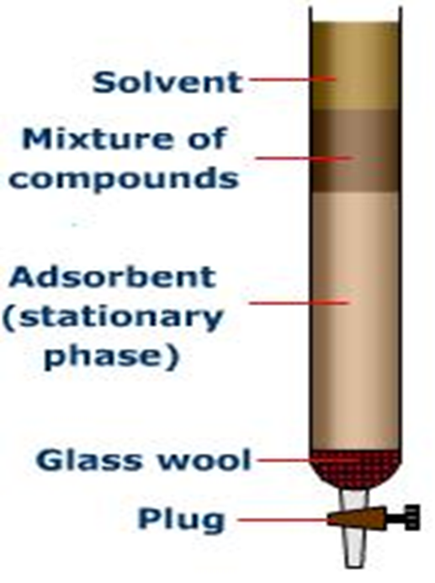


COLUMN CHROMATOGRAPHY
  Chromatography is the term used to describe a separation technique in which a mobile phase carrying a mixture is caused to move in contact with a selectively absorbent stationary phase.
  There are a number of different kinds of chromatography, which differ in the mobile and the stationary phase used.

Slide 4
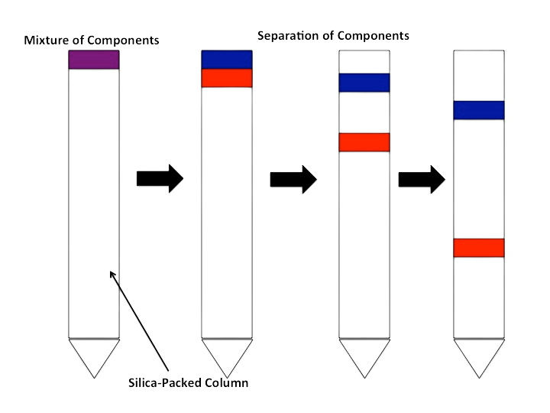
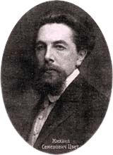
COLUMN CHROMATOGRAPHY
Column Chromatography was developed by the American chemist D.T Day in 1900, M.S. Tswett,the Polish botanist, in 1906 used adsorption columns in his investigations of plant pigments.

Slide 5
COLUMN CHROMATOGRAPHY
  Column chromatography is one of the most useful methods for the separation and purification of both solids and liquids.
  This is a solid - liquid technique in which the stationary phase is a solid & mobile phase is a liquid.
PRINCIPLE
  Adsorption
  Mixture of components dissolved in the M.P is introduced in to the column. Components moves depending upon their relative affinities.

Slide 6
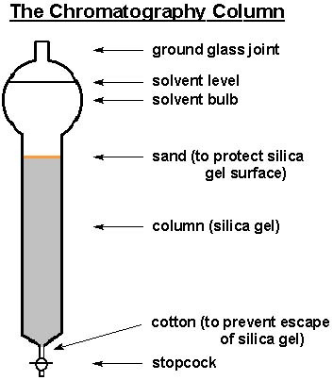
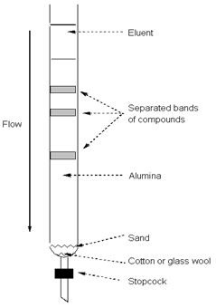
COLUMN CHROMATOGRAPHY
Adsorption column chromatography, the adsorbent, packed in a glass column, and a solvent, the mobile phase, that moves slowly through the packed column. A solvent used as a mobile phase is called an eluent.

Slide 7
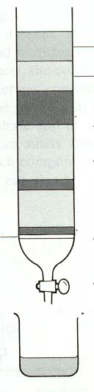
COLUMN CHROMATOGRAPHY
  A compound attracted more strongly by the mobile phase will move rapidly through the column, and elute from, or come off, the column dissolved in the eluent.
  In contrast, a compound more strongly attracted to the stationary phase will move slowly through the column.

Slide 8
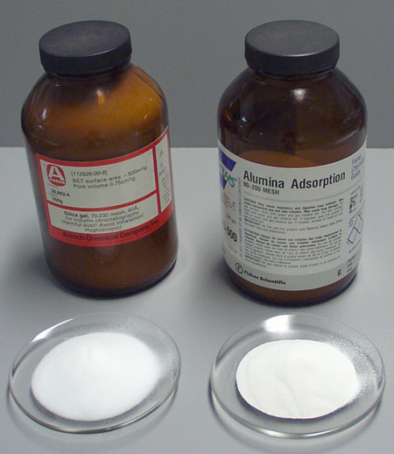
EXPERIMENTAL ASPECTS OF COLUMN CHROMATOGRAPHY
  Adsorbents: The usual adsorbents employed in column chromatography are silica, alumina, calcium carbonate, calcium phosphate, magnesia, starch, etc.,
  Alumina is generally suitable for chromatography of less polar compounds. Silica gel gives good results with compounds containing polar functional groups.

Slide 9
ADSORBENT IN C.C SHOULD MEET FOLLOWING CRITERIA
  Particles should be spherical in shape & uniform in size
  Mechanical stability must be high
  They shouldn’t react chemically
  It should be useful for separating for wide variety of compounds
  It should be freely available & inexpensive
(The particle size of the commercially available grade is in the range 50 – 200 µm.)

Slide 10
SELECTION OF STATIONARY PHASE
Success of chromatography depends upon proper selection of S.P, it depends on the following:
  Removal of impurities
  No. of components to be separated
  Length of the column used
  Affinity differences b/w components
  Quantity of adsorbent used

Slide 11
MOBILE PHASE
They act as solvent, developer & eluent. The function of a mobile phase are:
  As developing agent
  To introduce the mixture into the column – as solvent
  To developing agent
  To remove pure components out of the column – as eluent

Slide 12
  The choice of the solvent is depend on the solubility characteristics of the mixture. The solvents should also have sufficiently low boiling points to permit ready recovery of eluted material.
  However, polarity as seen the most important factor in adsorption chromatography.
Different mobile phases used: ( in increasing order of polarity)
  Petroleum ether, carbon tetrachloride, cyclohexane, ether, acetone, benzene, toluene, esters, water, etc
  It can b e used in either pure form or as mixture of solvents

Slide 13
THE LENGTH OF THE COLUMN DEPENDS UPON:
  Number of compounds to be separated
  Type of adsorbent used
  Quantity of the sample
  Affinity of compounds towards the adsorbent used
  Better separation will be obtained with a long narrow column than short thick column because number of plates will be more.

Slide 14
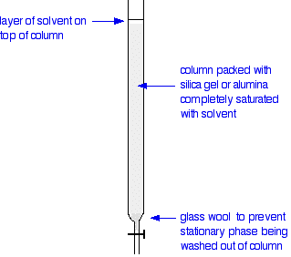
PREPARATION OF THE COLUMN
  It consists of a glass tube with bottom portion of the column – packed with glass wool/cotton wool or may contain asbestos pad,
» Above which adsorbent is packed
» After packing a paper disc kept on the top, so that the adsorbent layer is not disturbed
during the introduction of sample or mobile phase.

Slide 15
Packing techniques in C.C
  There are two types of preparing the column, they are:
i. Dry packing / dry filling
ii. Wet packing / wet filling
  The column should be free from impurity, before using column, it should be washed properly and dry it.
  Before filling column with stationary phase, cotton/glass wool is kept
  It should be uniformly filled

Slide 16
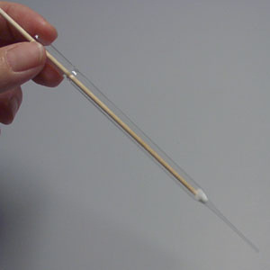
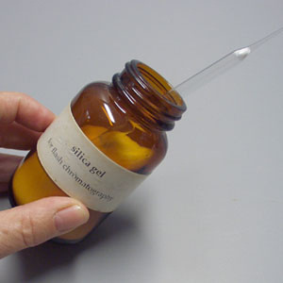
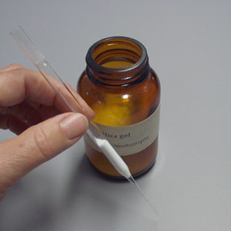
DRY PACKING TECHNIQUE
  Adsorbent is packed in the column in dry form
  Fill the solvent, till equilibrium is reached
  DEMERIT: Air bubbles are entrapped b/w M.P & S.P→ cracks appear in the adsorbent layer.
  After filling tapping can be done to remove void spaces.

Slide 17
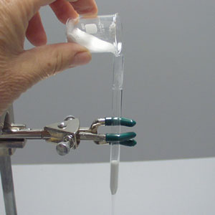
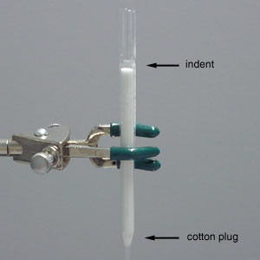
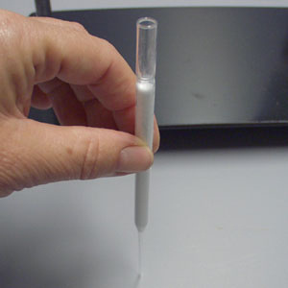

Slide 18
WET PACKING TECHNIQUE
◊ Ideal & common technique
» The material is slurred with solvent and generally added to the column in portions.
◊ S.P settles uniformly & no crack in the column of adsorbent.
» solid settle down while the solvent remain upward.
» this solvent is removed then again cotton plug is placed.

Slide 19
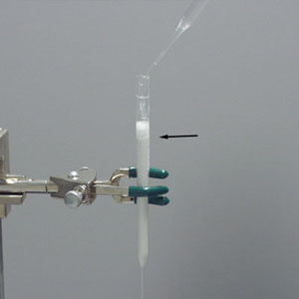
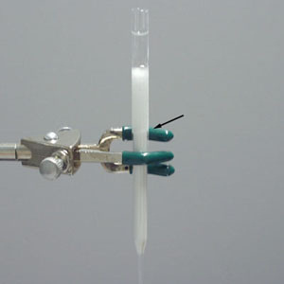
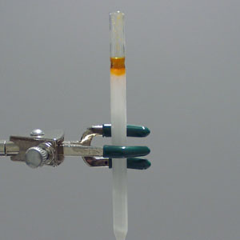
Introduction of the Sample
  The sample which is usually a mixture of components is dissolved in minimum quantity of the mobile phase.
  The entire sample is introduced into the column at once and get adsorbed on the top portion of the column.
  From this zone, individual sample can be separated by a process of elution.

Slide 20
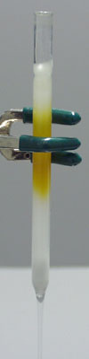
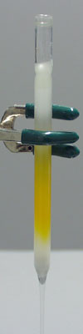
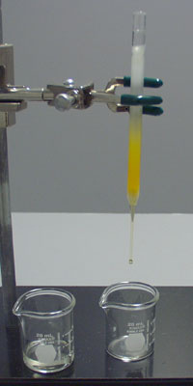
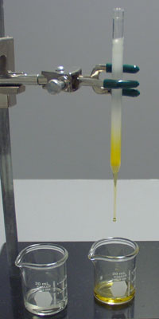

Slide 21
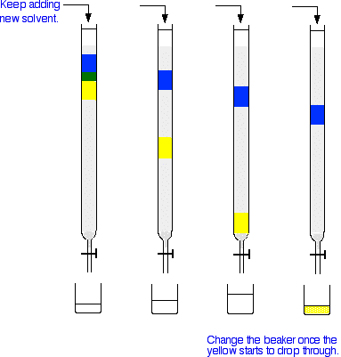

Slide 22
DEVELOPMENT TECHNIQUE ( ELUTION)
By elution technique, the individual components are separated out from the column. The two techniques are:
(i) Isocratic elution technique : in this elution technique , same solvent composition or
solvent of same polarity is used throughout the process of separation.
Example: chloroform only

Slide 23
GRADIENT ELUTION TECHNIQUES
( gradient – gradually)
  Solvents of gradually ↑ polarity or ↑ elution strength are used during the process of separation.
  E.g. initially benzene, then chloroform, then ethyl acetate then chloroform

Slide 24
DETECTION OF COMPONENTS
  If the compounds separated in a column chromatography procedure are colored, the progress of the separation can simply be monitored visually.
  If the compounds to be isolated from column chromatography are colorless. In this case, small fractions of the eluent are collected sequentially in labelled tubes and the composition of each fraction is analyzed by TLC.

Slide 25
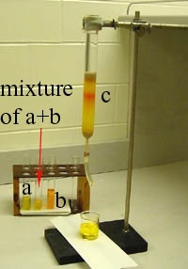
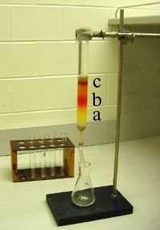
  Eluting the sample: Components a, b, and c separate as column progresses.
  Fractions can be collected in test tubes, vials, beakers, or Erlenmeyer flasks.

Slide 26
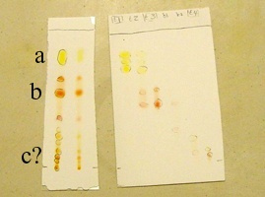
ANALYZING THE FRACTIONS
Analyze the fractions by thin-layer chromatography

Slide 27
FACTORS AFFECTING COLUMN EFFICIENCY
  Dimension of the column: column efficiency has been improved by increasing length/width ratio of the column.
  Particle size of column packing: separation to be improved by decreasing the particle size of the adsorbent.
  Activity of the adsorbent
  Temperature of the column: The speed of the elution increases at higher temperatures.
  Packing of the column
  Quality of solvents: solvents having low viscosities is giving better results.

Slide 28
APPLICATIONS
  Separation of mixture of compounds
  Purification process
  Isolation of active constituents
  Estimation of drugs in formulation
  solation of active constituents
  Determination of primary and secondary glycosides in digitalis leaf.
  Separation of diastereomers

Slide 29
ADVANTAGES OF C.C
  Any type of mixture can be separated
  Any quantity of mixture can be separated
  Wider choice of Mobile Phase
  Automation is possible

Slide 30
DISADVANTAGES OF C.C
  Time consuming
  more amount of Mobile Phase are required
  Automation makes the techniques more complicated & expensive

Slide 31
WRITER :-
WEBSITE :-
MOBILE NUMBER :-
MR. ANIKET BHARDWAJ
ABCCHEMISTRY.COM
9212142424
EDITOR :-
DESIGNER :-
MRS. ABHILASHA BHARDWAJ
MRS. SHWETA THAKUR

