Slide 1



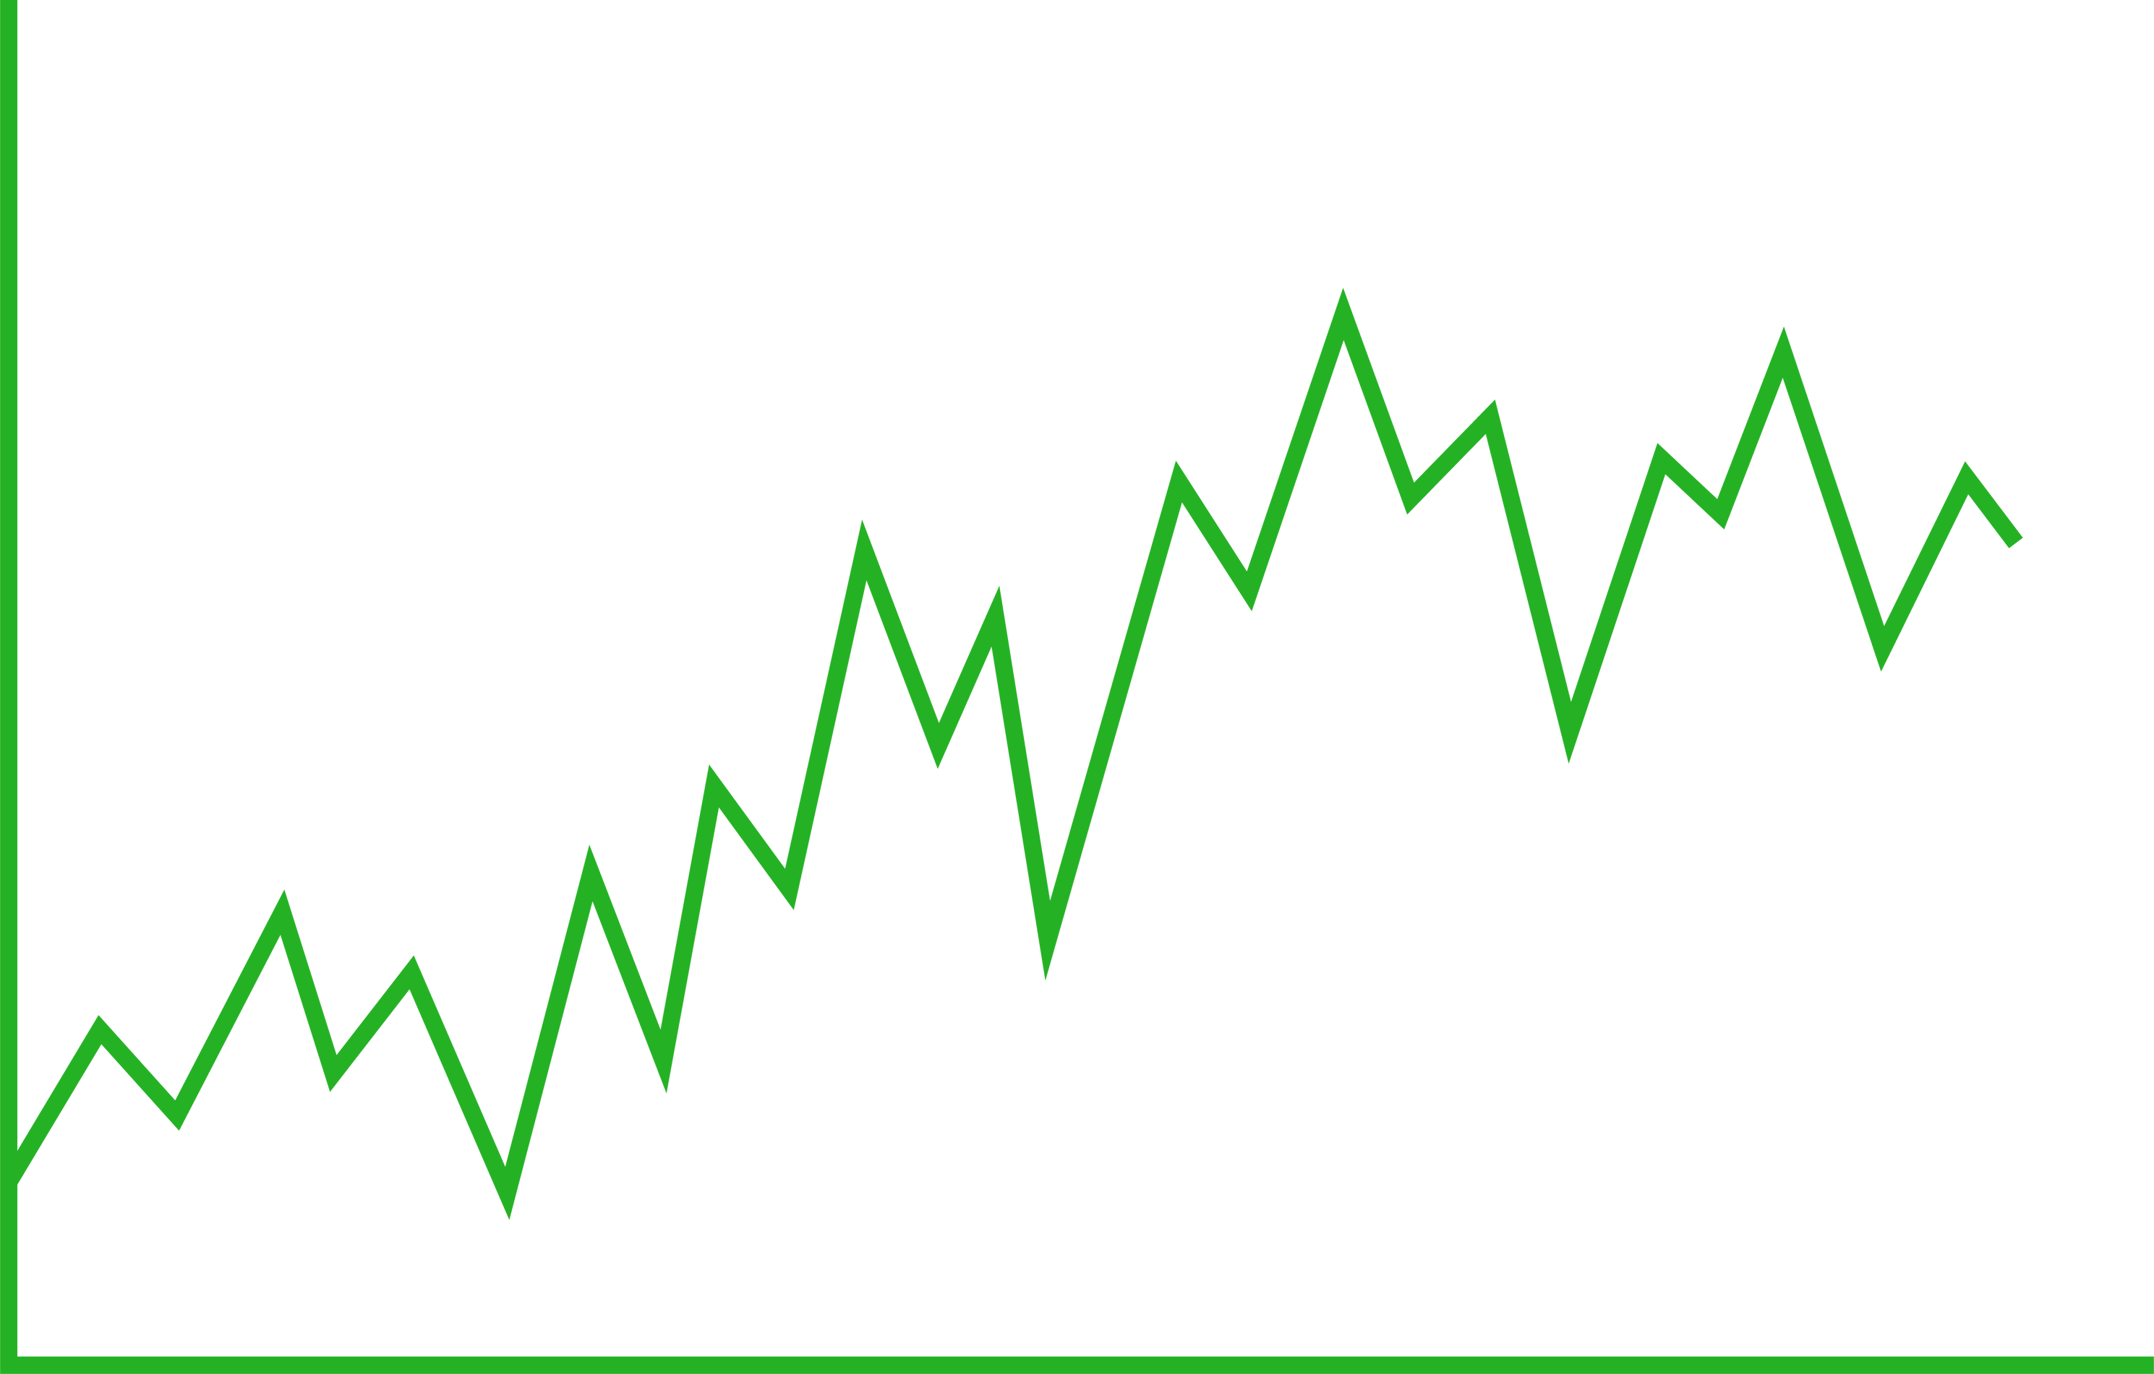







COURSE WORK
Crystal Field Theory (CFT)
WRITTEN BY
MR. ANIKET BHARDWAJ
Version : 1.00
Last UpdateD : 31-01-2025
Scan this for
PDF | PPT
of this Presentation
DWARKA, NEW DELHI, INDIA
Www.AniketBhardwaj.Com
Visit Inventor Profile
9212149491

Slide 2

UNIT - 5 | PAPER - 2
CRYSTAL FIELD THEORY (CFT)

Slide 3



THEORIES FOR METAL - LIGAND BONDING IN COMPLEXES
There are three theories to explain the nature of bonding in transition metal complexes
  Valence Bond Theory (VBT)
  Crystal Field Theory (CFT)
  Ligand Field Theory (LFT) or Molecular Orbital Theory (MOT)

Slide 4

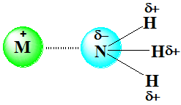
CRYSTAL FIELD THEORY (CFT)
  Considers the bond between metal and ligand is ionic arising purely due to electrostatic interaction. Hence the theory is called as crystal field theory.
  If the ligand is anion then the metal has to be a cation and the force of attraction is due to opposite charges.
  If the ligand is neutral molecules like H2O, NH3 etc then the negative end of their dipoles are attached to the metal ion.
  Considers each ligands as point of negative charges.
  Metal – Ligand bond is not covalent i.e. there is no overlapping of orbitals.

Slide 5
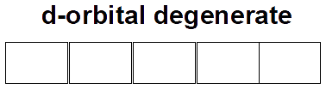
The five d-orbitals in a free metal ion are degenerate i.e. same energy. When a complex is formed, the electrostatic field of the ligands destroy the degeneracy of these orbitals i.e. these orbitals now have different energies.

Slide 6
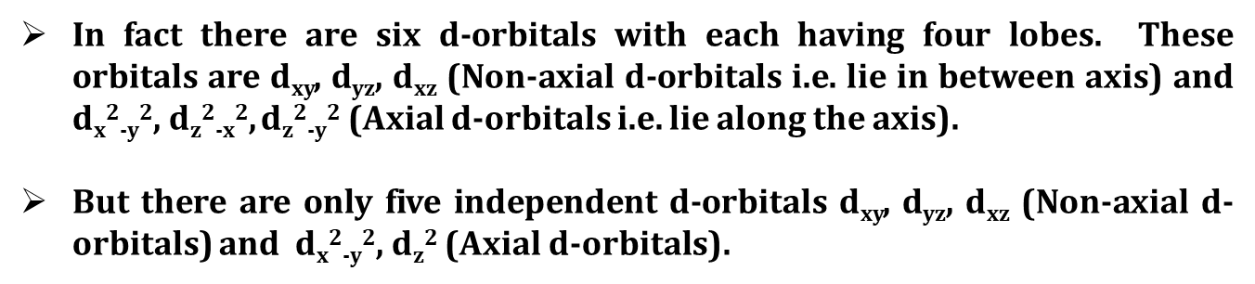
SHAPES OF D-ORBITALS

Slide 7
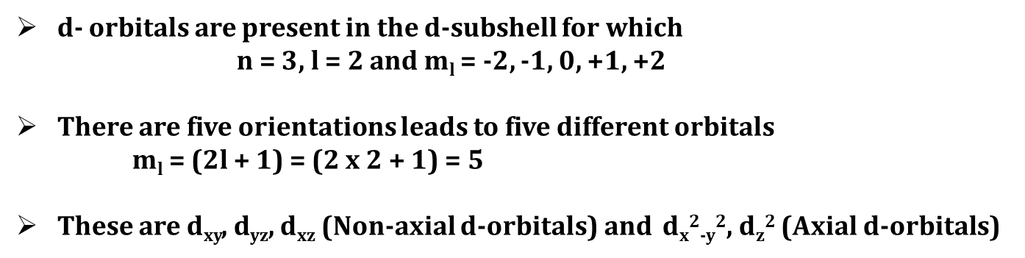
SHAPES OF D-ORBITALS

Slide 8
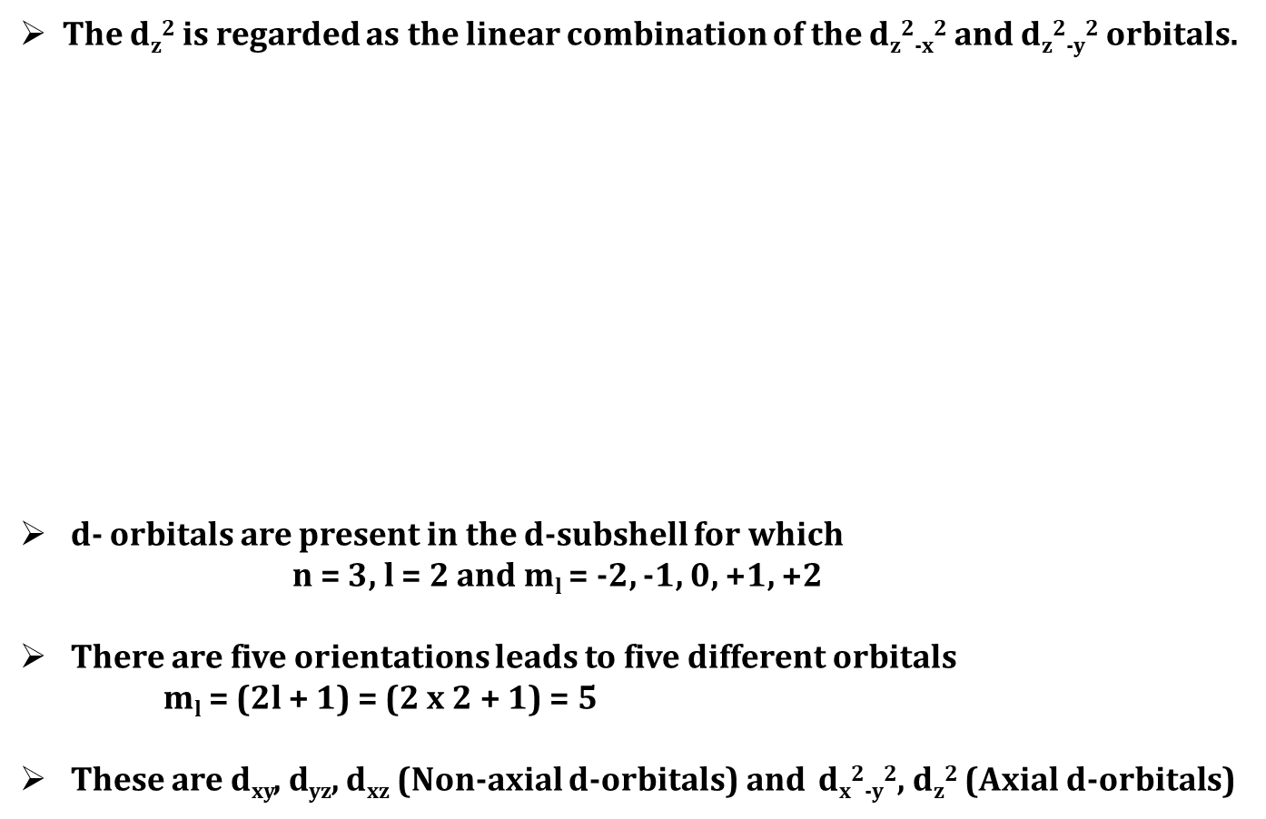
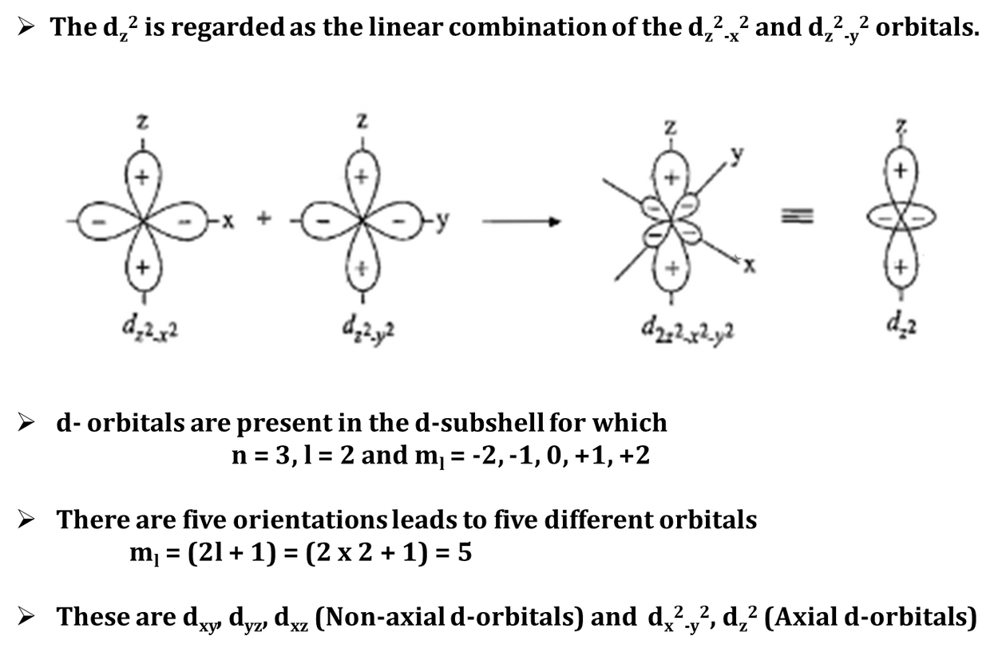

Slide 9
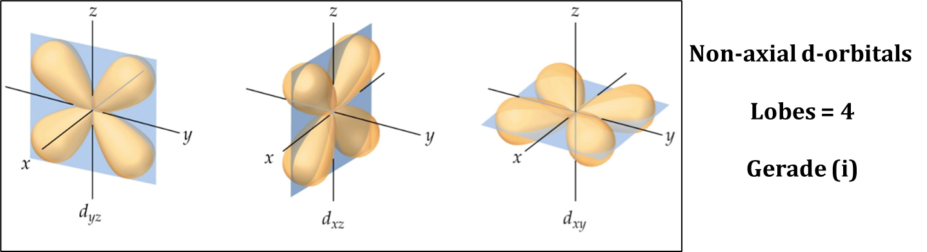
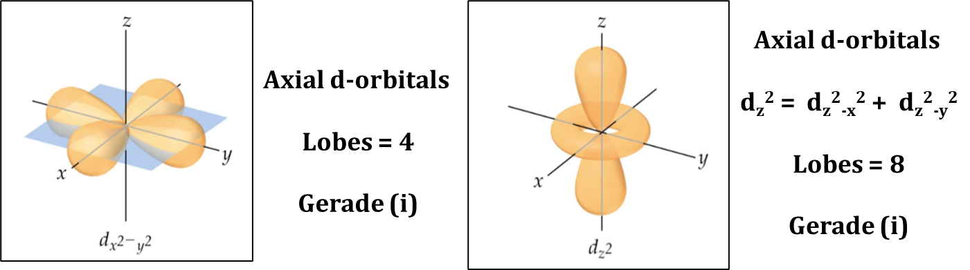

Slide 10
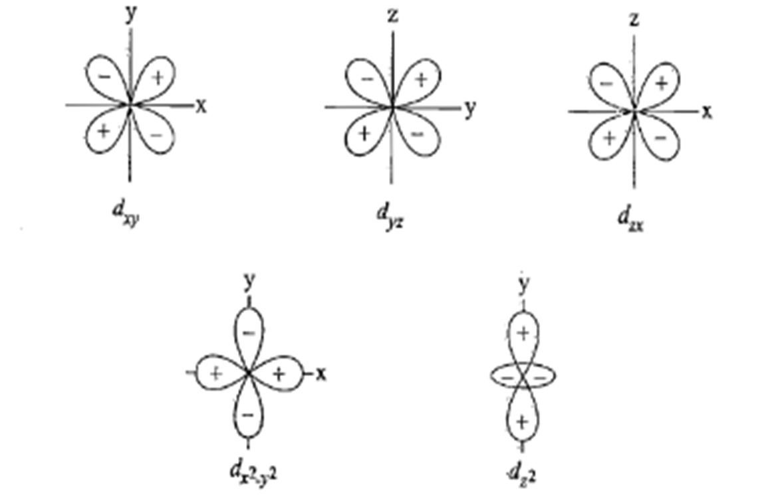
All the five d-orbitals are gerade because the opposite lobes have inversion centre (centre of inversion) with respect to phase of wave functions.

Slide 11
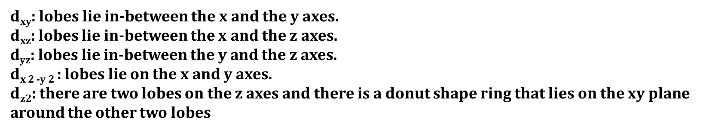
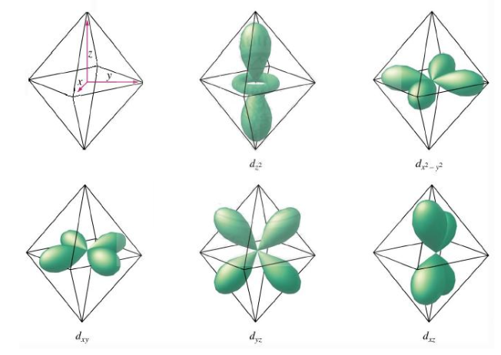

Slide 12
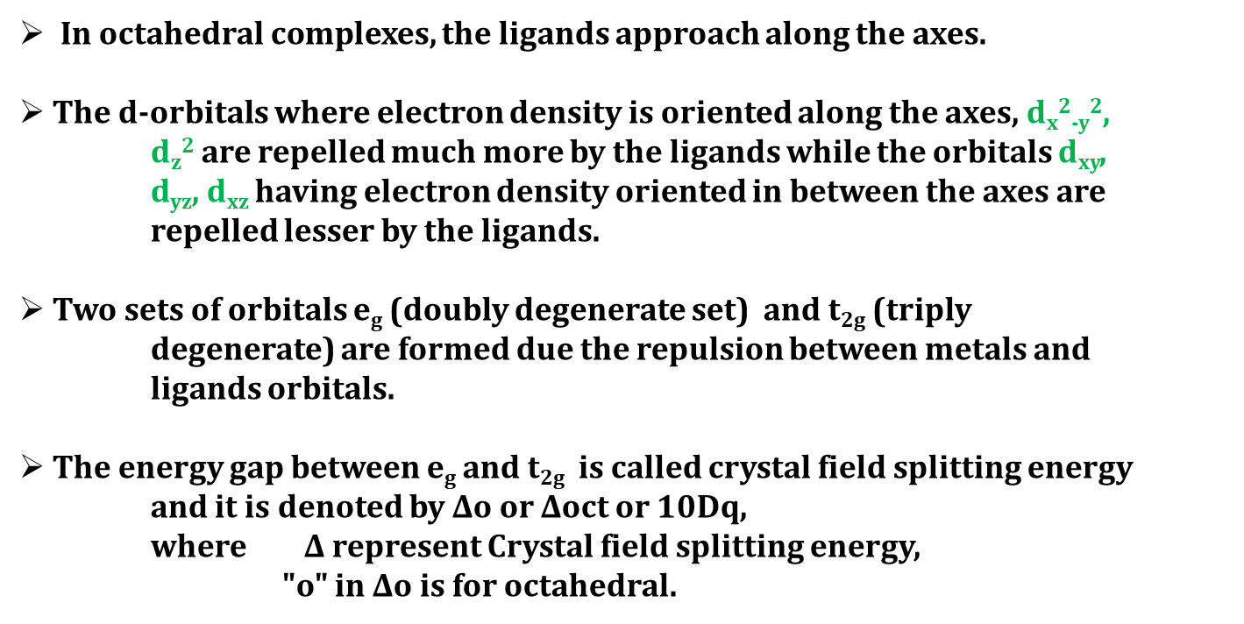

CRYSTAL FIELD SPLITTING D-ORBITALS IN OCTAHEDRAL COMPLEX

Slide 13
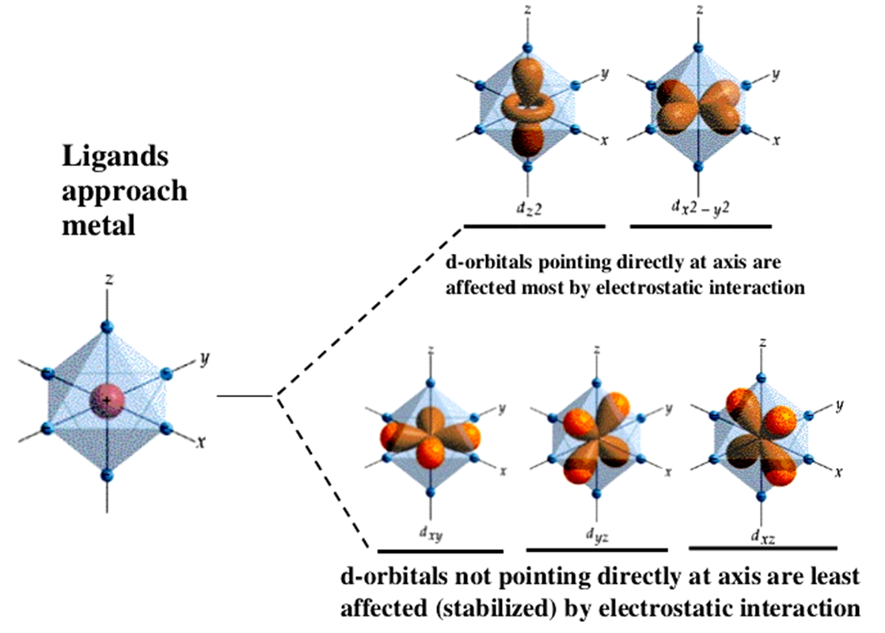
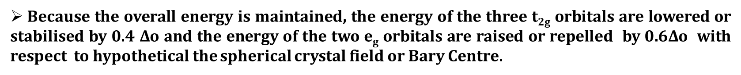

Slide 14
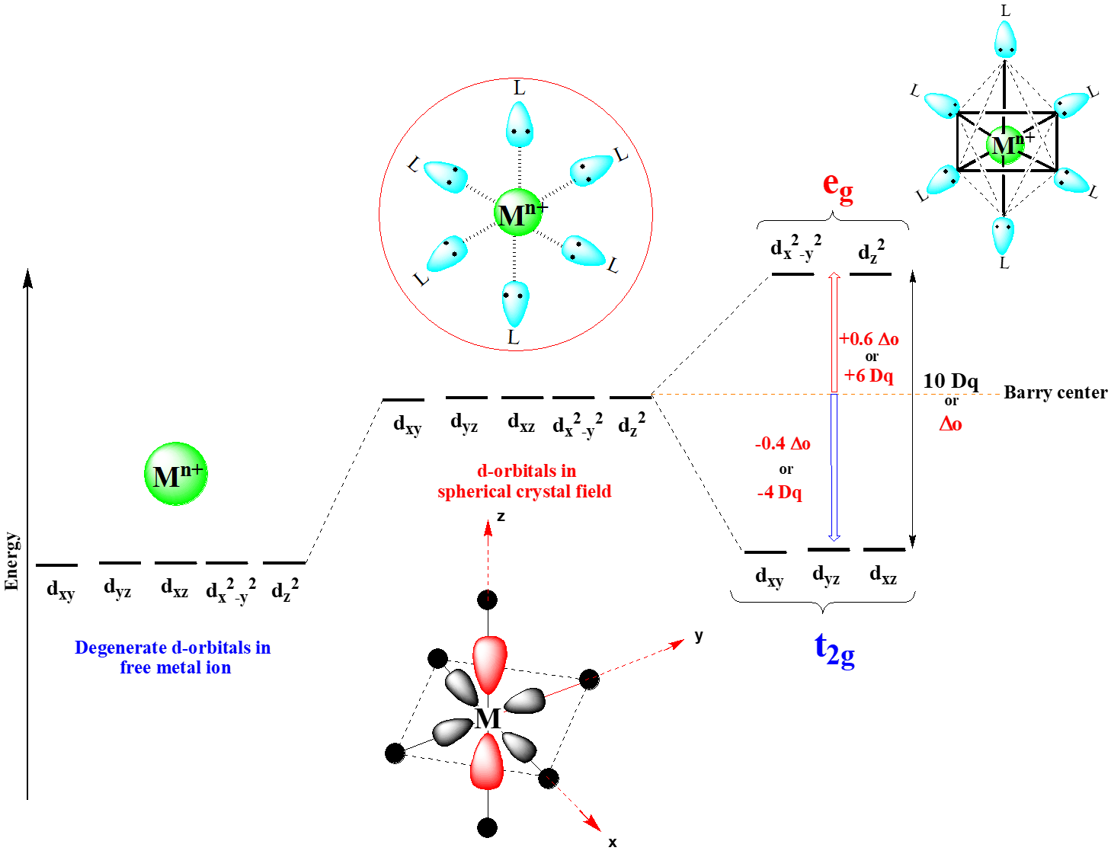

Slide 15
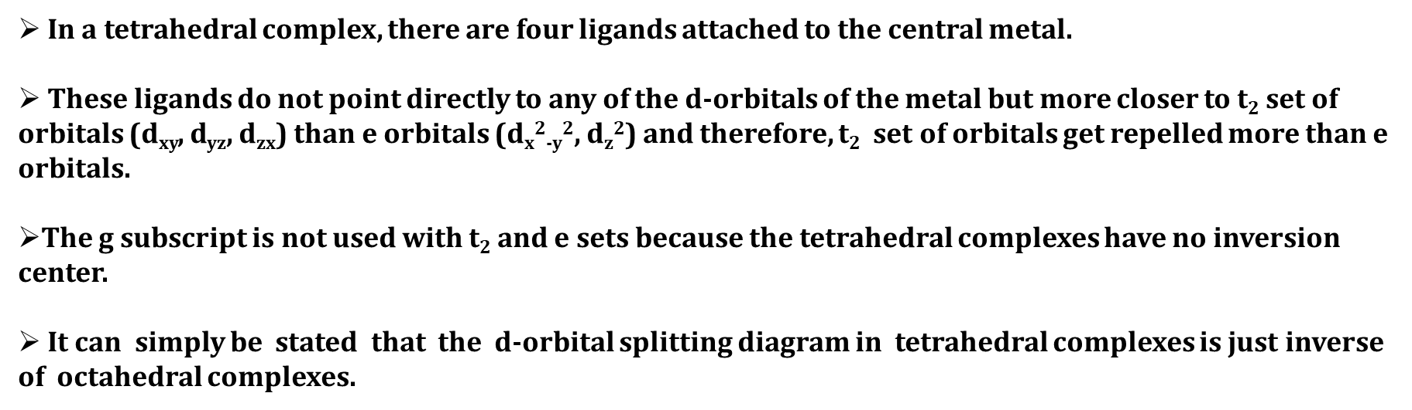
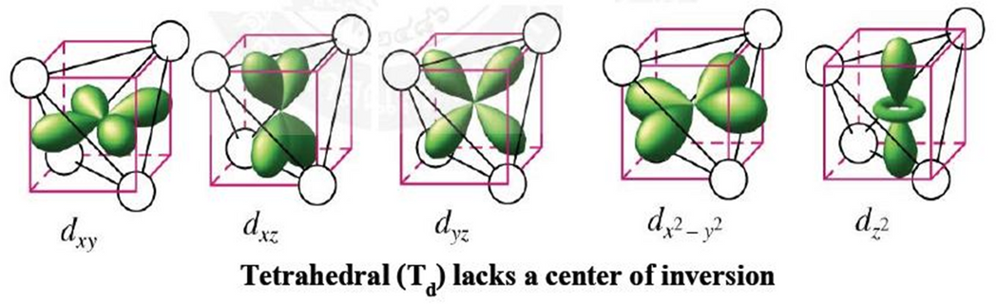
CRYSTAL FIELD SPLITTING D-ORBITALS IN OCTAHEDRAL COMPLEX

Slide 16
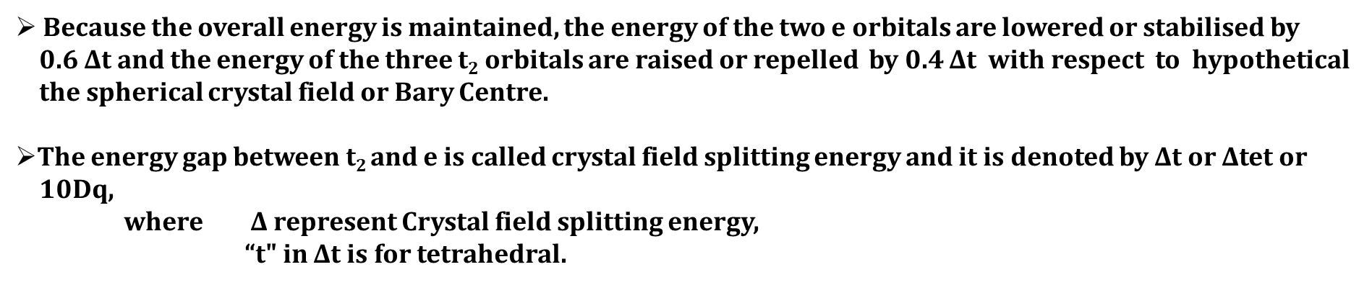
CRYSTAL FIELD SPLITTING D-ORBITALS IN OCTAHEDRAL COMPLEX

Slide 17
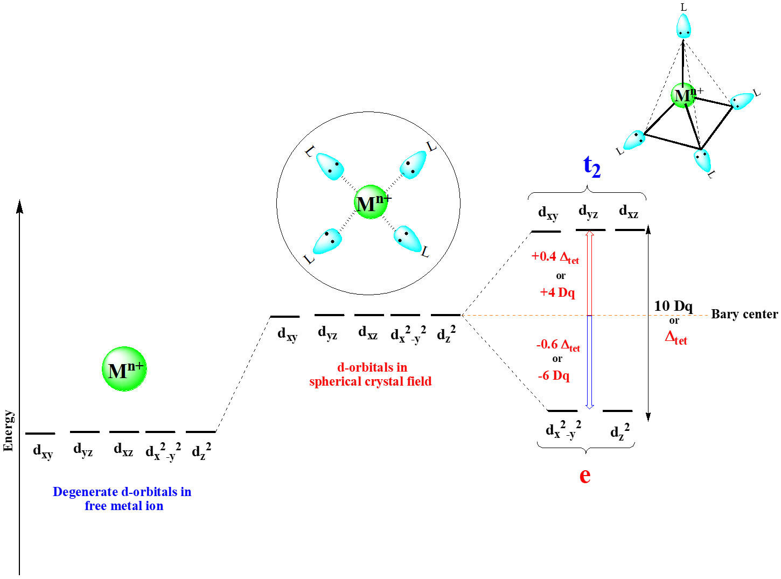

Slide 18
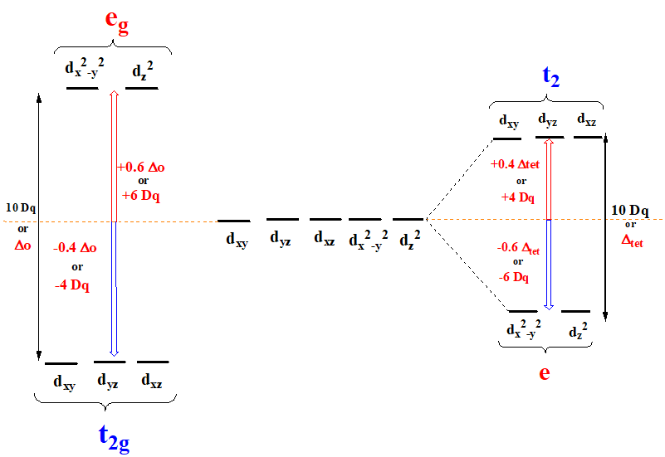
COMPARISON OF CRYSTAL FIELD SPLITTING OF D-ORBITALS IN
Octahedral and Tetrahedral complex

Slide 19
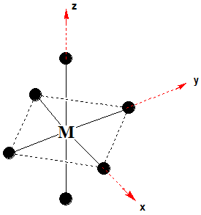
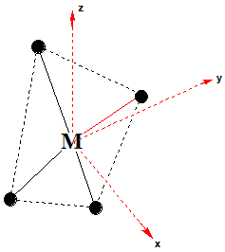
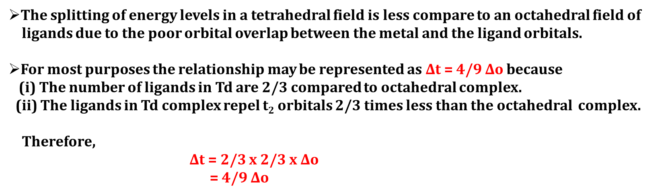

Slide 20
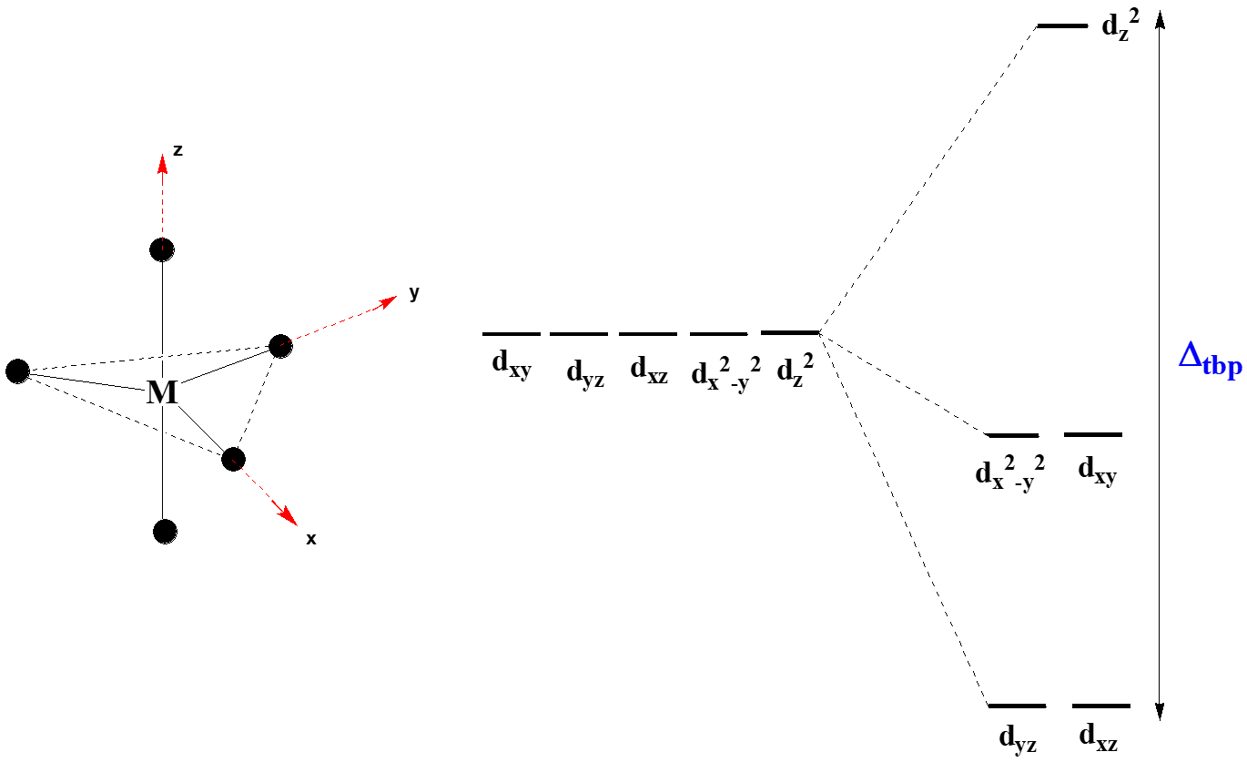
CRYSTAL FIELD SPLITTING OF D-ORBITALS IN TRIGONAL BIPYRAMIDAL COMPLEX

Slide 21
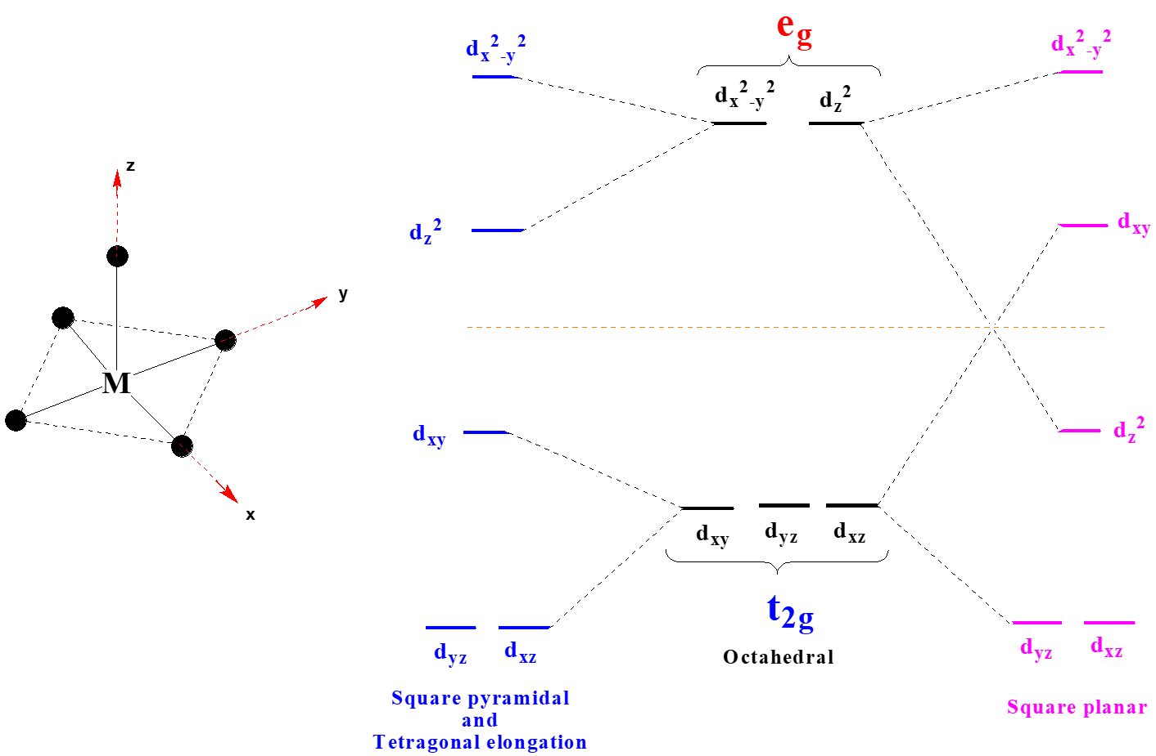
CRYSTAL FIELD SPLITTING OF D-ORBITALS IN SQUARE
PYRAMIDAL COMPLEX

Slide 22
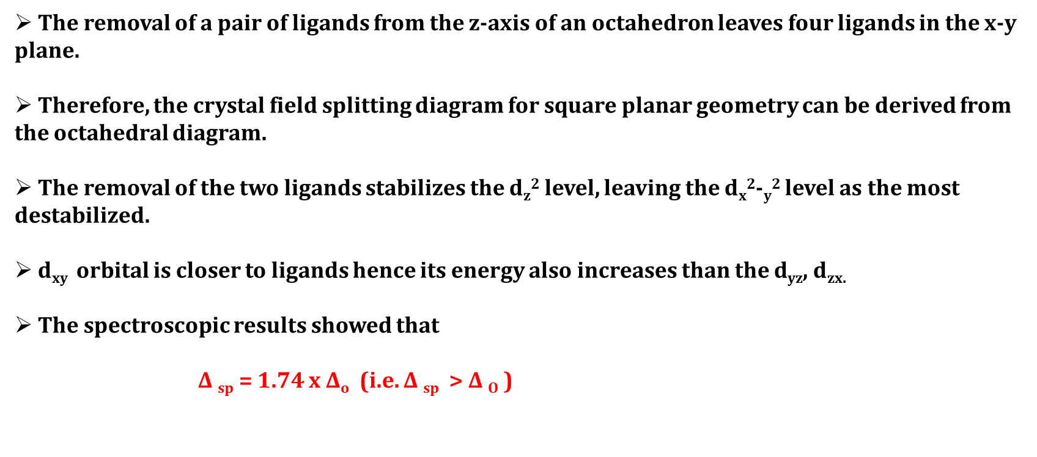
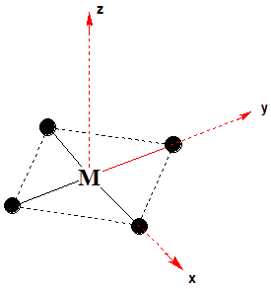
CRYSTAL FIELD SPLITTING OF D-ORBITALS IN SQUARE PLANAR COMPLEX

Slide 23
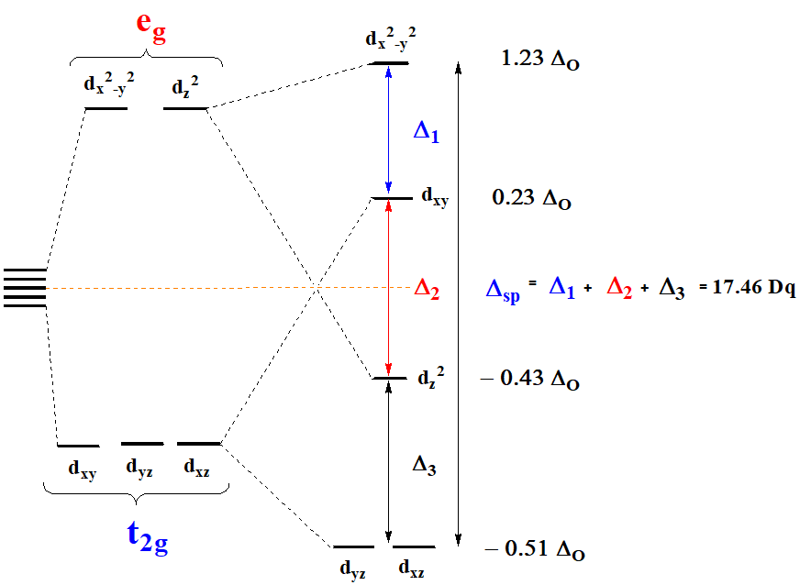

Slide 24
MAGNITUDE OF CFSE (Δ) WILL DEPEND ON :
Number of factors that affect the extent to which metal d-orbitals are split by ligands. The most important factors are listed below
Metal factors Ligand factors
(1) Oxidation state
(2) Number of d-electrons
(3) Nature of metal ion
(4) Spin pairing energy
(1) Ligand character
(2) Number and Geometry of the Ligands

Slide 25
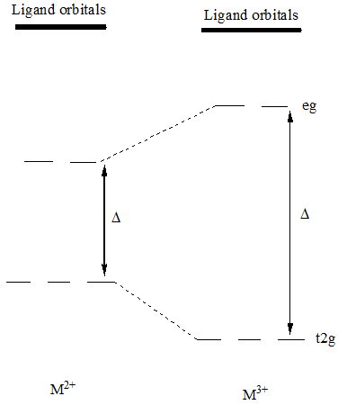
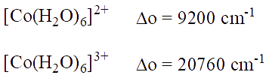
1 OXIDATION STATE
Higher the oxidation state of metal ion causes the ligands to approach more closely to it and therefore, the ligands causes more splitting of metal d-orbitals.

Slide 26


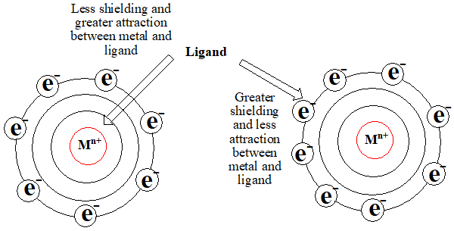
2. NUMBER OF D-ELECTRONS
For a given series of transition metal, complexes having metal cation with same oxidation state but with different number of electrons in d-orbitals, the magnitude of ∆ decreases with increase in number of d-electrons.

Slide 27
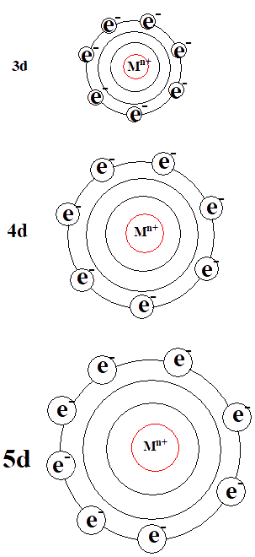
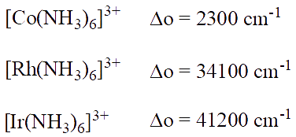
3. NATURE OF METAL ION
In complexes having the metal cation with same oxidation state, same number of d-electrons and the magnitude ∆ for analogues complexes within a given group increases about 30% to 50% from 3d to 4d and same amount from 4d to 5d.
(i) On moving 3d to 4d and 4d to 5d, the size of d-orbitalsincreases and electron density decreases therefore, ligands can approach metal with larger d-orbital more closely.
(ii) There is less steric hindrance around metal.

Slide 28
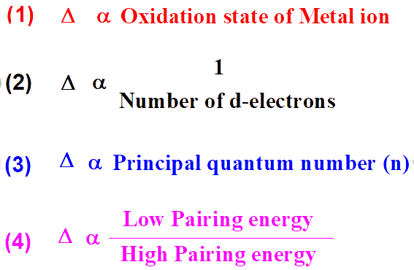
4. SPIN PAIRING ENERGY
Metal ion with higher pairing energy will have lower ∆, whereas metal ion with lower pairing energy will have higher ∆.
Metal factor summary affecting magnitude of CFSE (∆)

Slide 29

SPIN PAIRING ENERGY (P)
Energy required to put two electrons in the same orbital
The electron pairing energy has two terms
  Coulombic repulsion
  Loss of exchange energy on pairing
  Coulombic repulsion is caused by repulsion of electrons and it decreases down the group.
3d > 4d > 5d
Coulombic repulsion contribute to the destabilizing energy

Slide 30
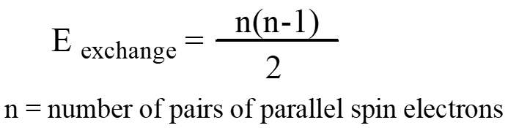
SPIN PAIRING ENERGY (P)
(2) Loss of exchange energy on pairing contributes to the stabilizing energy associated with two electrons having parallel spin.
Mathematically, exchange energy can be calculated using the following equation
How to calculate the loss of exchange energy for metal ion.

Slide 31
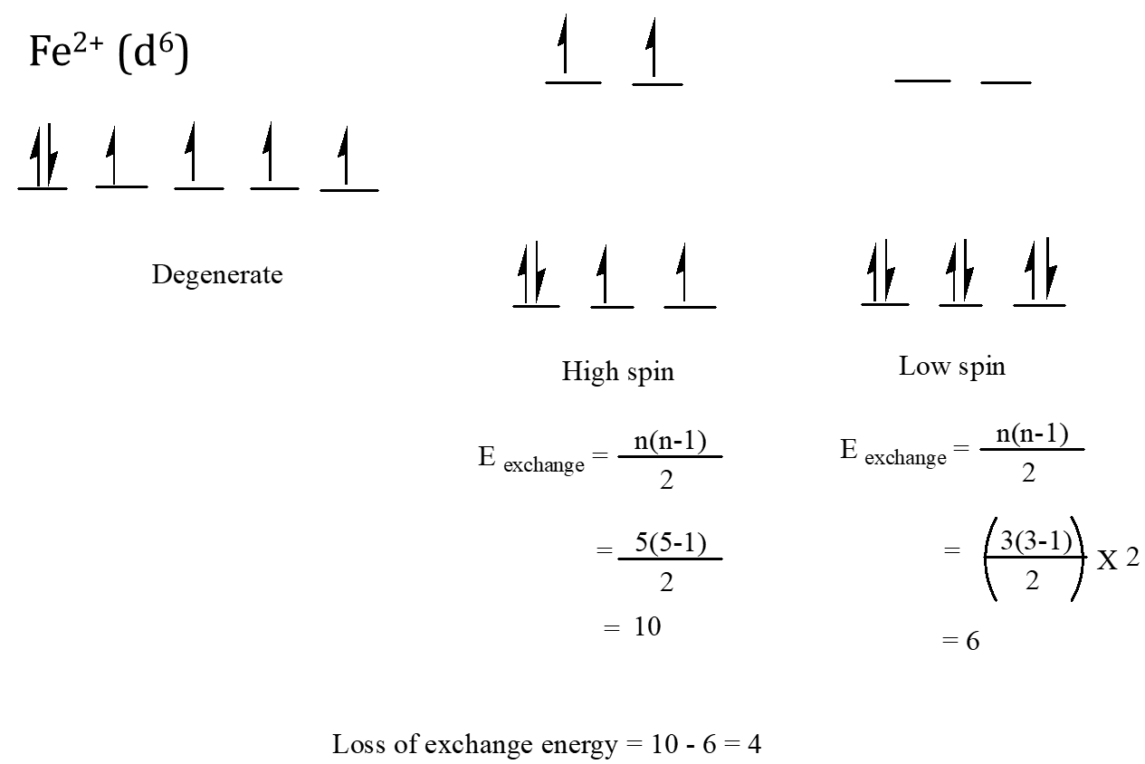

Slide 32
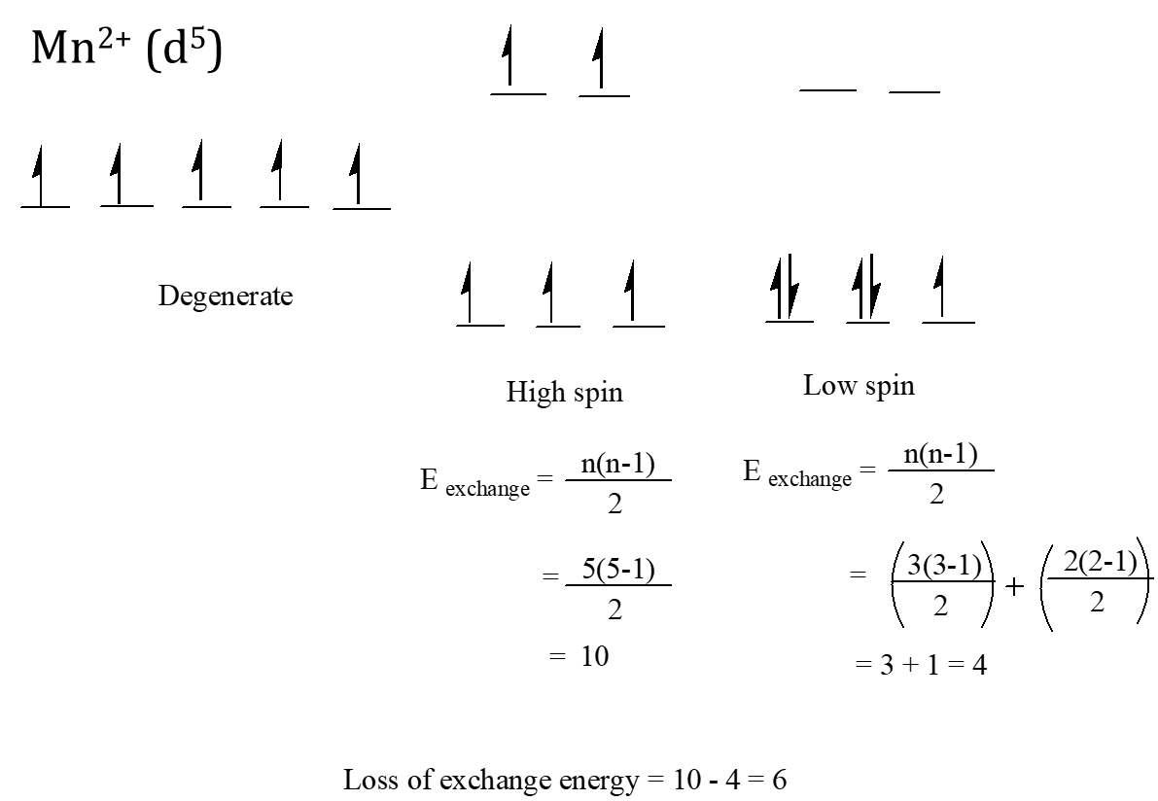

Slide 33
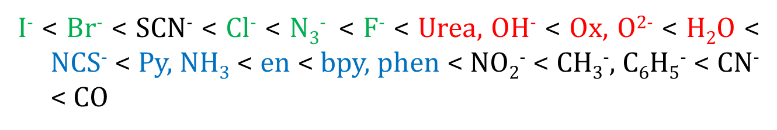
1. LIGAND CHARACTER
The ligands are classified as weak and strong field ligands.
Ligand which cause a small degree of splitting of d-orbital are called weak field ligands.
Ligand which cause large splitting of d-orbital are called strong field ligands.
The common ligands have been arranged in order of their increasing crystal field splitting power to cause splitting of d-orbitals from study of their effects on spectra of transition metal ions. This order usually called as Spectrochemical series.
X = Weak field
O = Middle
N = Strong
C = Very strong

Slide 34
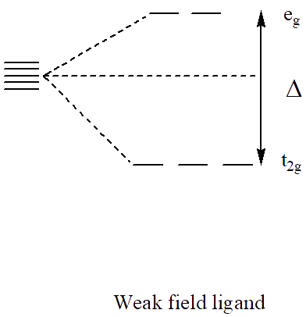
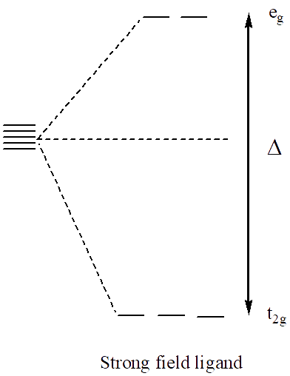

Slide 35

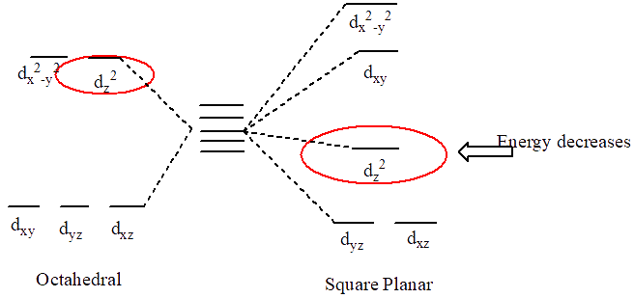
NUMBER AND GEOMETRY OF THE LIGANDS
The magnitude of crystal field splitting increases with increase of the number of ligands. Hence, the crystal field splitting will follow the order
Though the number of ligands in square planar complex is smaller than octahedral, the magnitude of splitting is greater for square planar than octahedral because of the fact that square planar complex are formed by much strong ligands and also the two electrons in dz2 orbital are stabilized.

Slide 36
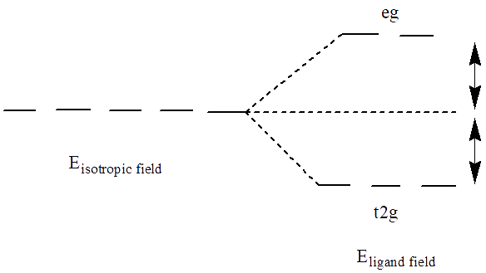
CRYSTAL FIELD STABILIZATION ENERGY
Crystal Field Stabilization Energy is defined as the difference in the energy of the electron configuration in the ligand field to the energy of the electronic configuration in the isotropic field.

Slide 37
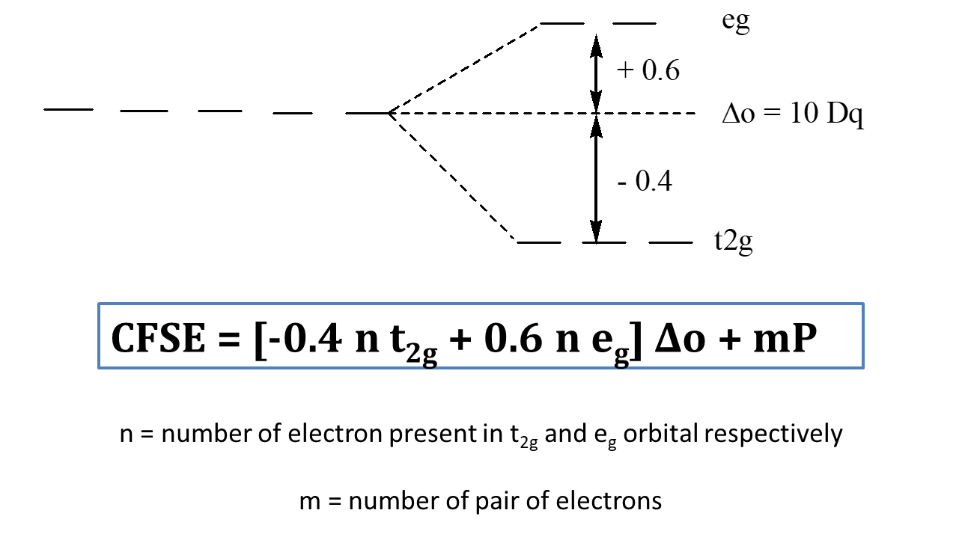
CRYSTAL FIELD STABILIZATION ENERGY OF OCTAHEDRAL COMPLEXES WILL BE CALCULATED
using

Slide 38
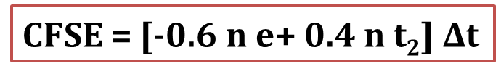
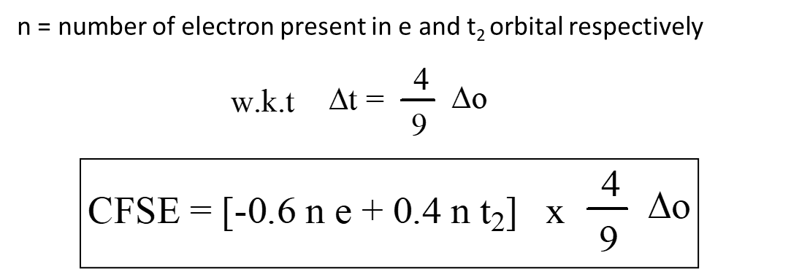
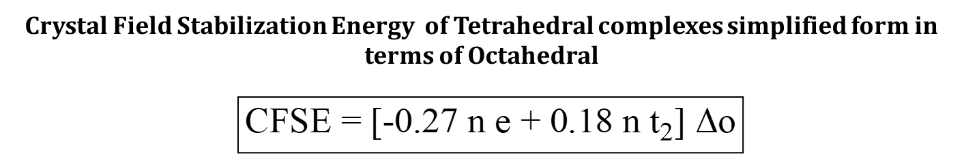
CRYSTAL FIELD STABILIZATION ENERGY OF TETRAHEDRAL COMPLEXES WILL BE CALCULATED using

Slide 39
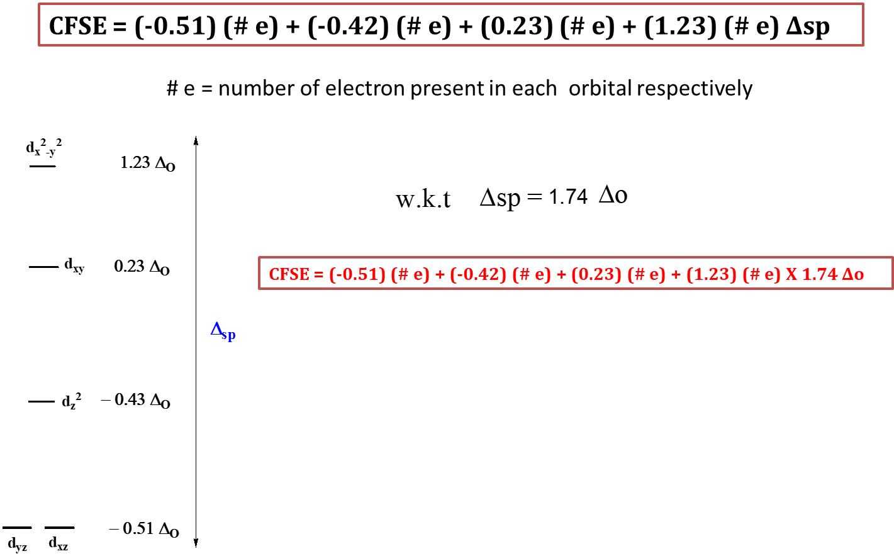
CRYSTAL FIELD STABILIZATION ENERGY OF SQUARE PLANAR COMPLEXES WILL BE CALCULATED using

Slide 40
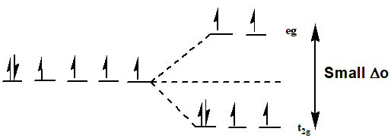
DISTRIBUTION OF D-ELECTRONS IN OCTAHEDRAL COMPLEX
The distribution of d-electrons in t2g and eg orbitals takes place according to Hund’s rule of maximum multiplicity i.e. pairing of electrons will occur only when each of five orbital is singly filled.
The complex having small value of ∆o, no pairing of electrons will takes place i.e. Arrangement of d-electron remains as in free metal ion.

Slide 41
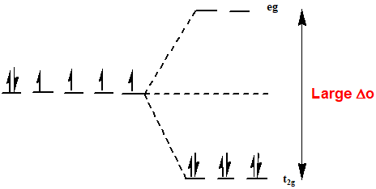
The complex having high value of ∆o,the distribution of electrons does not obey Hund’s rule.

Slide 42

WEAK FIELD OR HIGH SPIN OR SPIN FREE COMPLEXES
In weak field octahedral complex the value of ∆o small and no pairing of d-electrons. These complexes have maximum number of unpaired electrons are called high spin or spin free complexes.

Slide 43

STRONG FIELD OR LOW SPIN OR SPIN PAIRED COMPLEXES
In strong field octahedral complex the value of ∆o is large and pairing of d-electrons. These complexes have maximum number of paired electrons are called low spin or spin paired complexes.

Slide 44



Slide 45


Slide 46


Slide 47
PAIRING ENERGY
IF ∆O > P, FAVORS LOW SPIN COMPLEXES
IF ∆O < P, FAVORS HIGH SPIN COMPLEXES
IF ∆O = P, HIGH AND LOW SPIN COMPLEXES EQUALLY EXISTS

Slide 48




Slide 49
FOR COMPLEXES THE HIGH SPIN AND LOW SPIN WILL BE DECIDED ON THE BASIS OF LIGAND FIELD STRENGTH
For Weak field ligands pairing energy will not be considered with CFSE
Whereas for strong field ligands pairing energy will be considered along with CFSE

Slide 50



Slide 51






Slide 52




Slide 53




TETRAGONAL DISTORTION OR JAHN-TELLER DISTORTION

Slide 54

JAHN-TELLER DISTORTION THEOREM
States that any non linear molecule in an electronically degenerate state is unstable and the molecule becomes distorted in such a way as to remove degeneracy, lower its symmetry and the energy.
Order of Jahn-Teller distortion
Practically, distortion in the regular octahedral geometry is observed when eg orbitals which point directly at ligands, are asymmetrically filled.
The t2g orbitals do not point directly at ligands, asymmetrical filling of electrons in them does not give any observable distortion.

Slide 55


Slide 56


CONFIGURATIONS SHOWING WEAK JAHN-TELLER DISTORTION

Slide 57


Z-OUT & Z-IN JAHN-TELLER DISTORTION
The degeneracy of orbitals can be removed by lowering the symmetry of molecule. This can be achieved by either elongation of bonds along the z-axis (Z-out distortion) or by shortening the bonds along the z-axis (Z-in distortion). Thus an octahedrally symmetrical molecule is distorted to tetragonal geometry.
Z-out Jahn-Teller distortion: In this case, the energies of d-orbitals with z factor are lowered since the bonds along the z-axis are elongated. This is the most preferred distortion and occurs in most of the cases, especially when the degeneracy occurs in eg level.
Z-out distortion or Tetragonal elongation

Slide 58

Z-in Jahn-Teller distortion: In this case the energies of orbitals with z factor are increased since the bonds along the z-axis are shortened.
Z-in distortion or Tetragonal elongation

Slide 59


Slide 60

STATIC & DYNAMIC JAHN-TELLER DISTORTIONS
Static Jahn-Teller distortion: Some molecules show tetragonal shape under all conditions i.e., in solid state and in solution state; at lower and relatively higher temperatures. This is referred to as static Jahn-Teller distortion. It is observed when the degeneracy occurs in orbitals. Hence, the distortion is strong and permanent.
Dynamic Jahn-Teller distortion: In some molecules, the distortion is not seen either due to random movements of bonds or else the distortion is so weak. However, the distortion can be seen by freezing the molecule at lower temperatures. This condition is referred to as dynamic Jahn-Teller distortion.
For example, complex ion shows dynamic Jahn-Teller distortion and appears octahedral. In this case, the distortion is small since the degeneracy occurs in orbitals.
Fe2+ in the above complex is a high spin system with configuration.

Slide 61


Slide 62


Slide 63

CONSEQUENCES OF JAHN-TELLER DISTORTIONS

Slide 64


Slide 65



Slide 66



Slide 67

3) Splitting of absorption bands in the electronic spectra of complexes due to Jahn-Teller distortion.

Slide 68
4) Disproportionation of Au (II) salts
Au (II) ion is less stable and undergoes disproportionation to Au (I) & Au (III) even though Cu (II) & Ag (II) are comparatively stable.
One may expect same stability since all are d9 system & undergoes Jahn-Teller distortion.
However, the ∆ value increases down the group. Hence, Au (II) ion reaches maximum and causes high destabilization of last electron in dx2-y2 .
Therefore,
Au (II) either undergo
oxidation to Au (III) – d8 system
(or) reduction to Au (I)- d10 system.

Slide 69


Slide 70


COLOROF TRANSITION METAL COMPLEX AND CFT
Colors exhibited by transition-metal complexes are caused by excitation of an electron from a lower-energy d orbital to a higher-energy d orbital, which is called a d–d transition. For a photon to effect such a transition, its energy must be equal to the difference in energy between the two d orbitals, which depends on the magnitude of Δo.

Slide 71

COLOR DEPENDS ON OXIDATION STATE
Different oxidation states of one metal can produce different colors

Slide 72

COLOR DEPENDS ON LIGAND FIELD
The specific ligands coordinated to the metal center also influence the color of coordination complexes. Because the energy of a photon of light is inversely proportional to its wavelength, the color of a complex depends on the magnitude of Δo.
Increasing ligand field strength

Slide 73



SELECTION RULE
1. Laporte Selection Rule
2. Spin Selection Rule

Slide 74
CLASSIFICATION OF INTENSITIES OF ELECTRONIC TRANSITIONS
Transition type | Example | Typical values of ε /dm3cm-1mol-1
Spin forbidden, Laporte forbidden (partly allowed by spin–orbit coupling) | [Mn(H2O)6]2+ | < 1
Spin allowed (octahedral complex), LaportE forbidden (partly allowed by vibronic coupling and d-p mixing) | [Co(H2O)6]2+ | 1 - 10
Spin allowed (tetrahedral complex), Laporte allowed (but still retain some original character) | [CoCl4]2- | 10 - 1000
Spin allowed, Laporte allowed e.g. charge transfer bands | KMnO4 | 1000 - 50000

Slide 75


Slide 76


Slide 77


MAGNETIC PROPERTIES OF METAL COMPLEXES BY CFT
Magnetism is caused by moving charged electrical particles (Faraday, 1830s). These particles can be the current of electrons through an electric wire, or the movement of charged particles (protons and electrons) within an atom. These charged particles move much like planets in a solar system:
Nucleus spin around its own axis, causing a very weak magnetic field.
Electrons orbit around the nucleus, causing a weak magnetic field.
Electrons spin around their own axis, causing a significant magnetic field .
Spinning electrons generate the bulk of the magnetism in an atom. Within each orbit, electrons with opposite spins pair together, resulting in no net magnetic field. Therefore only unpaired electrons lead to magnetic moment

Slide 78



In the presence of weak field ligand, the complex has small value of ∆o. Hence,no pairing of electrons will takes place i.e. Number of unpaired electrons are more and magnetic moments is greater.
Since F- is weak field ligand no pairing of electrons will takes place.
Hence, it is paramagnetic.
While in the presence of strong field ligand, the complex has large value of ∆o. Pairing of electrons will takes place i.e. Number of unpaired electrons are less and magnetic moment is lesser.
Since CN- is strong field ligand pairing of electrons will takes place.
Hence, it is diamagnetic.

Slide 79




Spin only formula
Van-Vleck formula used
when seperation energy levels are small
Used when seperation energy levels are large
Spin-orbit coupling equation applies only to ions having A or E ground term
λ = Spin-orbit coupling constant
α = 4 for A ground term
α = 2 for E ground term

Slide 81

MAGNETIC PROPERTIES: SPIN ONLY AND EFFECTIVE

Slide 82



make orbital contributions to magnetic moment

Slide 83


SPIN AND ORBITAL CONTRIBUTIONS TO
For the first-row d-block metal ions the main contribution to magnetic susceptibility is from electron spin. However, there is also an orbital contribution (especially for the second and third row TM) from the motion of unpaired electrons from one d-orbital to another. This motion constitutes an electric current, and so creates a magnetic field.
Spin contribution – electrons are spinning creating an electric current and hence a magnetic field
Orbital contribution - electrons
move from one orbital to
another creating a current and hence a magnetic field

Slide 84


GOUY BALANCE USED TO MEASURE THE MAGNETICSUSCEPTIBILITIES

Slide 85



CRYSTAL FIELD THEORY TO EXPLAIN OBSERVED PROPERTIES OF COMPLEXES:
Variation of some physical properties across a period:
  Lattice energy of transition metal ions in a complex
  Ionic radii of transition metal ions in a complex
  Enthalpy of hydration of transition metal ions
  Site preference of Spinels and Inverse spinels
Lattice Energy: Energy released when one mole of an ionic solid is formed from isolated gaseous ions.
Calculated theoretically using the
Born- Lande Equation
Experimentally determined using the Born- Haber cycle

Slide 86



Slide 87


Slide 88


Slide 89





IONIC RADII

Slide 90


Why does the ionic radii decreases and then increases??

Slide 91

Enthalpy of hydration of transition metal ions
The amount of energy released when a mole of the ion dissolves in a large amount of water forming an infinite dilute solution in the process.
Higher the charge on the ions and smaller the size, more exothermic will be the hydration energy. So it is expected to increase smoothly on going from left to right of the transition metals (green line in the graph)
The heats of hydration show two “humps” consistent with the expected CFSE for the metal ions. The values for d5 and d10 are the same as expected with a CFSE equal to 0.

Slide 92




Slide 93




Slide 94


Slide 95


Slide 96
ADVANTAGES OF CRYSTAL FIELD THEORY
  Explains colors of complexes.
  Explains magnetic properties of complexes ( without knowing hybridization) and temperature dependence of magnetic moments.
  Classifies ligands as weak and strong.
  Explains anomalies in physical properties of metal complexes.
  Explains distortion in shape observed for some metal complexes.

Slide 97
DISADVANTAGES OF CRYSTAL FIELD THEORY
  Evidences for the presence of covalent bonding (orbital overlap) in metal complexeshave been disregarded.
  Cannot predict shape of complexes (since not based on hybridization).
  Charge Transfer spectra not explained by CFT alone.

Slide 98
WRITER :-
WEBSITE :-
MOBILE NUMBER :-
MR. ANIKET BHARDWAJ
ABCCHEMISTRY.COM
9212142424
EDITOR :-
DESIGNER :-
MRS. ABHILASHA BHARDWAJ
MRS. SHWETA THAKUR

