Slide 1











COURSE WORK
The Hydrogen Atom
WRITTEN BY
MR. ANIKET BHARDWAJ
Version : 1.00
Last UpdateD : 31-01-2025
Scan this for
PDF | PPT
of this Presentation
DWARKA, NEW DELHI, INDIA
Www.AniketBhardwaj.Com
Visit Inventor Profile
9212149491

Slide 2

UNIT - 1B | paper - 2
THE HYDROGEN ATOM

Slide 3



INTRODUCTION
A hydrogen atom is an atom of the chemical element hydrogen.
The electrically neutral atom contains a single positively charged proton and a single negatively charged electron bound to the nucleus by the Coulomb force.
General Symbol 1H
  Protons 1
  Neutrons

Slide 4
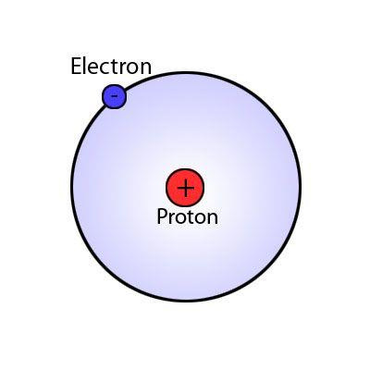

Slide 5


SCHRODINGER EQUATION OF HYDROGEN ATOM
We know that Schrodinger equation:
𝝏
𝟐
𝚿
𝝏
𝟐
𝚿
𝝏
𝟐
𝚿
𝟖𝝅𝟐𝝁
+
+
+
𝑬−𝒗𝚿=𝟎
𝝏𝒙𝟐
𝝏𝒚𝟐
𝝏𝒛𝟐
𝒉𝟐
We can also write as: Laplacian
𝟖𝝅
𝟐
𝝁
𝛁𝟐𝚿+
𝑬−𝒗𝜳=𝟎
𝒉
𝟐

Slide 6

Continue..
We also know that:
Here (r)is the distance between electron and radius.
Hydrogen atom is a spherical symmetrical system. We can’t use cartesian co-ordinates, we use spherical co-ordinates.

Slide 7
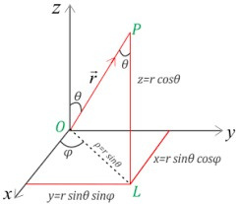
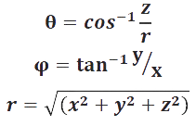
Conti…
Relation between cartesian and spherical co- ordinates is given as:

Slide 8
Conti…
Relation between cartesian and spherical co- ordinates is given as:

Slide 9


Conti…
Schrodinger equation in spherical co-ordinates:
we first separate the radial (r )and angular variables(θ,Φ). For this we substitute:
By solving equation 2) we get:

Slide 10
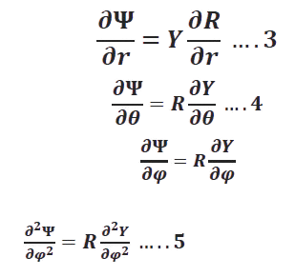
Conti…
Again differentiate we get:

Slide 11

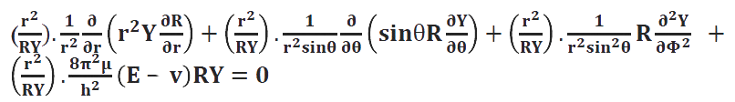
Conti…
By putting equ 3,4 and 5 in equ 1 we get:
Multiplying above expression by

Slide 12
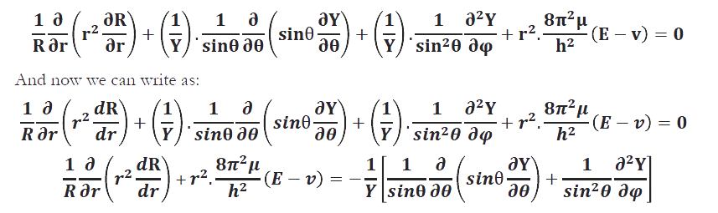
Conti…

Slide 13


Conti…
Hence this equation can be correct only if both sides are equal to some constant.
Let this constant be 𝒍
The radial equation is:
𝒍+𝟏
𝒅𝐑
𝒅𝒓
𝟐
𝟏
𝝏
𝒓
𝒓
𝟐
𝟖𝝅
𝝁
𝑬−𝒗 =𝒍
𝒍+𝟏 ….𝟔
𝟐
+
.
𝑹𝝏𝒓
𝒉𝟐

Slide 14



Conti…
And angular equation is:
Now again we have two variables there for
Put in above expression we get:

Slide 15
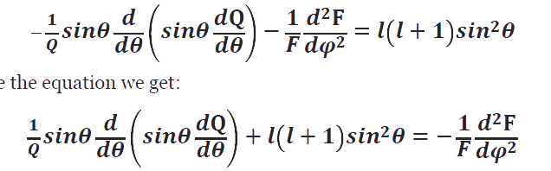
Conti…
Multiplying above expression with
𝑠𝑖𝑛
2
θ we get:
Rearrange the equation we get:

Slide 16
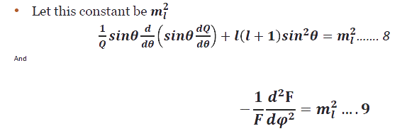
Conti…
Again two sides of the equation are function of different variables. They must be equal to some constant.

Slide 17
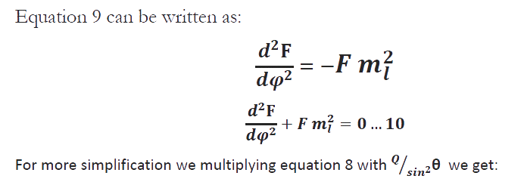
Conti…

Slide 18
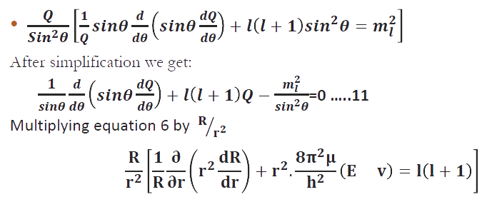
Conti…

Slide 19

Conti…
Thus we break down the Schrodinger equation of hydrogen atom into three ordinary differential equation, each having a single variable.
We trying to find out acceptable solutions of these equation.

Slide 20
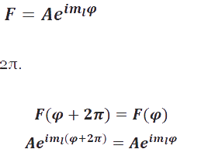
QUANTUM NUMBER
Solution of the Equations
Solution of F ( φ ) equation 10 is
A is constant.
Since φ repeats its value after 2π
Then:

Slide 21
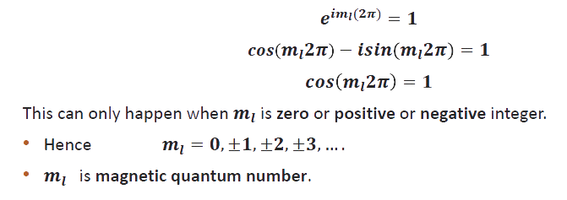
Conti…

Slide 22
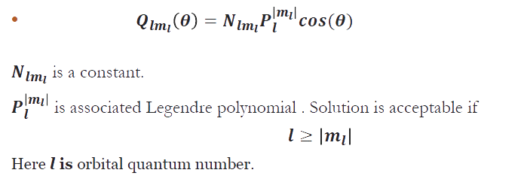
Finding the solution of equation 11

Slide 23
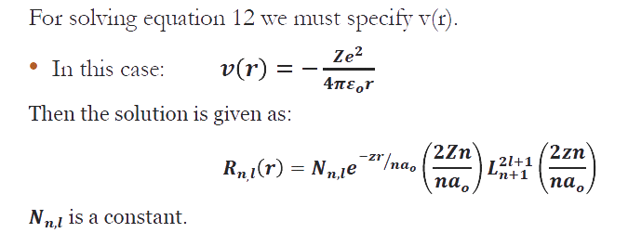
Conti…

Slide 24
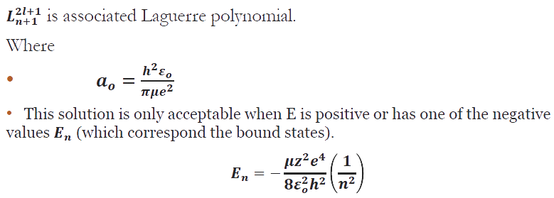
Conti…

Slide 25
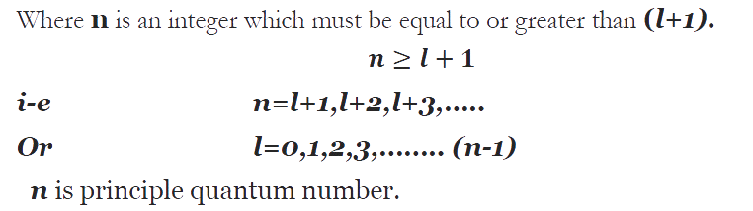
Conti…

Slide 26
MAGNETIC EFFECT ON HYDROGEN ATOM
The Dutch physicist Pieter Zeeman (and 1902 physics Nobelist) observed with a state of the art spectrometer of the time, (which we would now consider pretty crude) that many spectral lines split in a magnetic field into three (and more) spectral lines, one stays at the original position, the spacing of the other two depends linearly on the strength of the magnetic field. It is called the Zeeman effect.
  A good theory of the hydrogen atom needs to explain this !!

Slide 27
NORMAL ZEEMAN EFFECT
  Normal Zeeman effect, which is actually not observed with modern spectrometers, historically “normal” because of easy explanation
  Model the electron in the H atom as a small permanent magnet.
  Think of an electron as an orbiting circular current loop of I = dq / dt around some nucleus (that was not known to exist at that time).
  The current loop has a magnetic moment μ and the period T = 2πr / v. (don’t confuse this μ with reduced mass)
  where L = mvr is the magnitude of the orbital
  angular momentum for a circular path.

Slide 28
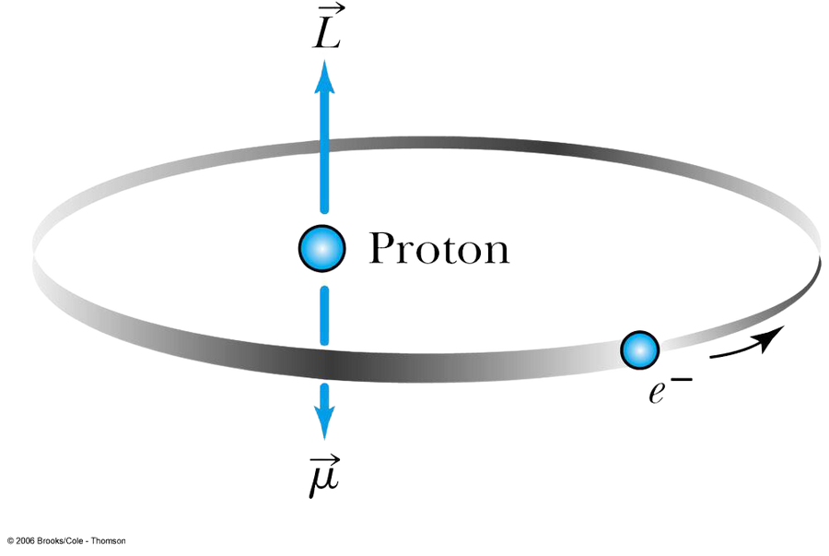
NORMAL ZEEMAN EFFECT
  When there is no magnetic field to align them, doesn’t have a effect on total energy. In an external magnetic field a dipole has a potential energy

Slide 29
NORMAL ZEEMAN EFFECT
  If there is a magnetic field in direction z, it will act on the magnetic moment, this brings in an (extra) potential energy term into the Hamiltonian operator.
  So an external magnetic field should have an effect on atoms, spectral lines are “fingerprint” characteristics of atoms, in an external magnetic field, each spectral line should be splitting into three lines, distance between two extra lines proportional to the strength of the magnetic field, tested by experiment, observed, part of Nobel prize

Slide 30
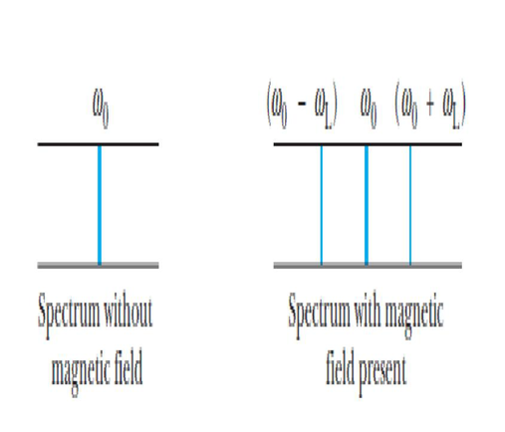
THE NORMAL ZEEMAN EFFECT FOR HYDROGEN
  The potential energy due to the external magnetic field is quantized due to the magnetic quantum number mℓ.
  When a magnetic field is applied, the otherwise degenerate 2p level of atomic hydrogen is split into three different energy states with energy difference of ΔE = μBB Δmℓ.
  The larger B, the larger the splitting, if B is switched off suddenly, the three lines combine as if nothing ever happened, total intensity of lines remains constant in the splitting

Slide 31
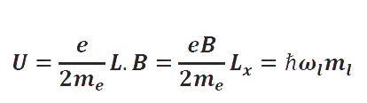
  What is really observed with good spectrometers: there are a lot more lines in atomic spectra when they are in a magnetic field ! So called Anomalous Zeeman effect, which is the only one observed with good spectrometers !!.

Slide 32
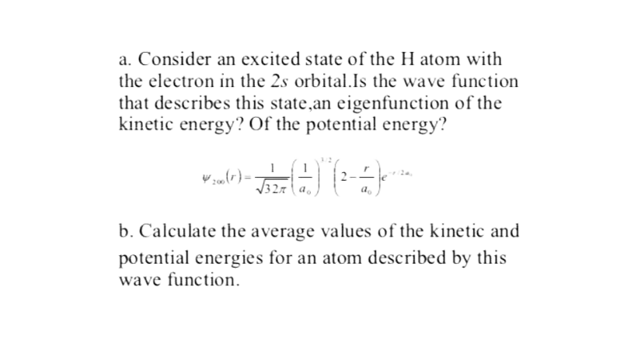
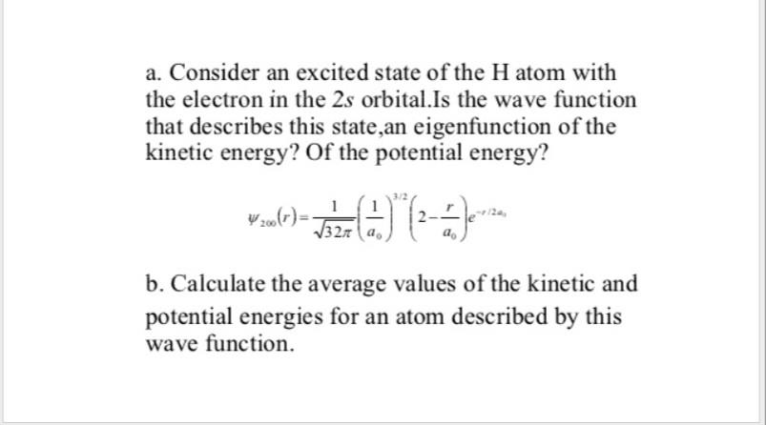

Slide 33
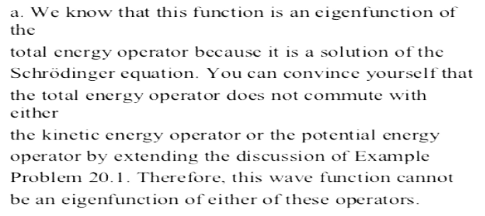
SOLUTION

Slide 34
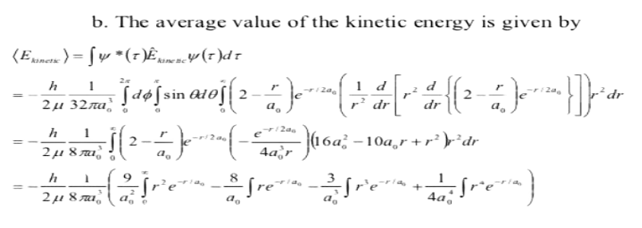
SOLUTION

Slide 35
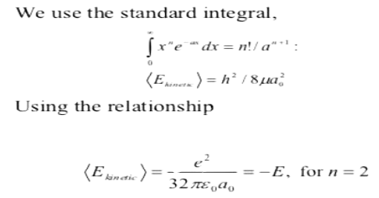
SOLUTION

Slide 36
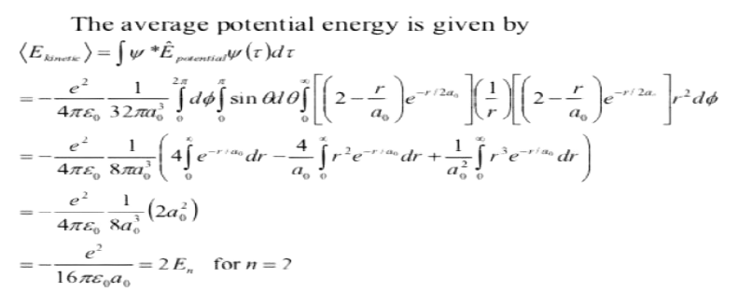
SOLUTION

Slide 37
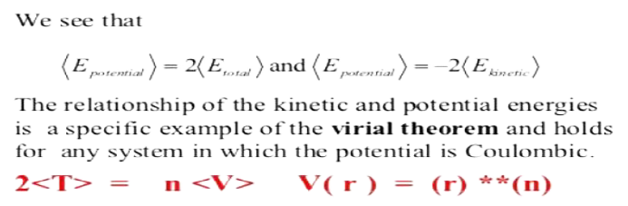
SOLUTION

Slide 38
WRITER :-
WEBSITE :-
MOBILE NUMBER :-
MR. ANIKET BHARDWAJ
ABCCHEMISTRY.COM
9212142424
EDITOR :-
DESIGNER :-
MRS. ABHILASHA BHARDWAJ
MRS. SHWETA THAKUR

