Slide 1











UNIT - 1A | PAPER - 1
WRITTEN BY
MR. ANIKET BHARDWAJ
Version : 1.00
Last UpdateD : 31-01-2025
Scan this for
PDF | PPT
of this Presentation
DWARKA, NEW DELHI, INDIA
Www.AniketBhardwaj.Com
Visit Inventor Profile
9212149491

Slide 2

UNIT 1A - PAPER 1
DIFFERENT TYPES OF FORCES
1. Covalent Bond
2. Ionic Bond
3. Vander Walls
4. H-Bonding
5. VESPER Theory
6. Bent's Rule
7. M.O.T. (Homo & Hetero Nuclear)
8. Acid-Based Strength
9. HSAB Concept

Slide 3

















UNIT - 1A | PAPER - 1
MOLECULAR GEOMETRY AND BONDING THEORIES
AbcChemistry.Com
AniketBhardwaj.Com
92121-49491
AbcChemistry24
AbcChemistry24
AbcChemistry24
AbcChemistry24
AbcChemistry24
AbcChemistry24
AbcChemistry24
AbcChemistry24
AbcChemistry24
AbcChemistry24

Slide 4

MOLECULAR SHAPES
•Lewis structures give atomic connectivity: they tell us which atoms are physically connected to which.
•The shape of a molecule is determined by its bond angles.
•Consider CCl4: experimentally we find all Cl-C-Cl bond angles are 109.5°.
•Therefore, the molecule cannot be planar.
•All Cl atoms are located at the vertices of a tetrahedron with the C at its center.

Slide 5
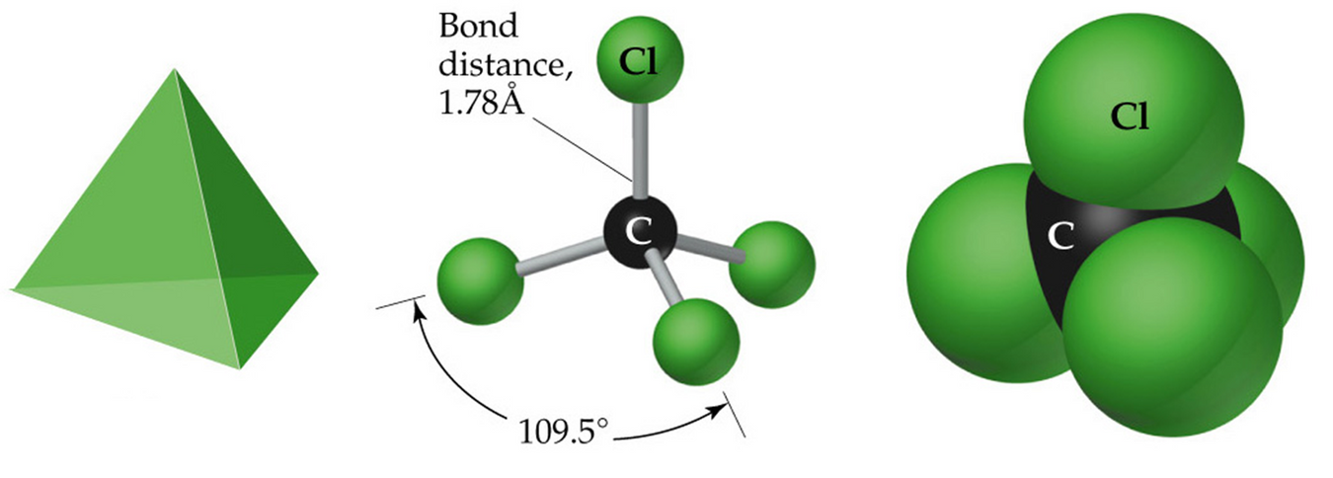
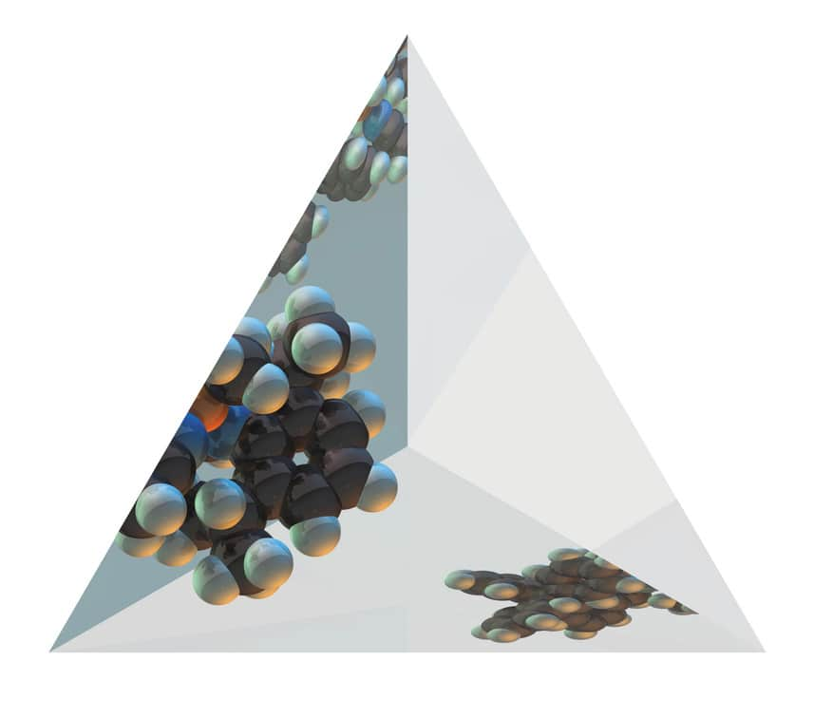
MOLECULAR SHAPES

Slide 6
MOLECULAR SHAPES
  In order to predict molecular shape, we assume the valence electrons repel each other. Therefore, the molecule adopts whichever 3D geometry minimized this repulsion.
  We call this process Valence Shell Electron Pair Repulsion (VSEPR) theory.
  There are simple shapes for AB2 and AB3 molecules.

Slide 7
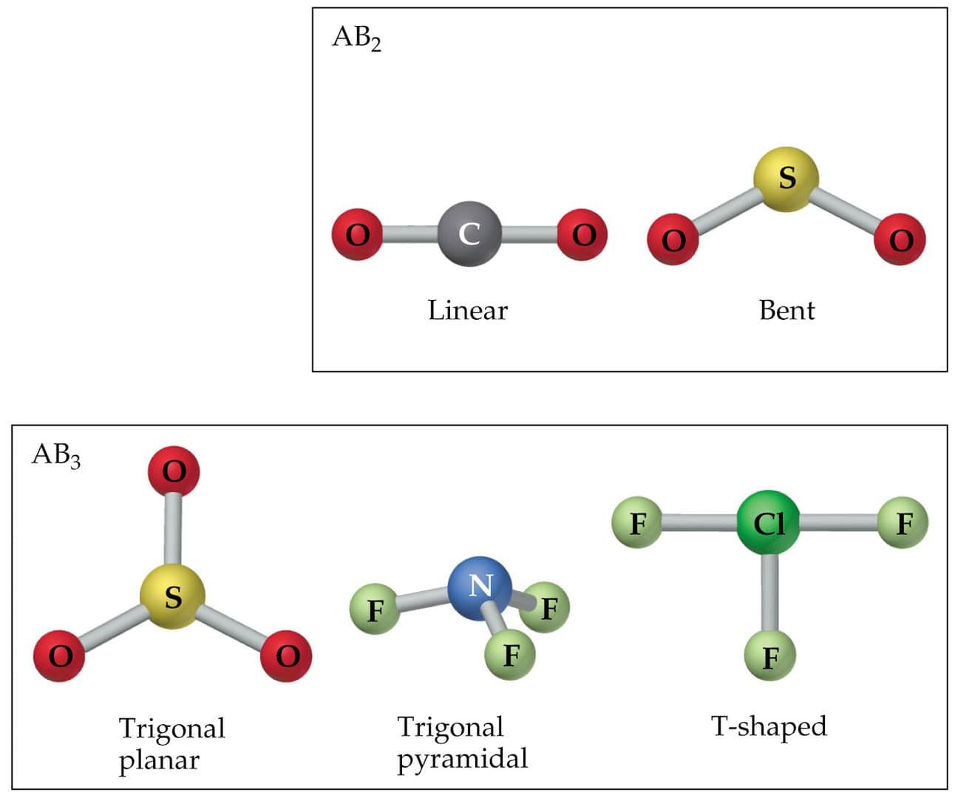

Slide 8

  There are five fundamental geometries for molecular shape:

Slide 9
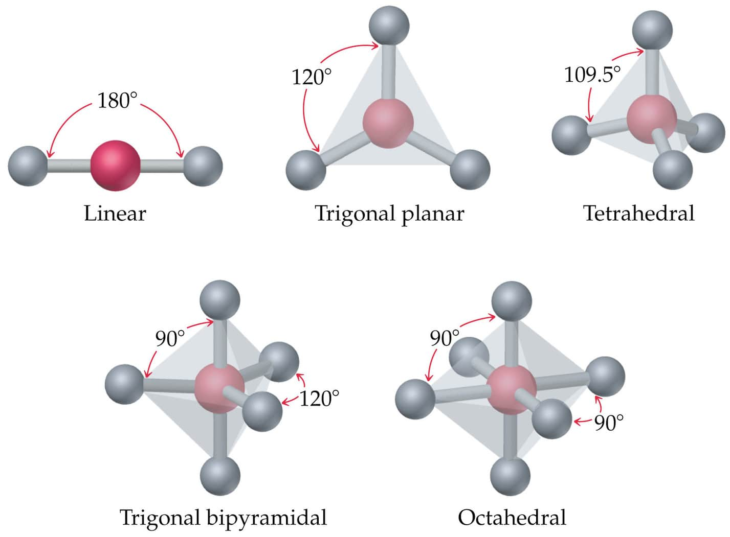

Slide 10
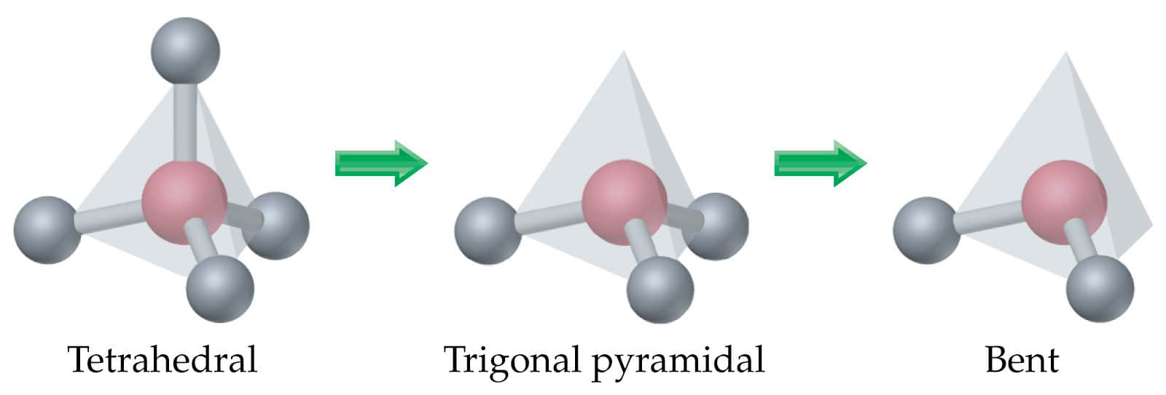
  When considering the geometry about the central atom, we consider all electrons (lone pairs and bonding pairs).
  When naming the molecular geometry, we focus only on the positions of the atoms.

Slide 11
VSEPR MODEL
  To determine the shape of a molecule, we distinguish between lone pairs (or non-bonding pairs, those not in a bond) of electrons and bonding pairs (those found between two atoms).
  We define the electron domain geometry by the positions in 3D space of ALL electron pairs (bonding or non-bonding).
  The electrons adopt an arrangement in space to minimize e - e repulsion.
-
-

Slide 12
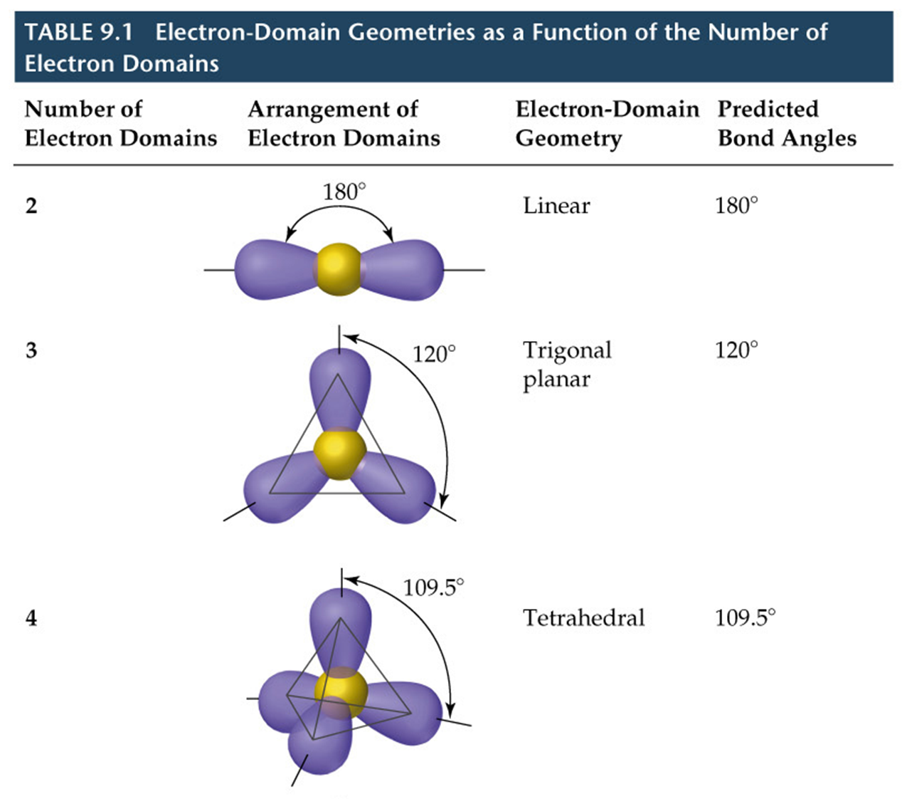

Slide 13
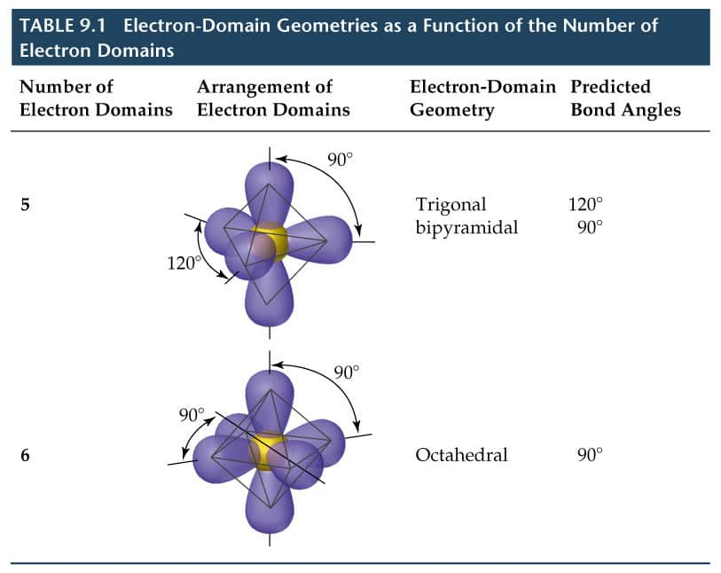

Slide 14
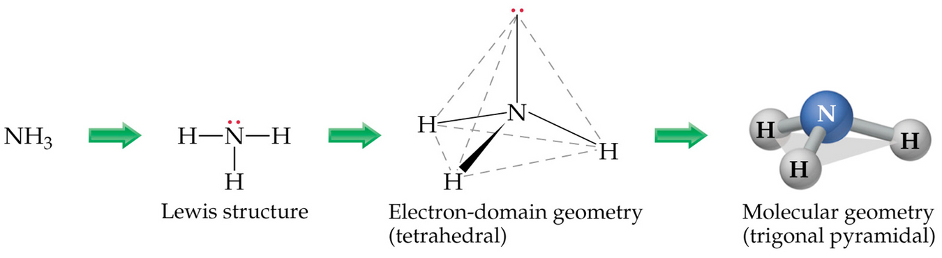
VSEPR MODEL
  To determine the electron pair geometry:
  draw the Lewis structure,
  count the total number of electron pairs around the central atom,
  arrange the electron pairs in one of the above geometries to minimize e -e repulsion, and count multiple bonds as one bonding pair.
-
-

Slide 15
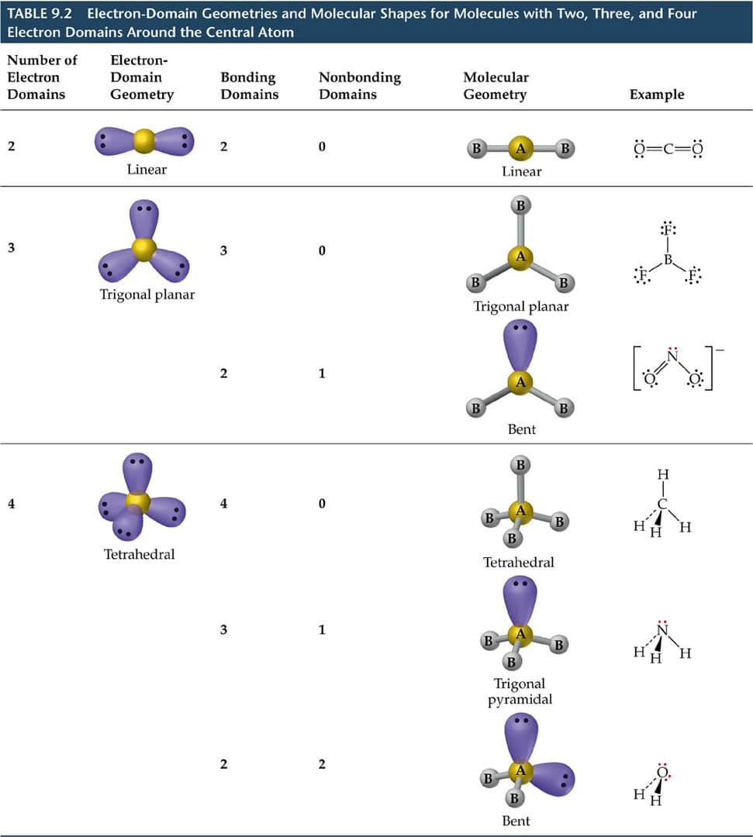
VSEPR MODEL

Slide 16
THE EFFECT OF NONBONDING ELECTRONS AND MULTIPLE BONDS ON BOND ANGLES
  The Effect of Nonbonding Electrons and Multiple Bonds on Bond Angles
  We determine the electron pair geometry only looking at electrons.
  We name the molecular geometry by the positions of atoms.
  We ignore lone pairs in the molecular geometry.
  All the atoms that obey the octet rule have tetrahedral electron pair geometries.

Slide 17
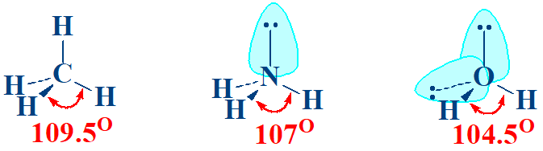
THE EFFECT OF NONBONDING ELECTRONS AND MULTIPLE BONDS ON BOND ANGLES
  By experiment, the H-X-H bond angle decreases on moving from C to N to O:
  Since electrons in a bond are attracted by two nuclei, they do not repel as much as lone pairs.
  Therefore, the bond angle decreases as the number of lone pairs increase.

Slide 18
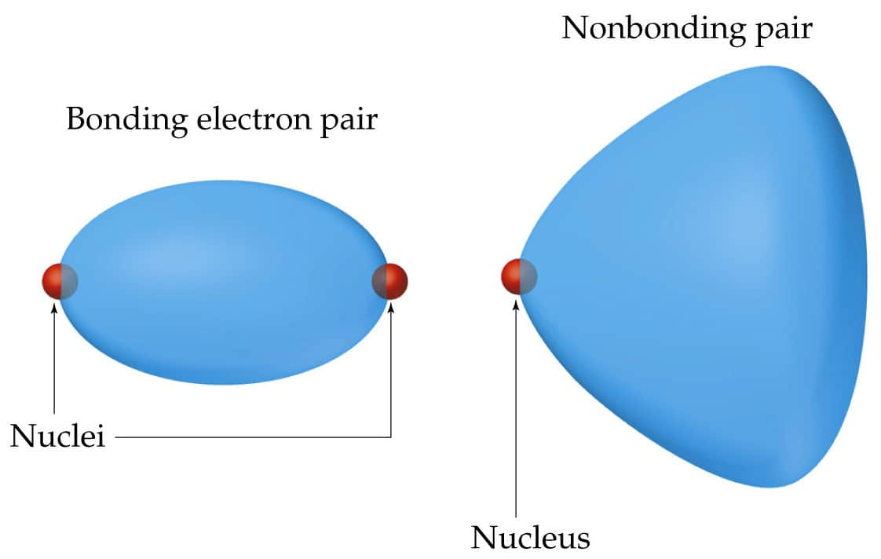
THE EFFECT OF NONBONDING ELECTRONS AND MULTIPLE BONDS ON BOND ANGLES

Slide 19
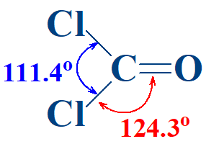
THE EFFECT OF NONBONDING ELECTRONS AND MULTIPLE BONDS ON BOND ANGLES
  Similarly, electrons in multiple bonds repel more than electrons in single bonds.

Slide 20
MOLECULES WITH EXPANDED VALENCE SHELLS
  Atoms that have expanded octets have AB5 (trigonal bipyramidal) or AB6 (octahedral) electron pair geometries.
  For trigonal bipyramidal structures there is a plane containing three electrons pairs. The fourth and fifth electron pairs are located above and below this plane.
  For octahedral structures, there is a plane containing four electron pairs. Similarly, the fifth and sixth electron pairs are located above and below this plane.

Slide 21
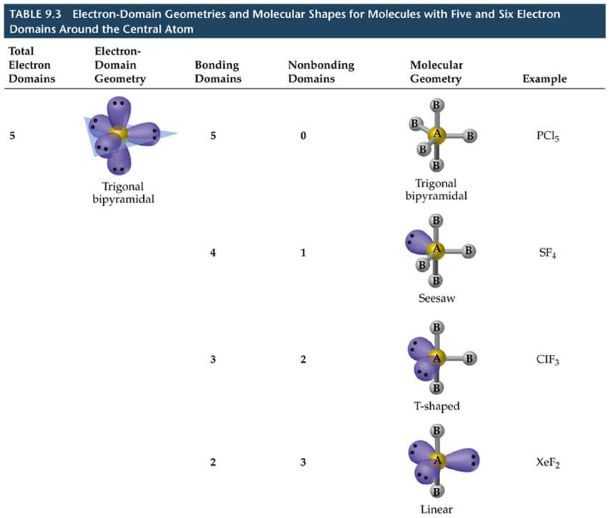

Slide 22
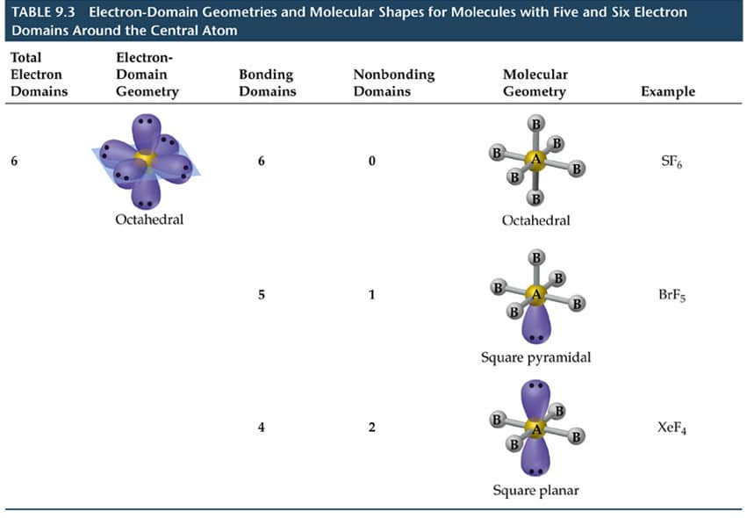

Slide 23
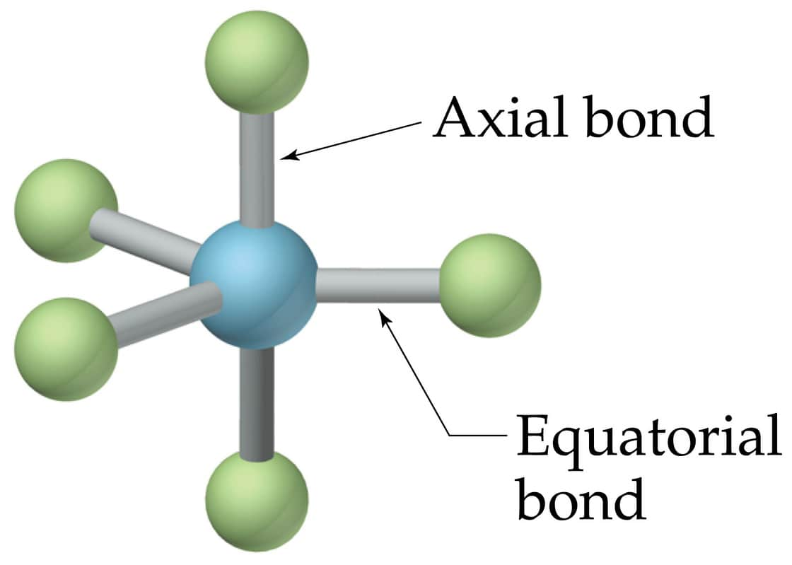
MOLECULES WITH EXPANDED VALENCE SHELLS
-
-
  To minimize e - e repulsion, lone pairs are always placed in equatorial positions.

Slide 24
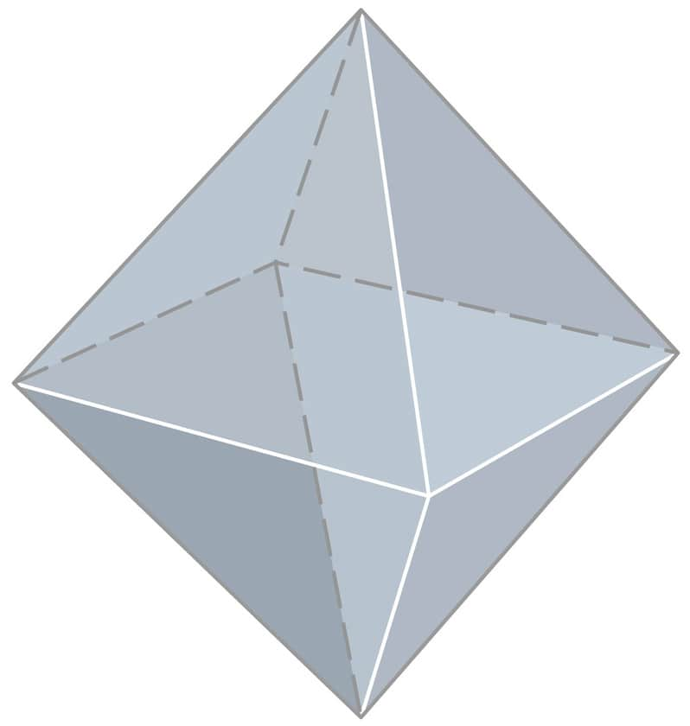
MOLECULES WITH EXPANDED VALENCE SHELLS

Slide 25
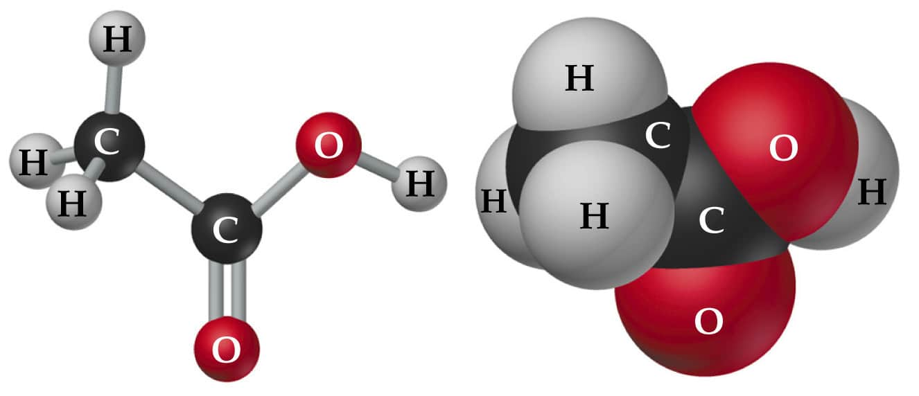
SHAPES OF LARGER MOLECULES
  In acetic acid, CH₃COOH, there are three central atoms.
  We assign the geometry about each central atom separately.

Slide 26
MOLECULAR SHAPE AND MOLECULAR POLARITY
  When there is a difference in electronegativity between two atoms, then the bond between them is polar.
  It is possible for a molecule to contain polar bonds, but not be polar.
  For example, the bond dipoles in CO₂ cancel each other because CO₂ is linear.

Slide 27
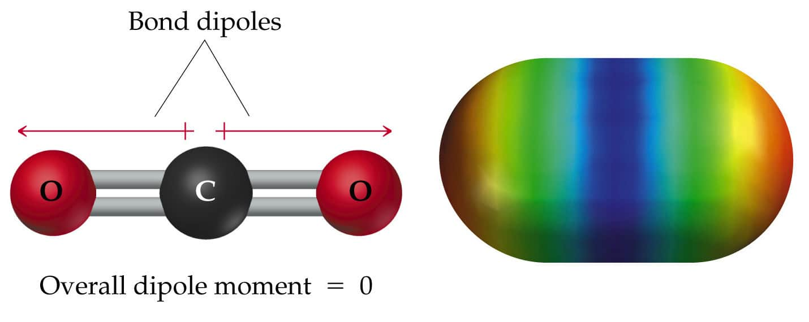
MOLECULAR SHAPE AND MOLECULAR POLARITY

Slide 28
MOLECULAR SHAPE AND MOLECULAR POLARITY
  In water, the molecule is not linear and the bond dipoles do not cancel each other.
  Therefore, water is a polar molecule.

Slide 29
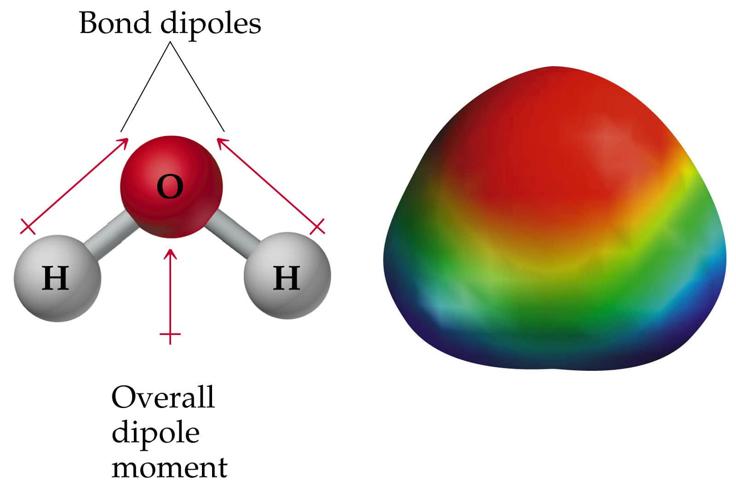

Slide 30
MOLECULAR SHAPE AND MOLECULAR POLARITY
  The overall polarity of a molecule depends on its molecular geometry.

Slide 31
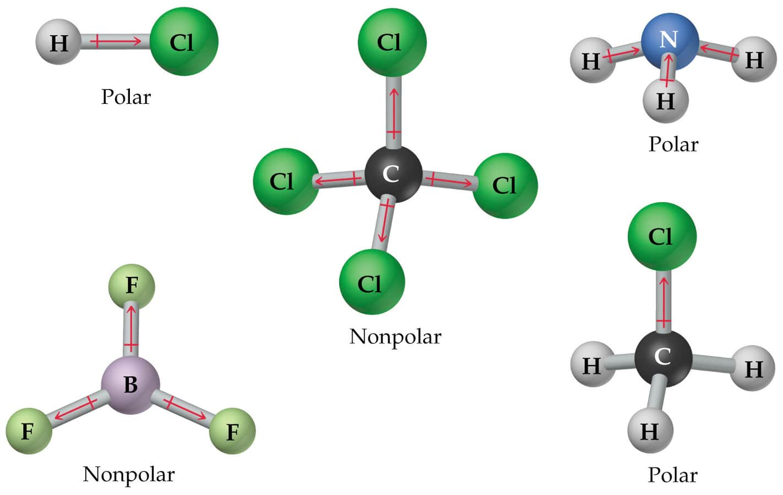
MOLECULAR SHAPE AND MOLECULAR POLARITY

Slide 32
COVALENT BONDING AND ORBITAL OVERLAP
  Lewis structures and VSEPR do not explain why a bond forms.
  How do we account for shape in terms of quantum mechanics?
  What are the orbitals that are involved in bonding?
  We use Valence Bond Theory:
  Bonds form when orbitals on atoms overlap.
  There are two electrons of opposite spin in the orbital overlap.

Slide 33

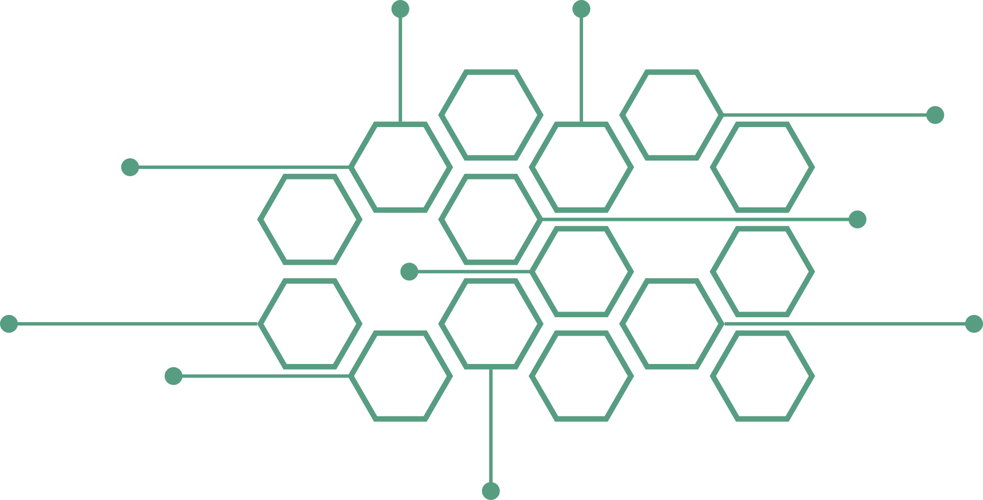
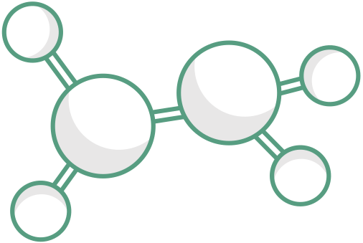
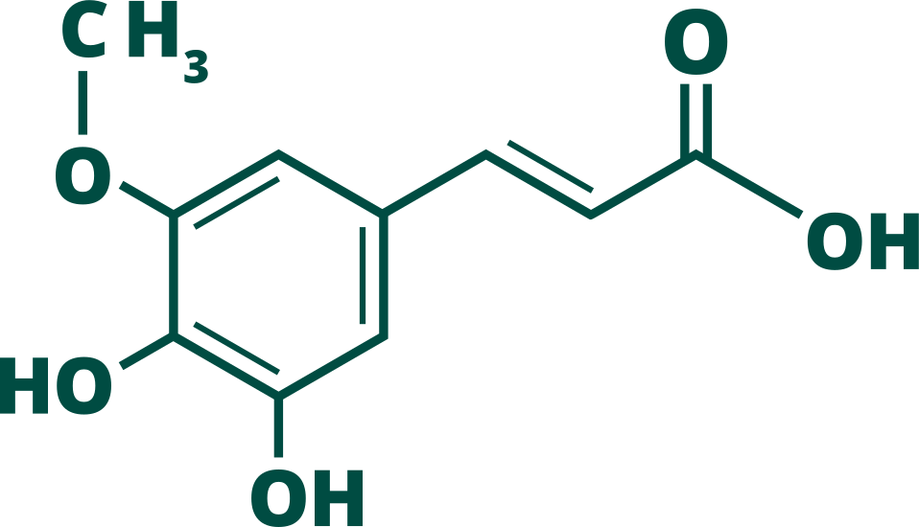


















ABC CHEMISTRY
ANIKET BHARDWAJ CHEMISTRY
Best Chemical Science Coaching (CY) for JAM, NET, GATE, CUET
AbcChemistry.Com
92121-49491
@AbcChemistry24
Mr. Aniket Bhardwaj
Managing Director @ AbcChemistry
Ph.D. Chemistry (P)
AniketBhardwaj.Com
EDITOR
DESIGNER
MRS. ABHILASHA BHARDWAJ
MRS. SHWETA THAKUR

